Slide 1

Did CARES Act funding undermine the accuracy COVID-19 death reporting?
A statistical inquiry by Antonio Chaves
Adobe Photoshop stock image

Slide 2
Abstract: During the first half of 2020 the most deaths from COVID-19 were reported in the Northeast and Midwest, but by the end of 2021 this trend shifted to Southern and Western states. This shift has been attributed in part to a lack of masking and social distancing in these states, but this analysis fails to adjust for differences in pre-existing comorbidities and massive disparities in CARES funding per state (from $20,000 per COVID patient in New York to $470,000 per patient in West Virginia). Preliminary statistical analysis reveals a positive correlation between CARES payments and COVID deaths. Did hospitals in states with higher payments lower their reporting standards in order to get more funding? If these causes of death are inaccurate, how might they have been misconstrued?

Slide 3
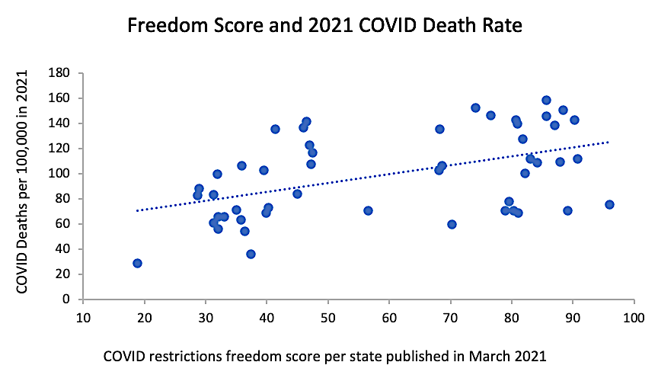
This graph supports the hypothesis that coronavirus restrictions “saved lives.”
But this raw data fails to account for pre-existing differences between these states.
r = 0.49
(Pearson)
X-axis data from WalletHub: https://wallethub.com/edu/states-coronavirus-restrictions/73818
Y-axis data from the CDC: https://www.cdc.gov/nchs/pressroom/sosmap/covid19_mortality_final/COVID19.htm

Slide 4
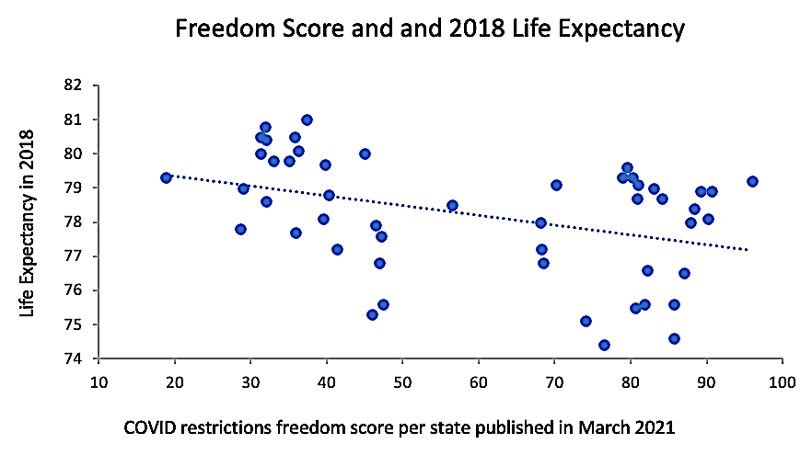
On average, people in states with less COVID restrictions also had lower life expectancies.
r = -0.39
P < 0.01
(Pearson)
r = -0.41
P < 0.005
(Spearman)
X-axis data from WalletHub: https://wallethub.com/edu/states-coronavirus-restrictions/73818
Y-axis data from the CDC: https://www.cdc.gov/nchs/pressroom/sosmap/life_expectancy/life_expectancy.htm

Slide 5
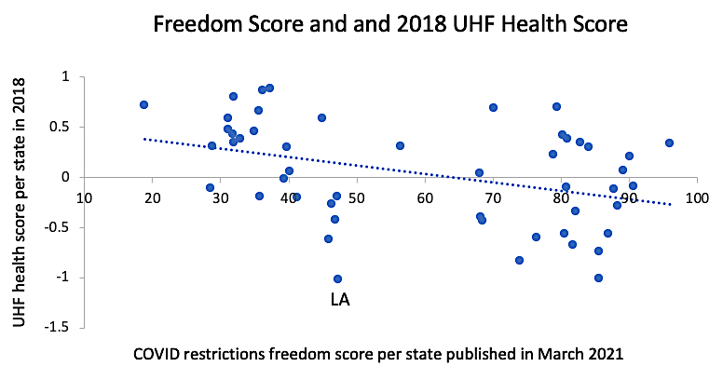
Residents of states with less COVID restrictions were also more likely to score poorly on health.
r = -0.39
P < 0.01
(Pearson)
r = -0.43
P < 0.005
(Spearman)
X-axis data from WalletHub: https://wallethub.com/edu/states-coronavirus-restrictions/73818
Y-axis data from the United Health Foundation: https://assets.americashealthrankings.org/app/uploads/2018ahrannual_020419.pdf

Slide 6
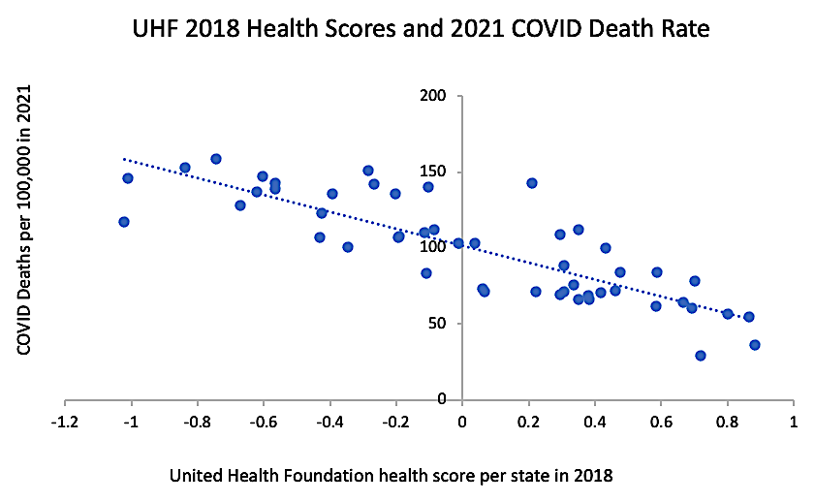
People with better overall health are less likely to die from respiratory infections.
r = -0.84
(Pearson)
X-axis data from the United Health Foundation: https://assets.americashealthrankings.org/app/uploads/2018ahrannual_020419.pdf
Y-axis data from the CDC: https://www.cdc.gov/nchs/pressroom/sosmap/covid19_mortality_final/COVID19.htm

Slide 7
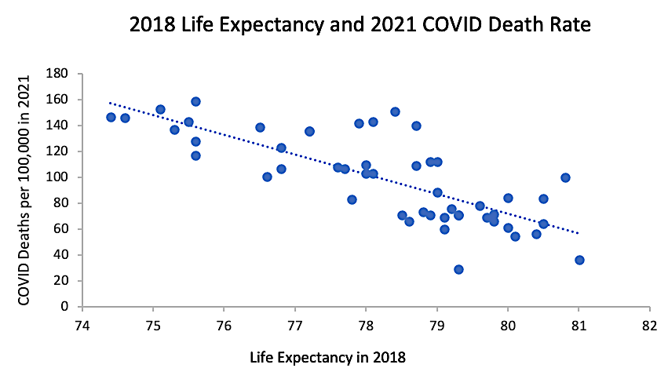
Reporting of COVID-19 deaths are also inversely correlated with life expectancy.
r = -0.77
(Pearson)
X-axis data from the CDC: https://www.cdc.gov/nchs/pressroom/sosmap/life_expectancy/life_expectancy.htm
Y-axis data from the CDC: https://www.cdc.gov/nchs/pressroom/sosmap/covid19_mortality_final/COVID19.htm

Slide 8
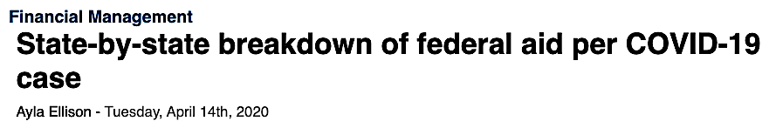
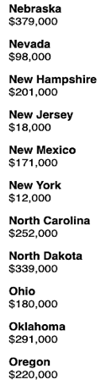
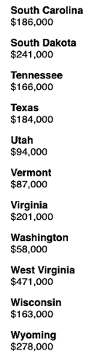
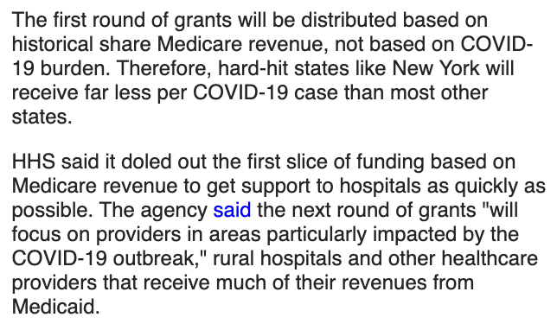
Did CARES funding adversely affect the reporting of COVID deaths per state?
Why did states like Nebraska and West Virginia get 20X more funding per patient than New York and New Jersey?
Data from Becker’s Hospital Review: https://www.beckershospitalreview.com/finance/state-by-state-breakdown-of-federal-aid-per-covid-19-case.html

Slide 9
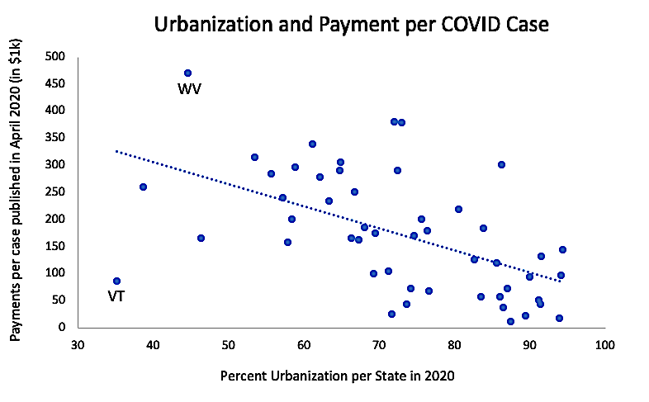
States that were more urbanized often received lower payments.
r = -0.54
(Pearson)
X-axis data from the Visual Capitalist: https://www.visualcapitalist.com/sp/mapping-us-urbanization-by-state/
Y-axis data from Becker’s Hospital Review: https://www.beckershospitalreview.com/finance/state-by-state-breakdown-of-federal-aid-per-covid-19-case.html

Slide 10
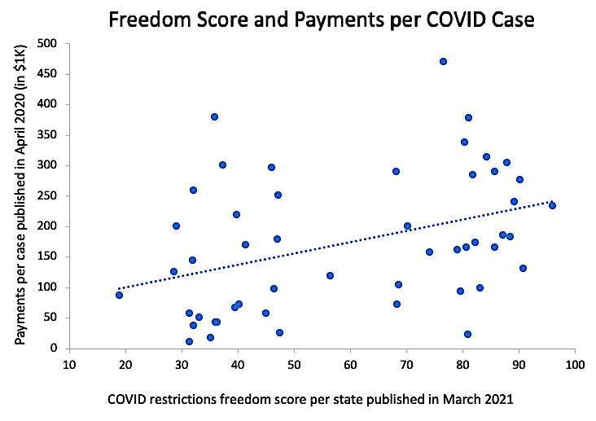
States with less coronavirus restrictions often received higher payments.
r = 0.39
P < 0.01
(Pearson)
r = 0.41
P < 0.005
(Spearman)
X-axis data from WalletHub: https://wallethub.com/edu/states-coronavirus-restrictions/73818
Y-axis data from Becker’s Hospital Review: https://www.beckershospitalreview.com/finance/state-by-state-breakdown-of-federal-aid-per-covid-19-case.html

Slide 11
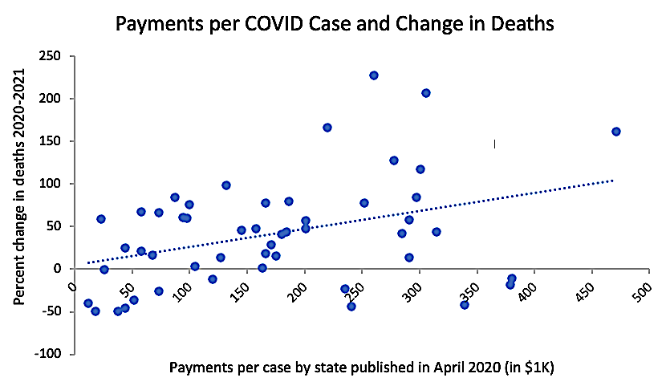
Did these higher CARES payments influence how some states reported COVID deaths in 2021?
If many of these deaths were not caused by COVID-19, how were these numbers generated?
r = 0.37
P < 0.01
(Pearson)
r = 0.32
P < 0.05
(Spearman)
X-axis data from Becker’s Hospital Review: https://www.beckershospitalreview.com/finance/state-by-state-breakdown-of-federal-aid-per-covid-19-case.html
Y-axis data from the CDC: https://www.cdc.gov/nchs/pressroom/sosmap/covid19_mortality_final/COVID19.htm

Slide 12

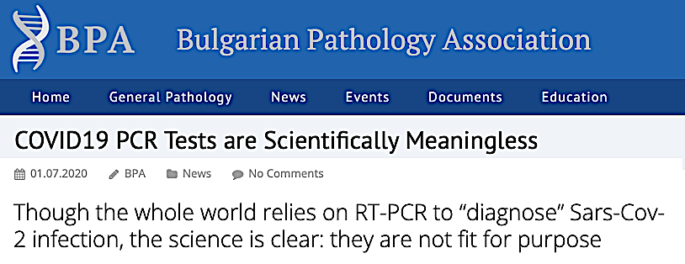
How reliable were the COVID tests?
If PCR testing often generates false positives, what are the odds a hospital patient will be misdiagnosed after getting tested multiple times?
Did high CARES payments incentivize hospitals and clinics to test more frequently?
From the Bulgarian Pathology Association: https://bpa-pathology.com/covid19-pcr-tests-are-scientifically-meaningless/
From the Internet Archive: https://archive.org/details/kary-mullis-with-pcr-you-can-find-almost-anything-in-anybody

Slide 13
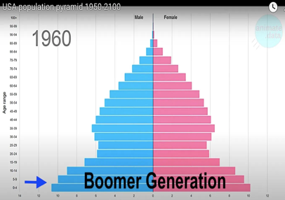
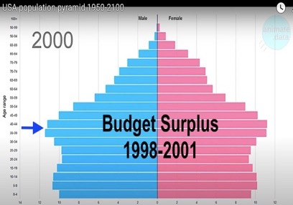
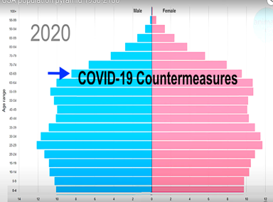


Could some “COVID” deaths be attributed to this anticipated rise in all-cause mortality*?
The term “boomer” refers to Americans born during the “baby boom” that happened after the end of World War II (1946 to 1964).
The budget surplus of 1998-2001 was largely driven by a critical mass of working Americans contributing record amounts of tax revenue during the 1980’s and 1990’s. This is when boomers were in their prime.
In 2020, boomers were between ages 56 and 76. This is when many of them started to die off.
*Hat Tip: Jonathan Couey of Gigaohm Biological https://gigaohmbiological.com/
Video stills from AnimateData: https://www.youtube.com/@AnimateData

Slide 14
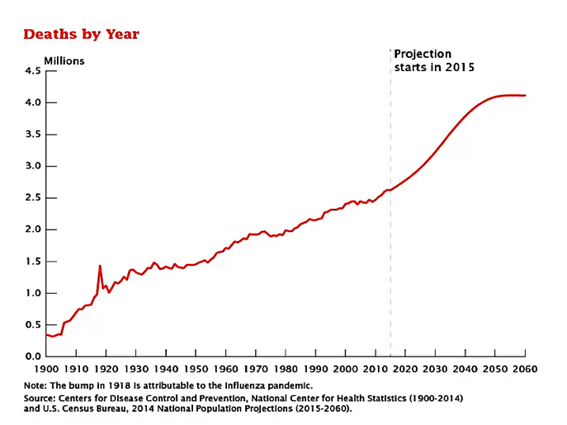
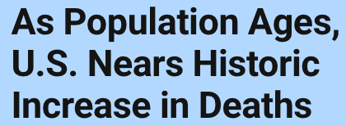
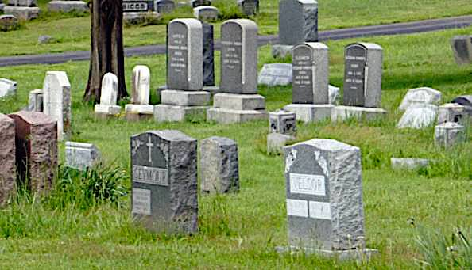
This article from the US Census Bureau predicted a steep rise in the death rate after 2015.
The inflection point begins near 2020; the same year a pandemic was declared in the US.
Downloaded from the US Census: https://www.census.gov/library/stories/2017/10/aging-boomers-deaths.html

Slide 15
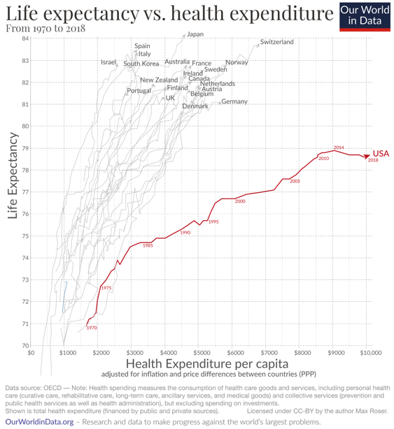
Could some “COVID” deaths be attributed to the recent decline in US life expectancy?*
Why did life US life expectancy decline in 2016 and 2018!?
*Hat Tip: Mark Kulacz of Housatonic https://rumble.com/user/Housatonic
Max Roser (2020) - “Why is life expectancy in the US lower than in other rich countries?” Published online at OurWorldinData.org. Retrieved from: https://ourworldindata.org/us-life-expectancy-low

Slide 16
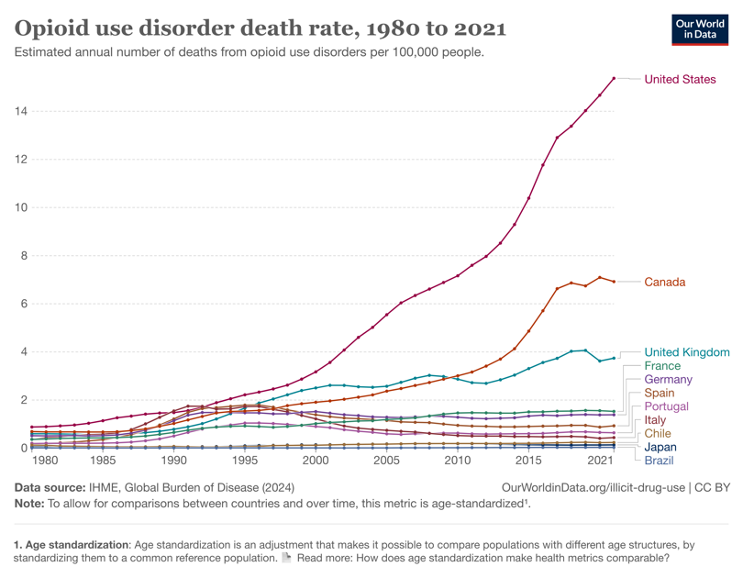
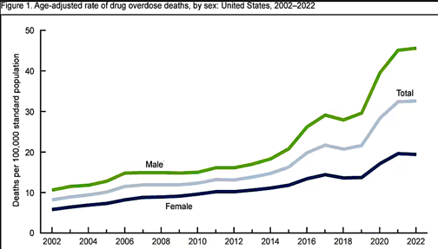
Could some “COVID” deaths be attributed to opioids?*
Why did overdose deaths spike in 2020?
https://www.cdc.gov/nchs/products/databriefs/db491.htm
*Hat Tip: Mark Kulacz of Housatonic https://rumble.com/user/Housatonic
Max Roser (2020) - “Why is life expectancy in the US lower than in other rich countries?” Published online at OurWorldinData.org. Retrieved from: https://ourworldindata.org/us-life-expectancy-low

Slide 17
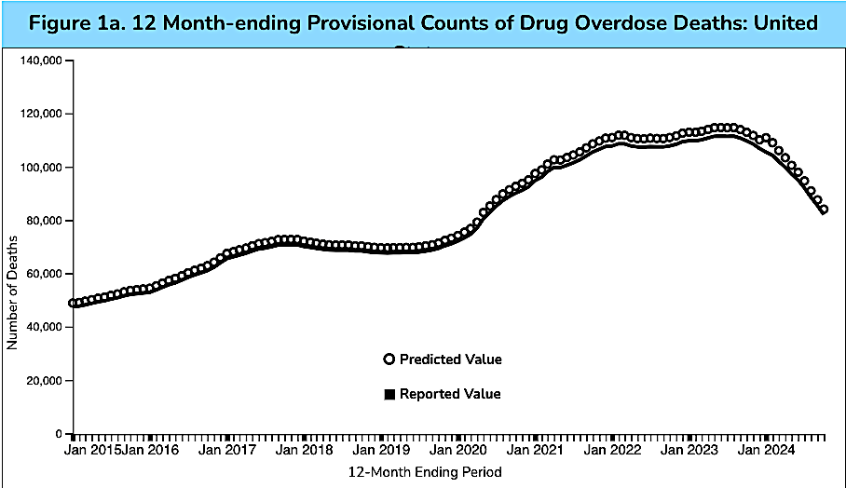
This interactive chart from the CDC indicates that about 416,000 Americans died from drug overdoses from January of 2020 to January of 2024.
Data downloaded from the CDC: https://www.cdc.gov/nchs/nvss/vsrr/drug-overdose-data.htm

Slide 18
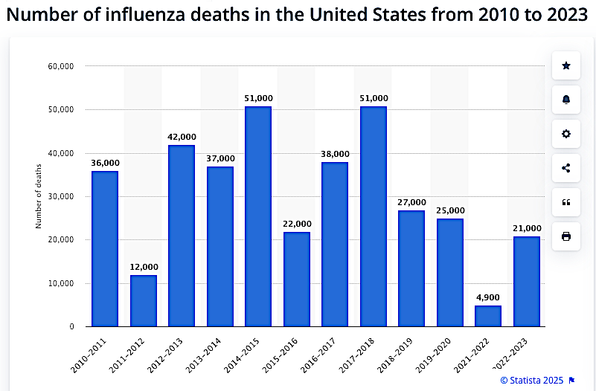
Could some “COVID” deaths be attributed to underreporting of the seasonal flu?
?
Data downloaded from Statista: https://www.statista.com/statistics/1124915/flu-deaths-number-us/

Slide 19
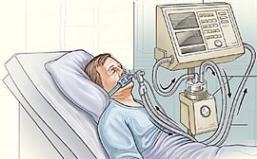
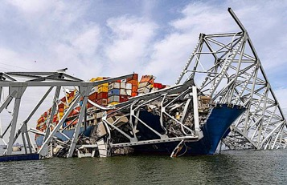
Did pandemic countermeasures make things worse?
The Prep Act of 2020 provided liability protection to health workers and manufacturers from all procedures and products designated as “pandemic countermeasures.”
https://www.federalregister.gov/documents/2020/03/17/2020-05484/declaration-under-the-public-readiness-and-emergency-preparedness-act-for-medical-countermeasures
Did the Prep Act liability protections and CARES Act funding incentivize US hospitals to prioritize novel countermeasures over patient needs?
Did novel recommendations like widespread intubation/ventilation, remdesivir (US), midazolam (UK), high-flow oxygen,* and the withholding of antibiotics do more harm than good?
Hanlon’s razor: Never attribute to malice that which can be adequately explained by incompetence or stupidity.
Key Bridge Collapse in Baltimore (3/26/24)
*Hat Tip: Mark Kulacz of Housatonic https://rumble.com/user/Housatonic

Slide 20
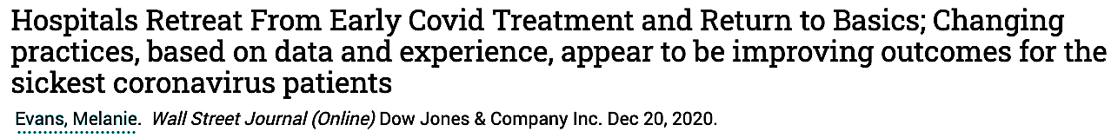
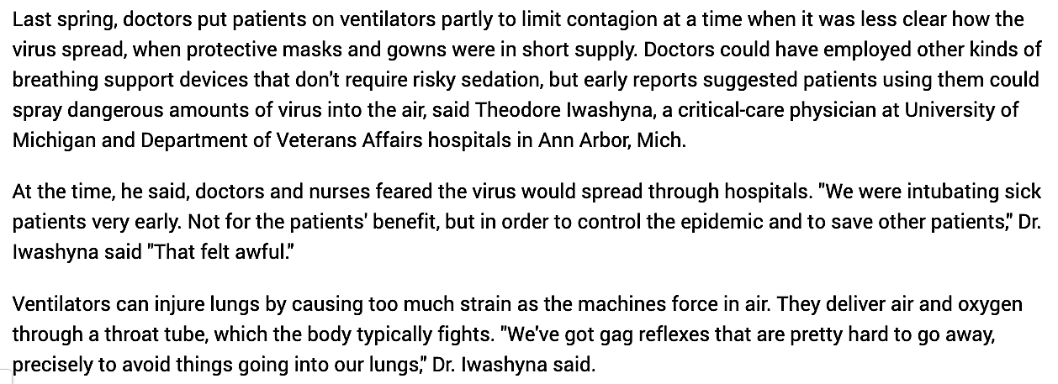
Widespread intubation/ventilation was “not for the patients’ benefit” but to “control the epidemic.”

Slide 21
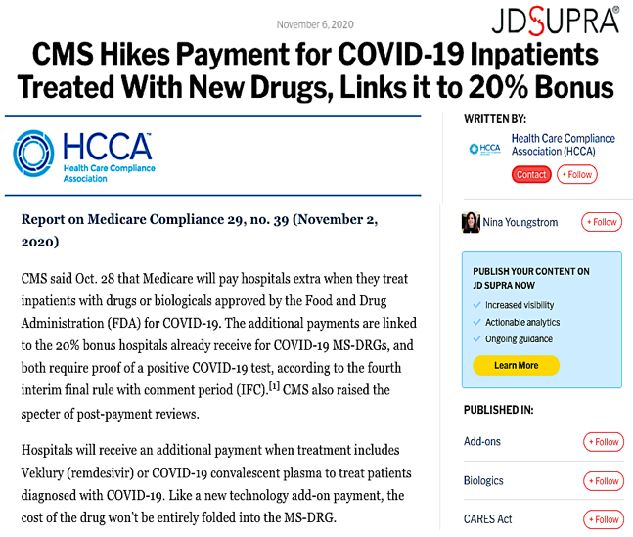
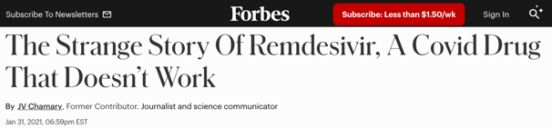
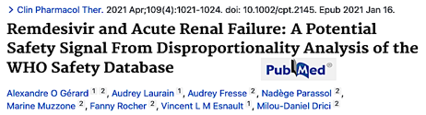
Bonuses were given for remdesivir despite its questionable efficacy and problematic safety record.
From Forbes: https://www.forbes.com/sites/jvchamary/2021/01/31/remdesivir-covid-coronavirus/
From Clinical Pharmacology & Therapeutics: https://pubmed.ncbi.nlm.nih.gov/33340409/
Posted in JD Supra: https://www.jdsupra.com/legalnews/cms-hikes-payment-for-covid-19-19452/

Slide 22
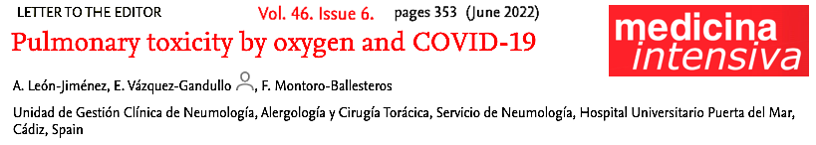
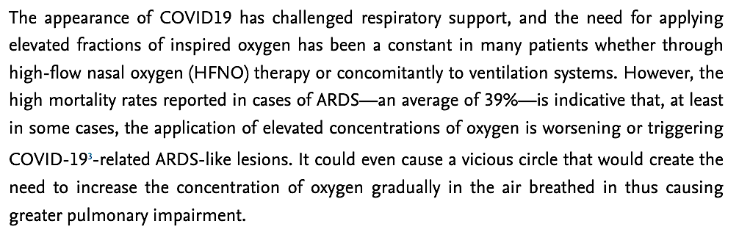
High-flow oxygen therapy may have also irreversibly damaged the lungs of some COVID patients.
From Medicina Intensiva: https://www.medintensiva.org/en-pulmonary-toxicity-by-oxygen-covid-19-articulo-S2173572722000777

Slide 23
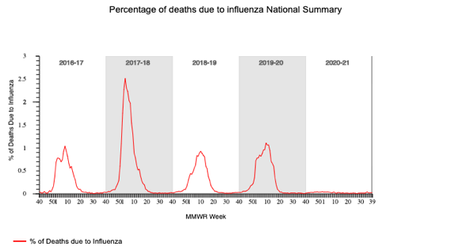
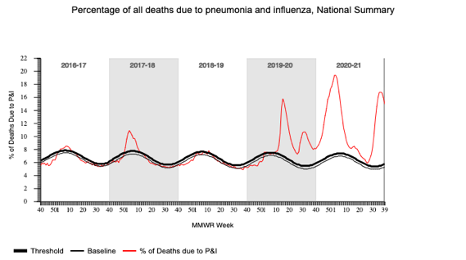
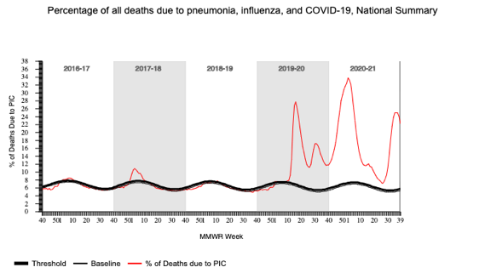
Why did influenza deaths “disappear” 2020-2021?
Why did pneumonia deaths spike 2020-2021?
Why does this coincide with COVID deaths?*
*Hat Tip: Jonathan Couey of Gigaohm Biological https://gigaohmbiological.com/
Downloaded from the CDC: https://gis.cdc.gov/grasp/fluview/mortality.html

Slide 24
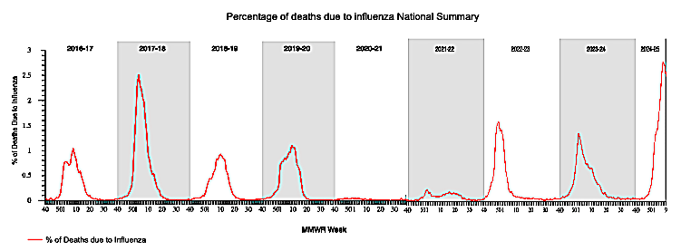
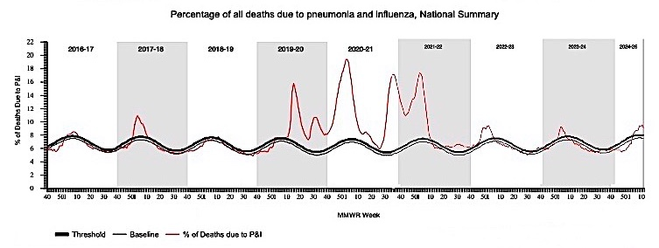
Why did influenza and pneumonia mortality return to pre-pandemic levels after 2022?
Downloaded from the CDC: https://gis.cdc.gov/grasp/fluview/mortality.html

Slide 25
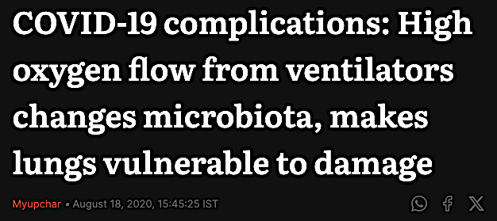
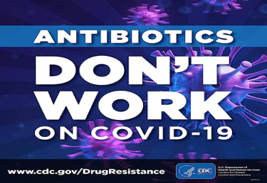
Did government recommendations discourage health workers from detecting and treating cases of bacterial pneumonia caused by prolonged exposure to high flow oxygen?
…high flow oxygen from mechanical ventilation promotes the growth of microbes (such as Staphylococcus aureus) in the lungs which can result in pneumonia and abscess. From First Post: https://www.firstpost.com/health/covid-19-complications-high-oxygen-flow-from-ventilators-changes-microbiota-makes-lungs-vulnerable-to-damage-8723411.html
From the CDC: https://www.cdc.gov/antimicrobial-resistance/data-research/threats/COVID-19.html

Slide 26
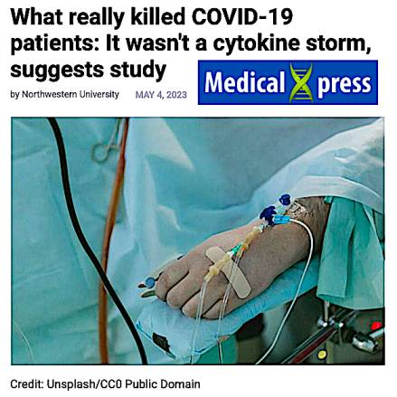
How many cases of pneumonia-related septic shock were mislabeled as a “cytokine storm”?
…The investigators found nearly half of patients with COVID-19 develop a secondary ventilator-associated bacterial pneumonia…Those who were cured of their secondary pneumonia were likely to live, while those whose pneumonia did not resolve were more likely to die…The study findings also negate the cytokine storm theory…
Downloaded from: https://medicalxpress.com/news/2023-05-covid-patients-wasnt-cytokine-storm.html

Slide 27
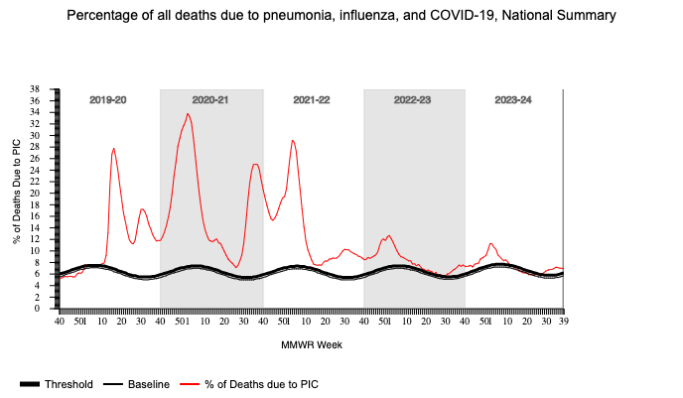
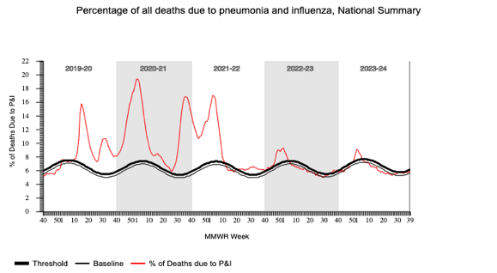
How many of these “COVID” deaths are the consequences of untreated bacterial pneumonia?
How many of these deaths could have been prevented by treatment with antibiotics?
Downloaded from the CDC: https://gis.cdc.gov/grasp/fluview/mortality.html

Slide 28
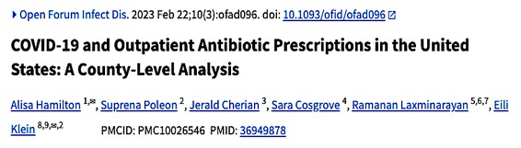
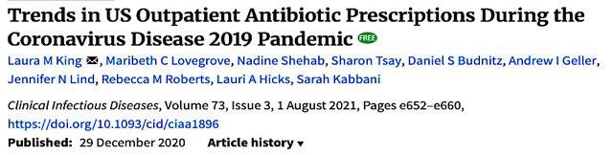
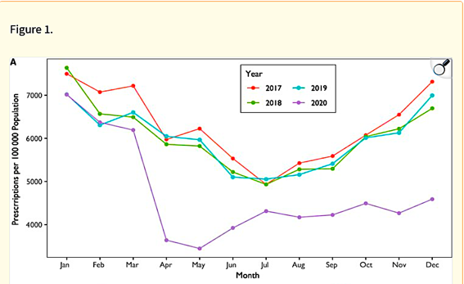
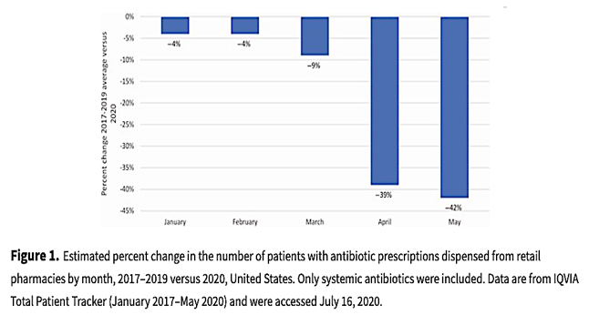
These articles report massive declines in antibiotic prescriptions in the US during the spring of 2020.
Downloaded from: https://pmc.ncbi.nlm.nih.gov/articles/PMC10026546/
Downloaded from : https://academic.oup.com/cid/article/73/3/e652/6054971

Slide 29
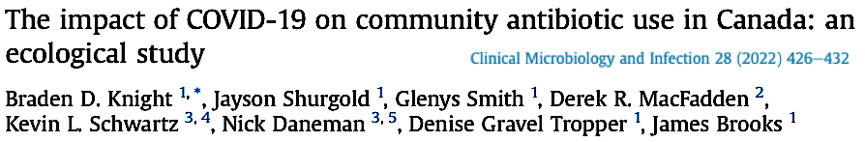
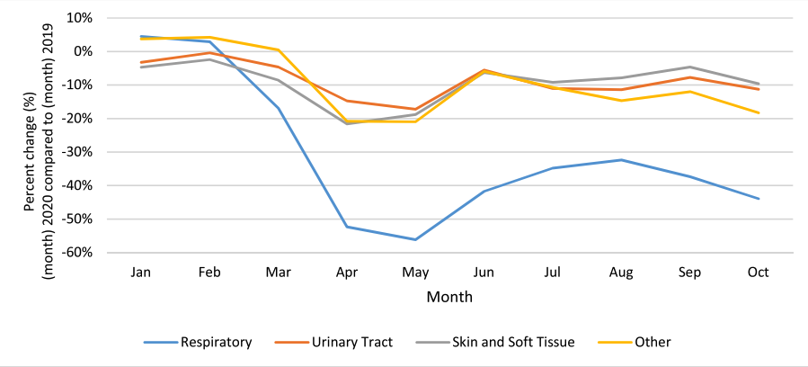
This chart from Canada shows the steepest decline for treatment of respiratory infections.
Downloaded from : https://www.clinicalmicrobiologyandinfection.com/article/S1198-743X(21)00614-5/pdf

Slide 30
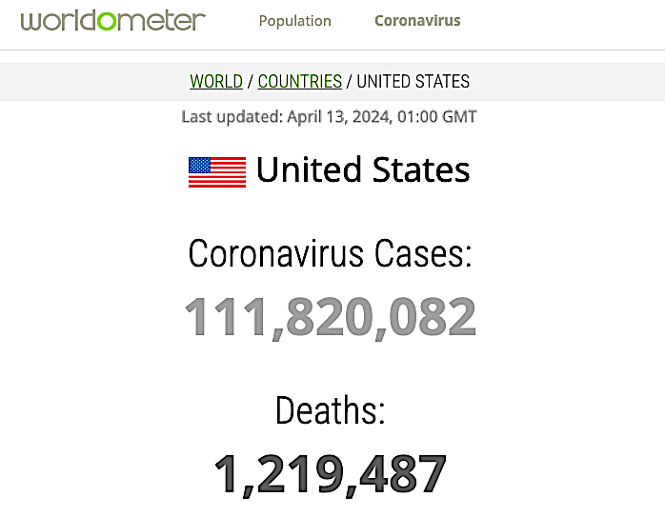
Will we ever learn the true number of Americans that died of COVID-19?
From the Worldometer: https://www.worldometers.info/coronavirus/country/US/

Slide 31


According to the CDC, only 6% of “COVID deaths” listed COVID-19 as the sole cause.
From the CDC: https://web.archive.org/web/20200817174827/https://www.cdc.gov/nchs/nvss/vsrr/covid_weekly/index.htm

Slide 32


Slide 33

entropyrider.com

Slide 34


Special thanks to Jonathan Couey (Gigaohm Biological) & Mark Kulacz (Housatonic) for their insight on the countermeasures and alternate causes of death:
https://gigaohmbiological.com/
https://rumble.com/user/Housatonic

