Slide 1
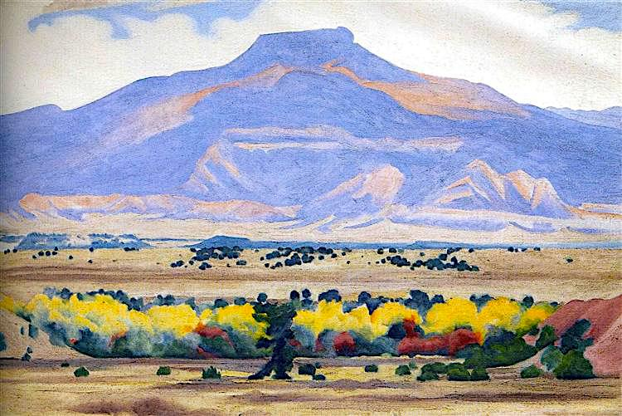
Terrestrial Biomes
“Pedernal” by Georgia O’Keeffe

Slide 2
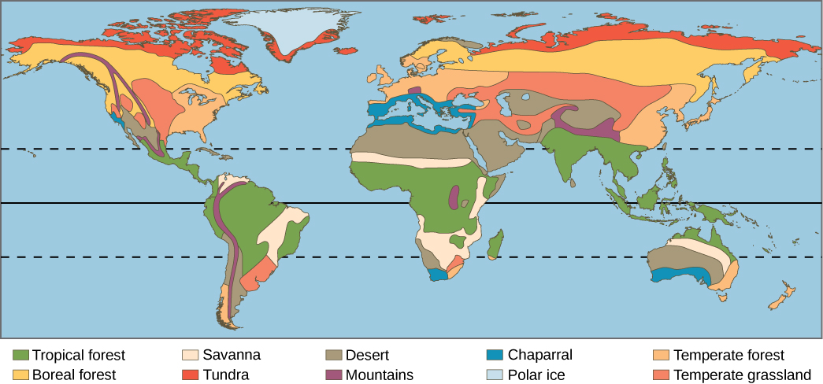
Worldwide Distribution of Terrestrial Biomes
From “Environmental Issues” by Andrew Frank https://pressbooks.bccampus.ca/environmentalissues/front-matter/introduction/

Slide 3
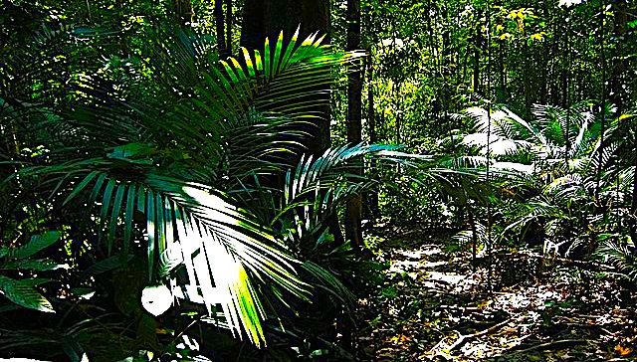
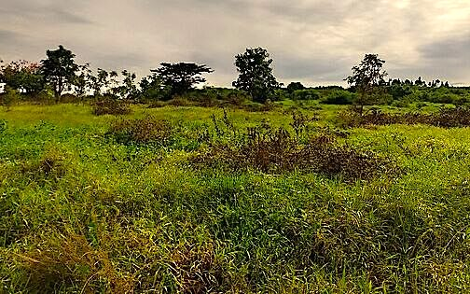
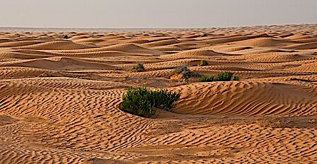
Tropical and Subtropical
Broadleaf trees with spreading roots. Poor soils due to leaching of nutrients by rain. Most biodiverse of all biomes on land.
Grasses with scattered trees. Extensive root system to survive the extensive dry season and occasional fires.
Low diversity and low vegetation density. The few perennials have reduced foliage and the stems are adapted for water storage.

Slide 4
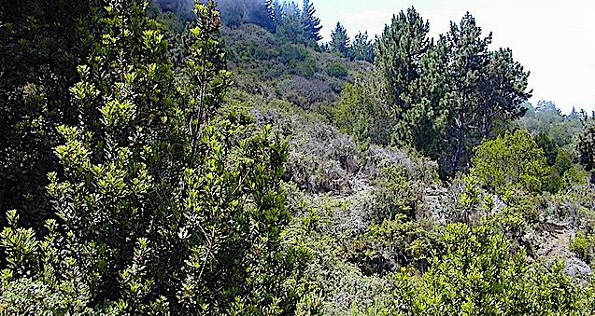
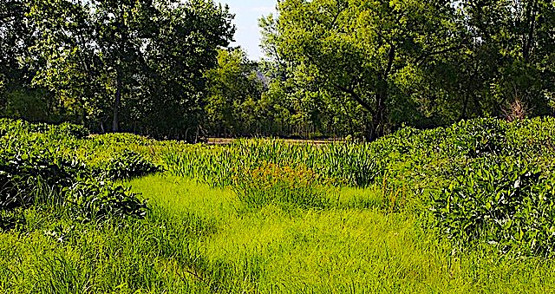
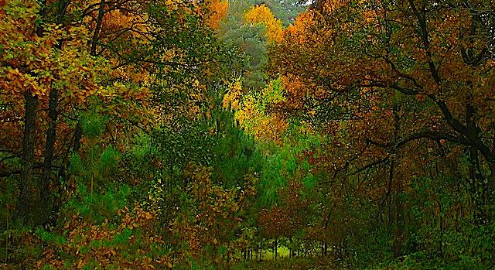
Temperate
Mostly shrubs, some depend on fires to release nutrients and some species have seeds that germinate only after a fire.
Grasses with deep roots and deep rich soil. The lack of trees is attributed to low rainfall, grazing, and occasional fires.
Broadleaf deciduous trees with some conifers. Rich soil due to thick leaf litter that minimizes leaching of nutrients.

Slide 5
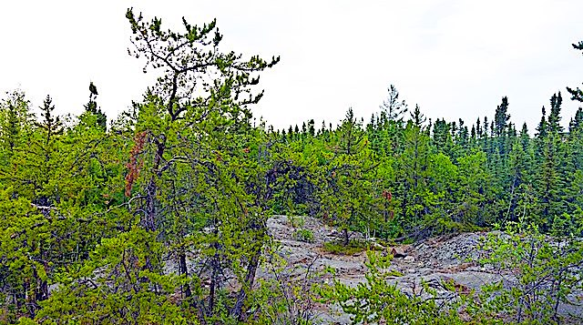
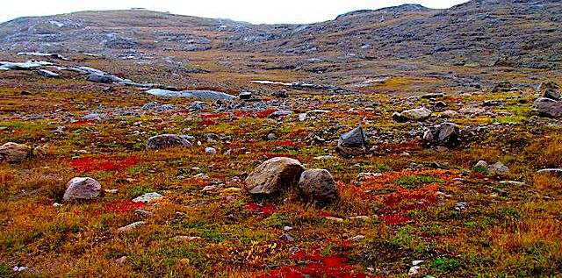
Arctic and Subarctic
Low biodiversity with mostly needle-leaf evergreens. Soils are acidic and nitrogen-poor due to slow decomposition of leaf litter.
Low biodiversity with no trees due to permafrost layer beneath the soil. Plant growth is rapid during summer due to 24 hours of sunlight. Low precipitation and low evaporation.

Slide 6
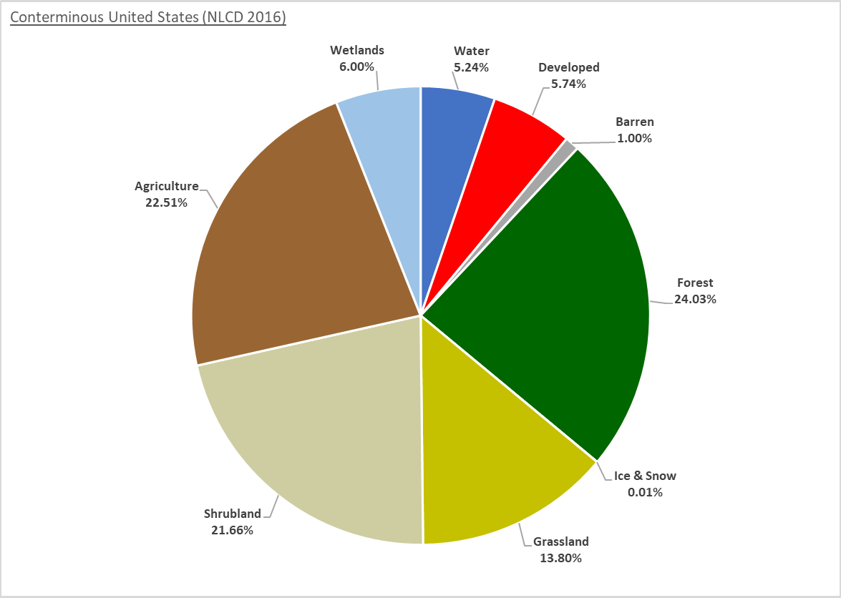
According to the US Geological Survey, as of 2016, slightly over 28% of terrestrial biomes in the US have been developed for agriculture and other purposes.

Slide 7
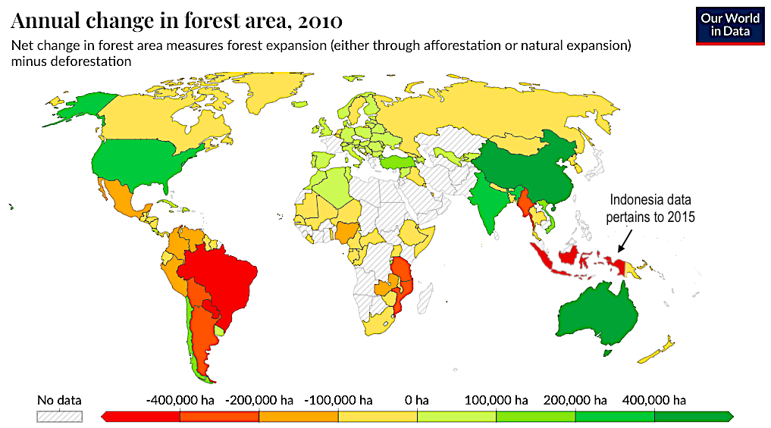
The biggest ongoing threat to terrestrial ecosystems is deforestation. Even though tropical forests are most at risk, Canadian and Russian forests face ongoing pressures due to worldwide lumber demand.

Slide 8
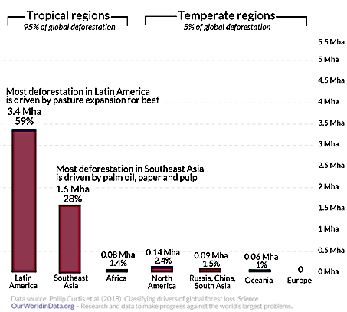
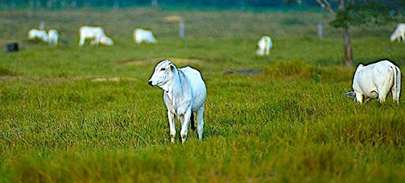
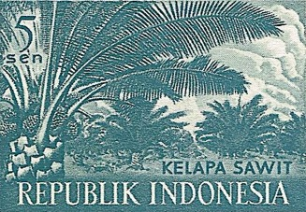
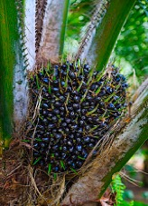
Most deforestation takes place in Latin America and Southeast Asia.
This is driven largely by the beef and palm oil production.

Slide 9
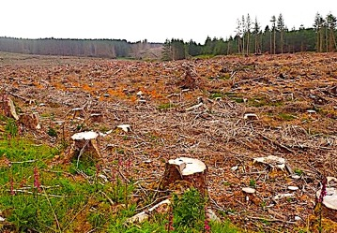
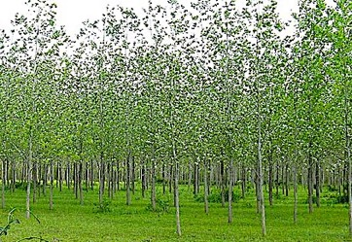
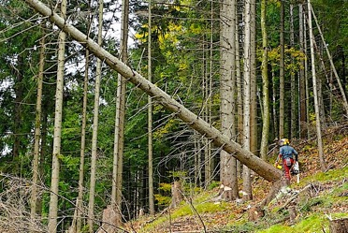
Clear-cutting for lumber is the fastest and cheapest way to harvest wood but it increases erosion and destroys habitats.
When clear-cutting is followed by tree-planting, the resulting even-aged “plantation forest” fails to provide the wide range of micro-habitats found in old-growth forests of different species and uneven-aged trees.
Selective cutting of trees minimizes environmental impacts, but this strategy is expensive because it is time-consuming for the small amount of lumber harvested.

Slide 10
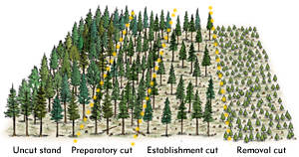
Strip logging strikes a balance between the environmental expense of clearcutting and the financial expense of selective cutting.
Cutting in thin strips minimizes the damage of erosion while facilitating the natural process of succession.
Image downloaded from the government of British Columbia, Canada: https://www.for.gov.bc.ca/hfd/pubs/SSIntroworkbook/varshel.htm
Notes:
Answer: b

Slide 11
Acknowledgement:
Unless otherwise indicated, all images in this presentation were downloaded from Wikimedia Commons: https://commons.wikimedia.org/wiki/Main_Page

