Slide 1
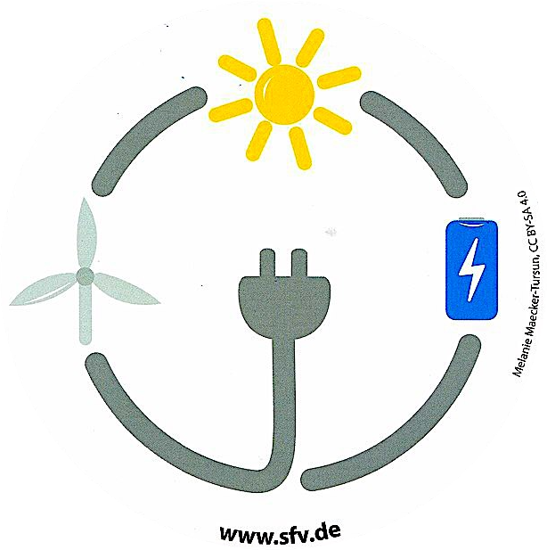
Renewable Energy

Slide 2
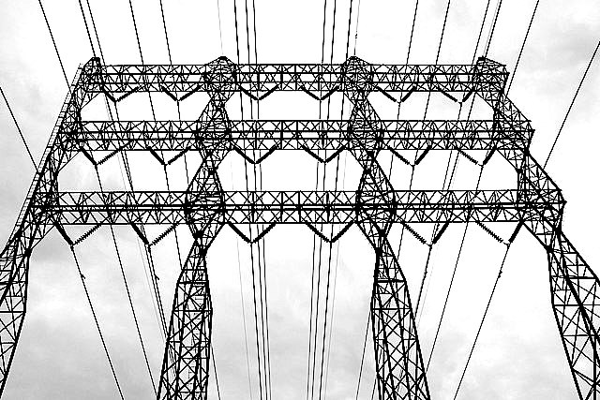
Electricity

Slide 3
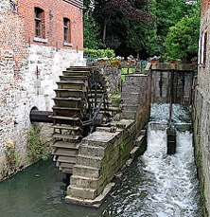
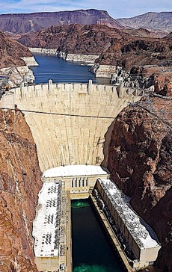
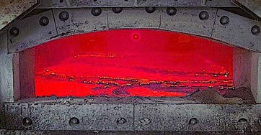
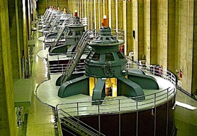
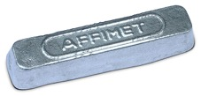
Hydroelectric
The power of moving water has been put to work since ancient times, then by the 1890’s innovators started to utilize this constant flow of free energy to generate electricity.
Most renewable electricity generated worldwide is hydroelectric, and in the US it makes up about 6% of total electricity generated.* The historic Hoover Dam has 17 turbines that generate enough electricity to serve over a million homes.
In Norway, hydroelectric makes up a whopping 90% of total electricity.* Norway uses much of this cheap electricity to smelt aluminum for export.
* Information from Our World in Data: https://ourworldindata.org/grapher/share-electricity-hydro

Slide 4
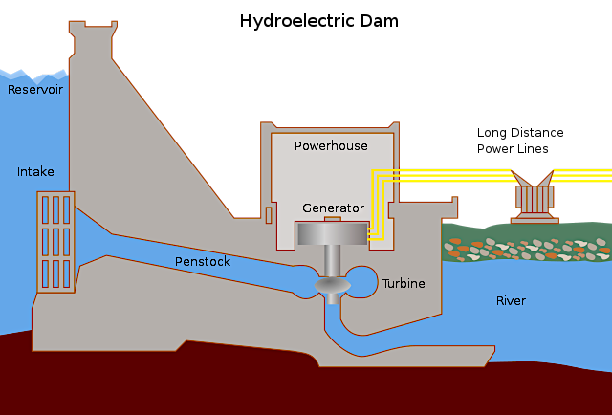
Hydroelectric power involves the building of dam to concentrate the energy of moving water to propel a turbine that in turn, powers the generator.

Slide 5
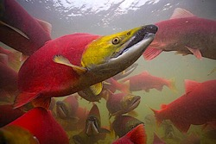
Advantages of Hydroelectric:
Does not release any emissions into the air.
Fuel does not need to be added and lasts indefinitely.
Disadvantages of Hydroelectric:
Disrupts the reproduction of migratory fish.
Disrupts ecosystems downstream by depriving flood-plain ecosystems of normal water flow and nutrient-rich silt deposits.*
Inundation of natural habits and villages: The World Commission on Dams estimates that 40-80 million people have been displaced by dams after their lands were submerged.*
Protests against plans for a dam that will submerge Xingu territory.
*Information from the World Commission on Dams: https://www.water-alternatives.org/index.php/volume3/v3issue2/80-a3-2-3/file

Slide 6
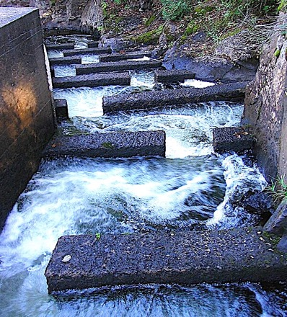
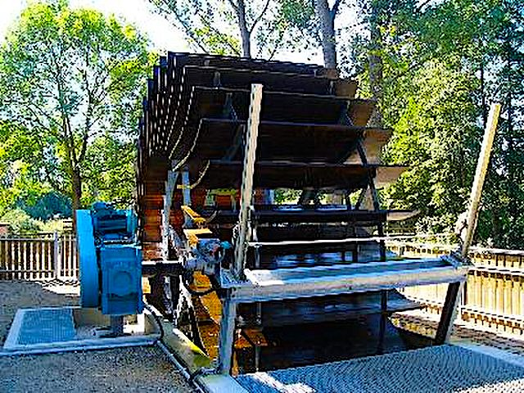
The problem of salmon migration can be mitigated with “fish ladders” that go around the dam.
A strategy for minimizing the overall impact of hydroelectric is doing away with the dam altogether and using only a portion of the river current for energy.

Slide 7
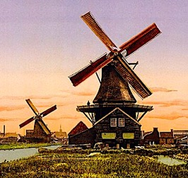
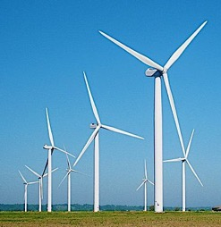
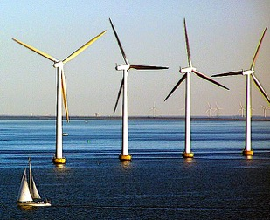
Wind Turbines
Windmills have been used in Europe since the Middle Ages, but the first wind turbine used to generate electricity was built in Cleveland Ohio in 1888.*
In 2007, wind power made up only 5% of the renewable energy used in the US,* but In Denmark wind energy accounted for a whopping 53% of total power demand in 2022.**
Most wind energy in Denmark is generated offshore.
* Information from the US Department of Energy: https://www.eia.gov/kids/history-of-energy/timelines/wind.php
** Information from the US Department of Energy: https://iea-wind.org/about-iea-wind-tcp/members/denmark/

Slide 8
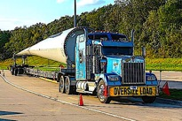
Advantages of Wind Turbines:
Does not release any emissions into the air.
Fuel does not need to be added and lasts indefinitely.
Disadvantages of Wind Turbines:
Blades kill birds and bats.
Wind turbines require a large amount of space.
The power source is intermittent.
Wind turbine blades last only 20-25 years and usually end up in landfills because they are difficult to recycle.*
* Information from Intelligent Living: https://www.intelligentliving.co/what-happens-to-old-wind-turbines-the-answers-not-so-eco-friendly/

Slide 9
Other Applications of Wind Energy:
The Wallenius Marine company made plans for a cargo ship that will use state-of-the-art sail technology that may reduce fossil fuel emissions by as much as 90%.*
* Information from Wallenius Marine: https://www.walleniusmarine.com/our-services/ship-design-newbuilding/ship-design/wind-powered-vessels/

Slide 10
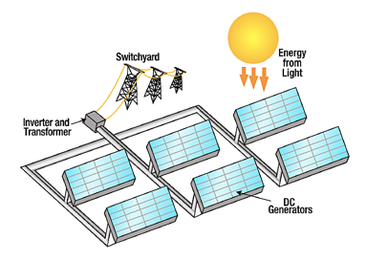
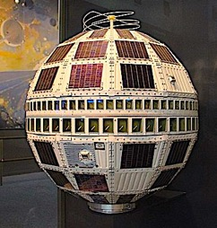
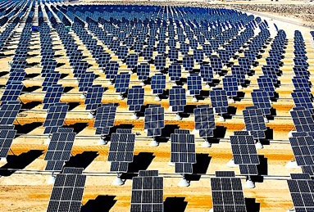
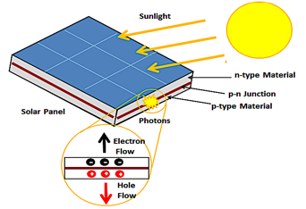
Photovoltaic
In 1839 French physicist Edmond Becquerel discovered the “photovoltaic effect, whereby exposure to sunlight caused certain materials to produce a measurable voltage.
During the 1950s American researchers revisited this phenomenon to develop photovoltaic cells that could power orbiting satellites indefinitely.
Starting in the 1970’s, photovoltaic were mass produced and prices continue to decline.
Image of photovoltaic effect from: https://energyeducation.ca/encyclopedia/Main_Page

Slide 11
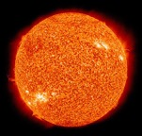
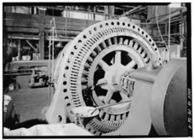
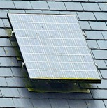
Advantages of Photovoltaic:
Does not release any emissions into the air.
Fuel does not need to be added and lasts indefinitely.
Minimal maintenance and no moving parts.
Can be easily scaled down for households.
Disadvantages of Photovoltaic:
Start-up costs are still high.
The power source is intermittent.
The manufacture and disposal is problematic because photovoltaics often contain toxic heavy metals like cadmium and lead.*
* Information provided by the EPA: https://www.epa.gov/hw/end-life-solar-panels-regulations-and-management

Slide 12
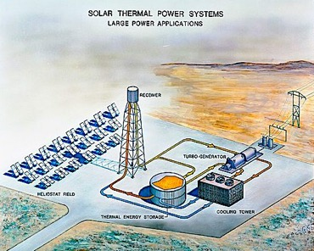
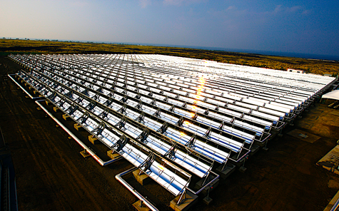
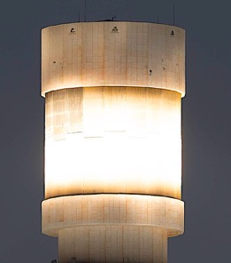
Solar Thermal Electricity
Solar thermal generates electricity by collecting concentrated solar heat that is later used to boil water for propelling a steam-driven turbine.
This is accomplished with an array of mirrors that focus the sun’s energy to a “power tower” containing molten sodium and potassium nitrate salts. After the salt is heated to temperatures exceeding 500∘ C it is piped to a thermal energy storage tank where this heat is used to boil water.*
* Information from the US Department of Energy: https://www.osti.gov/servlets/purl/791898

Slide 13
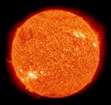
Advantages of Solar Thermal:
Does not release any emissions into the air.
Fuel does not need to be added and lasts indefinitely.
Molten salt can store enough heat to continue generating electricity for 10 hours.*
Cost of operation are competitive with coal-fired power.*
Disadvantages of Solar Thermal:
The mirror array takes up a great deal of space.
The power source is less effective in the winter.
The concentrated sunlight incinerates birds that fly to the mirrors.**
* Information from Inside Climate News: https://insideclimatenews.org/news/16012018/csp-concentrated-solar-molten-salt-storage-24-hour-renewable-energy-crescent-dunes-nevada/
** Information from Science Alert: https://www.sciencealert.com/this-solar-plant-accidentally-incinerates-up-to-6-000-birds-a-year

Slide 14
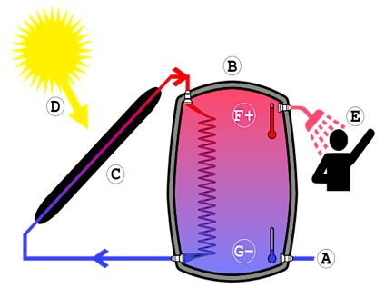
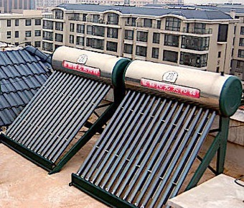
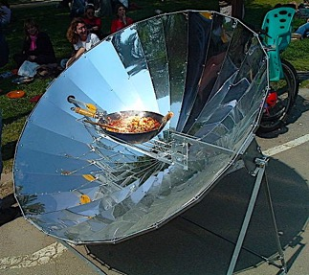
Other Applications of Solar Thermal:
Solar collectors are commonly used in China to heat water.
Concentrated solar power can also be used on a smaller scale for cooking.

Slide 15
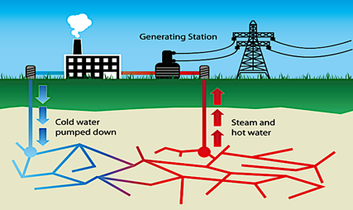
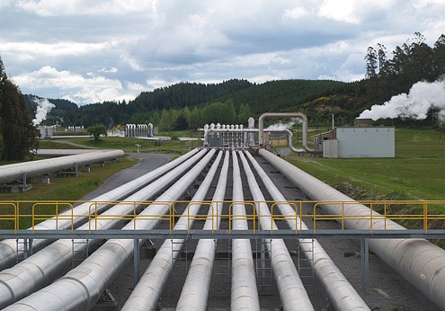
Geothermal Electricity
Superheated water from deep underground is piped to the surface to produce steam in order to propel a turbine coupled with a generator. In the US, geothermal electricity is generated almost entirely in Western states, with Nevada obtaining about 10% of total electricity from geothermal.*
* Information from the US Department of Energy: https://www.eia.gov/energyexplained/geothermal/use-of-geothermal-energy.php

Slide 16
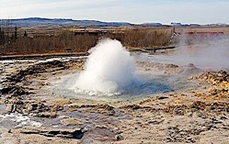
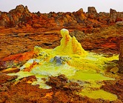
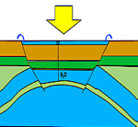
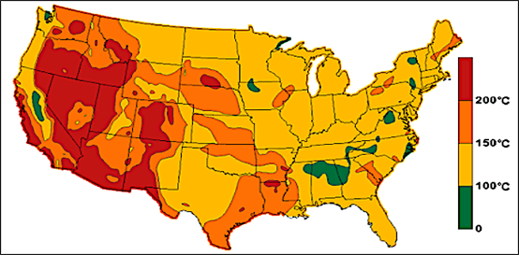
Advantages of Geothermal:
Fuel does not need to be added and lasts indefinitely.
Under normal conditions the power supply is constant.
Disadvantages of Geothermal:
High upfront costs.
Can emit toxic gases and metals.
Can cause tremors land subsidence.
The locations where this can be done are limited by geology.

Slide 17
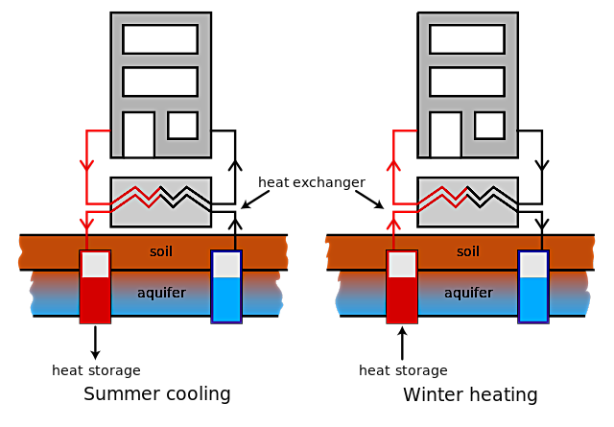
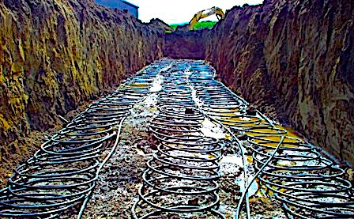
Other Applications of Geothermal:
Geothermal heat pumps utilize constant underground temperatures to heat houses in the winter and cool them in the summer.
Heat pumps do not require access to hot springs because they do not generate electricity. They only require space for installation of the underground tubing.
Geothermal heat pump tubing being prepared for burial.

Slide 18
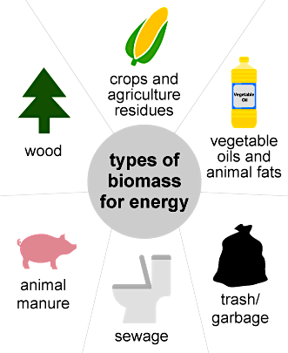
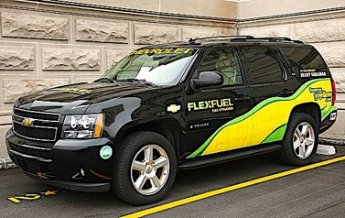
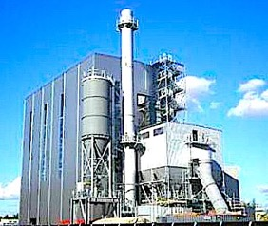
Biomass Electricity
Only 8% of biomass energy in the US is used for electricity.*
The rest is used for transportation, heating and industry.*
The Helius Biomass Plant in Scottland burns wastes from nearby malt whisky distilleries to generate electricity.**
* Information from the US Department of Energy: https://www.eia.gov/energyexplained/biomass/
** Information from Biomass Magazine: https://biomassmagazine.com/articles/helius-corde-chp-plant-opens-in-scotland-earns-ro-accreditation-8896

Slide 19
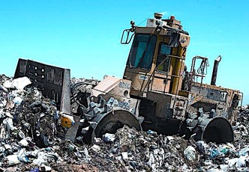
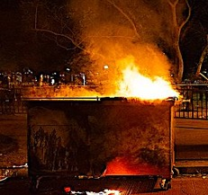
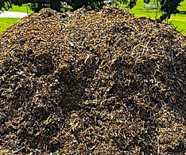
Advantages of Biomass Electricity:
Reduces combustible wastes in landfills.
Carbon neutral if relying only on wastes.
Disadvantages of Biomass Electricity:
Burning trash pollutes the air.
Storage, transportation, and extraction of some waste materials can be expensive.
The fuel requires a lot of storage space due to its low energy density.
Biofuels can result in high food prices and deforestation when land is set aside to grow it.

Slide 20
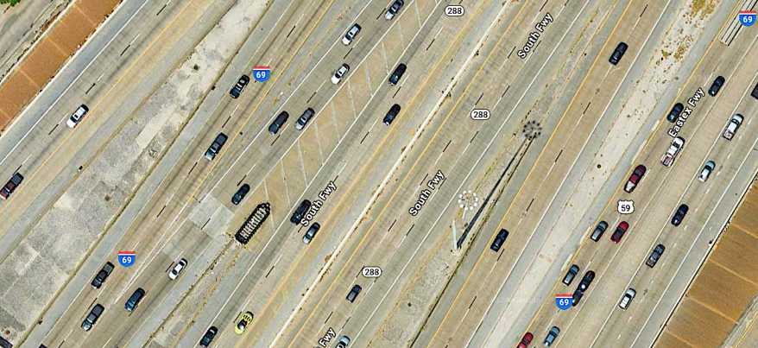
Personal Transportation
Google satellite view of an expressway in Houston.

Slide 21
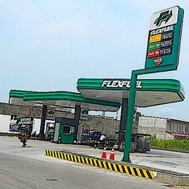
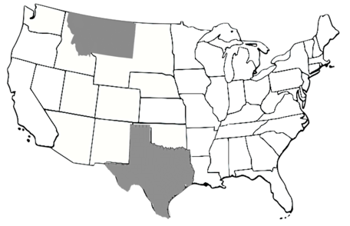
Ethanol is currently promoted as a renewable alternative to gasoline in the US but there are two problems:
Most ethanol in the US comes from corn, and US agriculture is heavily fossil fuel-dependent. Consequently, corn ethanol would not significantly reduce fossil fuel consumption.
Cellulose ethanol from switchgrass is regarded as the environmentally friendlier alternative to corn, but there is still the problem of setting aside land for biofuels: Even if this does reduce gasoline consumption, the amount of land for switchgrass ethanol to meet US demand exceeds the size of Texas and Montana combined.*
* Information from Sustainability (4/27/2009): https://www.mdpi.com/2071-1050/1/3/335

Slide 22
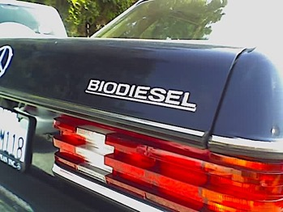
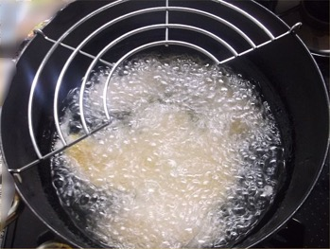
Biodiesel from plant oils has been proposed as a renewable alternative to petroleum-derived diesel, but there is a serious problem:
Indonesia’s biodiesel program has boosted demand for palm oil to the extent that palm oil plantations are now become Indonesia’s biggest driver of deforestation.*
In the US, biodiesel is made from used cooking oil. This process is carbon neutral because it utilizes a waste product. Unfortunately, the small amount of oil waste generated by restaurants cannot make a significant dent in petroleum-derived diesel consumption.
* Information from Mongabay (6/9/2021): https://news.mongabay.com/2021/06/indonesias-biodiesel-program-fuels-deforestation-threat-report-warns/

Slide 23
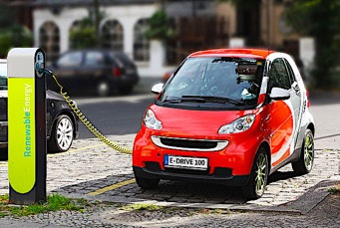
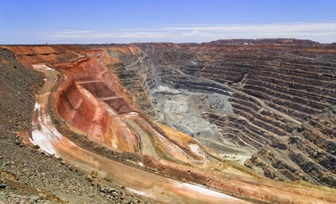
Electric Cars are the ultimate “flex-fuel” vehicle due to the many ways electricity can be generated, but there are serious problems:
Electric cars are expensive because lithium is a rare metal which requires a great deal of soil to be excavated for its extraction.
Lithium batteries are also not very safe: Lithium battery fires are so hazardous that firefighters are often instructed to let them burn out on their own.
Image of mine from Portugal Resident (2/17/20) https://www.portugalresident.com/protests-force-government-to-pull-two-areas-identified-for-lithium-mining/
Image of car fire from FOX Weather (8/31/23) https://www.foxweather.com/weather-news/tesla-electric-car-fire-precautions

Slide 24
Hydrogen Fuel Cells use a proton-exchange membrane to harness energy from the following reaction to generate electricity:
2H₂ + O₂ ---⊳ 2H₂O + energy
This electric current can then be used to power an electric motor. The overall process has three times the efficiency of the internal combustion engine, but there is a serious problem:
The amount of energy needed to extract hydrogen from water and compress it for storage and distribution far exceeds the energy return on the fuel cell.

Slide 25
Tentative Alternatives?
Methanol Fuel Cells use an alcohol that can be easily manufactured from methane. Methanol can also be generated by chemically combining carbon monoxide and hydrogen. Since it is a liquid, the storage and distribution of this fuel is less problematic.
Zinc-Air Batteries are cheaper, lighter, non-flammable, and environmentally friendlier than lithium batteries. The ongoing challenge is to make them rechargeable for use in cars.*
Compressed Air Cars do not require combustible fuels or toxic metals, and many sources of energy can be used to compress the air that powers the motor.**
Zinc-Air batteries used in hearing aids.
* Information from Motortrend: https://www.motortrend.com/news/zinc-air-batteries-light-cheap-green-ready-cars/
** Information from Brilliant: https://www.youtube.com/watch?v=fFoYPj3Ntzc

Slide 26
Acknowledgement:
Unless otherwise indicated, all images in this presentation were downloaded from Wikimedia Commons: https://commons.wikimedia.org/wiki/Main_Page

