Slide 1
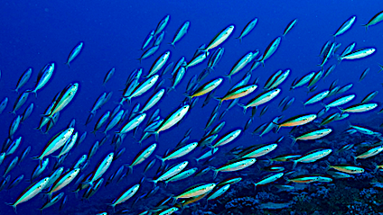
Population Ecology

Slide 2
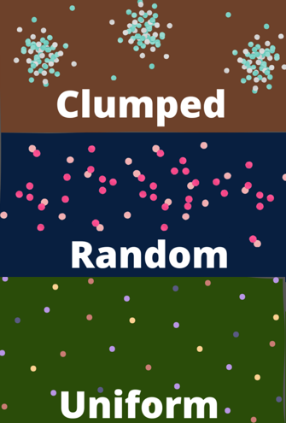
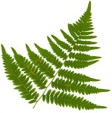
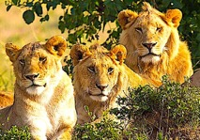
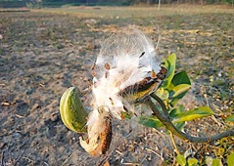
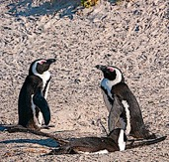
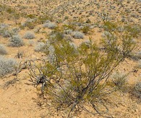
A population is the number of individuals of the same species in a given area.
Populations are distributed in three distinct patterns:
Clumped distribution prevails in social animals and in plants with no mechanism for seed dispersal over long distances.
Random distribution prevails in plants where the offspring are scattered by variable weather patterns like wind.
Uniform distribution prevails in animals or plants that employ physical or chemical means to maintain their space requirements.

Slide 3
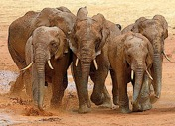
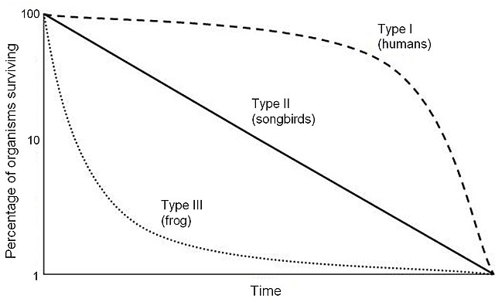
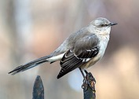
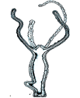
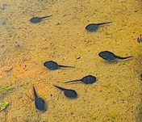
The age distribution of a given population depends in on where the species lands on the survivorship curve.
Type I have few offspring and mostly die later in life.
Type II die at the same rate at any point in life.
Type III have large numbers of offspring to compensate for the small number that survive to breed.

Slide 4
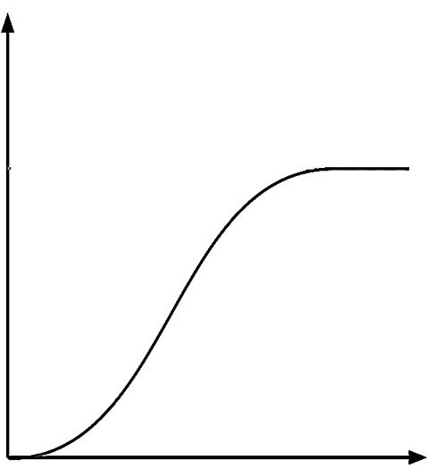
The growth of a population entering a new habitat that is conducive to its survival goes through three distinct phases:
During lag phase, reproduction is slow because the population is still adapting to the new territory.
During exponential growth, the rate of growth occurs at its fastest rate because the resources needed to thrive are still abundant. This rate approximates the biotic potential.
During logistic growth, the rate of growth stabilizes as individuals start to compete over limited resources.
The point where logistic growth occurs approximates the carrying capacity of the habitat.
Carrying Capacity
C
B
Total Population
A
Time

Slide 5
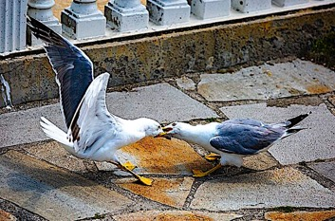
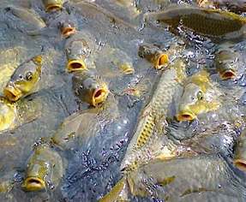
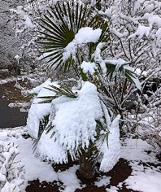
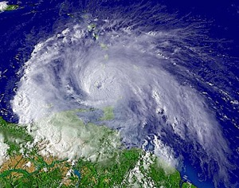
Limiting factors for population growth can be either density-dependent or density-independent.
Density-dependent limits on population growth include competition for resources like food, water, and oxygen, living space, sunlight, spread of diseases, and predation.
Density-independent limits on population growth include overall climate, water chemistry, and frequency of natural disasters.

Slide 6
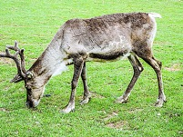
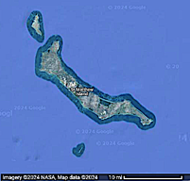
Review Question
What happened to the reindeer population in St. Matthew Island? (K = carrying capacity)
Notes:
Answer: a

Slide 7
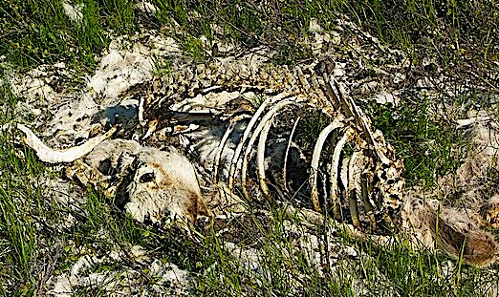
Review Question
The population grew exponentially, but after far exceeding the carrying capacity many reindeer died of starvation.
Notes:
Answer: a

Slide 8
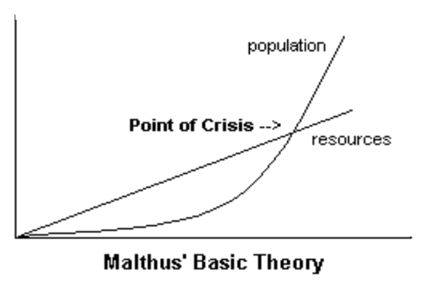
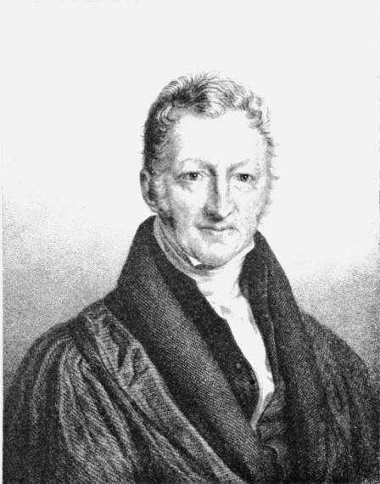
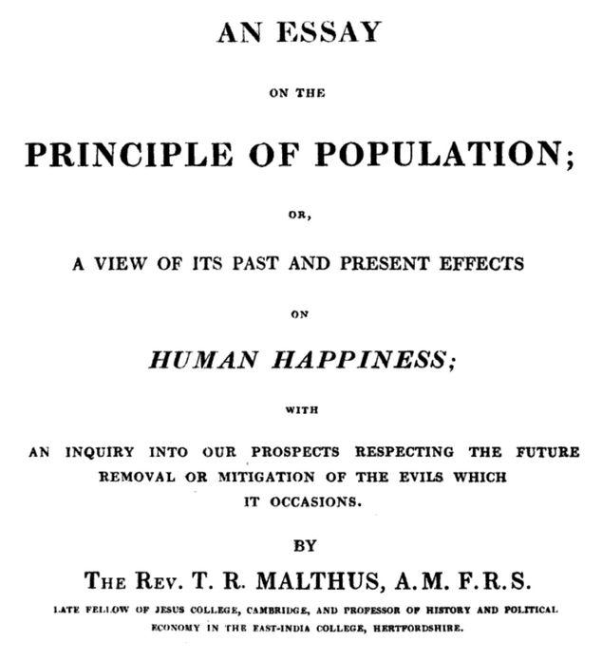
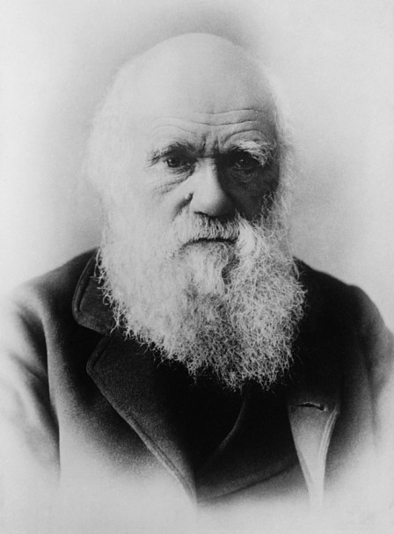
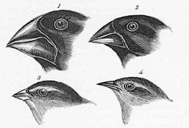
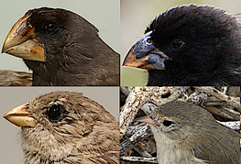
Near the end of the 18th century, Thomas Malthus predicted that human population growth would eventually exceed the food production.
This “Malthusian scenario” has yet to come true, but it did serve as a basis for Charles Darwin’s theory on the origin of different species through a struggle for survival, accompanied by the natural selection of traits that provided a competitive edge.
Drawing of Galapagos finches from “The Origin of the Species.”

Slide 9
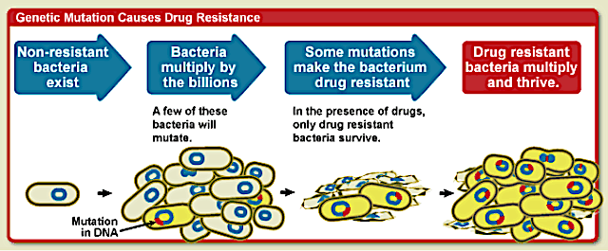
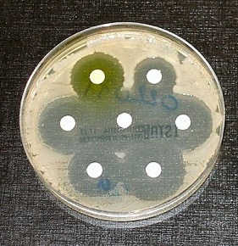
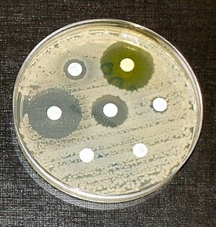
Natural selection is responsible for the ongoing ”arms race” between antibiotic resistant bacteria and the need for new antibiotics to replace those that are becoming obsolete. This is further exacerbated by the ongoing misuse of antibiotics in medical care and agriculture.
The clear areas of the petri dish surrounding the disks indicate where bacteria cells were killed by antibiotics released from each white disk.
The plate on the far right demonstrates a strain of bacteria that is resistant to four of the seven different antibiotics that were applied.

Slide 10
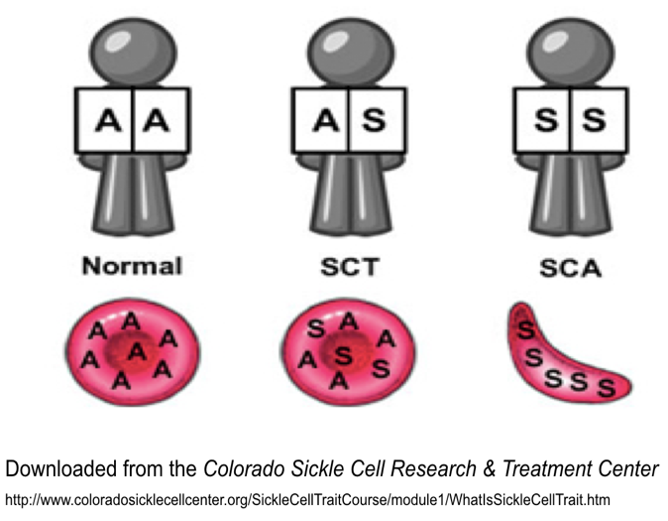
Natural selection is also responsible for the prevalence of sickle cell trait among people of African descent. People possessing one or two copies of this mutation are immune to malaria.
Sickle cell trait is a double-edged sword because people with two copies of this mutation suffer from impeded circulation due to sickle cell anemia.
Normal
Sickle Cell Anemia

Slide 11
Acknowledgement:
Unless otherwise indicated, all images in this presentation were downloaded from Wikimedia Commons: https://commons.wikimedia.org/wiki/Main_Page

