Slide 1
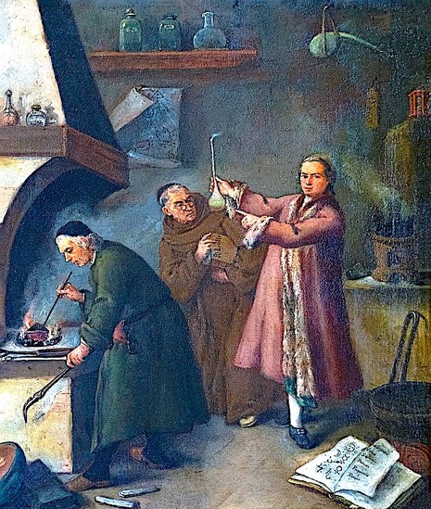

Understanding Matter

Slide 2
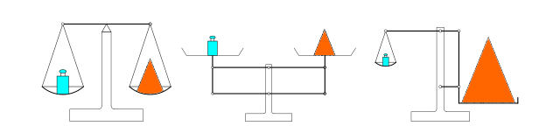
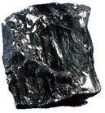
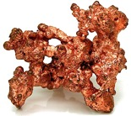
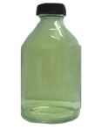
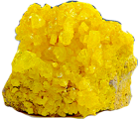
Matter is defined as anything that takes up space and mass.
Elements are substances that cannot be chemically broken down into other substances.
Carbon
Copper
Sulfur
Chlorine (gas)

Slide 3





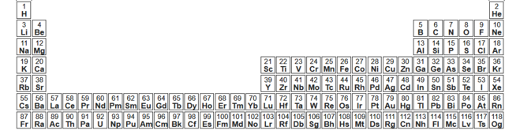
Western scholars up to the Middle Ages believed that the basic “elements” were Earth, water, wind, and fire.
Today we know there are more than one hundred elements!

Slide 4
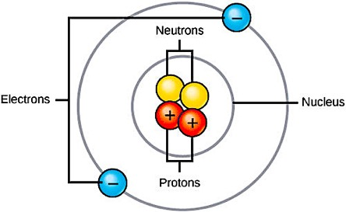
The atom is the smallest distinct unit of an element.
Atoms are made up of protons, neutrons, and electrons.
Protons and electrons have positive and negative charges respectively. Neutrons have no charge.
Protons and neutrons reside in the nucleus and make up almost the entirety of the element’s mass.
From “Environmental Issues” by Andrew Frank https://pressbooks.bccampus.ca/environmentalissues/front-matter/introduction/

Slide 5
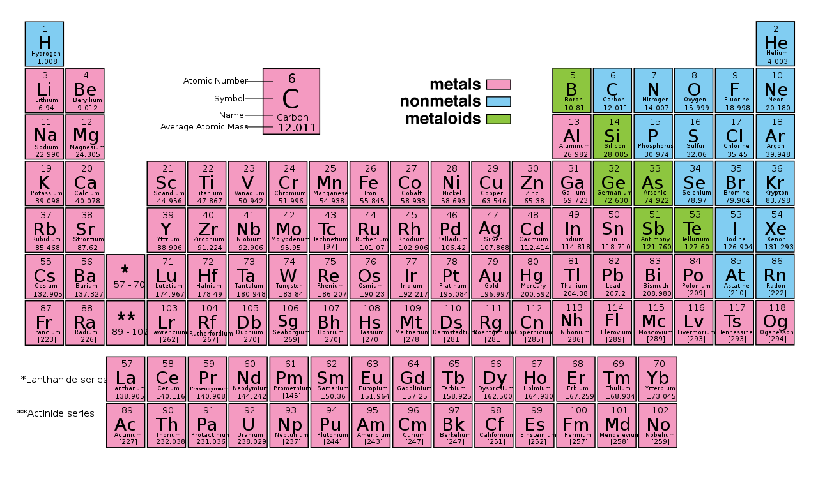
Most of the known elements are metals. Note how nearly all of the nonmetals are on the upper right portion of the periodic chart
You will not be tested on these categories on the periodic chart.

Slide 6
In an atom that has not reacted with its surroundings, the number of electrons is equal to the number of protons.
The periodic chart lists elements by symbol and organizes them on the basis of their chemical properties.
The atomic number indicates the number of protons in each atom.
9
F
The atomic mass is the average mass in atomic mass units (amu).
Fluorine
This is roughly equivalent to the sum of protons and neutrons in each atom.
18.998

Slide 7
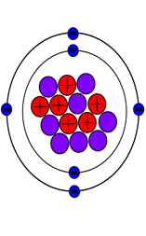
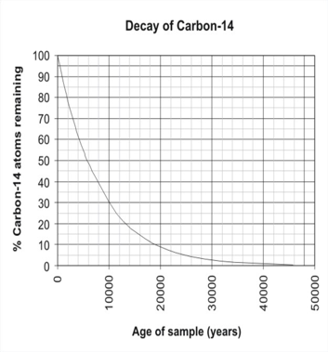
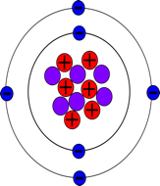
The number of protons in a given element determines its identity because it is constant, but the same element can be made up atoms with different amounts of neutrons. These different ”versions” of the same element are called isotopes.
Carbon-14 is not only rare, it is also unstable, and breaks down at a constant rate.
Carbon-12
Carbon-14
6 protons
6 neutrons
6 protons
8 neutrons

Slide 8
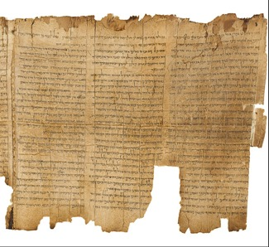
The number of protons in a given element determines its identity because it is constant, but the same element can be made up atoms with different amounts of neutrons. These different ”versions” of the same element are called isotopes.
Carbon-14 is not only rare, it is also unstable, and breaks down at a constant rate.
This is why it is used to determine the age of ancient artifacts derived from previously living materials.
Carbon-12
Carbon-14
6 protons
6 neutrons
6 protons
8 neutrons

Slide 9
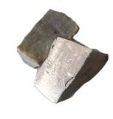

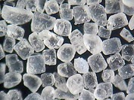




Many elements can chemically combine to form compounds.
Sodium
Chlorine
Sodium Chloride
Carbon
Oxygen
Carbon Dioxide

Slide 10
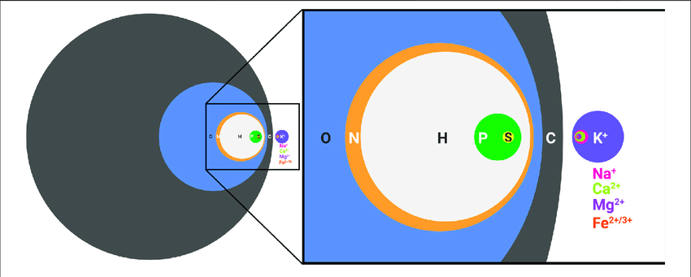
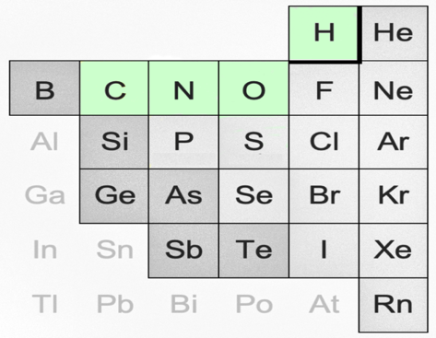
Carbon, nitrogen, oxygen, and hydrogen are the main elements involved the compounds of life.
Phosphorous (P), sulfur (S), potassium (K), sodium (Na), magnesium (Mg), iron (Fe), and other micronutrients also occur in much lesser amounts. This shows their dry weight ratios in the compounds that make up living cells.

Slide 11
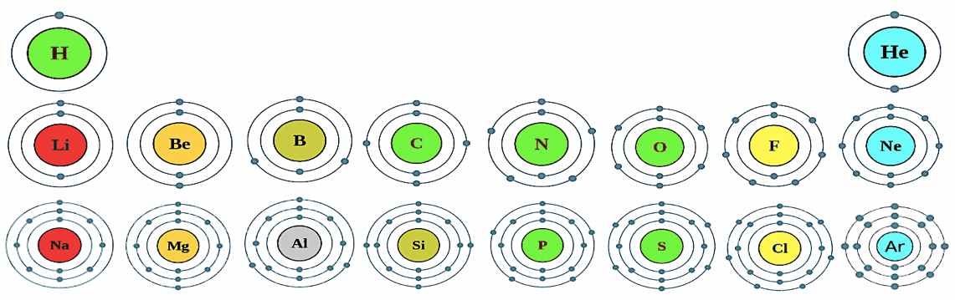
The outermost electrons determine chemical properties.
Noble gases (indicated by the arrow) do not form compounds because their outermost electron shell is “full.”
These elements (in the boxes) are very reactive because they are only one electron away from noble gas configuration.
This is just to improve your understanding. You will not be tested on this.

Slide 12
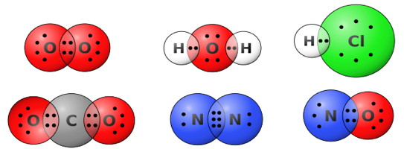
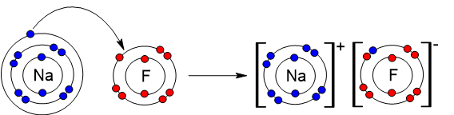
Elements form chemical bonds in order to obtain the configuration of noble gases. This can involve either the electron sharing (covalent) or electron transfer (ionic).

Slide 13
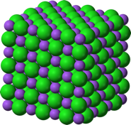
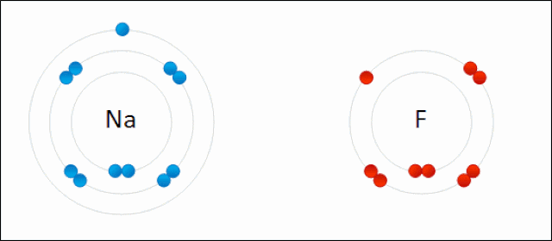
Ionic bonds form a continuous network of positively and negatively charged ions. They usually occur between metal and nonmetal.

Slide 14
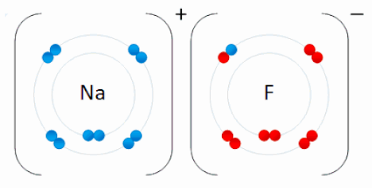
Ionic bonds form a continuous network of positively and negatively charged ions. They usually occur between metal and nonmetal.
Important: This is not a molecule! These are two ions.

Slide 15
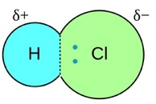

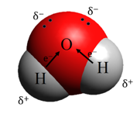
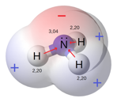
Electron sharing can be equal
and unequal.
Hydrogen Molecule
Hydrogen Chloride Molecule
Unequal sharing results in covalent bonds that are polar.
Water Molecule
Ammonia Molecule

Slide 16
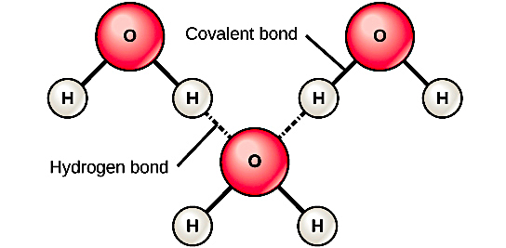

Unequal sharing of electrons between oxygen and hydrogen atoms generates strong intermolecular forces called hydrogen bonds.
Hydrogen bonding is responsible for the properties that make water conducive to life. These include:
solvent properties
cohesion & adhesion
high specific heat
crystallization of the solid
From “Environmental Issues” by Andrew Frank https://pressbooks.bccampus.ca/environmentalissues/front-matter/introduction/

Slide 17


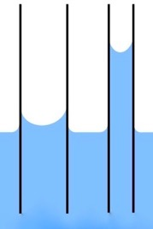

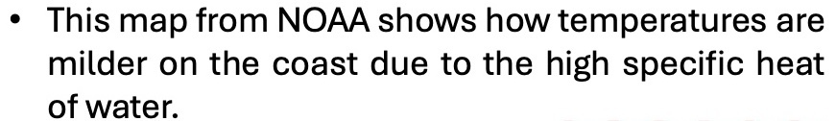
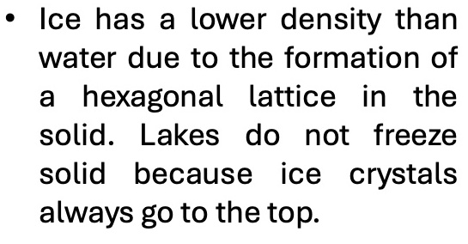
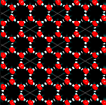
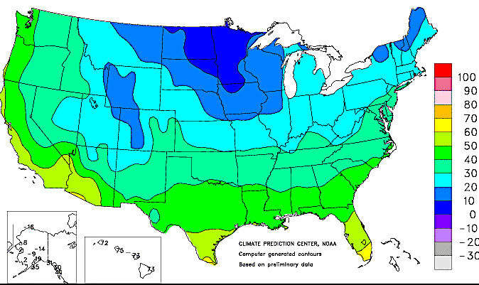

Slide 18
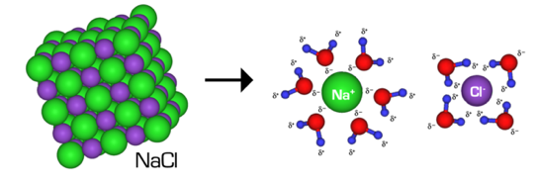
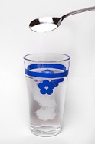
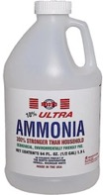
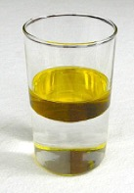
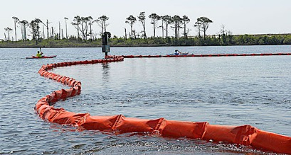
Solvent properties of water
Both sugar and ammonia dissolve in water because both substances are polar.
Sodium chloride dissolves in water because the polar water molecules pull the ions apart from each other and surround them according to their ionic charges.
Hydrocarbons like gasoline and other organic solvents do not dissolve in water because they are non-polar. This is why oil spills are cleaned up by containing the spill and using absorbent materials to remove the oil at the surface.

Slide 19
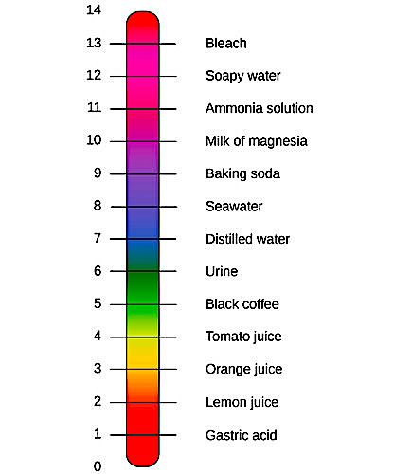
Even pure water is never 100% H₂O molecules: A small proportion of the water molecules spontaneously dissociate into hydrogen ions and hydroxide ions at a predictable concentration. The pH scale indicates which ions are higher in concentration. In pure water the pH is 7.
The pH scale
H₂O ⊲---⊳ H⁺ + OH⁻
If pH < 7, the solution is acidic OH⁻ < H⁺
If pH > 7, the solution is basic OH⁻ > H⁺
If pH = 7, the solution is neutral OH⁻ = H⁺
From “Environmental Issues” by Andrew Frank https://pressbooks.bccampus.ca/environmentalissues/front-matter/introduction/

Slide 20
Review Questions
Covalent bonds an (intra/inter)-molecular force.
Hydrogen bonds an (intra/inter)-molecular force.
Hydrogen bonding occurs because water molecules are (polar/non-polar).
Why does ice float?
Why are coastal climates usually milder that inland climates?
Notes:
Answer: a

Slide 21
Review Questions
Covalent bonds an (intra/inter)-molecular force.
Hydrogen bonds an (intra/inter)-molecular force.
Hydrogen bonding occurs because water molecules are (polar/non-polar).
Why does ice float? It has a lower density.
Why are coastal climates usually milder that inland climates? Water has a high specific heat, so the temperature of the water and the immediate surroundings changes at a slower rate.
Notes:
Answer: a

Slide 22
Review Questions
Sugar dissolves in water because it is ____________.
Oil does not dissolve in water because it is ____________.
If the concentration of the H⁺ exceeds that of the OH⁻, the solution is _______ and the pH is (above/below/equal to) 7.
What term is used to label the opposite situation?
Notes:
Answer: a

Slide 23
Review Questions
Sugar dissolves in water because it is polar.
Oil does not dissolve in water because it is non-polar.
If the concentration of the H⁺ exceeds that of the OH⁻, the solution is acidic and the pH is (above/below/equal to) 7.
What term is used to label the opposite situation?
  The solution is basic
Notes:
Answer: a

Slide 24

Acknowledgement:
Unless otherwise indicated, all images in this presentation were downloaded from Wikimedia Commons: https://commons.wikimedia.org/wiki/Main_Page

