Slide 1
Why Study Environmental Science?

Slide 2
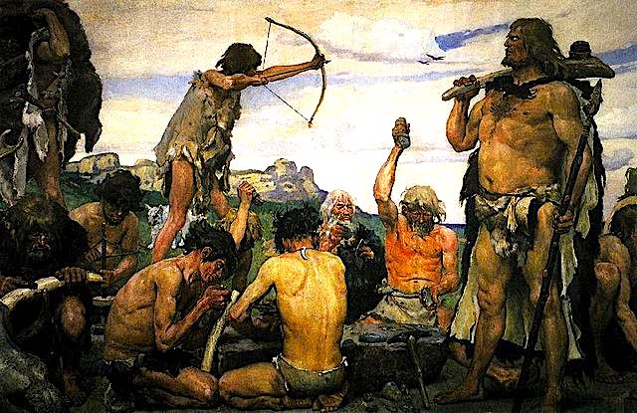
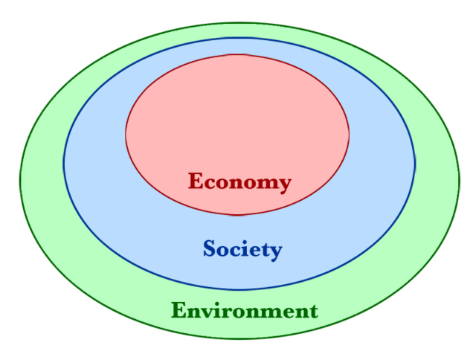
Without an economy or social order, life is “poor, nasty, brutish, and short,”*
but neither of these can exist in the absence of natural resources.
* Quote from ”The Leviathan” by Thomas Hobbes

Slide 3
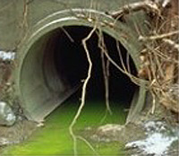
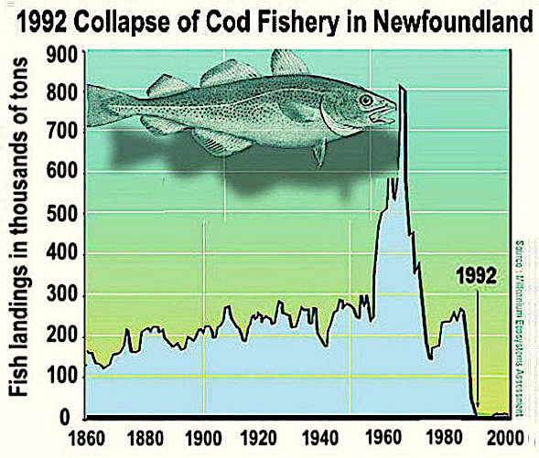
Environmental scientists and policy-makers deal with issues like pollution and resource depletion…
…with the ultimate goal of striking a balance between our economic needs and the environment.

Slide 4
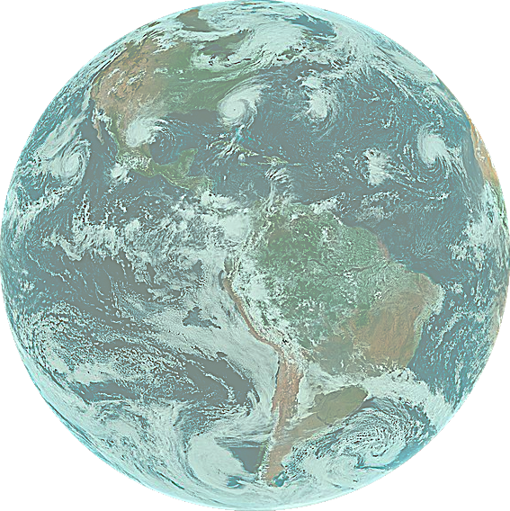
This is why environmental science is the most interdisciplinary of the natural sciences.
STEM
Biology
Chemistry
Physics
Geology
Engineering
Statistics
Social Sciences
Economics
History
Politics
Law
Humanities
Philosophy
Literature
Ethics

Slide 5
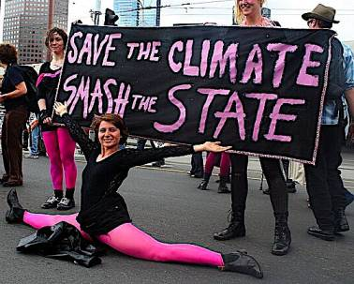
Environmental science is not only interdisciplinary, it also confronts issues that are deeply controversial.
Passion is a powerful force, but without rational discussion it cannot provide helpful solutions.

Slide 6
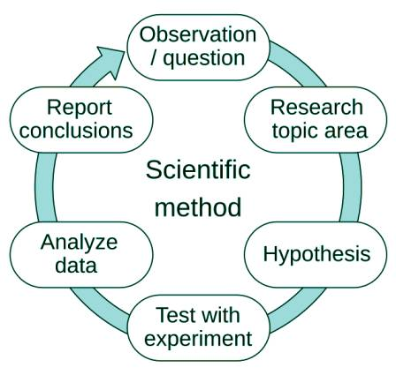
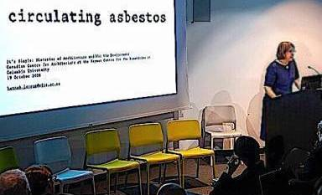
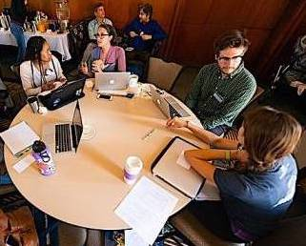
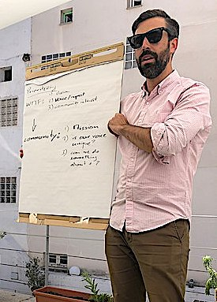
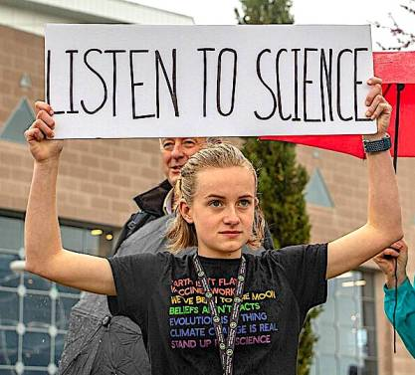
The conscientious scientist presents data that is carefully vetted...
…and listens to other perspectives…
…in hopes that cooler heads prevail,
…because at the end of the day, science is not a religion:
It is an ongoing process.

Slide 7
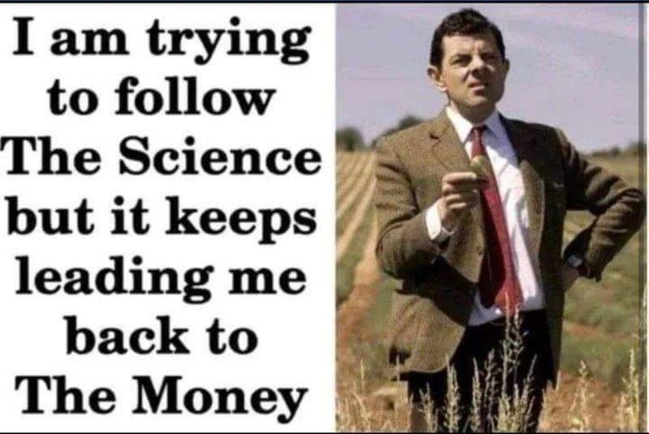
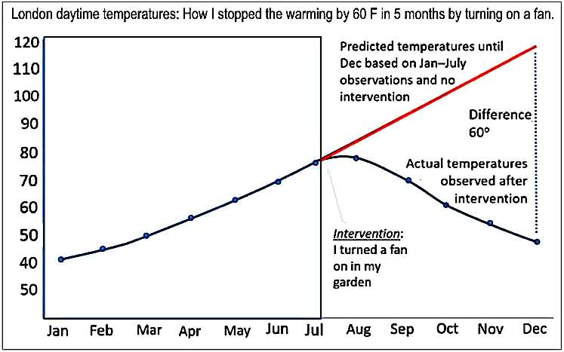
Scientific progress is vital to our quality of life, but it is often messy…
…and not all results are presented in good faith!
A major goal of this course is to give you skills to objectively discern the issues without wasting time on junk science or bottomless rabbit holes.
FYI: This chart is satire!
Chart by Norman Fenton https://www.youtube.com/watch?v=8Avq_tMz2LU&t=74s
Image generated by Bing AI.

Slide 8
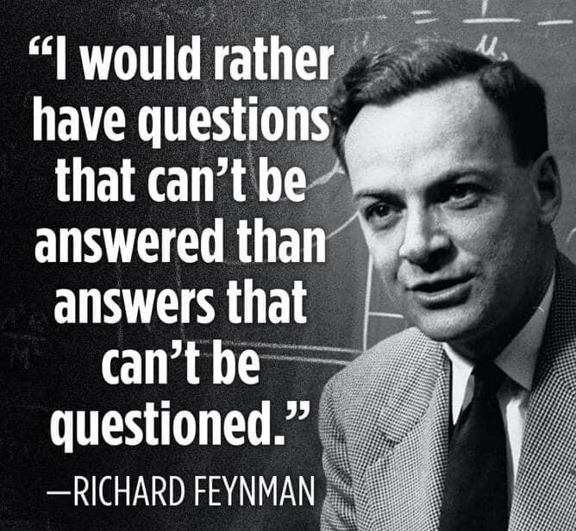

Slide 9
Guidelines for Dealing with Controversy:
Occam's razor: a scientific and philosophical rule that entities should not be multiplied unnecessarily which is interpreted as requiring that the simplest of competing theories be preferred to the more complex or that explanations of unknown phenomena be sought first in terms of known quantities.
Merriam-Webster: https://www.merriam-webster.com/dictionary/Occam's%20razor

Slide 10
Your Dictionary: https://www.yourdictionary.com/articles/examples-occams-razor

Slide 11
Guidelines for Dealing with Controversy:
Occam's razor: a scientific and philosophical rule that entities should not be multiplied unnecessarily which is interpreted as requiring that the simplest of competing theories be preferred to the more complex or that explanations of unknown phenomena be sought first in terms of known quantities.
Merriam-Webster: https://www.merriam-webster.com/dictionary/Occam's%20razor
Hitchen’s razor: What can be asserted without evidence can be dismissed without evidence.
Life Lessons: https://lifelessons.co/critical-thinking/philosophical-razors/

Slide 12
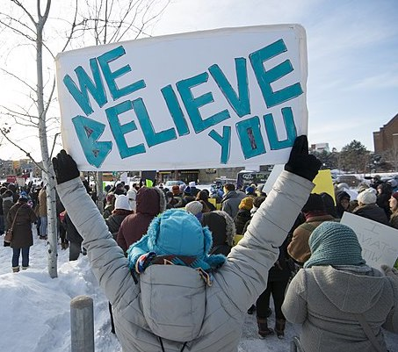
In a court of law, the burden of proof always rests on the claimant, not the suspect.
This is why regardless of public opinion, unsupported allegations never go to trial.
The same standard should apply to unsupported talking points.

Slide 13
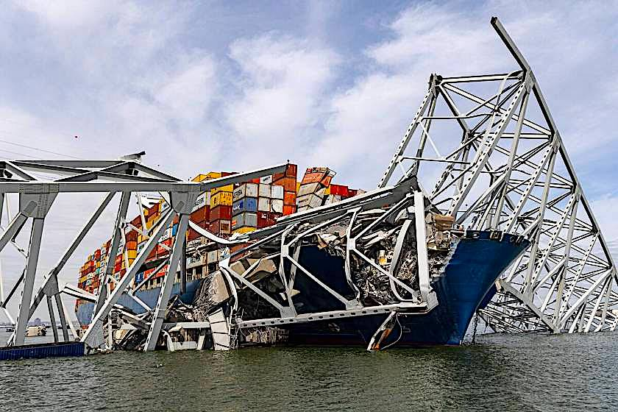
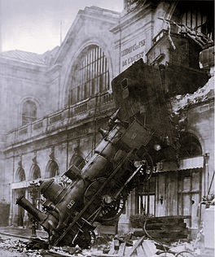
Guidelines for Dealing with Controversy:
Occam's razor: a scientific and philosophical rule that entities should not be multiplied unnecessarily which is interpreted as requiring that the simplest of competing theories be preferred to the more complex or that explanations of unknown phenomena be sought first in terms of known quantities.
Merriam-Webster: https://www.merriam-webster.com/dictionary/Occam's%20razor
Hitchen’s razor: What can be asserted without evidence can be dismissed without evidence.
Life Lessons: https://lifelessons.co/critical-thinking/philosophical-razors/
Hanlon’s razor: Never attribute to malice that which can be adequately explained by incompetence or stupidity.
Life Lessons: https://lifelessons.co/critical-thinking/philosophical-razors/
Key Bridge Collapse in Baltimore (3/26/24)

Slide 14
Survival Guide for this Course

Slide 15
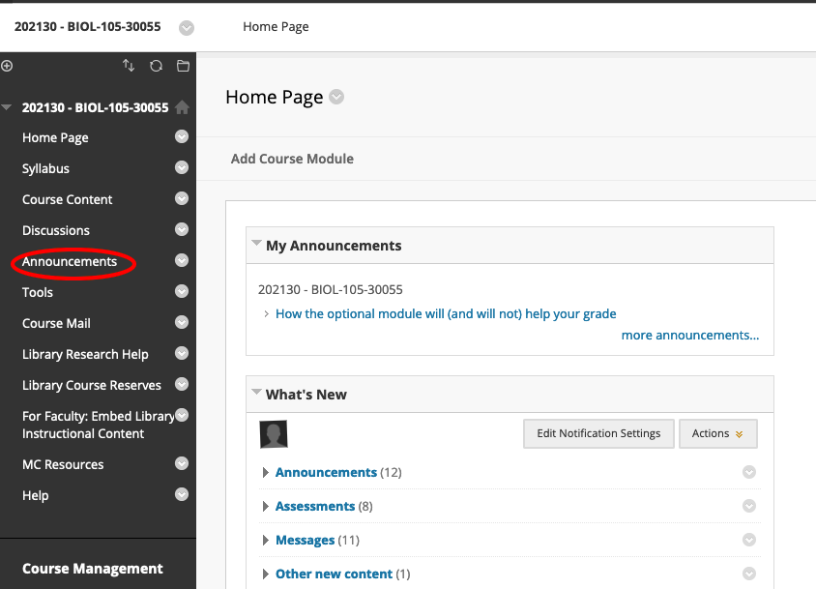
Check your announcements daily
Check your announcements on a daily basis.

Slide 16
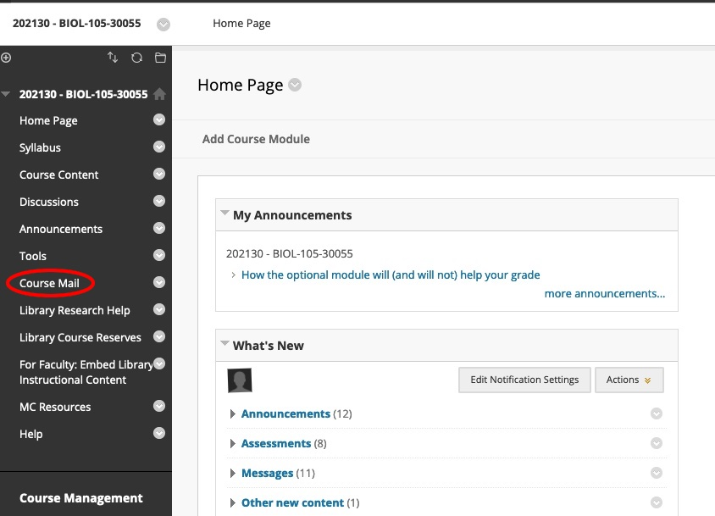
Check your course mail daily
The same goes for your course mail.

Slide 17
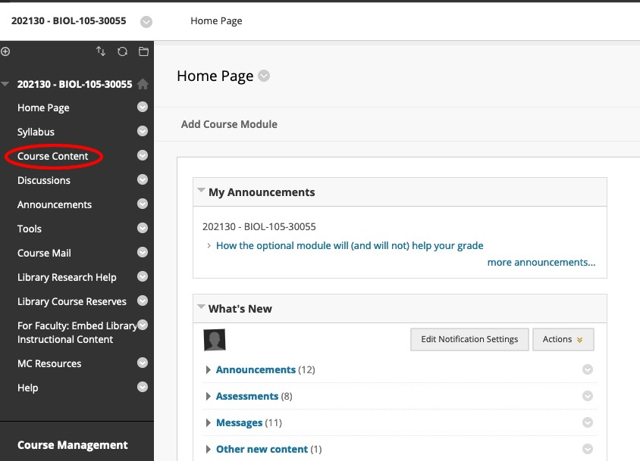
Open this link for access to power points, quizzes and assignments.

Slide 18
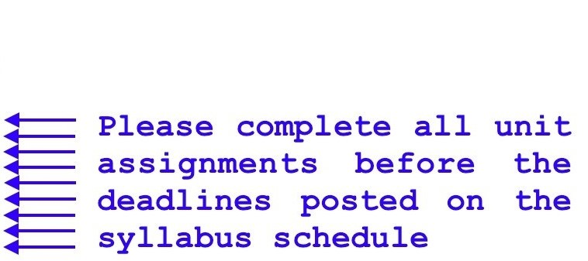
Your unit folder should look something like this.

Slide 19
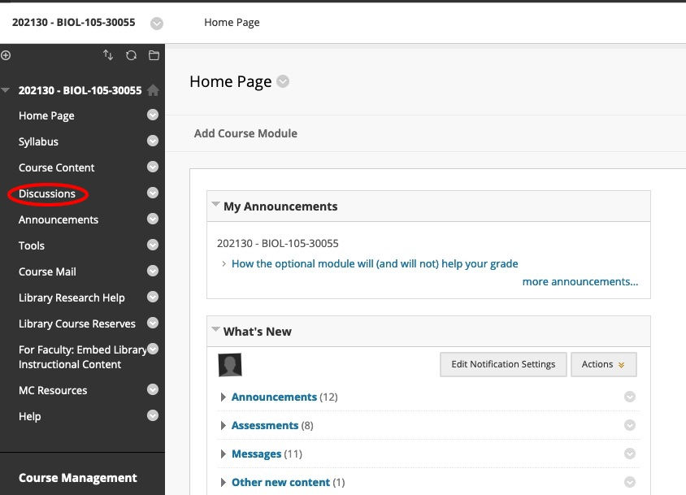
Do not forget to post to online discussions!

Slide 20
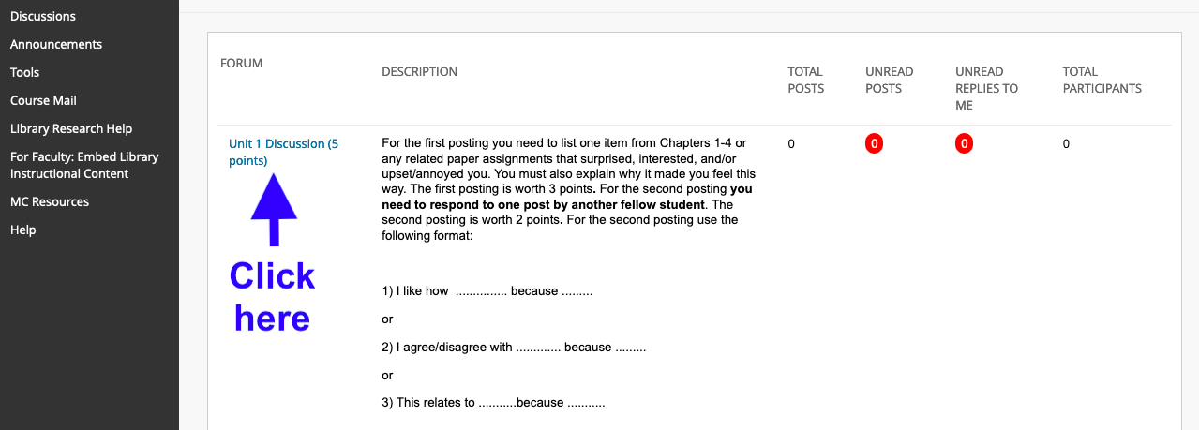
Click here to post your response.

Slide 21
Acknowledgement:
Unless otherwise indicated, all images in this presentation were downloaded from Wikimedia Commons: https://commons.wikimedia.org/wiki/Main_Page

