Slide 1
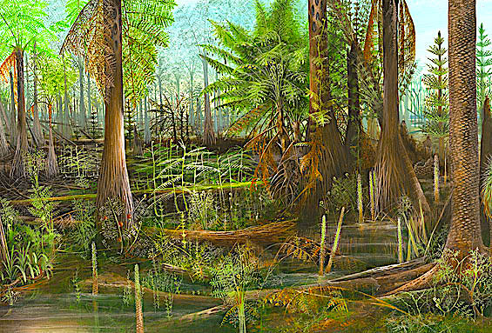
Fossil Fuels
Image on left downloaded from the Smithsonian: https://forces.si.edu/atmosphere/04_00_07.html

Slide 2
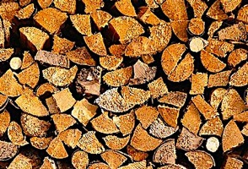
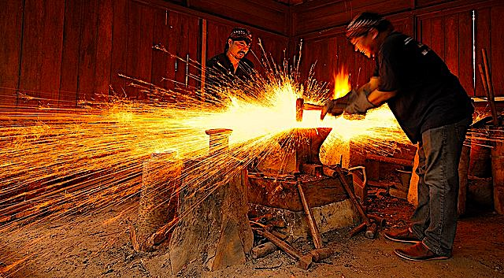
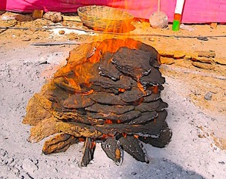
Biofuels came first:
From the pre-historic times to the 1800’s, nearly all energy needs were met with some form of biomass.
Dung fire in Tibet.

Slide 3
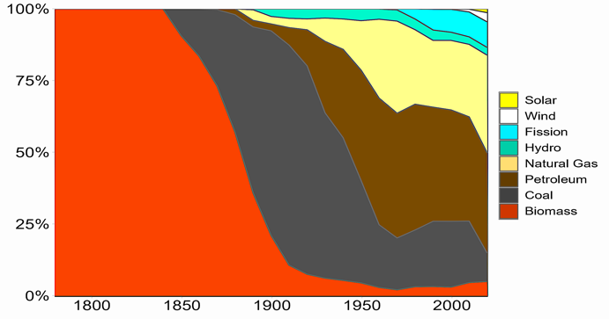
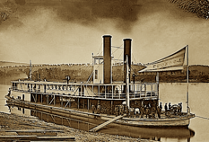
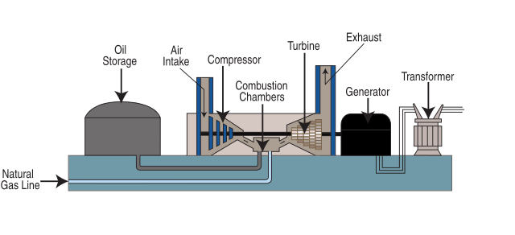
The Industrial Revolution is mainly responsible for the transition to fossil fuels.
Coal was mined extensively to meet the exploding demand for combustible material following the widespread use of steam engines.
Mass production of automobiles with internal combustion engines created a new demand for petroleum.
In recent years cleaner-burning natural gas started to displace coal as the fuel for power plants.
Downloaded from: https://commons.wikimedia.org/wiki/File:US_Energy_Consumption_historical_percent.png

Slide 4
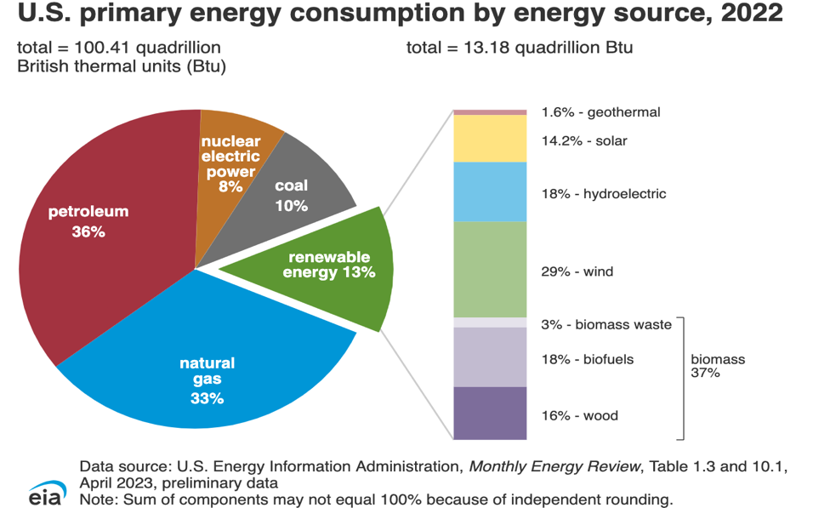
Fossil fuels now make up about 80% of all energy us in the US.

Slide 5
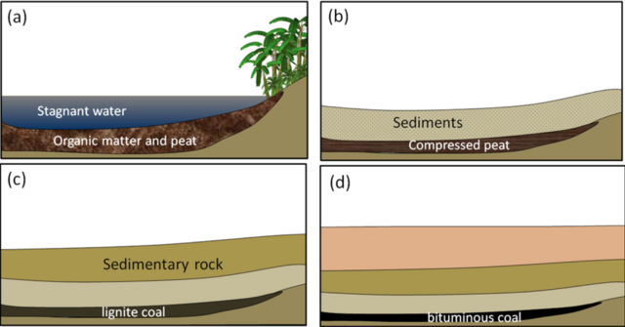
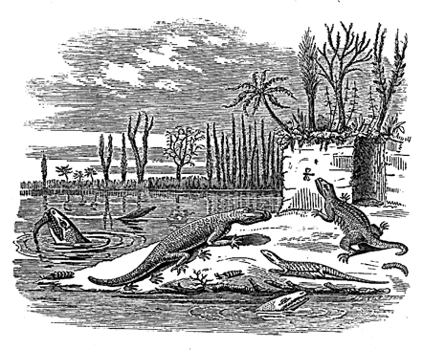
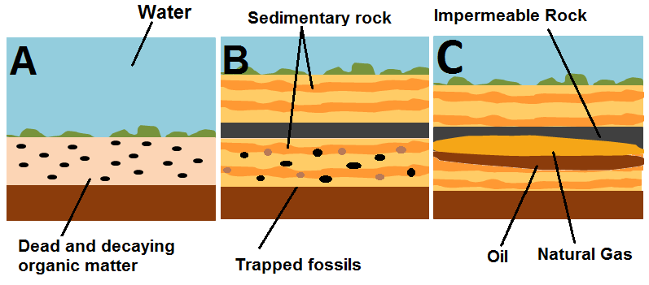
Fossil fuels were formed when organic matter decomposed under anaerobic conditions over hundreds of millions of years.
Most of this organic matter is believed to have its origin during the Carboniferous Period.
Downloaded from: https://energyeducation.ca/encyclopedia/Oil_formation

Slide 6
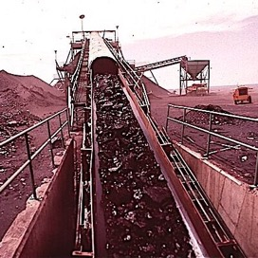
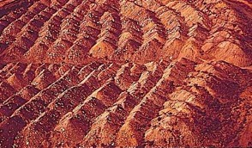
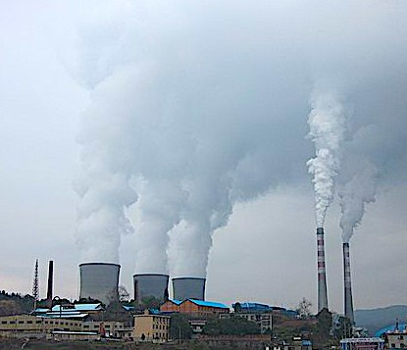
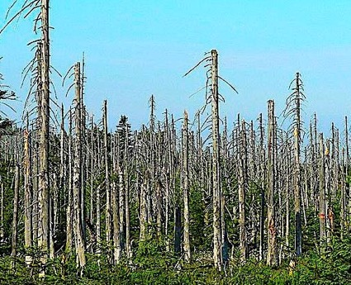
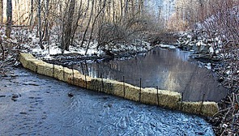
Coal is the most plentiful and least expensive of the three fossil fuel, but the same cannot be said of the cost to the environment.
Coal is dirty when it is extracted: Strip mining and mountaintop removal damages the land and contaminates nearby surface waters.
Coal is dirty when it is burned: Coal burning releases large amounts of contaminants and plays a leading role in acid rain.

Slide 7
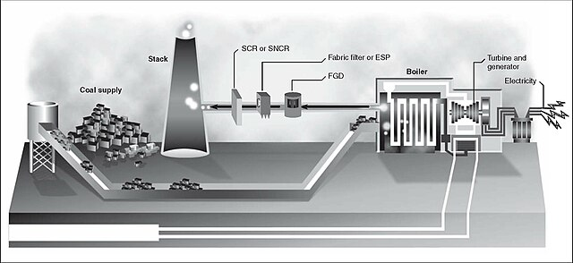
Most of the coal in the US is used to generate electricity. Coal-fired power plants involve steam-driven turbines where the steam current propels a turbine, which in turn, powers the electric generator.

Slide 8
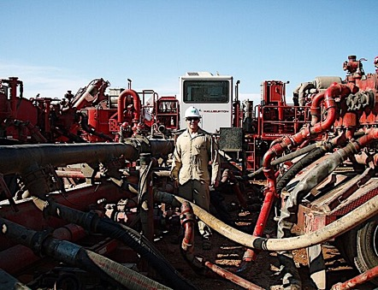
Natural gas is cleanest burning of the three fossil fuels because it is almost entirely composed of methane. This is why it is so popular for cooking.
Unfortunately, as conventional reserves are depleted, dirtier methods of gas drilling are being used to meet the growing demand.

Slide 9
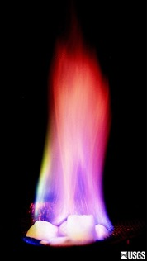
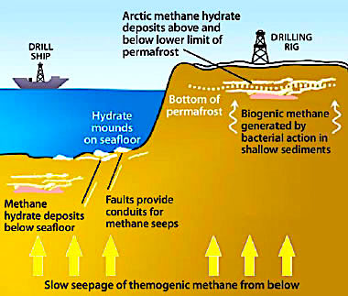
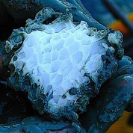
Gas can be made more abundant than coal, but there’s a problem:
Most of the world’s methane is in the form of methane hydrate, a complex of methane and water molecules that form a white solid that has is referred to as “the ice that burns.” The US Geological Survey estimates that the energy contained in methane hydrate deposits far exceeds that of all other fossil fuels combined.
The problem is that its location on the ocean floor makes mass extraction of methane hydrates an expensive and risky process.
Image ownloaded from: https://web.archive.org/web/20180314125615/https://www.netl.doe.gov/File%20Library/Research/Oil-Gas/methane%20hydrates/MH-Primer2011.pdf

Slide 10
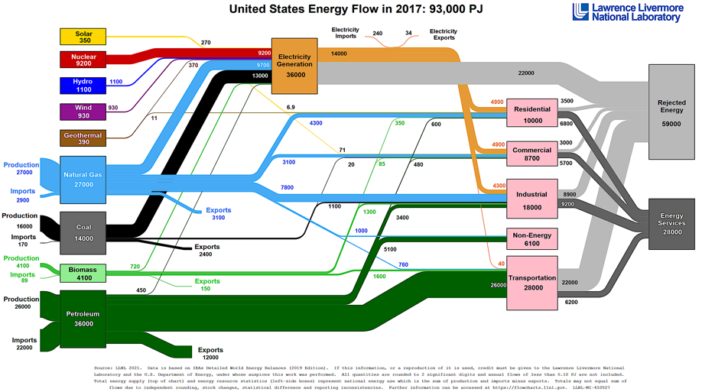
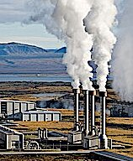
Oil is the most strategically important fuel due to its critical role in transportation.
Supplies of gas and coal are less critical because the energy mix used to generate electricity is more diversified.
Downloaded from: https://flowcharts.llnl.gov/

Slide 11
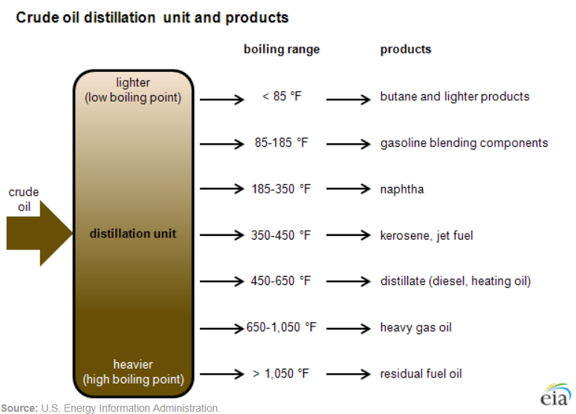
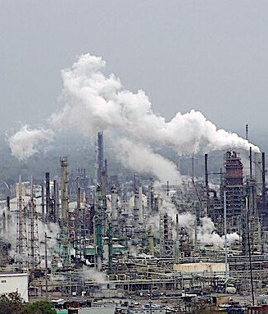
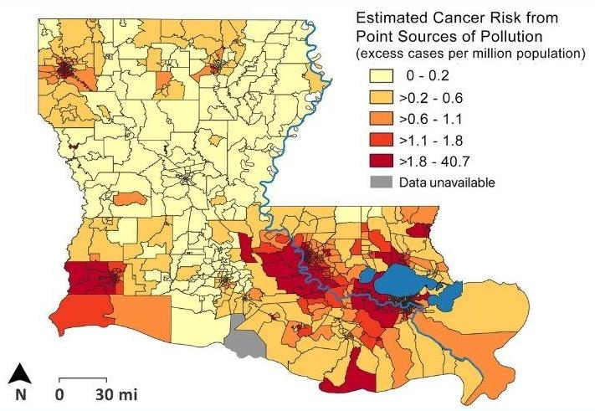
Unlike coal and natural gas, crude oil needs to be “refined” prior to use. This is accomplished through a “fractional distillation” process that separates these portions by boiling point.
Unfortunately, refineries are now the top source of VOC pollution in the US.
The oil refinery depicted above is from a region of Louisiana infamously referred to as “cancer alley.”
Image of cancer risk map downloaded from Tulane University: https://law.tulane.edu/tulane-study-louisianas-severe-air-pollution-linked-dozens-cancer-cases-each-year

Slide 12
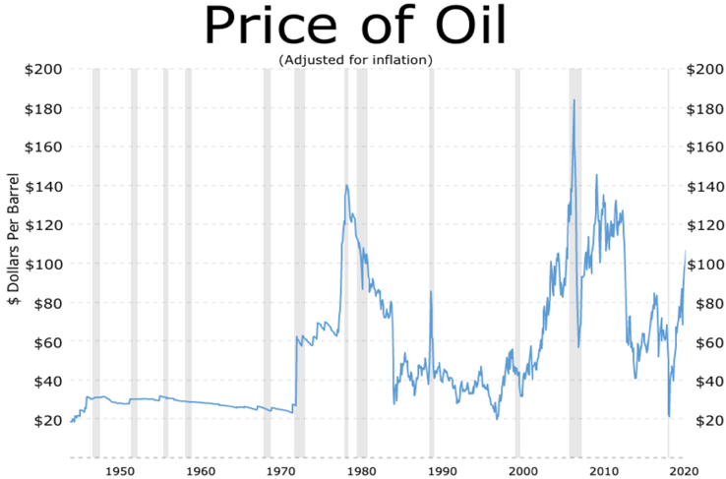
Disruptions in the world supply of oil have a profound effect on prices at the pump.
The 1973 embargo is a textbook example of how price controls only make things worse!
1973 OPEC oil embargo of US
Nixon imposes price controls
Crude Prices: 70 Year Historical Chart Source: Macrotrends
https://www.macrotrends.net/1369/crude-oil-price-history-chart

Slide 13
Nevertheless, high oil prices can shrink the economy.
This is why most economists oppose punitive taxes on petroleum.
1991 recession
2009 recession
Do high oil prices cause recessions? Source: Economics Help (3/14/22)
https://www.economicshelp.org/blog/167932/economics/do-rising-oil-prices-cause-recession/

Slide 14
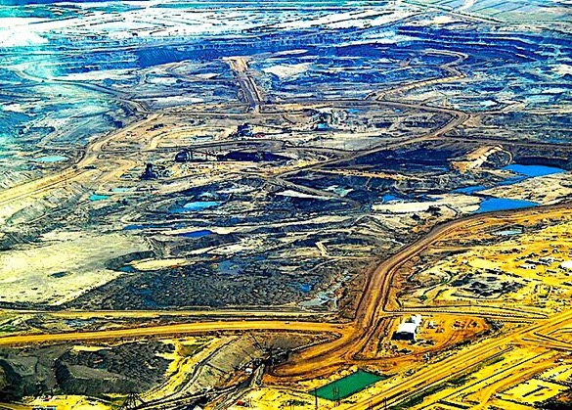
As conventional sources of oil dry up, industry is increasingly relying on dirtier methods of oil extraction like fracking and tar sand extraction.
Tar sand landscape in Alberta, Canada.

Slide 15
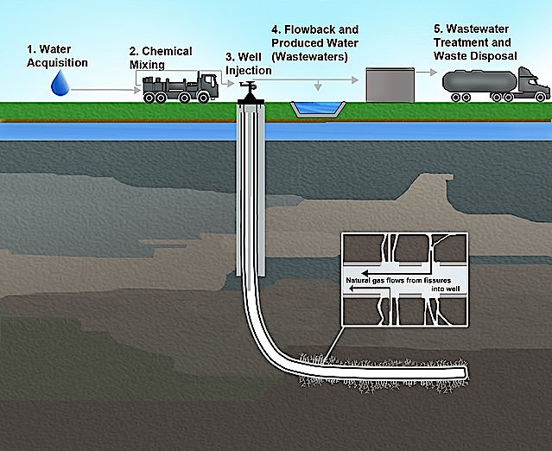
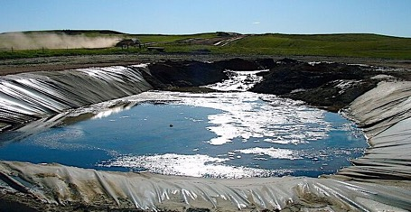
Fracking or “hydraulic fracturing,” involves the blasting of large volumes of water, chemical, and sand to fracture shale rock formations in order to release oil or gas that is trapped within these rock layers.
Unfortunately, fracking requires vast amounts of water and local aquifers often get contaminated.

Slide 16
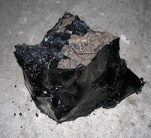
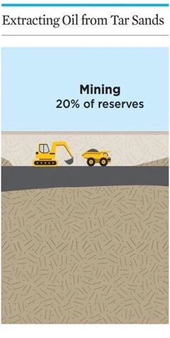
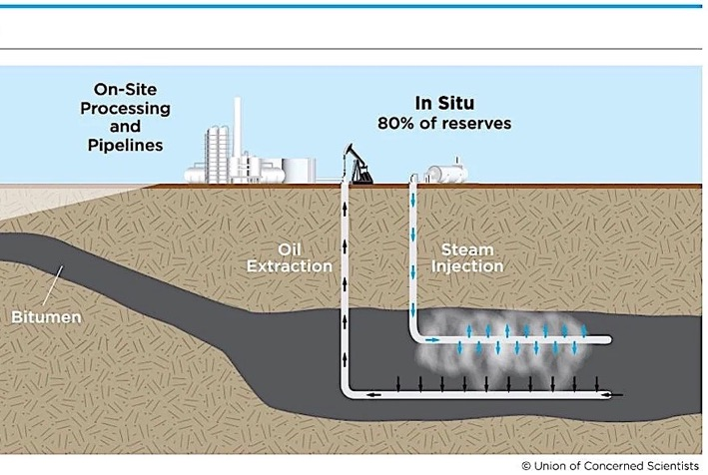
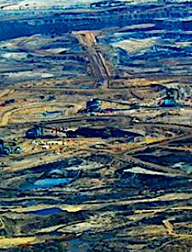
Tar Sands are a mixture sand, clay, water, and bitumen. Since bitumen is is too thick to be pumped out of the ground, it is extracted by:
Steam injection to soften the oil for pumping.
Open pit mines that cause damage comparable to that of strip mining for coal.
Downloaded from https://www.ucsusa.org/resources/what-are-tar-sands

Slide 17
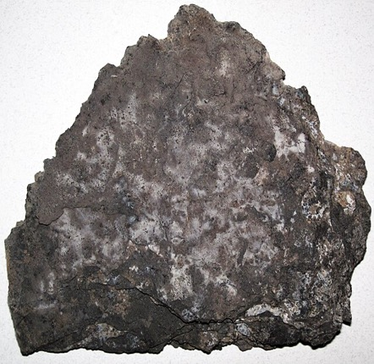
Extracting oil from rocks:
Kerogen is waxy solid that can be extracted from buried organic shale. When the kerogen is heated, it can release significant amounts of oil and natural gas.
This process is not yet cost-effective because the energy needed for extraction is almost the same as that of the gas and oil that is extracted.

Slide 18
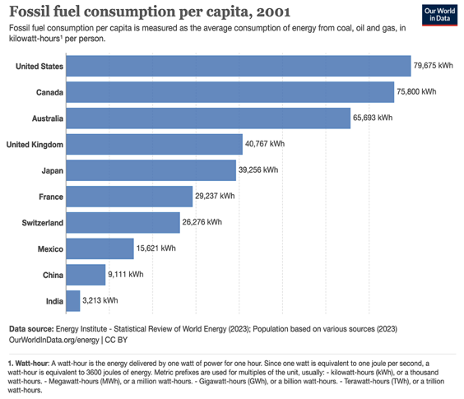
Current Trends and the Long-Term Outlook for Fossil Fuels
Currently, Americans on average use significantly more fossil fuels than Western Europeans with comparable standards of living.
Further strains on the environment are anticipated as heavily populated nations like China and India grow their economies.

Slide 19
Acknowledgement:
Unless otherwise indicated, all images in this presentation were downloaded from Wikimedia Commons: https://commons.wikimedia.org/wiki/Main_Page

