Slide 1
Lithium

Slide 2
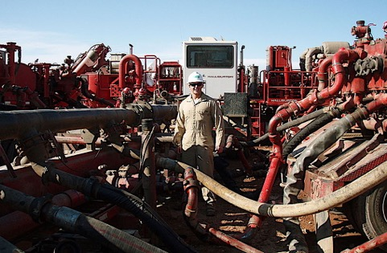

Slide 3
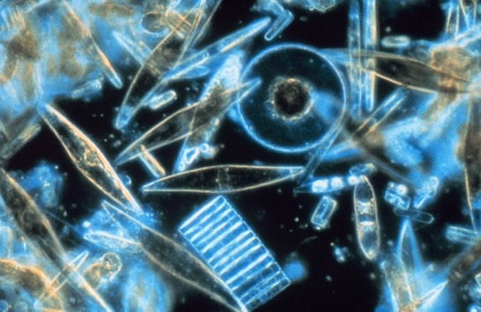

Slide 4
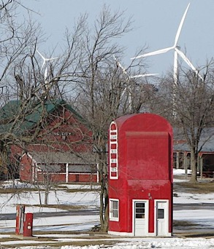
When wind farms are proposed near population centers, residents often oppose them.
Local people object to wind farms for aesthetic reasons, creating a not-in-my-backyard (NIMBY) syndrome.
.Wind turbines also pose a threat to birds and bats, which are killed if they fly into the rotating blades.

Slide 5
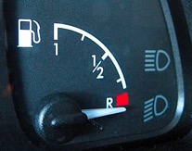
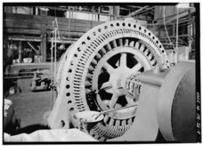
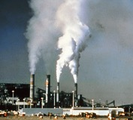

Slide 7
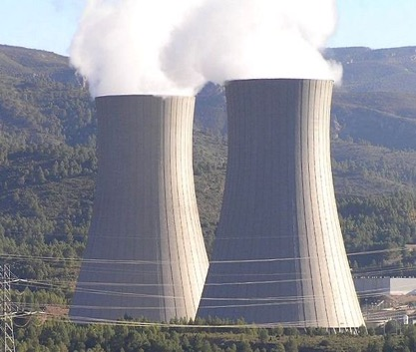
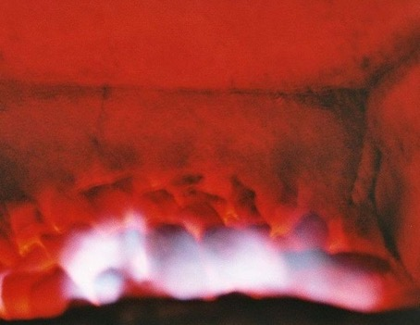

Slide 8
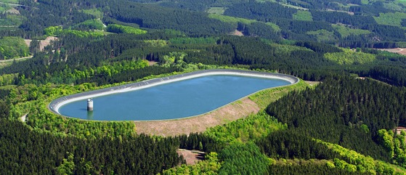

Slide 10
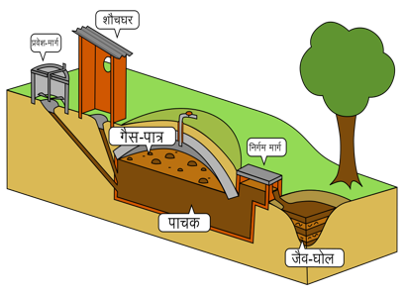

Slide 11
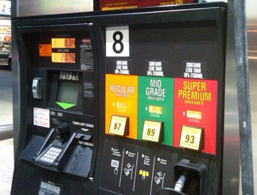
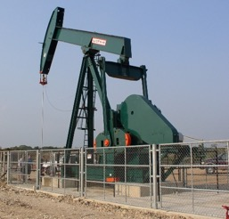
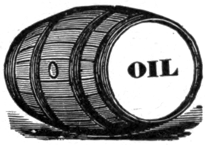
Net energy =
energy returned
– energy invested

Slide 12
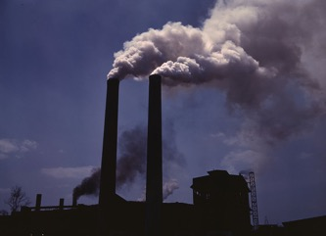
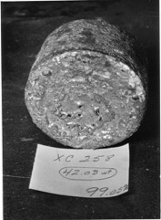
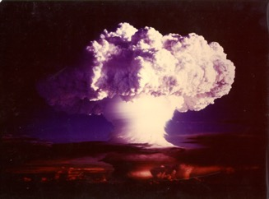

Slide 13
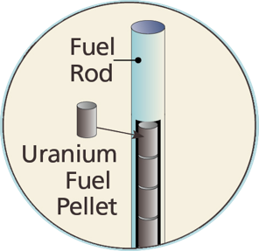
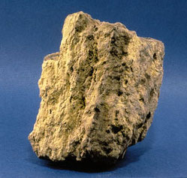
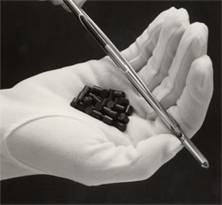

Slide 14
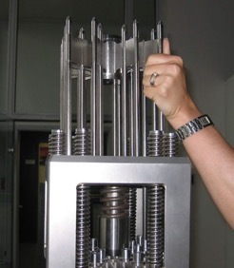
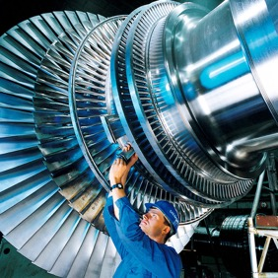

Slide 15
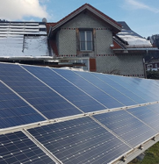
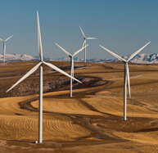

Slide 16
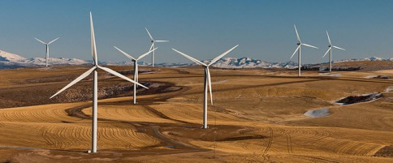
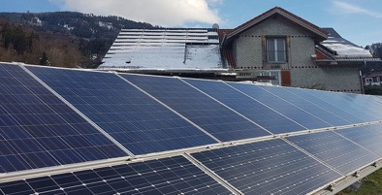
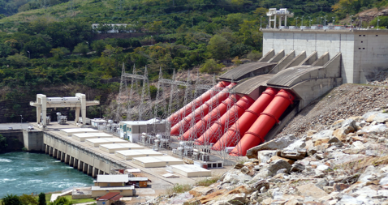

Slide 17
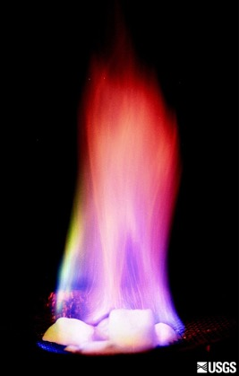
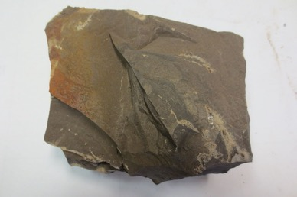
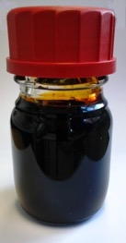

Slide 18
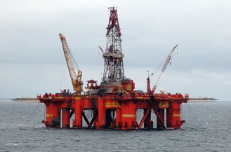
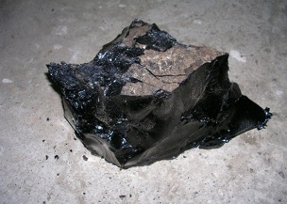

Slide 19
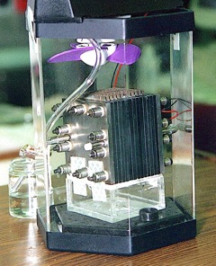
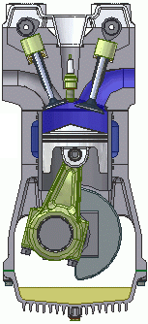
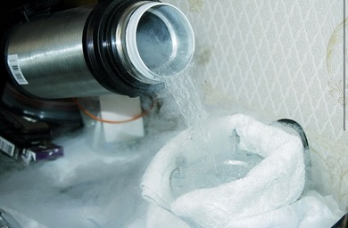
Fuel Cells
Fuel cells generate electricity
from fuel instead of burning it
Fuel cell vehicles get three
times more miles per unit fuel than combustion engines because almost no waste heat is generated
Fuel cells are not widely used because generating, storing, and transporting large quantities of hydrogen is impractical

Slide 20
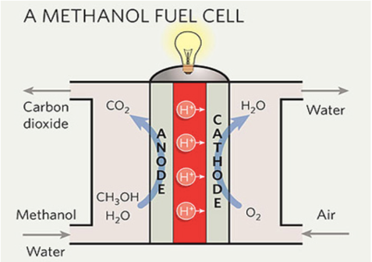
Not all fuel cells run on hydrogen
Research is being done on fuels cells that run on energy carriers that are more convenient
Image on right downloaded on 4/14/20 from “Renew Economy” at https://reneweconomy.com.au/solar-methanol-and-the-third-industrial-revolution-42856/

Slide 21
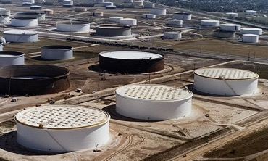
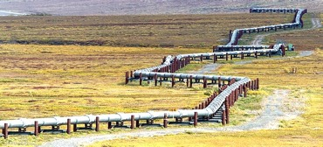
Fun facts about fossil fuel subsidies not in your book:
The largest expenditure is for the Strategic Petroleum Reserve
The second largest expenditure is tax exemptions for farm fuel.
The third largest expenditure is Low-Income Energy Assistance.
Additional subsidies help keep more oil and gas jobs in the US
From The Surprising Reason That Oil Subsidies Persist, Forbes (4/25/2012) https://www.forbes.com/sites/energysource/2012/04/25/the-surprising-reason-that-oil-subsidies-persist-even-liberals-love-them/?sh=2ebaf5653279

Slide 22
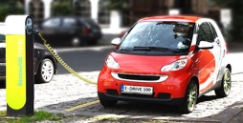
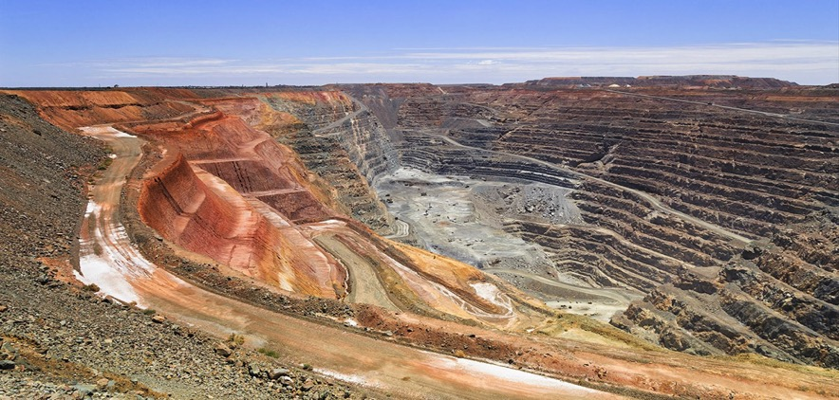
What about electric vehicles?
Lithium mining is not green!
From Protests force government to pull three areas identified for lithium mining,
Portugal Resident (2/17/20) https://www.portugalresident.com/protests-force-government-to-pull-two-areas-identified-for-lithium-mining/

