Slide 1
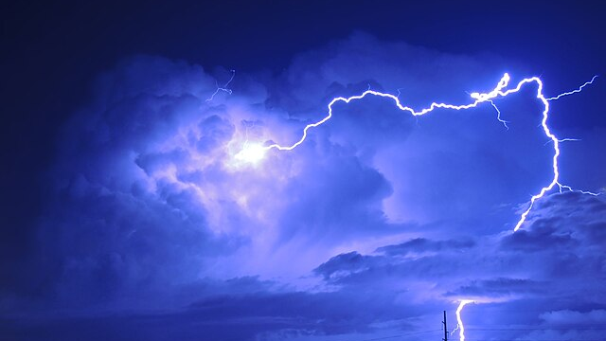
Understanding Energy

Slide 2
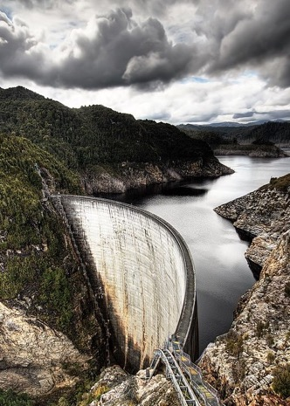
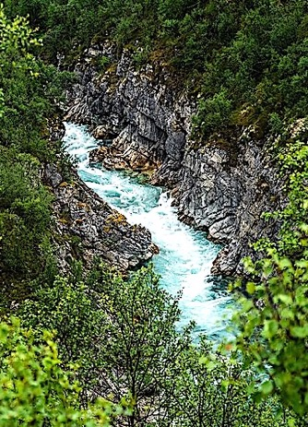
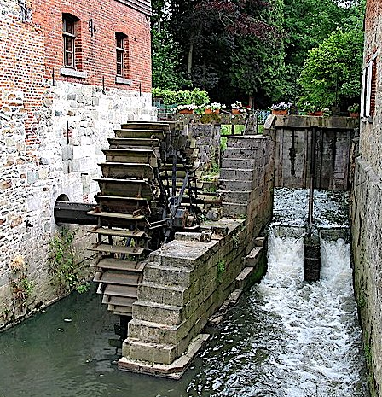
Since ancient times, people knew how to harness the energy of moving water.
potential energy
kinetic energy

Slide 3
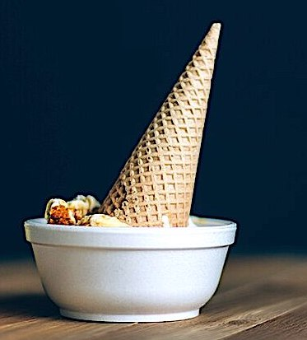
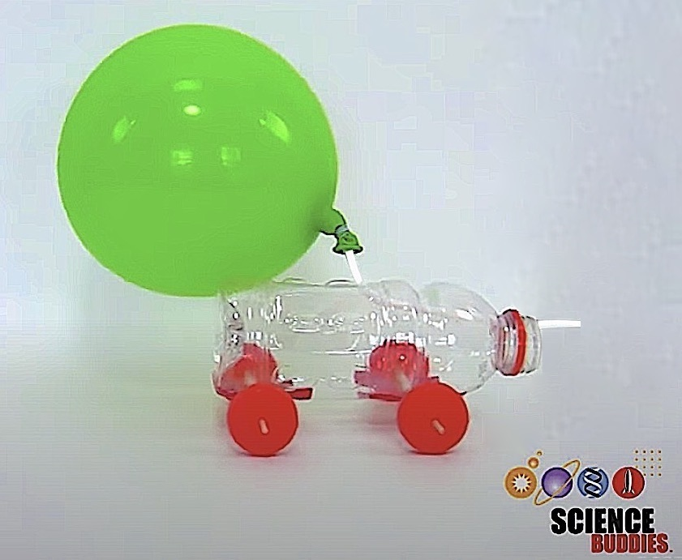
First Law of Thermodynamics
The change in energy of an object plus the change in energy of the surroundings equals zero (∆E_{object} + ∆E_{surroundings} = 0).
+∆E
-∆E
-∆E
+∆E
-∆E
+∆E
In other words, the total change energy in an object will always have the opposite sign as that of the surroundings, and the magnitude of this change is the same (∆E_{object} = -∆E_{surroundings}).
Balloon car video still from Science Buddies: https://www.sciencebuddies.org/stem-activities/balloon-car

Slide 4
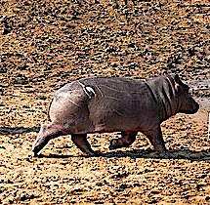
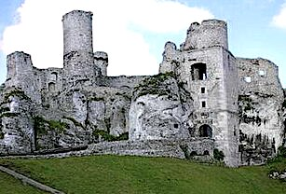
Second Law of Thermodynamics
All changes increase entropy. This is often expressed as dissipated heat. This “waste heat” cannot be harnessed to do work because it is too spread out.
+∆W
+∆H
-∆E
+∆H
-∆E
+∆W
In other words, no work can be accomplished with 100% efficiency because dissipated heat makes up a significant portion of the energy that is spent. Since entropy is always increasing, all material objects decay over time.
Balloon car video still from Science Buddies: https://www.sciencebuddies.org/stem-activities/balloon-car

Slide 5
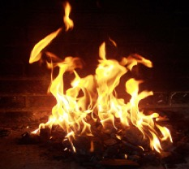
Combustion
Produces about
400 Cal. heat & light energy
Due to the first law of thermodynamics, the energy released from the combustion of sugar equals the energy that goes into the surroundings.

Slide 6
Cellular Respiration
The equation for respiration is identical to that of combustion.
+∆H
Due to the second law of thermodynamics, more than half the energy from respiration is dissipated heat.
Produces about
160 Cal. of cellular energy
…and about
240 Cal. of heat energy
For comparison, the efficiency of an internal combustion engine is 20%.

Slide 7
Photosynthesis
x
Requires about
1570 Cal. light energy to generate 400 Cal. Sugar*
Since the equation for photosynthesis is the reverse of respiration/combustion, it requires an energy input. This input is provided in the form of sunlight.
The efficiency of converting this light energy into chemical energy is 25%.
*Source: https://www.britannica.com/science/photosynthesis/Proteins

Slide 8
Review Questions
What is the purpose of cellular respiration?
What process provides the energy needed for cellular respiration?
What process synthesizes sugar from carbon dioxide and water?
What provides energy for the synthesis of sugar?
Why does the consumption of 400 calories of sugar only generate 160 calories of cellular energy?
Notes:
Answer: a

Slide 9
Review Questions
What is the purpose of cellular respiration? It generates energy for our cells.
What process provides the energy needed for cellular respiration? the breaking down of sugar
What process synthesizes sugar from carbon dioxide and water? photosynthesis
What provides energy for the synthesis of sugar? sunlight
Why does the consumption of 400 calories of sugar only generate 160 calories of cellular energy? The the remaining energy is expressed as dissipated heat because second law of thermodynamics limits the level of efficiency that is possible.
Notes:
Answer: a

Slide 10
Acknowledgement:
Unless otherwise indicated, all images in this presentation were downloaded from Wikimedia Commons: https://commons.wikimedia.org/wiki/Main_Page

