Slide 1
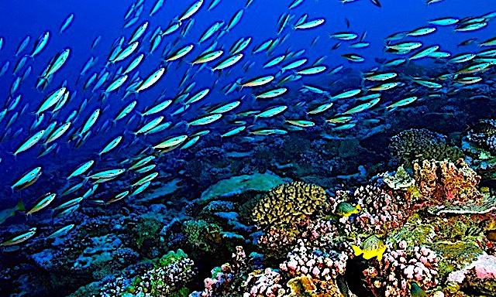
Community Ecology

Slide 2
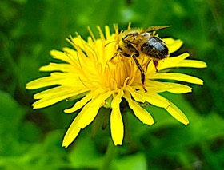
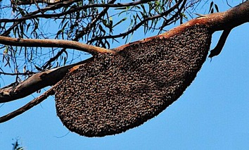
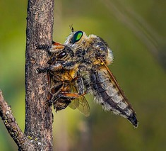
A specie’s role in the ecosystem is its niche.
The place where the species lives, gathers food, and reproduces is its habitat.
Most most interspecies relationships center around the struggle for the resources needed to survive and reproduce.
Interspecies relationships determined by the struggle for survival can be adversarial, beneficial, or neutral.
Robber fly preys on a bee.

Slide 3
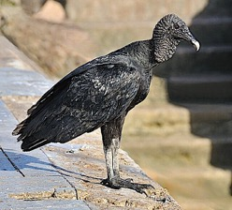
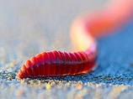
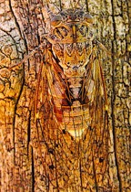
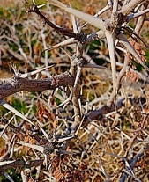
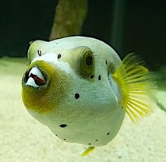
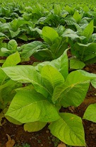
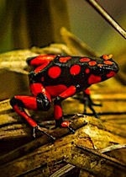
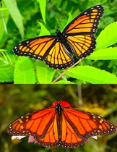
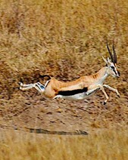
With the exception of scavengers and detritivores, all animals are adapted to consume another living organism. Consequently, many animals and plants employ strategies and adaptations to minimize being eaten by their adversaries. These include:
camouflage
physical barriers
toxins
warning colors on some toxic species.
mimicry of warning colors found on toxic species.
speed
Scavenger
Detritivores
Puffer Fish
Tobacco
Dart Frog
Monarch & Viceroy

Slide 4
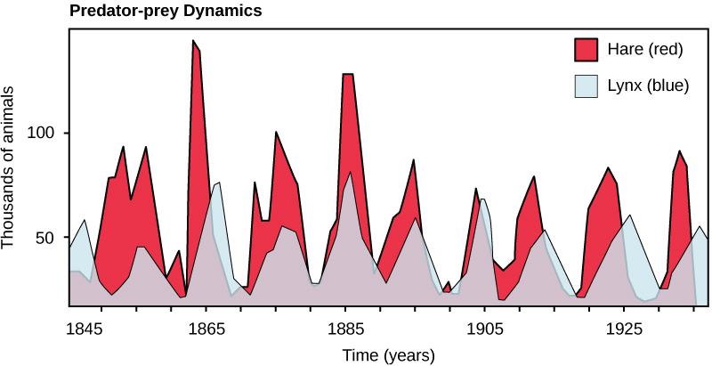
Predator-prey relationships are adversarial for the prey, but they prevent population explosions that might otherwise result in habitat destruction and mass starvation.
Graph from “Environmental Issues” by Andrew Frank https://pressbooks.bccampus.ca/environmentalissues/front-matter/introduction/

Slide 5
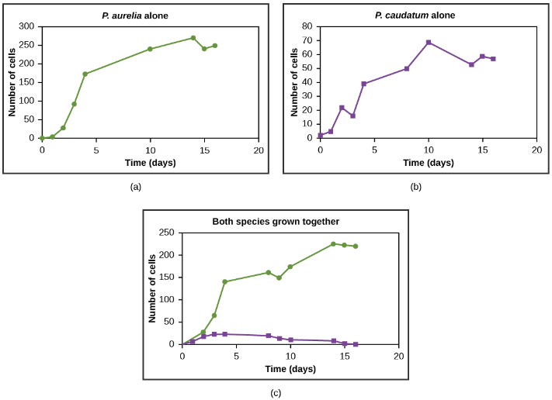
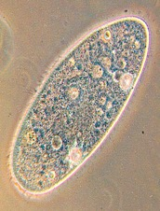
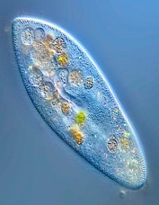
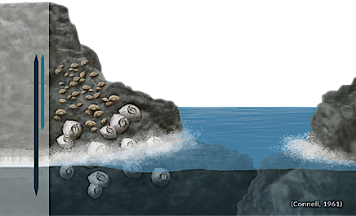
Competition for limited resources is an adversarial relationship for both sides, and according to the competitive exclusion principle only two outcomes are possible when two species occupy the same niche:
One species is eliminated.
Both species adapt through the strategy of resource partitioning.
In the example on the left, two species of barnacle co-exist by occupying different levels of the shoreline.
Graphs from “Environmental Issues” by Andrew Frank https://pressbooks.bccampus.ca/environmentalissues/front-matter/introduction/

Slide 6
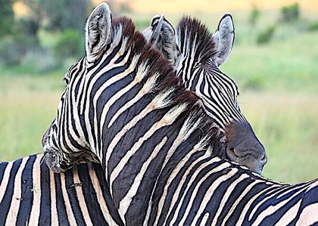
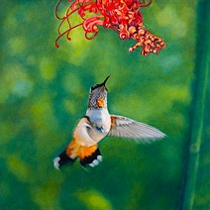
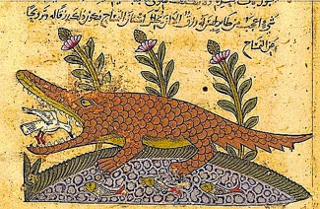
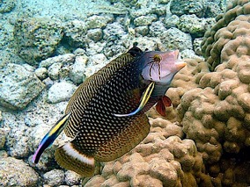
In mutualism both sides benefit. This is the opposite of competition.
When a pollinating animal visits different flowers, the pollinator is provided with a nectar reward for helping the plant reproduce.
Cleaning services from small birds and fish provide food for the service provider and relief from parasites for the crocodile and the dragon wrasse.

Slide 7
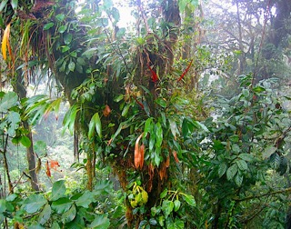
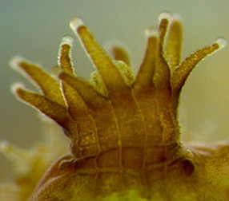
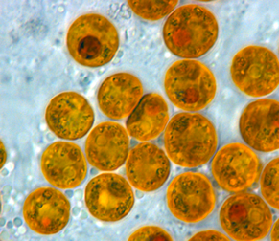
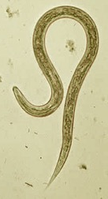
Symbiosis is a close relationship between two species. This term is often mistakenly confused with mutualism, but this is inaccurate because symbiotic relationships can also be adversarial:
In parasitism, the parasite benefits at the expense of the host. In this example, the hookworm lives in the intestine and consumes nutrients provided by the host.
In commensalism, the occupant benefits with no evidence of harm or benefit to the host. In this example the epiphytes get access to more sunlight with no evidence of harm to the tree.
In mutualistic symbiosis both sides benefit. Zooxanthellae is a species of algae that live in the tissues of coral polyps. The wastes from the polyp nourish the algae and products of photosynthesis from the algae feed the polyp.

Slide 8
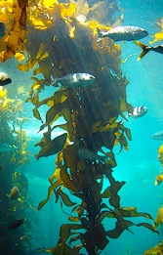
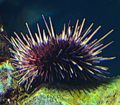
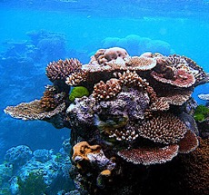
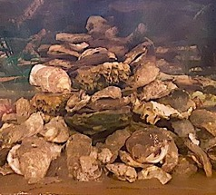
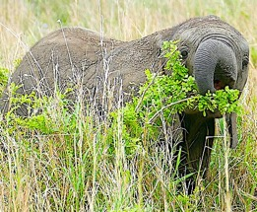
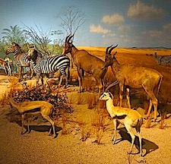
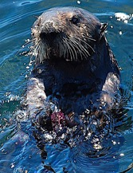
Not all niches are equally valuable. Some species play a pivotal role in providing the habit or maintaining biodiversity.
Foundation species like oysters and corals generate or enhance the habitat for the entire community.
Keystone species maintain biodiversity by keeping certain populations in check:
African elephants prevent trees from overtaking the grasslands that support the grazing community because they preferentially graze on woody plants. For this role they are also referred to as “ecosystem engineers.”
Sea otters prey on sea urchins, which in turn, graze on kelp. This prevents sea urchins from overgrazing kelp forests which serve as foundation for a diverse community of fish and invertebrates that use the kelp for both food and shelter.

Slide 9
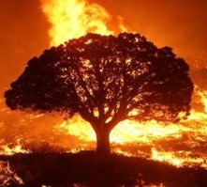
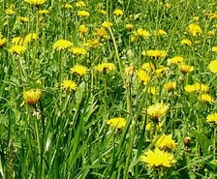
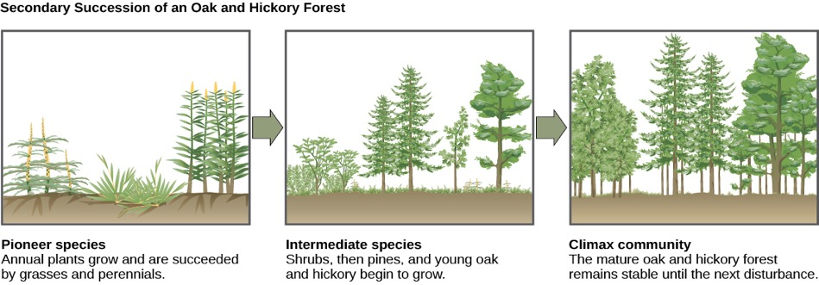
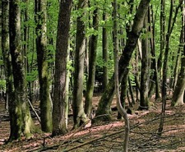
Disruptive events such as forest fires destroy the entire standing crop of vegetation, but they leave behind nutrient-rich soil due to the release of minerals that were previously locked up in the biomass.
Fast-growing grasses and weeds soon cover the landscape, thereby protecting the soil from erosion. This meadow of pioneer species is replaced by a series of increasingly larger plants until the original climax community is restored.
This overall process is referred to as “secondary succession.”
Succession image from “Environmental Issues” by Andrew Frank https://pressbooks.bccampus.ca/environmentalissues/front-matter/introduction/

Slide 10
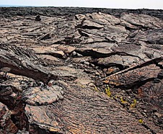
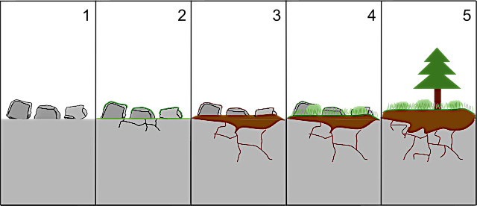
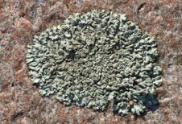
“Primary succession” is much more prolonged because the starting material is bare rock, so new soil needs to be generated by means of weathering.
This process typically occurs following some form of extreme geological upheaval such as an Earthquake or volcanic eruption.
Lichens represent a mutualistic symbiotic relationship between fungi that provide access to mineral nutrients and algae that provide the organic nutrients. Lichens are the pioneer species in primary succession because they are the only organisms capable of thriving on bare rock.

Slide 11
Acknowledgement:
Unless otherwise indicated, all images in this presentation were downloaded from Wikimedia Commons: https://commons.wikimedia.org/wiki/Main_Page

