Slide 1
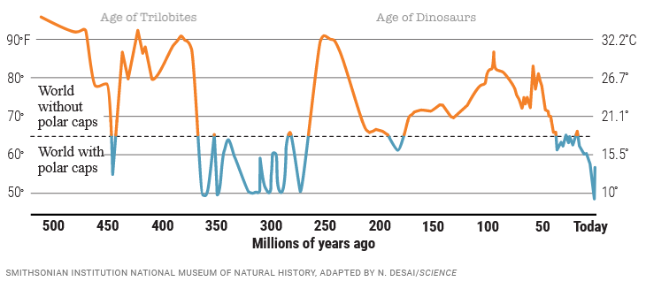
For large portions of geological history, the Earth was ice free:
https://www.science.org/content/article/500-million-year-survey-earths-climate-reveals-dire-warning-humanity

Slide 2
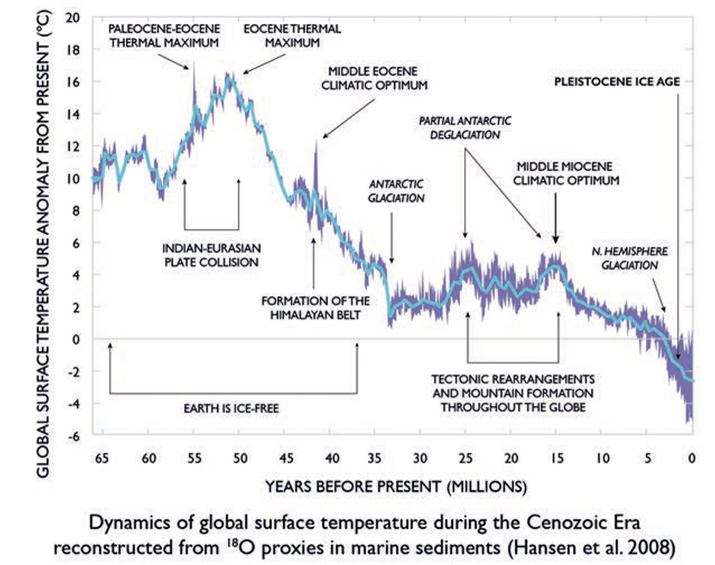
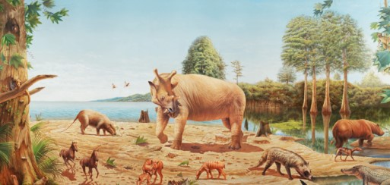
Last time the Earth was ice-free was 50 million years ago.
If this happens again, life will go on, but the economic hardships would be enormous.

Slide 3
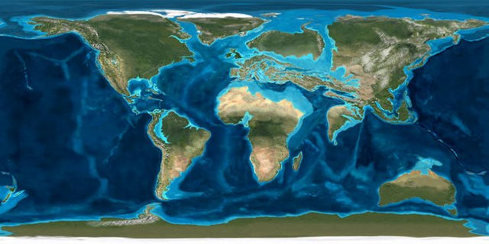
This map estimates sea levels and continent locations during the Eocene:
Video still from “Scotese Plate Tectonics & Paleogeography”
https://www.youtube.com/watch?v=UevnAq1MTVA

Slide 4
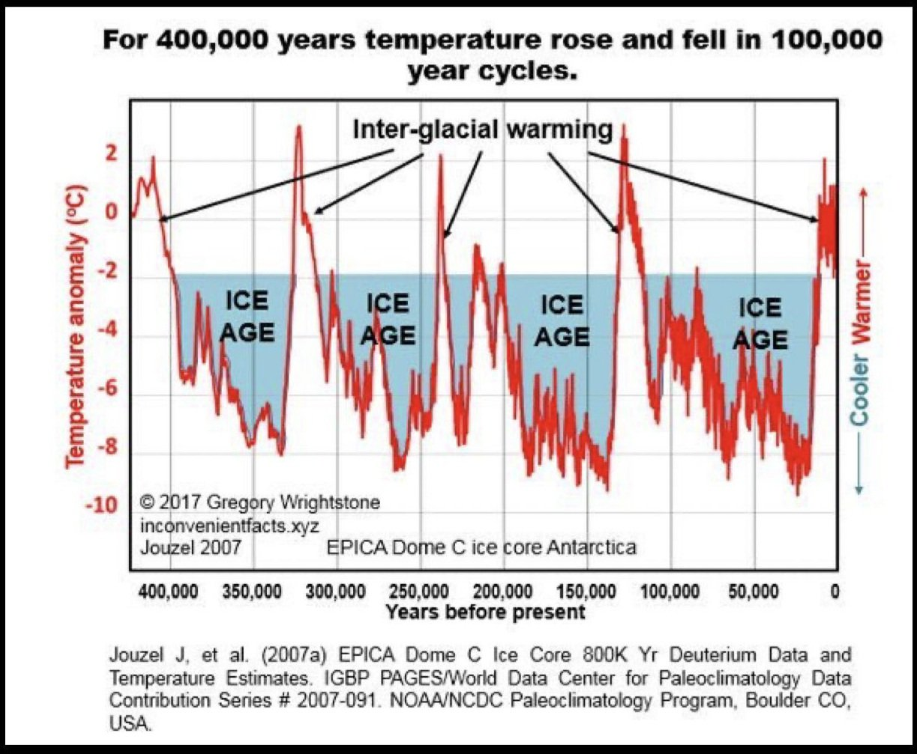
Predictions are further confounded by cycling that is unrelated to human activity:

Slide 5
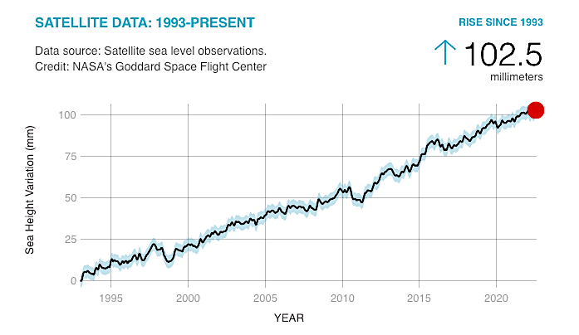
Can we estimate how fast sea levels are rising?
This graph covers 30 years. How many mm per year?
How many total mm by 2100? (77 years)
If 1 inch = 25.4 mm, how many total inches by 2100?
Is this estimate reliable? What did you need to assume?
Downloaded from: https://climate.nasa.gov/vital-signs/sea-level/

Slide 6
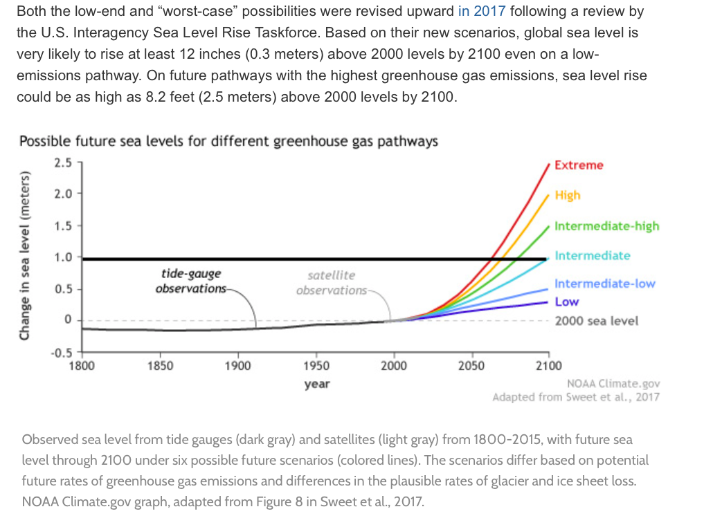
NOAA projects sea level increases that vary from a few inches to about 7 feet by 2100.
How does this square with your calculation?

Slide 7
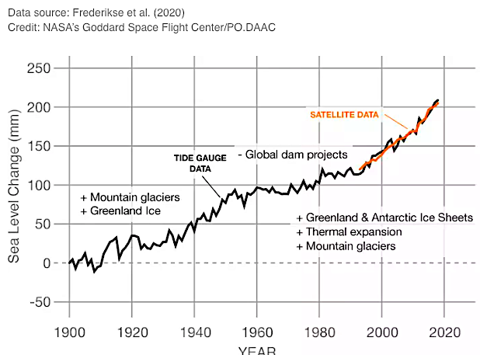
Based on earlier estimates, dam-building slows down sea level rises!
https://cliate.nasa.gov/vital-signs/sea-level/

Slide 8
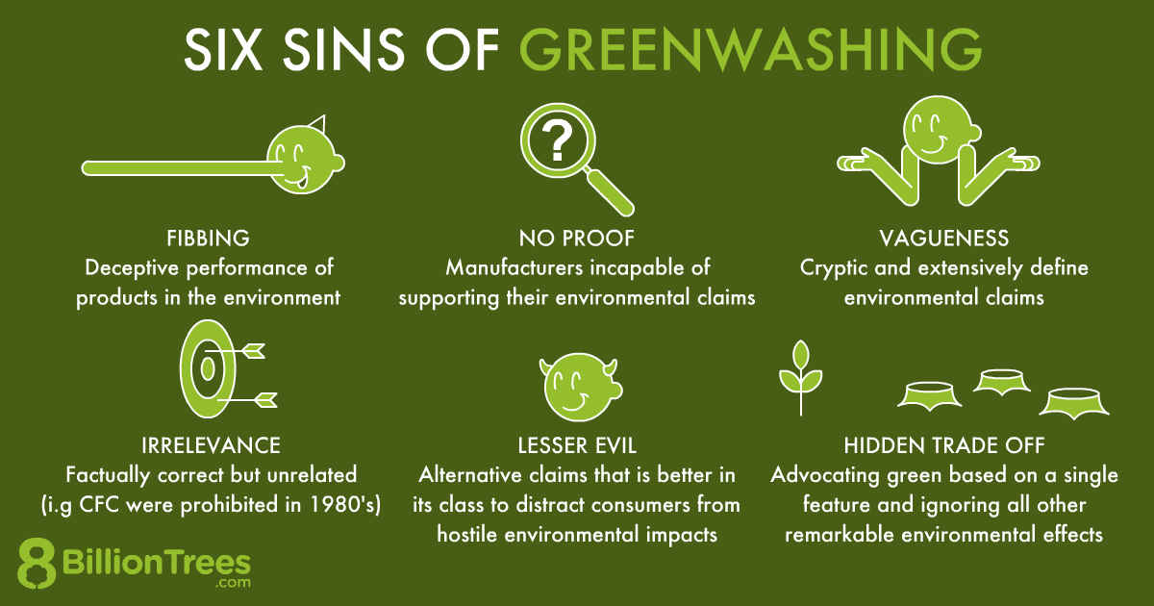
Unfortunately, carbon trading is riddled with fraud!
Greenwashing is when a company uses deception to appear “green” while engaging in business as usual.
Images downloaded from: https:///best-programs-providers8billiontrees.com/carbon-offsets-credits-companies-2021/neutral-certification-companies/

Slide 9
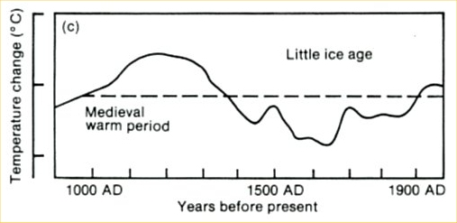
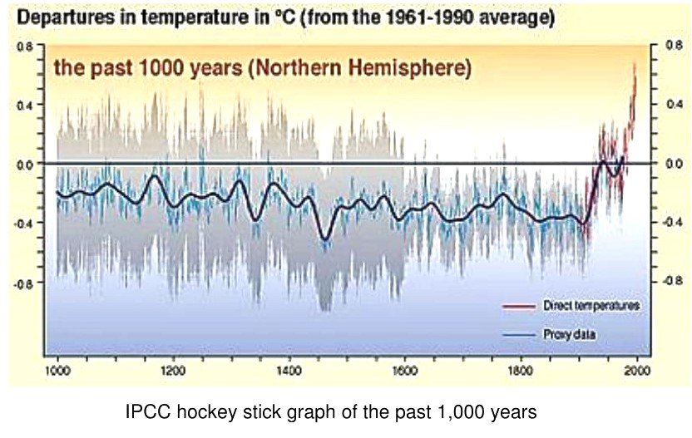
The graph in your book is from the 2001 IPCC Report.
It is very different from the report published in 1990.
1990 IPCC Report
2001 IPCC Report
The 1990 graph is reportedly based on a wide range of proxy data.
The 2001 graph reportedly grafted a narrower range of proxy data
…to selected temperature records from the 20th century.
This combination of sources differing in methodology forms the basis of the “hockey stick graph” controversy.
https://www.theunion.com/opinion/norm-sauer-mann-s-hockey-stick-a-documented-hoax/article_5e9bee14-1468-59aa-90d9-6d1e82f584cf.html

Slide 10
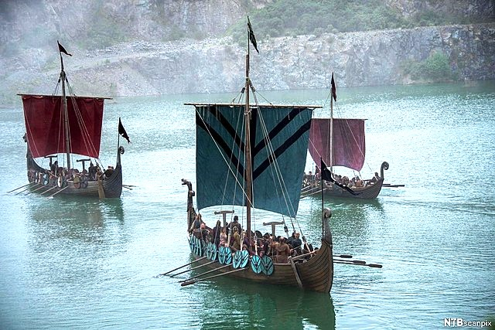
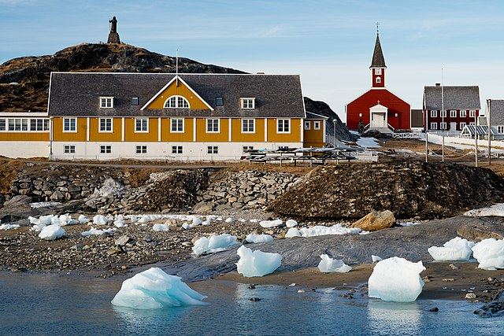
During the Middle Ages, Vikings cultivated these crops
in Greenland.
Barley
Rye
Oats
Cabbages
Onions
Garlic
Leeks
Turnips
Beans
Peas
Downloaded from: https://www.historyonthenet.com/life-on-a-viking-farm

Slide 11
The Viking settlement in Greenland lasted from 985-1450 AD.
Downloaded from: https://www.history.com/news/why-did-the-viking-disappear-from-greenland

Slide 12
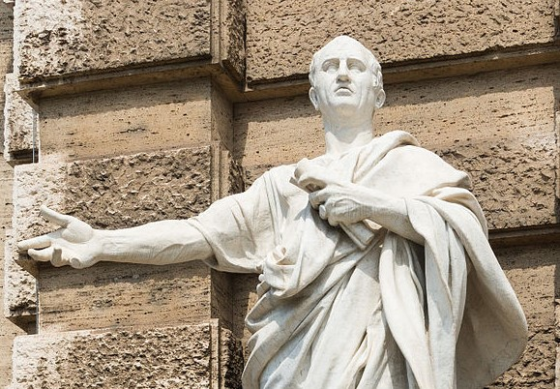
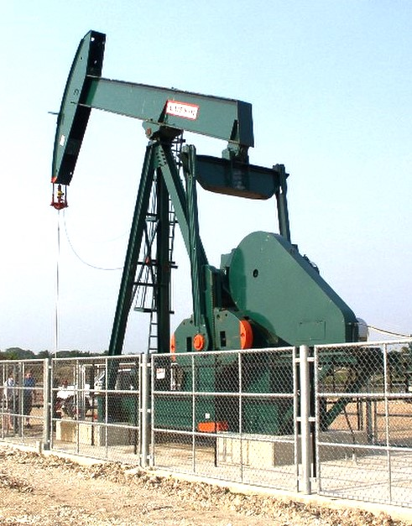
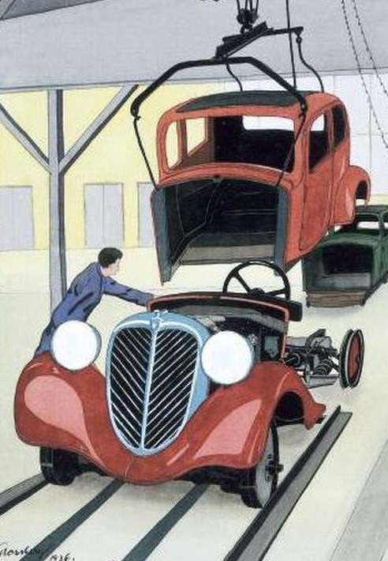
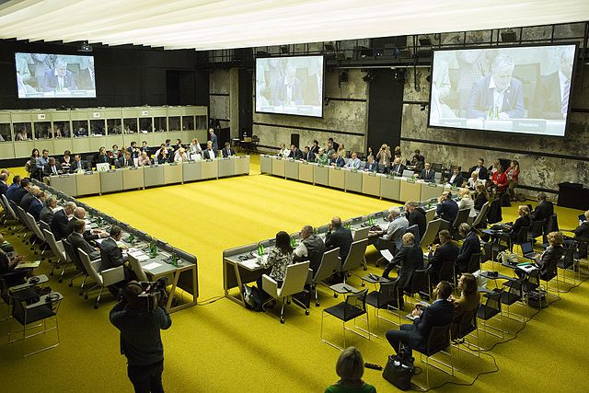
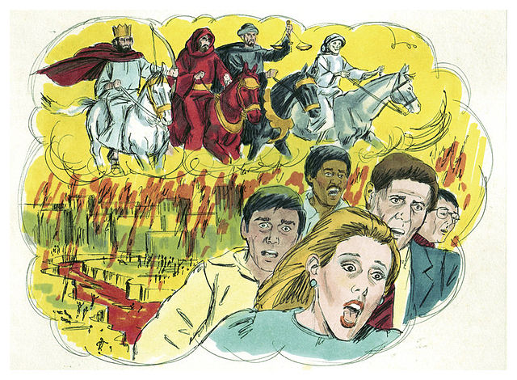
Cui bono?
Who benefits from climate change denial?
The fossil fuel industry and car manufacturers.
Who benefits from climate change alarmism?
International organizations, unelected bureaucrats and “green” corporations.

Slide 13
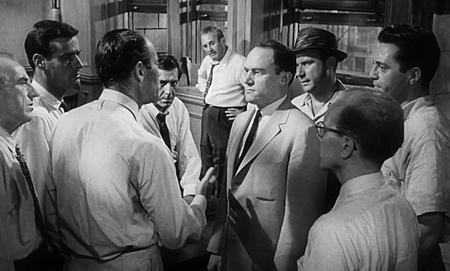
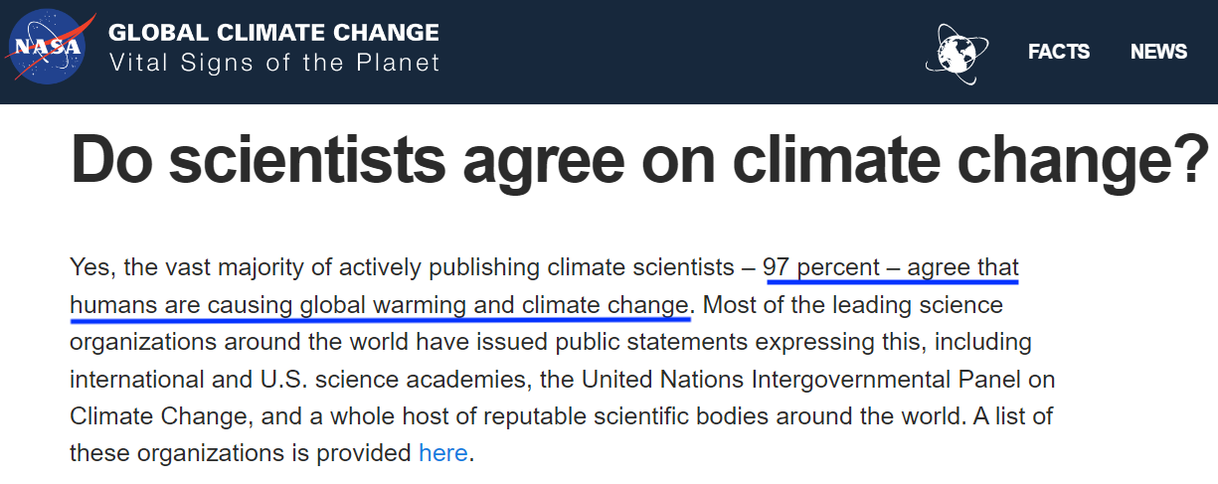
“Historically, the claim of consensus has been the first refuge of scoundrels; it is a way to avoid debate by claiming that the matter is already settled.” ― Michael Crichton
Scene from the 1957 movie “12 Angry Men”

