Slide 1
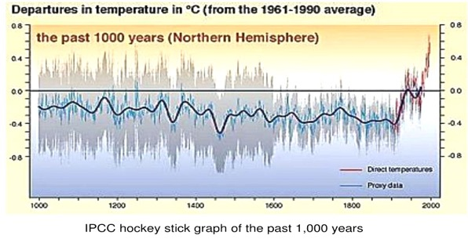
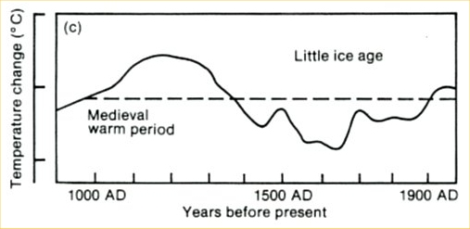
The more recent “hocky stick” graph (top) is more widely accepted by mainstream scientists.
But the Medieval Warm Period that is indicated in the older graph coincides almost perfectly with the 985-1450 timeline of the Greenland Viking settlement…
Downloaded from: https://www.history.com/news/why-did-the-viking-disappear-from-greenland

Slide 2
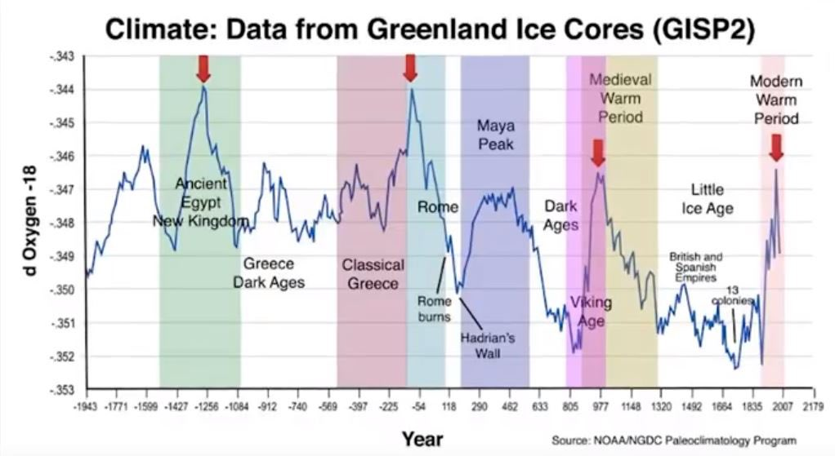
…and some proxy measurements indicate the Earth was even warmer during these earlier pre-industrial portions of human history.

Slide 3
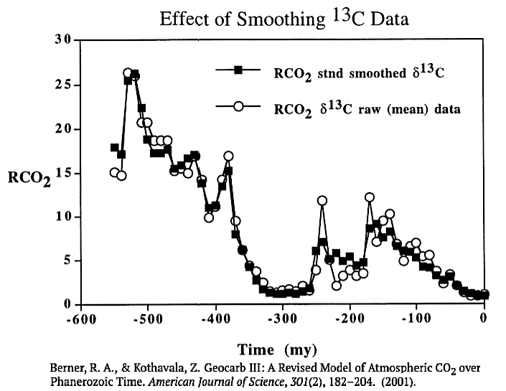
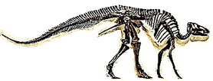
There is also evidence that carbon dioxide levels in the distant past far exceeded those of today.
Trilobites
Insects
Dinosaurs

Slide 4
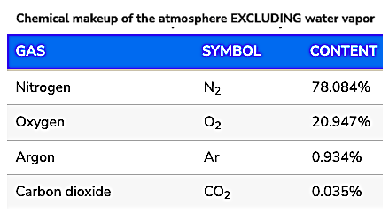
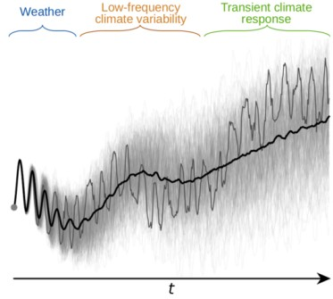
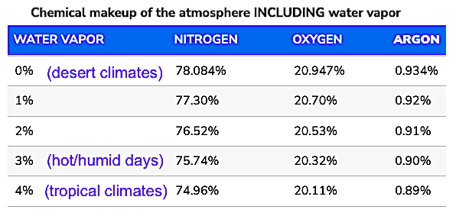
Most of the concern is over growing levels of carbon dioxide…
…but the overall percent of water vapor in the atmosphere far exceeds that of CO₂.
Water vapor is a greenhouse gas that can have the opposite effect when it forms clouds.
Can climate modelling take this into account?
https://www.noaa.gov/jetstream/atmosphere

Slide 5
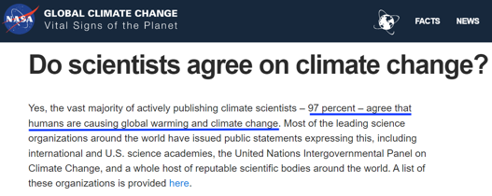
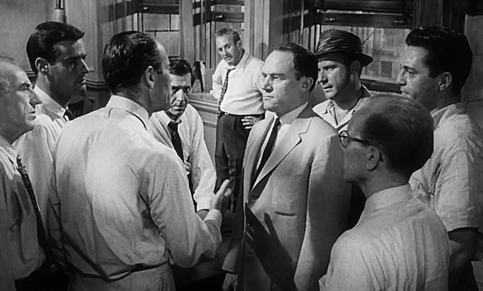
The 97% “consensus” on climate change is a popular talking point even though it is disputed.
If this number is accurate, what do we make of the 3% who disagree?
“Historically, the claim of consensus has been the first refuge of scoundrels; it is a way to avoid debate by claiming that the matter is already settled.” ― Michael Crichton
Scene from the 1957 movie “12 Angry Men”

Slide 6
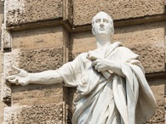
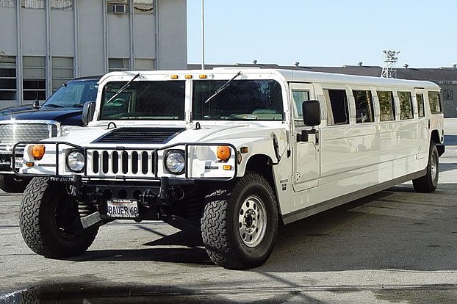
Cui bono?
Who benefits from climate change denial?

Slide 7
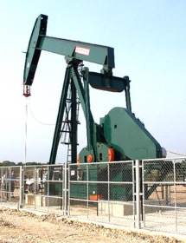
Cui bono?
Who benefits from climate change denial?
The fossil fuel industry and car manufacturers.

Slide 8
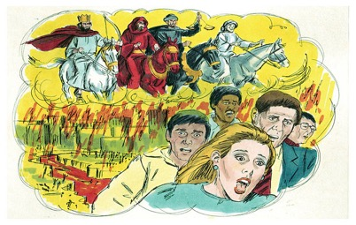
Cui bono?
Who benefits from climate change denial?
The fossil fuel industry and car manufacturers.
Who benefits from climate change alarmism?

Slide 9
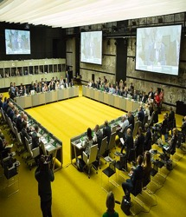
Cui bono?
Who benefits from climate change denial?
The fossil fuel industry and car manufacturers.
Who benefits from climate change alarmism?
International organizations, unelected bureaucrats and “green” corporations.

Slide 10
Acknowledgement:
Unless otherwise indicated, all images in this presentation were downloaded from Wikimedia Commons: https://commons.wikimedia.org/wiki/Main_Page

