Slide 1
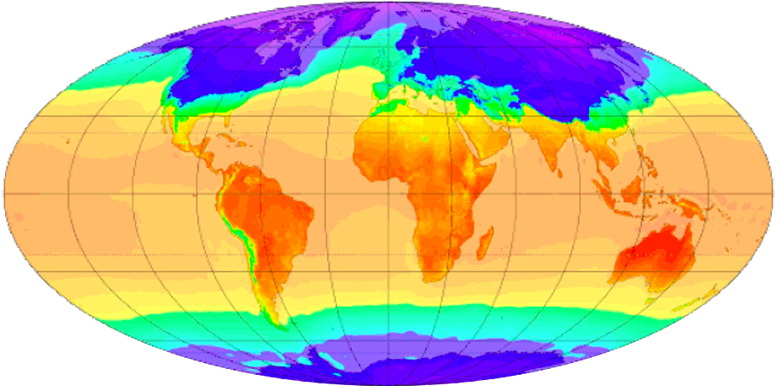
Climate Change

Slide 2
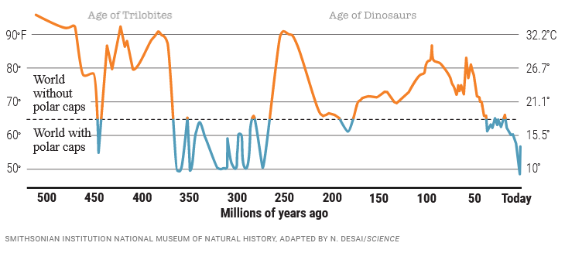
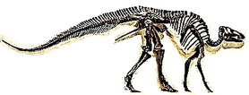
Earth’s climate has always been changing: Prior to 50 million years ago, the Earth was mostly ice-free.
Graph downloaded from https://www.science.org/content/article/500-million-year-survey-earths-climate-reveals-dire-warning-humanity

Slide 3
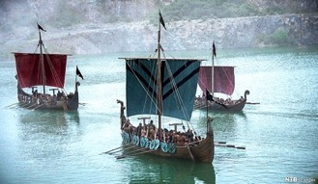
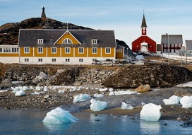
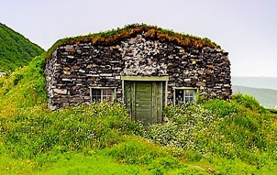
To a lesser extent, climate also changed during recorded history. During the “Medieval Warming Period,” the Vikings were able cultivate all of these crops in Greenland.
The Greenland settlement lasted from 985-1450 AD. The settlement was abandoned shortly after the start of the “Little Ice Age.”
Barley
Rye
Oats
Cabbages
Onions
Garlic
Leeks
Turnips
Beans
Peas
Crop list from: https://www.historyonthenet.com/life-on-a-viking-farm
Settlement dates from: https://www.history.com/news/why-did-the-viking-disappear-from-greenland

Slide 4
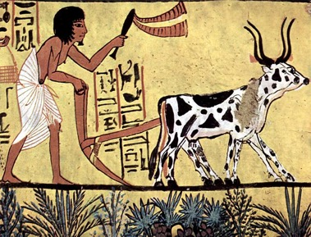
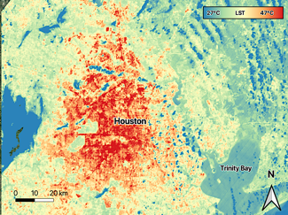
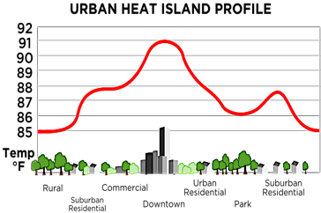
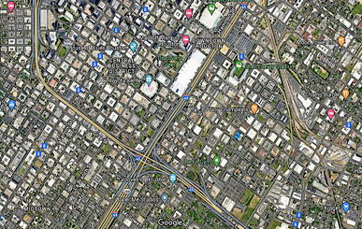
Not all climate change is natural: Humans have been altering local climates ever since they started clearing the land.
Today, major cities like Houston are subject to a “heat island effect” as the result of vast surfaces of uninterrupted pavement and concrete.
These impacts on climate are localized, but are current levels of human population and technology now affecting climate on a global scale?

Slide 5
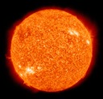
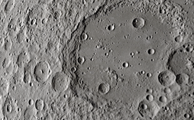
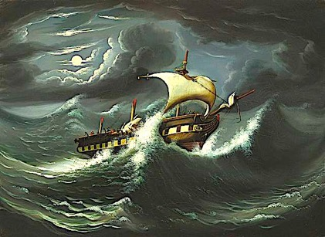
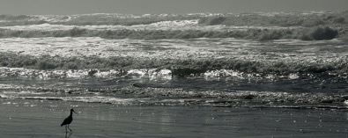
The sun drives the climate, but the moon has no climate because sunlight alone cannot generate weather conditions.
The Earth has weather only because the solar energy that reaches the Earth is mediated by the atmosphere and the ocean.

Slide 6
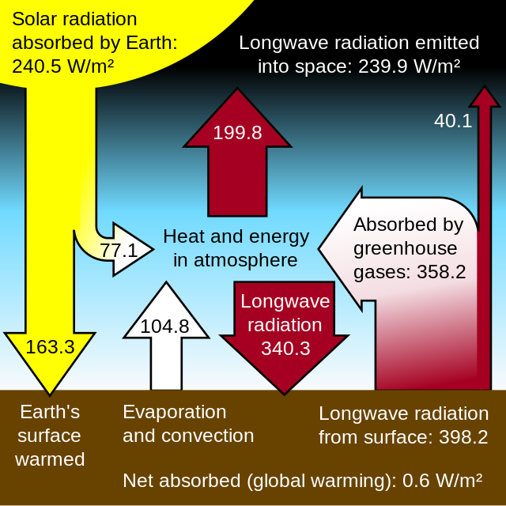
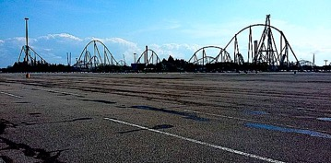
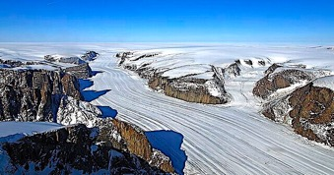
The solar energy that reaches Earth is either reflected back into space or absorbed.
The balance of what is absorbed depends on the color of the surface and the composition of the atmosphere.

Slide 7
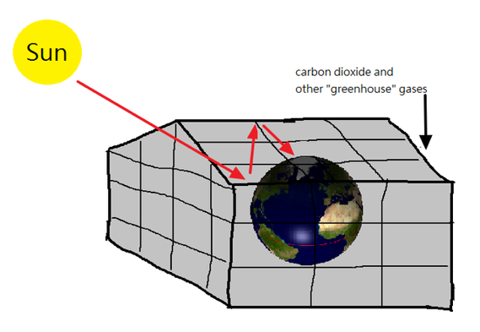
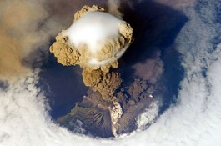
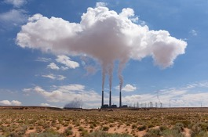
Greenhouses retain heat because the solar radiation that passes through the glass panels is absorbed by the opaque interior. “Greenhouse gases” like carbon dioxide have a similar effect on global temperatures due to their ability to absorb heat and then radiate it in all directions.
In sharp contrast, White aerosols from volcanos or industry have a cooling effect because they reflect this energy back into space.

Slide 8
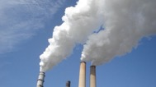
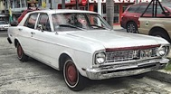
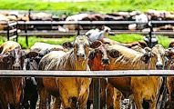
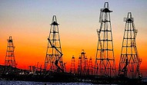
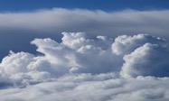
Greenhouse Gases You Need to Know:
Carbon dioxide (CO₂) is generated through the processes of respiration and combustion. There are concerns that humans are generating unprecedented amounts of CO₂ through the burning of fossil fuels.
Methane (CH₄) is naturally generated through anaerobic processes that take place in wetlands. Human activities like feedlots and gas drilling also contribute to atmospheric methane.
Water vapor (H₂O) is by far the most abundant of the greenhouse gases, and even though it is stronger than CO₂ in its ability to retain heat, water vapor can also has a cooling effect when it forms white clouds. This makes the role of water vapor impossible to predict.

Slide 9
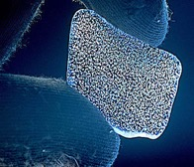
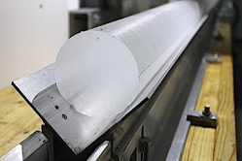
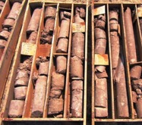
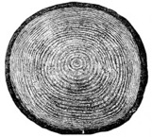
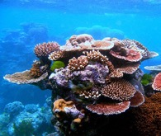
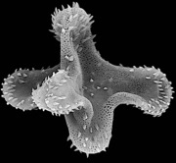
Proxy measurements are used to estimate climactic trends that took place prior to the existence of temperature records. These measurements include ice cores, sediment cores, tree rings, coral reef samples, and even fossilized pollen.
Ice core analysis is particularly valuable because ice caps contain trapped gas bubbles that allow researchers to obtain “snapshots” of the Earth’s atmosphere over a period of nearly million years.

Slide 10
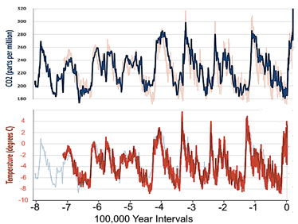
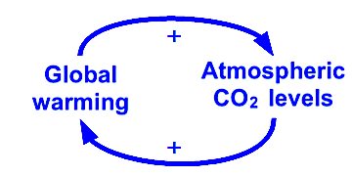
Carbon dioxide levels are correlated with temperature estimates. The fact that this trend covers nearly a million years raises three questions:
If we assume CO₂ levels were a major cause of this warming, what natural process generated these higher levels during these prehistoric times?
High atmospheric levels of CO₂ can also be an effect of warming because CO₂ is less soluble in warm water. If past warming increased atmospheric levels of CO_{2.}, what process generated these warming cycles?
Could CO₂ levels be both cause and effect, whereby both processes simulate each other synergistically in a positive feedback loop?
Graph downloaded from https://www.carbonbrief.org/explainer-how-the-rise-and-fall-of-co2-levels-influenced-the-ice-ages/

Slide 11
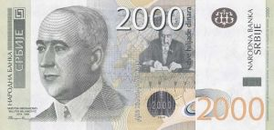
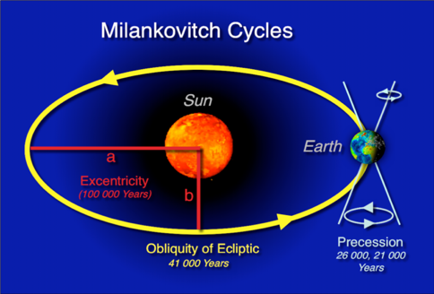
Early in the 20th century, Serbian geophysicist Milutin Milankovitch calculated cyclical variations in the Earth’s orbit that could profoundly affect climate.
Milankovitch Cycles are now the widely accepted explanation for the pre-historic cycling of Earth’s climate.
Image of Milutin Milankovitch on Serbian currency.

Slide 12
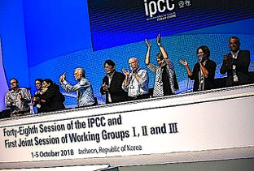
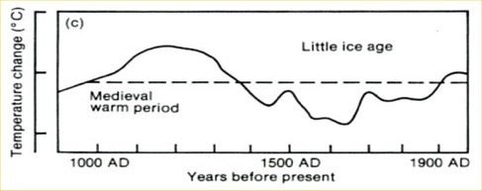
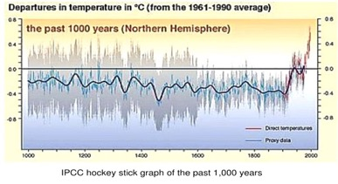
In 1988, the Intergovernmental Panel on Climate Change was formed in order to provide policymakers with timely information on climate.
In 1990 the IPCC published its first report based on the best available data.
In 2000 the IPCC published a second report which is widely known as the “hockey stick.” In this newer version most of the warming occurs during a rapid expansion of fossil fuel use in the 20th century.
Concerns have been raised over the accuracy of each report, but the second version is more widely accepted by policymakers.

Slide 13
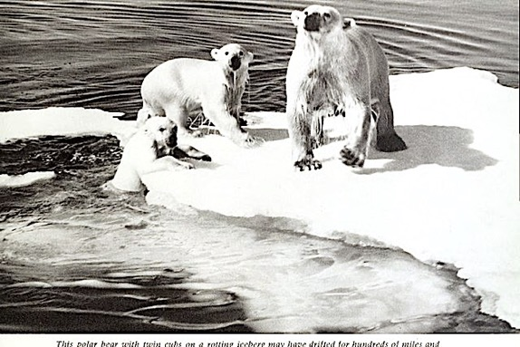
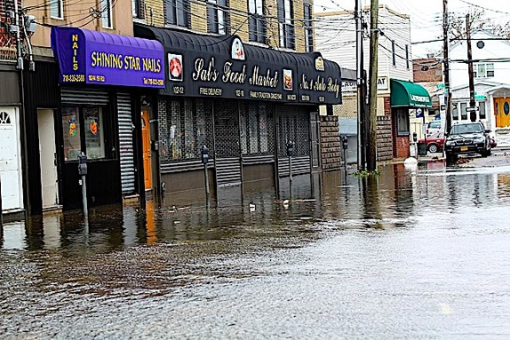
Some of the climate models predict desertification in tropical regions and worsening coastal storms, but the greatest concern is rising sea levels as the result of melting ice caps.

Slide 14
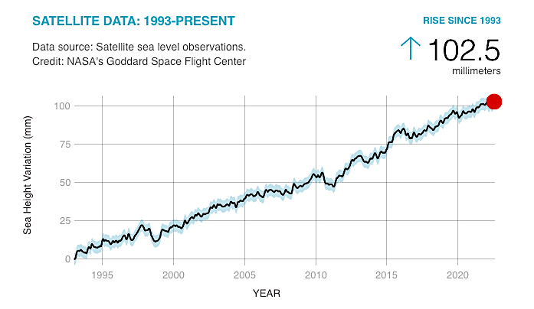
Can we predict how far sea levels will rise by 2100 based on this data from NASA?
This graph from NASA covers 30 years. How many mm per year?
102.5 mm ÷ 30 years = ?
How many total mm by the year 2100?
(2100-2023) X mm per year = ?
If 1 inch = 25.4 mm, how many total inches by the year 2100?
total mm from 2023-2100 ÷ 25.4 mm/inch = ?
Is this estimate reliable? What did you need to assume?
https://climate.nasa.gov/vital-signs/sea-level/

Slide 15
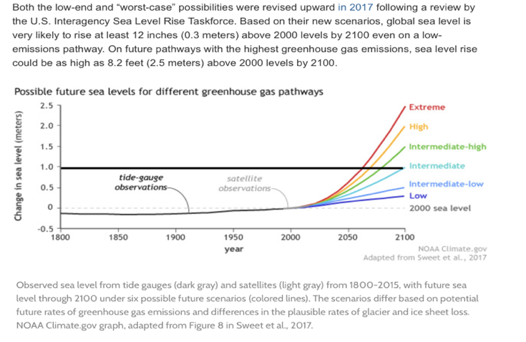
NOAA projects sea level increases that vary from a few inches to about 7 feet by 2100.
How does this square with your calculations?

Slide 16
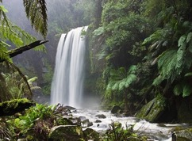
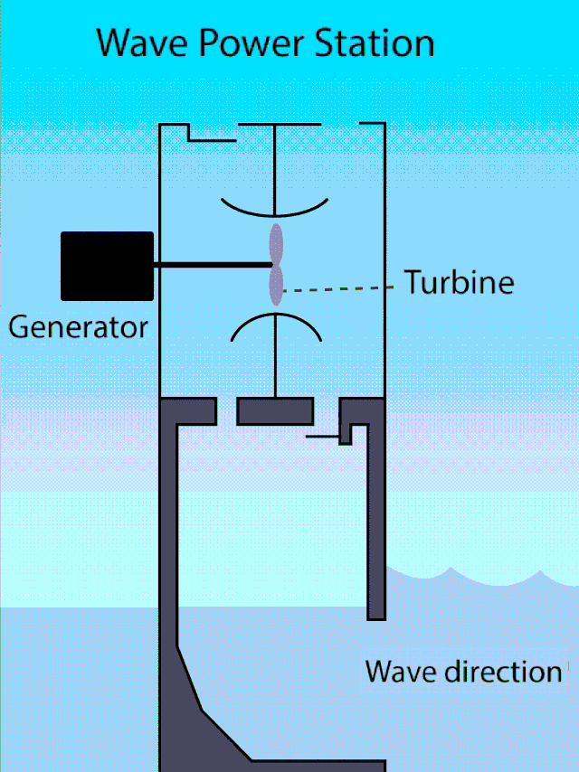
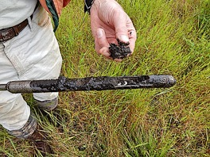
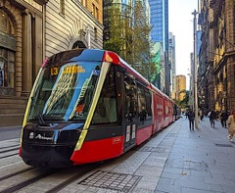
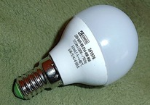
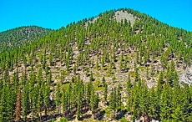
The magnitude of anthropogenic climate change is uncertain, but at the very least we can implement policies that provide undisputed benefits to both the environment and human society. These include:
Cleaner sources of energy.
Energy-saving products.
Access to public transportation.
Walkable communities.
Re-forestation.
Regenerative farming.
conserves carbon
captures carbon

Slide 17
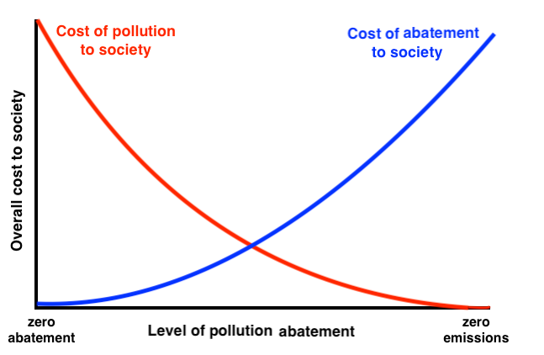
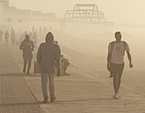
Whatever policy you choose, be mindful of the tradeoffs.
Do not overlook the law of unintended consequences!

Slide 18
Acknowledgement:
Unless otherwise indicated, all images in this presentation were downloaded from Wikimedia Commons: https://commons.wikimedia.org/wiki/Main_Page

