Slide 1
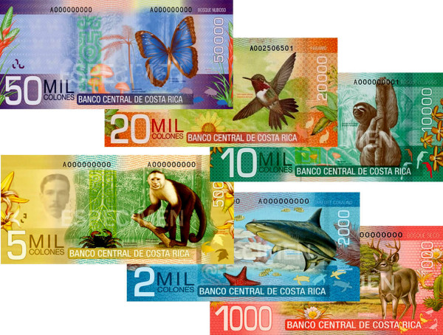
B i o d i v e r s i t y
Currency images downloaded from the Costa Rica Guide https://costa-rica-guide.com/practical/money/how-to-money-in-costa-rica/

Slide 2
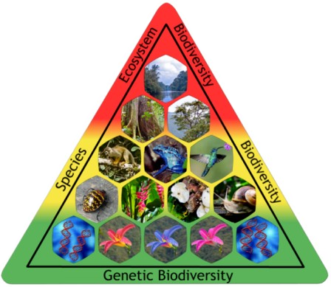
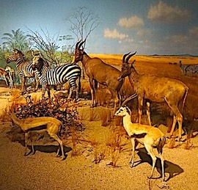
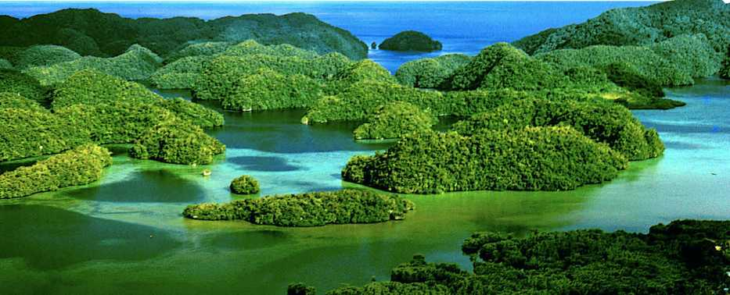
Biodiversity has three components:
Ecosystem biodiversity is about the variety of different habits in a given area.
Species biodiversity is about the number and distribution of different species in an ecosystem.
Genetic biodiversity is about the genetic variability within a population.

Slide 3
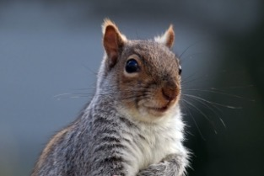
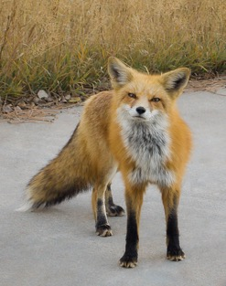
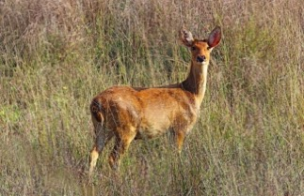
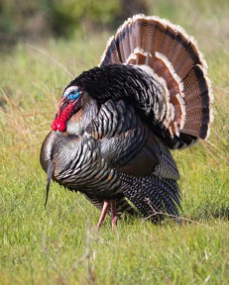
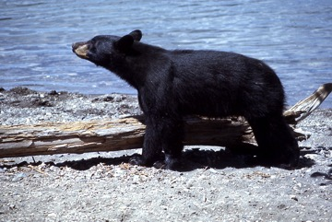
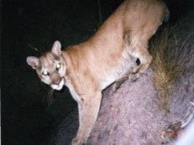
Rate from 0-10 the likelihood of you seeing one of these species on a weekly basis:

Slide 4
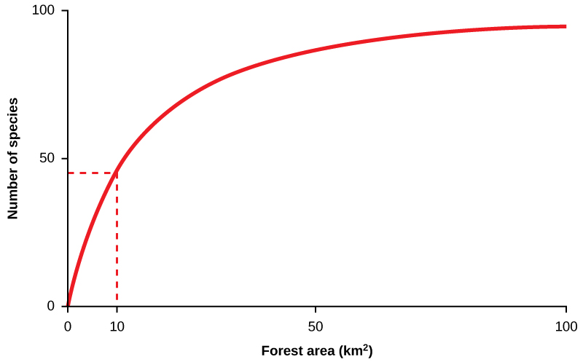
Biodiversity is largely a function of ecosystem size.
Larger forests have more species because they are able to accommodate top predators that enhance biodiversity by preying upon species that would otherwise dominate the habitat.

Slide 5
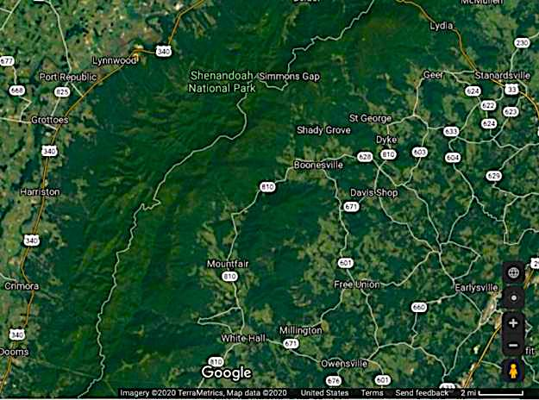
Shenandoah National Park is biodiverse because it contains large areas of uninterrupted forest.

Slide 6
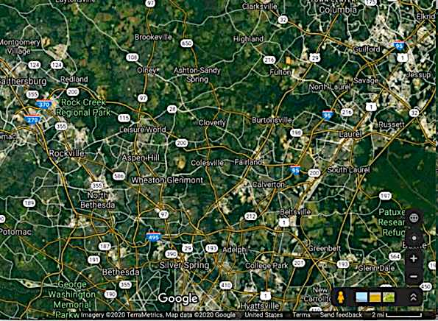
The suburbs of Maryland contain many green spaces, but they are fragmented by highways, shopping centers, and housing developments.

Slide 7
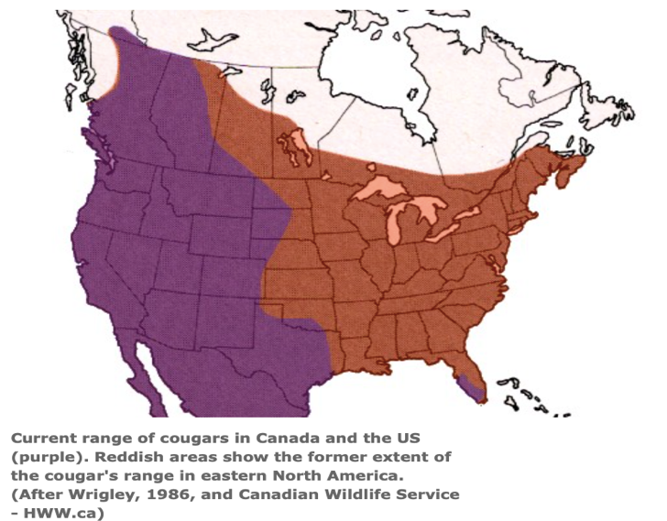
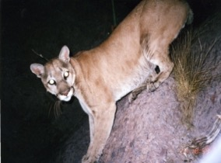
At one time cougars ranged throughout the continental US, but today they are found almost exclusively west of the Mississippi River.

Slide 8
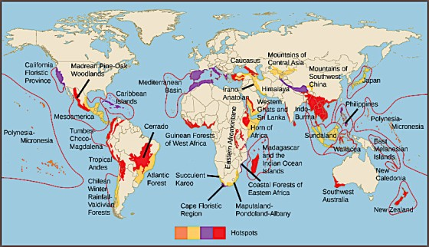
Less affluent nations and islands make up most of the current hotspots for endangered species.
Graph from “Environmental Issues” by Andrew Frank https://pressbooks.bccampus.ca/environmentalissues/front-matter/introduction/

Slide 9
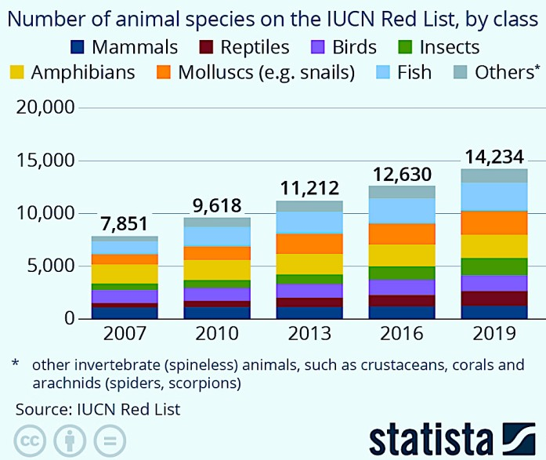
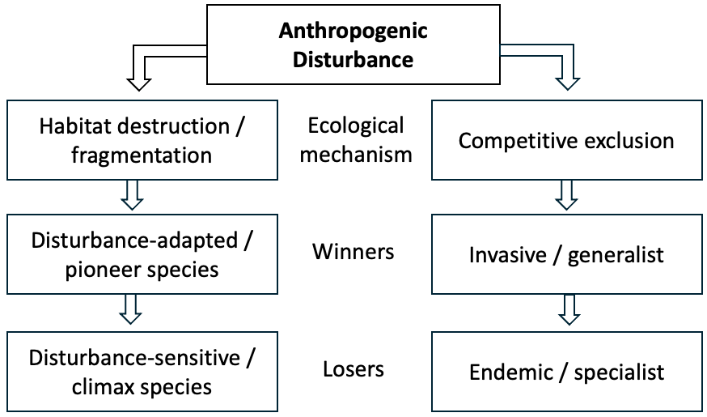
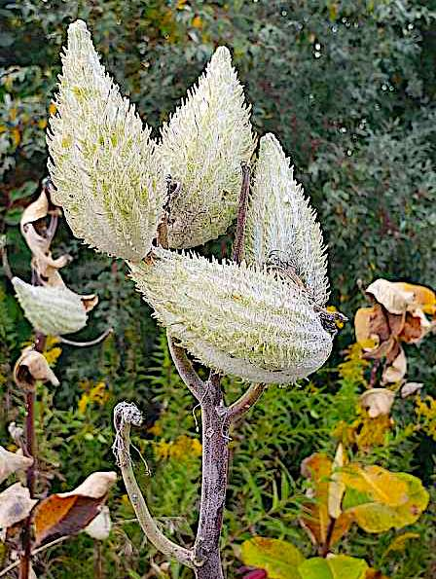
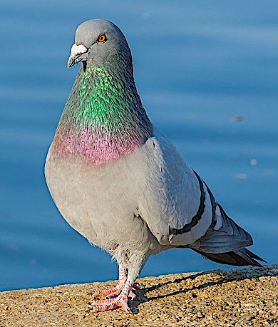
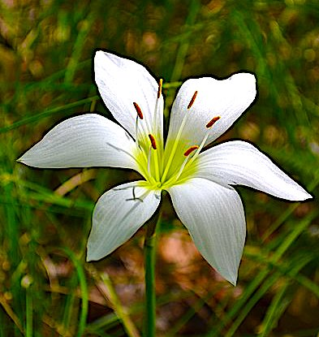
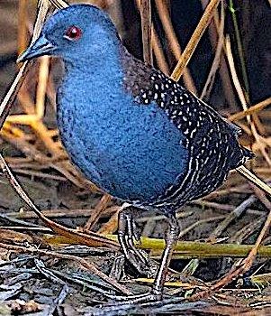
The endangered species list is growing, but not all species respond equally to man-made disturbances:
Habitat fragmentation generates an increasing proportion of “edge habitats” that favor disturbance-adapted pioneer species over species that are adapted to the more mature climax ecosystems.*
Invasive species and generalists also thrive at the expense of species that are specialized and/or endemic.
Milkweed
Rock Pigeon
Atamasco Lily
Black Rail
*Chart adapted from “A World of Winners and Losers: How Habitat Fragmentation Leads to Loss of Endemic Species” by Jesse Passman https://conservationbiologynews.wordpress.com/2012/09/17/a-world-and-winners-and-losers-how-habitat-fragmentation-leads-to-loss-of-endemic-species/ based on research by Tabarelli et al. (2012) https://www.sciencedirect.com/science/article/abs/pii/S0006320712002893

Slide 10
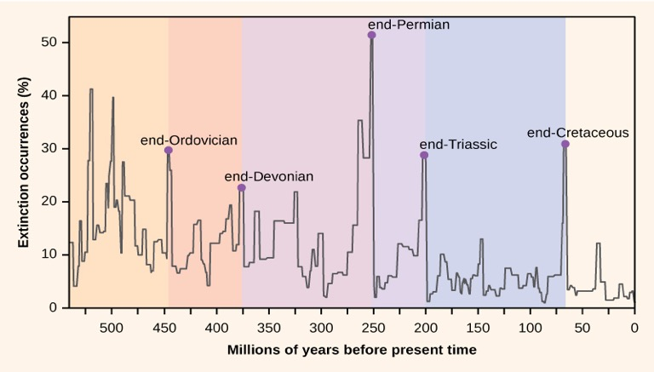
Mass extinctions are not a new phenomenon. The most famous extinction event was the disappearance of the dinosaurs at the end of the Cretaceous about 60 million years ago. Nevertheless, ongoing environmental pressures from human activity increasingly endanger the continued existence of vulnerable species of flora and fauna worldwide.
Graph from “Environmental Issues” by Andrew Frank https://pressbooks.bccampus.ca/environmentalissues/front-matter/introduction/

Slide 11
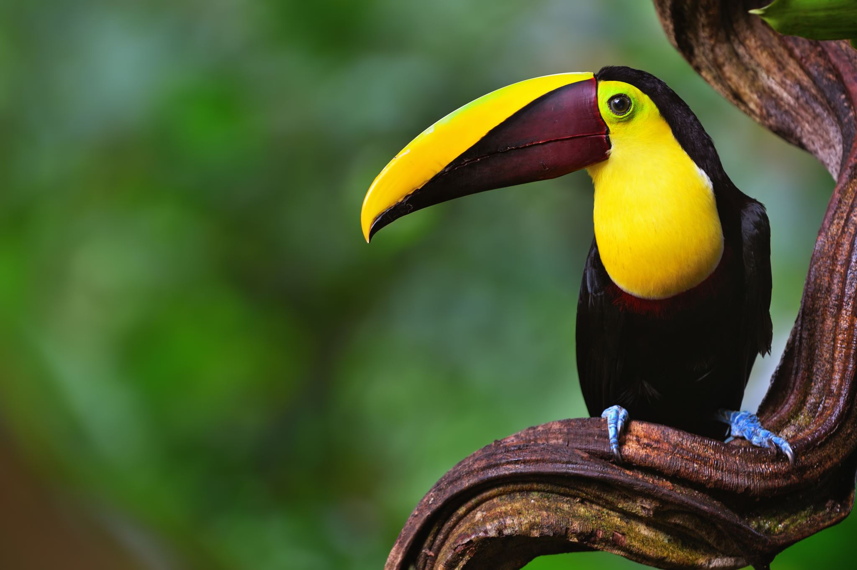
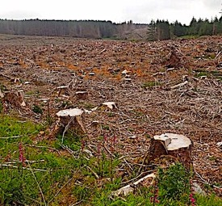
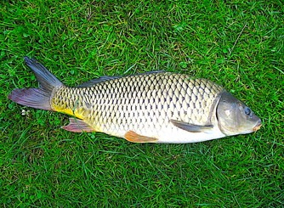
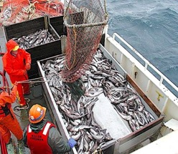
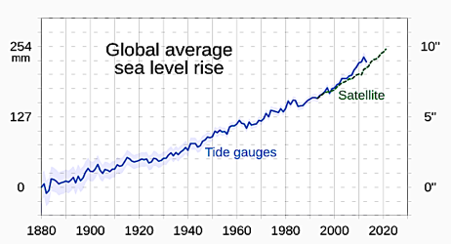
Biodiversity is not only aesthetically pleasing, it also enhances ecological services like soil integrity, pest control, pollination, and sources of future medicines. Anthropogenic threats to biodiversity include:
Habitat Destruction
Invasive Species
Overharvesting
Climate Change
Carp

Slide 12
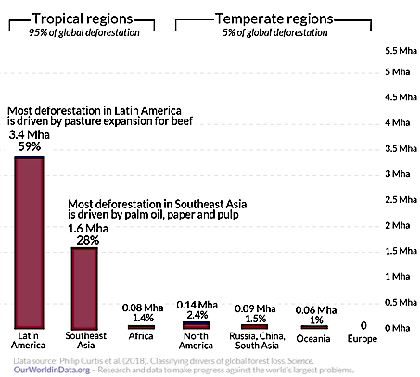
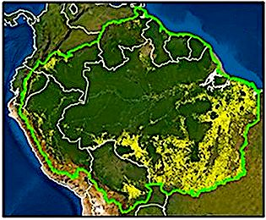
The most common form of habitat destruction is deforestation.
Worldwide, most deforestation takes place in Latin America and Southeast Asia.
Deforestation for agriculture in the Amazon basin 2001-2019

Slide 13
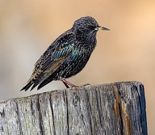
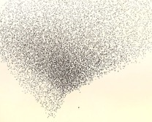
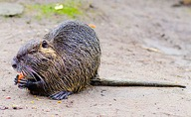
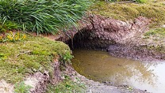
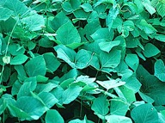
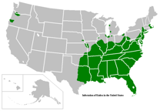
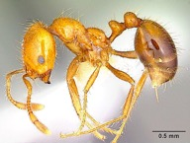
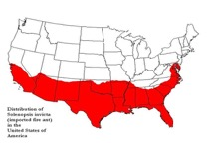
Starlings are native to Europe. They were imported to the US by a literary enthusiast who wanted to import all birds mentioned in Shakespeare plays. Starlings are invasive because they are prolific breeders that outcompete many native species in North America.
Nutria are native to South America. They were imported to the Louisiana to raise them for their fur. Nutria are invasive because their large burrows and voracious appetite for aquatic vegetation cause damage to shorelines.
Kudzu is native to Japan. It was imported to the US in the late 19th century as an ornamental plant and later used to control erosion. It is invasive because it grows so quickly that it outcompetes native species of plants for sunlight.
Fire ants were imported to the US through lumber shipments from South America. Fire ants are invasive because they outcompete other ants and their painful stings displace birds and mammals native to North America.

Slide 14
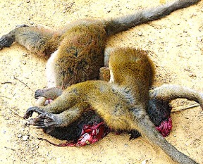
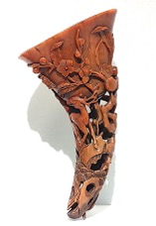
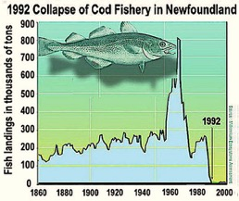
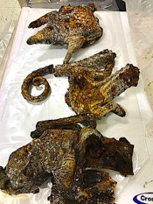
The poaching of endangered species in Africa is driven by the demand for bushmeat and exotic products.
Overfishing has also become a serious problem due to modern fishing technology. This problem is managed through enforcement of fishing quotas based on information derived from the monitoring of fish populations.
Dried Pangolin Meat
Fresh Lemur Meat
Rhinoceros Horn

Slide 15
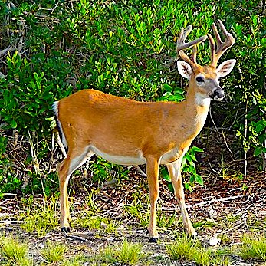
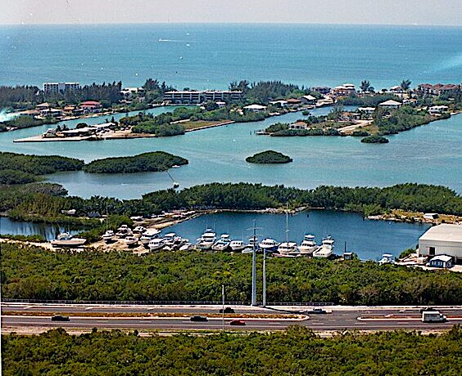
The Key deer is endemic to the Florida Keys. Its habitat was greatly reduced through by the growth of waterfront property during the 20th century.
Now it faces the additional threat of rising sea levels attributed to climate change.

Slide 16
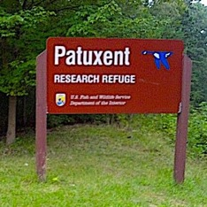
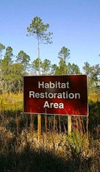
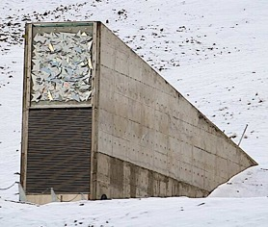
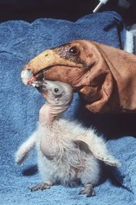
Strategies for mitigating biodiversity declines include:
Wildlife refuges.
Habitat restoration.
Seed vaults that keep genetically diverse legacy crops in cold storage.
Captive breeding of endangered species.
Legislation to prevent the harming of endangered species such as:
Endangered Species Act (US)
Convention on International Trade of Endangered Species (International)
Seed vault in Svalbard, Norway
The captive breeding image shows a California condor chick being feed with a condor puppet to simulate natural parenting.

Slide 17
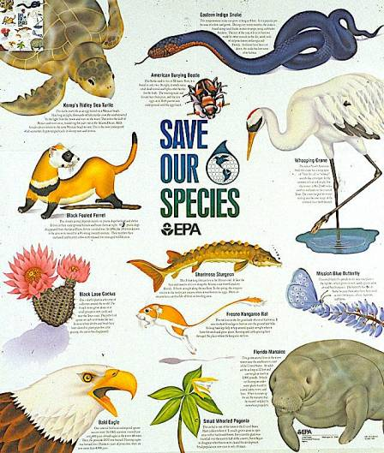
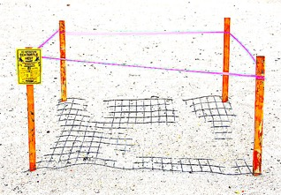
Endangered Species Act of 1973 addresses biodiversity in the US by regulating public and private land use and by developing plans to assist in the recovery of threatened and endangered species.
Kemp’s ridley sea turtle populations declined dramatically in the 20th century due to pollution, harvesting of turtle eggs, and habitat destruction. Under the ESA, nesting sites are fenced off and monitored to maximize the number of hatchlings successfully returning to the sea.

Slide 18
The Convention on International Trade of Endangered Species of 1975 is an international agreement that bans the trafficking of endangered species and their associated products. In the US, CITES is enforced by US customs.
Endangered species products seized by US customs.

Slide 19
Acknowledgement:
Unless otherwise indicated, all images in this presentation were downloaded from Wikimedia Commons: https://commons.wikimedia.org/wiki/Main_Page

