Slide 1
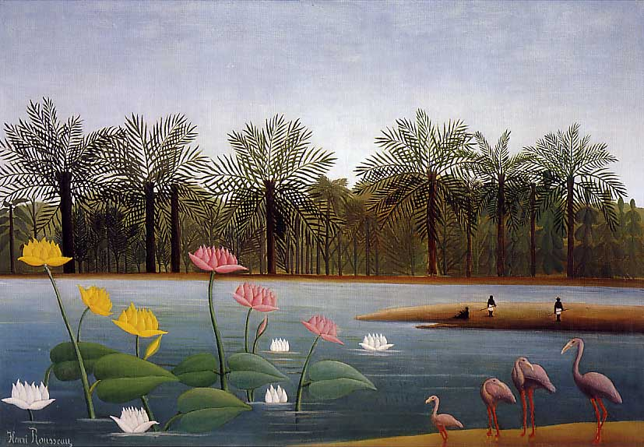
Aquatic Biomes
“The Flamingos” by Henri Rousseau

Slide 2
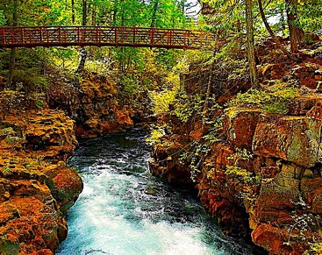
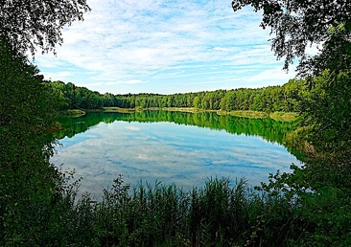
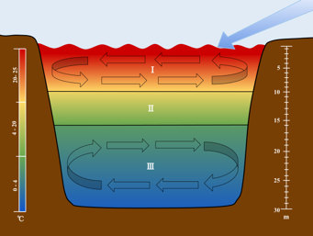
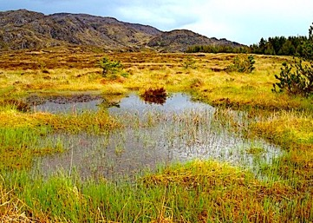
Rivers and their tributaries contain moving water provided by aquifers and runoff from the watershed. Nearly all rivers flow into the ocean.
Lakes and ponds are standing waters that vary in size. The lack of flow results in thermal stratification of the waters in the summer.
Wetlands are shallow, slow-moving bodies of water which may or may not seasonally dry out. Freshwater wetlands include swamps, marshes, and bogs.

Slide 3
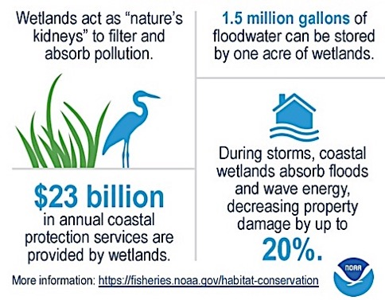
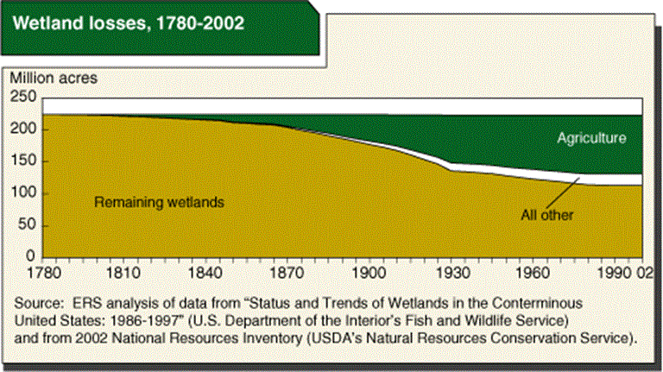
Wetlands only occupy about 6% of the continuous US, but their ecological importance in water purification and flood control cannot be underestimated.
Unfortunately, the expression “draining the swamp” did not always refer fighting government corruption: Wetlands have been drained for centuries to for urban and agricultural development, and despite growing awareness of their ecological value, wetlands are still disappearing faster than they are being restored.

Slide 4
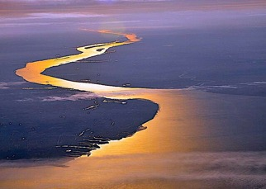
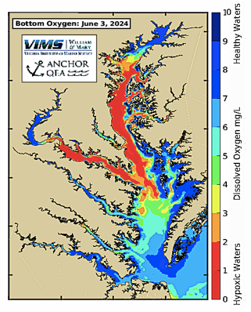
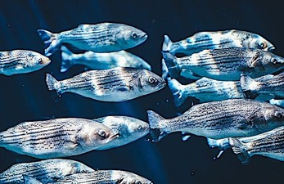
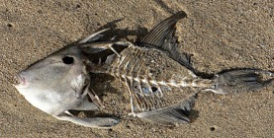
Estuaries occur where rivers empty into the ocean. Estuarine waters are rich in nutrients because of the accumulated organic matter they bring from the land by means of tributaries and runoff.
Estuaries serve as a “nursery” for many marine species because they are rich in phytoplankton and sheltered from strong waves. All species living in this ecosystem are adapted to large fluctuations in salinity as the result of tidal activity and rainfall.
Due to the magnitude of their watersheds, estuaries accumulate large concentrations of nutrient pollution from rural and urban sources that cause algae blooms that die off and generate “dead zones” of anoxic waters that kill fish and invertebrates.

Slide 5
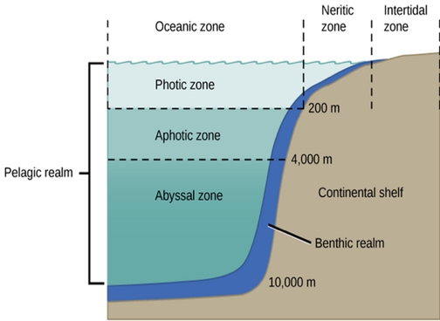
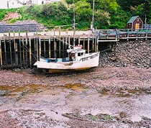
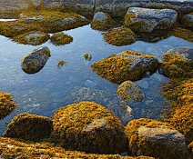
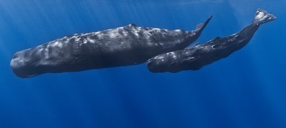
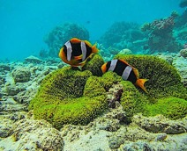
Marine Zones
The intertidal zone is the portion that is dry when the tide is low. Species adapted for this portion are tolerant to crashing waves and exposure to air. Some remain behind in tide pools that retain water during low tides.
The neritic zone remains submerged at low tide, and extends to the edge of the continental shelf. This portion is occupied by small fish and crustaceans.
The oceanic zone is much deeper and accommodates the larger animals. Since it is poor in nutrients, it is very sparsely populated.

Slide 6
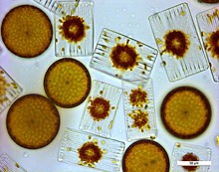
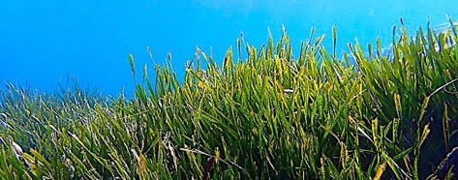
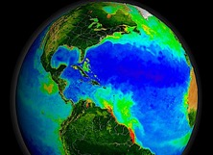
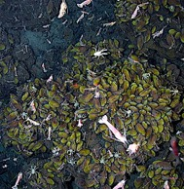
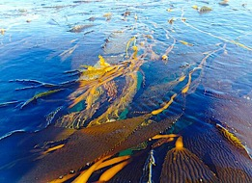
Marine Levels
All photosynthesis occurs in the photic zone.
In the abyssal zone the only light available is generated by means of bioluminescence.
Organisms that inhabit the pelagic realm either float or swim.
The benthic realm is dominated by species that crawl or remain sessile.

Slide 7
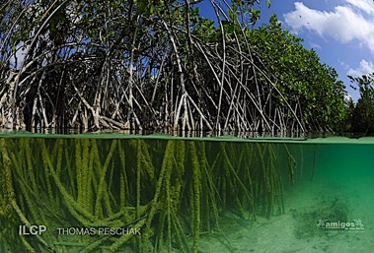
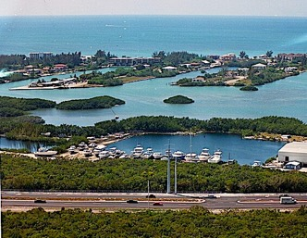
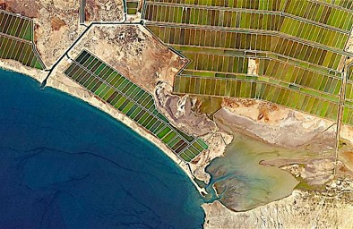
Mangroves are found in marine and estuarine tropical waters within 25º north and south of the equator. Their large stilt-like roots are designed for protection from ocean waves. Consequently, mangrove forests also protect the land from erosion and provide habitat and shelter for species seeking protection from predators.
Mangroves are currently threatened by coastal development and shrimp farming.
A Shrimp Farm in Mexico

Slide 8
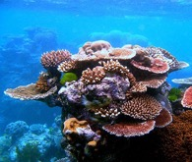
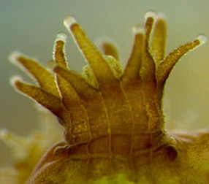
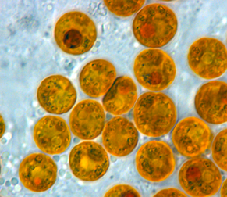
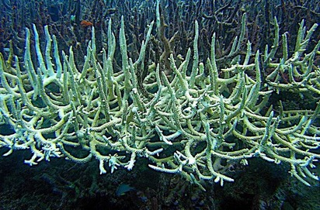
Coral reefs are found in nutrient-poor warm waters within 30º north or south of the equator. Coral reef communities are the most biodiverse ecosystems in the aquatic world
Most corals are found in clear, shallow waters favorable to the mutualistic symbiotic algae living in the polyp tissues.
Unfortunately, corals are now dying at at alarming rates as the result of nutrient pollution, sediment pollution, and rising water temperatures.
Bleached Coral

Slide 9
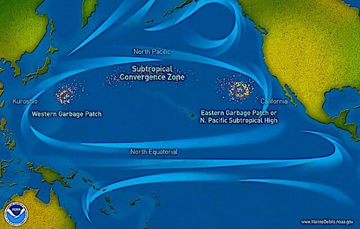
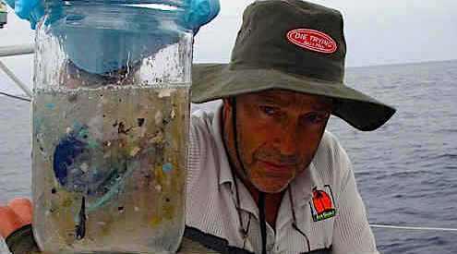
One of the greatest ongoing threats to the ocean is plastic pollution, and even though most of this waste stays near the shoreline, large amounts are carried thousands of miles by ocean currents to form massive cumulative “garbage patches” of microplastics that block sunlight needed for photosynthesis and harm the sea animals that ingest them by mistake. To date, there is no practical way to clean this up.
The ”Great Pacific Garbage Patch” alone is about twice the size of Texas.
Water sample image from the Algalita Marine Research and Education Foundation: https://www.oceansplasticleanup.com/Cleaning_Up_Operations/Algalita_Marine_Research_And_Education_Foundation.htm

Slide 10
Acknowledgement:
Unless otherwise indicated, all images in this presentation were downloaded from Wikimedia Commons: https://commons.wikimedia.org/wiki/Main_Page

