Slide 1
Air Pollution

Slide 2
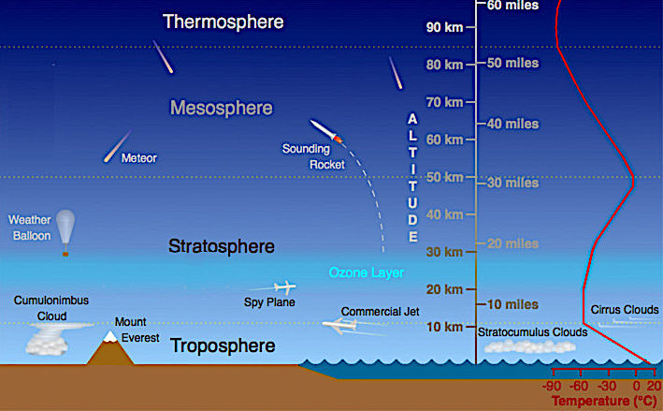
Our atmosphere is made up of multiple layers. The layer closest to Earth is called the troposphere. This is where the all our weather occurs.
Sandwiched between the troposphere and stratosphere is the ozone layer. This layer serves as a “sunscreen” that protects the Earth from receiving dangerous levels of ultraviolet light.

Slide 3
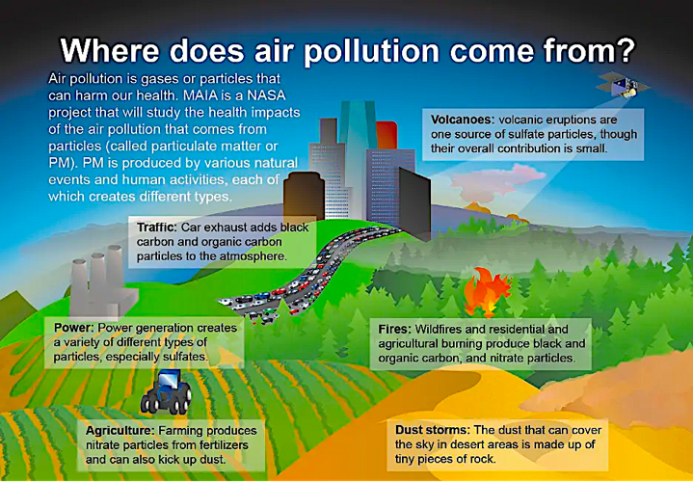
Air pollution includes any harmful substance or substances that remain suspended in the atmosphere. This includes gases and solids or liquids small enough to form aerosols. Sources of air pollution can be both natural and anthropogenic. Wildfires and volcanic eruptions are examples of natural sources of air pollution.

Slide 4
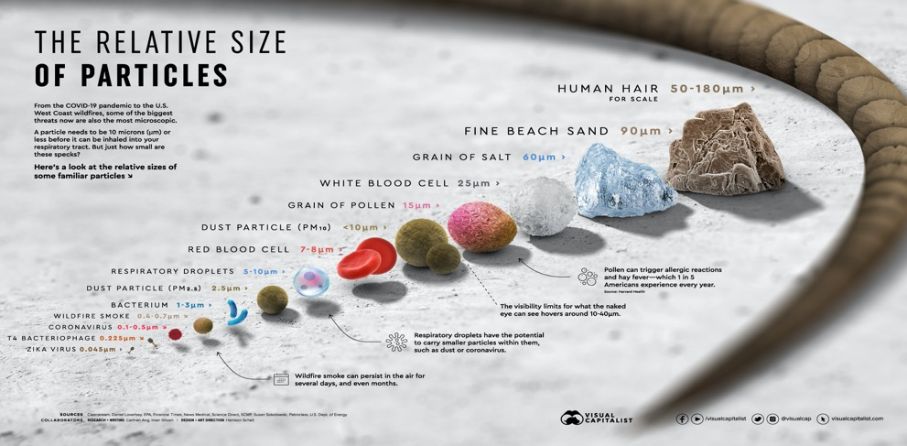
Solids and liquids small enough to form aerosols include smoke and dust particles. This is also referred to as particulate matter. Smoke from burning wood, coal, or oil consists mainly of volatile organic compounds (VOCs).
Downloaded from: https://www.visualcapitalist.com/wp-content/uploads/2020/10/relativesizeofparticles.html

Slide 5
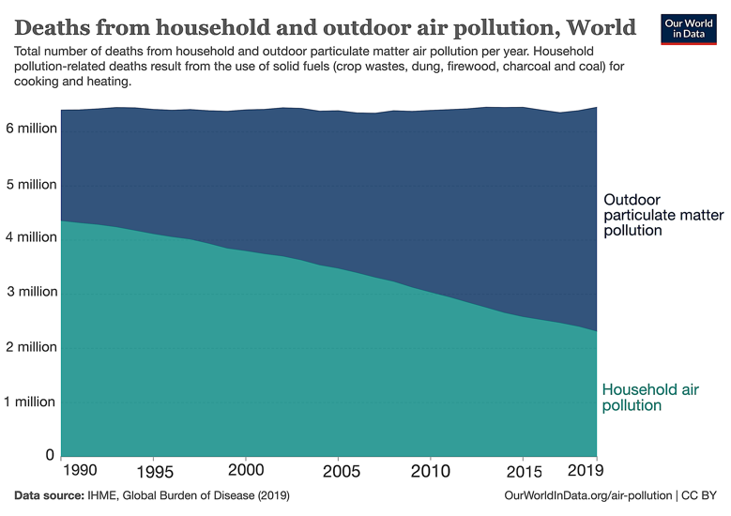
Air pollution does not only harm the environment: Worldwide about 6 million people die from air pollution. Most of these deaths take place in poor and middle-income countries.

Slide 6
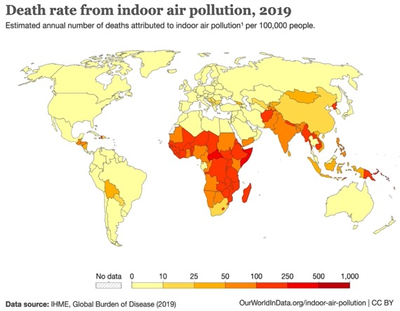
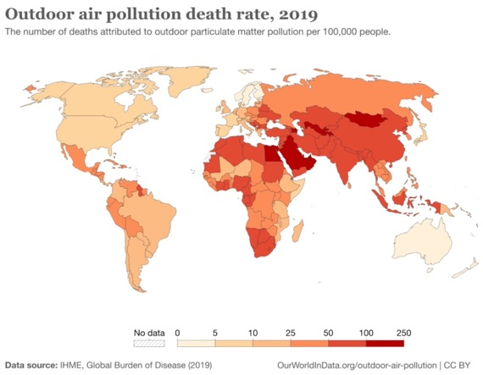
Deaths from indoor air pollution occur mostly in nations where rural populations rely on wood and dung fires for cooking.
Deaths from outdoor pollution occur mostly in middle income countries with growing industries and minimal environmental regulation.

Slide 7
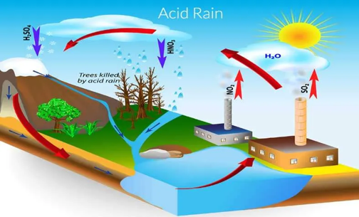
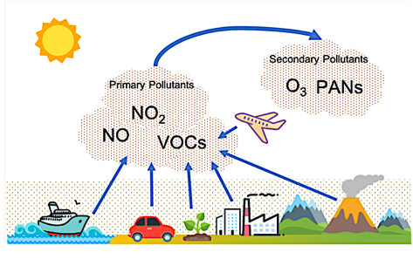
Primary pollutants are substances capable of causing harm as soon as they are generated from their sources. Examples of 1∘ pollutants include sulfur dioxide (SO₂), nitrogen oxides (NO & NO₂), and volatile organic compounds (VOCs). These are the main components of industrial smog.
Secondary pollutants are formed after primary pollutants interact with the environment to form additional harmful substances. For example, sulfur dioxide and nitrogen oxides can interact with the air to form nitric & sulfuric acids. These are the main ingredients of acid rain.
When nitrogen oxides interact with VOCs in the presence of sunlight, they form ground-level ozone (O₃) and peroxyacetyl nitrates (PANs). Theses are the main causes of photochemical smog.
Downloaded from “Engineering Choice”: https://www.engineeringchoice.com/what-is-acid-rain/

Slide 8
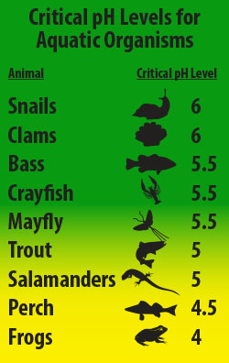
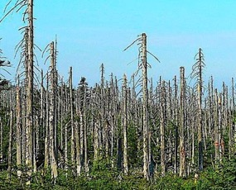
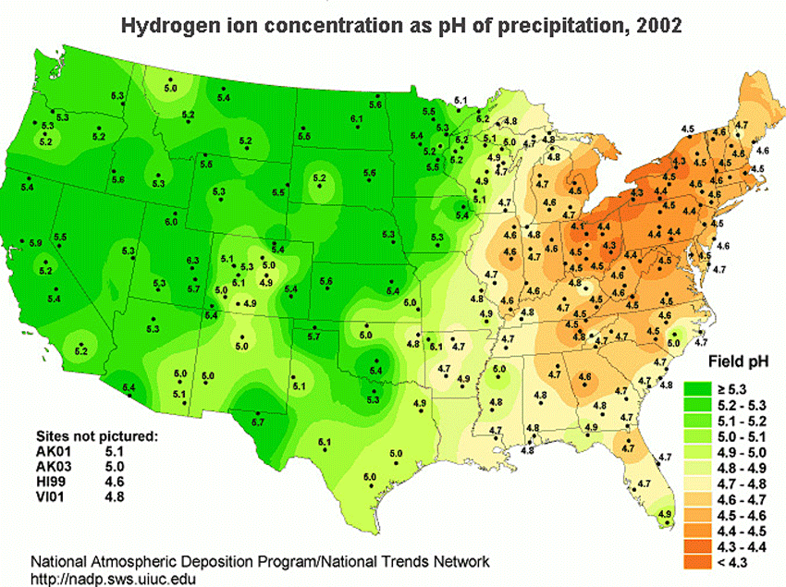
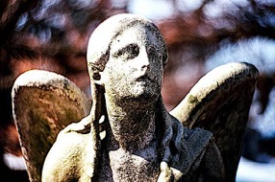
Acid rain lowers the pH of aquatic ecosystems and starves trees of nutrients by leaching away nutrients from the soil.
Most acid rain in the US occurs in regions where coal is burned.

Slide 9
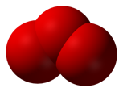
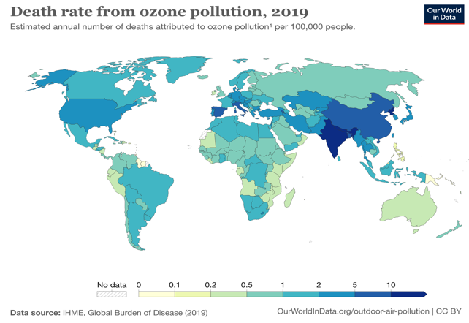
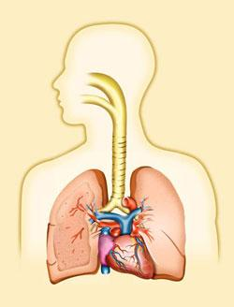
Ozone (O₃) is a triatomic allotrope of oxygen, that is more reactive than its more common diatomic cousin, O₂.
Ozone causes lesions on plant leaves and respiratory problems in humans as the result of irritated airways.
Worldwide, ozone plays a significant role in premature death.
O₂
Ozone

Slide 10
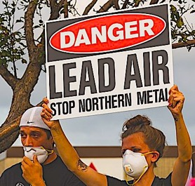
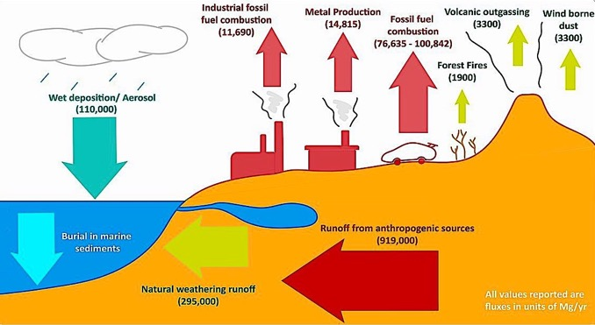
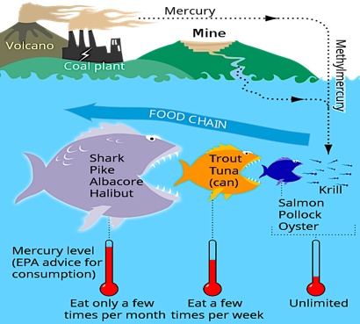
Toxic heavy metals can also enter the environment via the air.
Lead has a wide range of adverse affects on the environment and human health. It enters the air through smelting, manufacture of batteries, and use of leaded gasoline. Leaded fuels for cars were phased out in the US in the 1970’s but they are still used in aviation.
Mercury is a neurotoxin that bioaccumulates up the food chain. It enters the air through the burning of coal or incineration of trash.

Slide 11
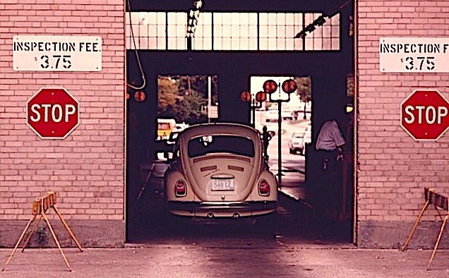
Air Pollution Mitigation

Slide 12
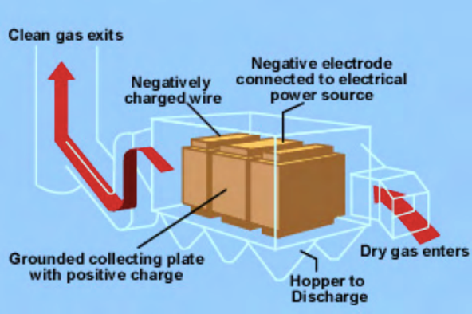
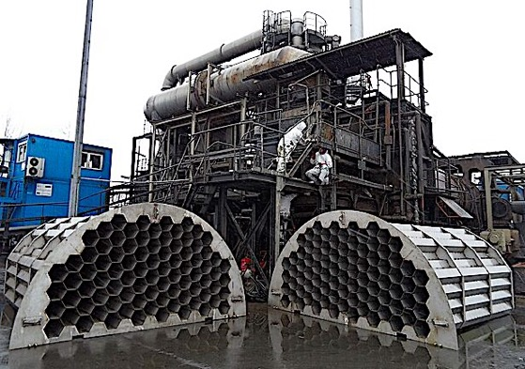
Electrostatic precipitators remove particulate matter from smokestack emissions by using negatively charged electrodes to attract the positively charged smoke particles.
This model serves a trash incinerator in Poland.
Downloaded from the EPA : https://archive.epa.gov/region6/6pd/rcra_c/pd-o/web/pdf/a4a-apc-equipment.pdf

Slide 13
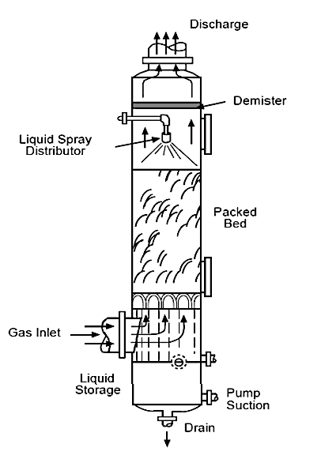
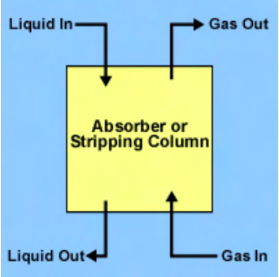
Wet Scrubbers remove both particulate matter and sulfur dioxide by spraying an aqueous solution that traps this noxious gas before it leaves the smokestack.
Downloaded from the EPA : https://archive.epa.gov/region6/6pd/rcra_c/pd-o/web/pdf/a4a-apc-equipment.pdf

Slide 14
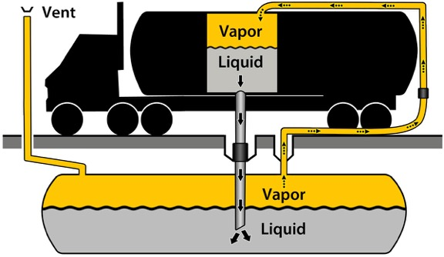
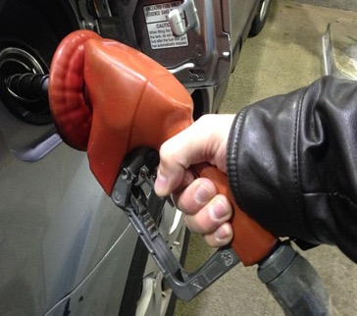
Vapor recovery systems at gas stations are designed to minimize escape of volatile organic compounds both at the storage tank and at the pump.
Downloaded from the website of Mecklenburg County government in NC: https://www.mecknc.gov/LUESA/AirQuality/PermittingRegulations/Pages/StageI.aspx

Slide 15
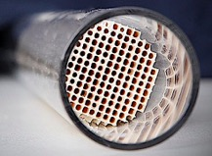
Catalytic converters contain rare metals that speed up the reactions between oxygen from the air harmful gases from internal combustion engines like carbon monoxide, nitrogen oxides, and unburned hydrocarbons
These devices are now required in all cars sold in the US.
Carbon Monoxide
CO₂
Hydrocarbons (C_{x}H_{x})
CO₂ + H₂O
Nitrogen Oxides (NO_{x})
N₂ + O₂

Slide 16
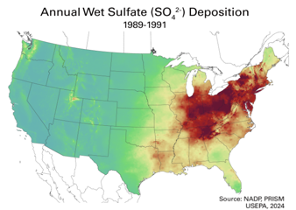
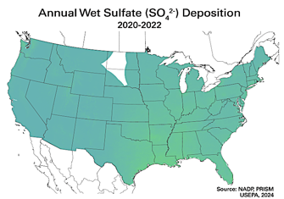
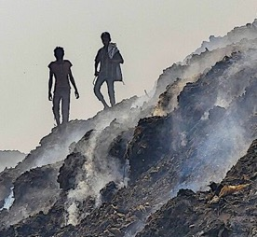
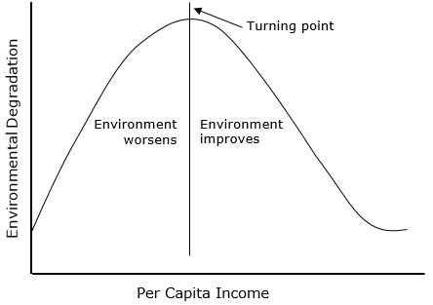
Clean air regulations improved most indicators of air for air quality in the US. These maps for example, show dramatic reductions in acid rain.
Unfortunately as the environment in the US gets cleaner, dirtier industries get outsourced to middle income countries like China and India.
They are here?
We are here.
Environmental Kuznet Cuve

Slide 17
Acknowledgement:
Unless otherwise indicated, all images in this presentation were downloaded from Wikimedia Commons: https://commons.wikimedia.org/wiki/Main_Page

