Slide 1
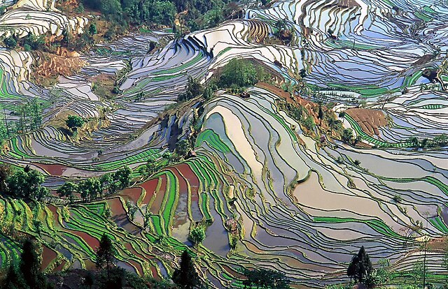
Agriculture

Slide 2
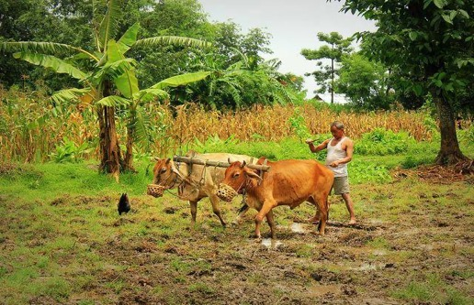
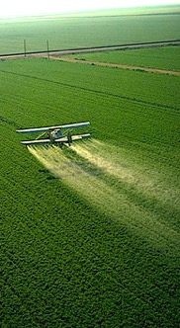
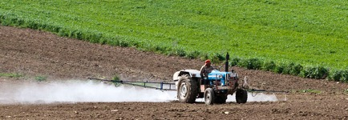
Traditional agriculture often prevails in middle and low-income nations.
In affluent nations this has been largely displaced by industrial agriculture.
Even though industrialization results in lower prices, the environmental impact of the chemical fertilizers, monoculture, pesticides, and fossil fuels involved in this process has raised concerns over its long-term role in feeding the world.

Slide 3
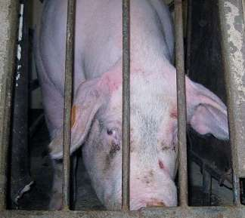
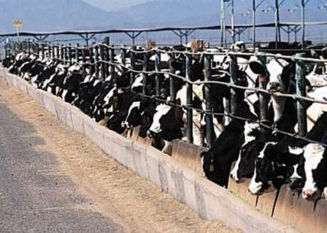
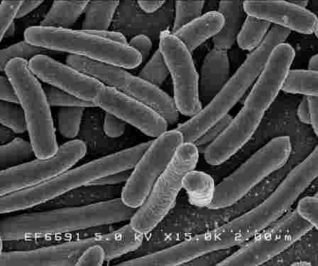
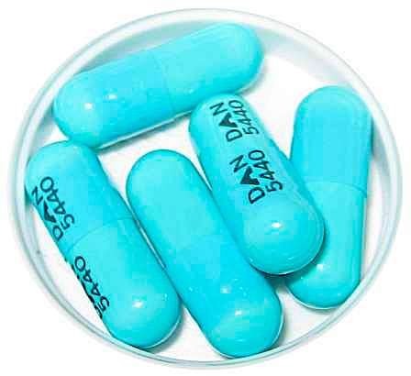
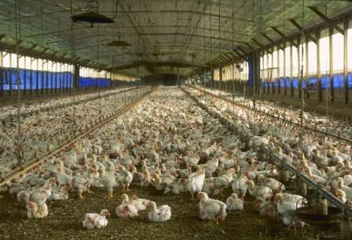
As for livestock, currently, 99% of US farm animals are raised in factory farms.* This mass production also results in lower food prices, but the costs to the environment and human health are not cheap:
73,000 people in the US are sickened by E. coli every year, and almost half of these illnesses are traced to contaminated ground beef.**
In the US, 80% of antibiotic use for animal agriculture. This favors the proliferation of antibiotic-resistant strains of bacteria ***
Factory farms generate massive volumes of concentrated wastes. Consequently, chicken farms in Maryland are now the leading source of nutrient pollution in the Chesapeake Bay.
*Information obtained from Animal Equality: https://animalequality.org
** Information from Emerging Infectious Diseases 2005 11(4) 603-609: https://www.ncbi.nlm.nih.gov/pmc/articles/PMC3320345/
*** Information from Food Safety News: https://www.foodsafetynews.com/2011/02/fda-confirms-80-percent-of-antibiotics-used-in-animal-ag/

Slide 4
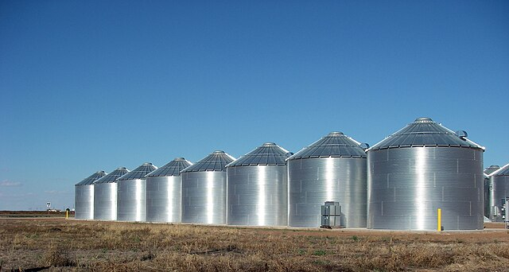
Food Security

Slide 5
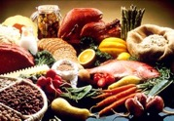
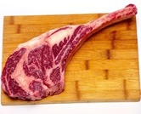
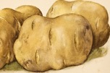
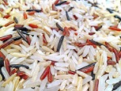
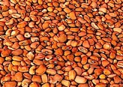
Main Nutrients Required by Humans and Animals
Carbohydrates
Proteins
Lipids
Water
All of these macronutrients with the exception of water can provide calories, but most traditional diets rely on carbohydrates as the main source of energy.
Most micronutrients are vitamins and minerals, and even though micronutrient deficiencies can profoundly affect quality of life, most concerns over food security focus on access to macronutrients.
Goiter due to iodine deficiency.

Slide 6
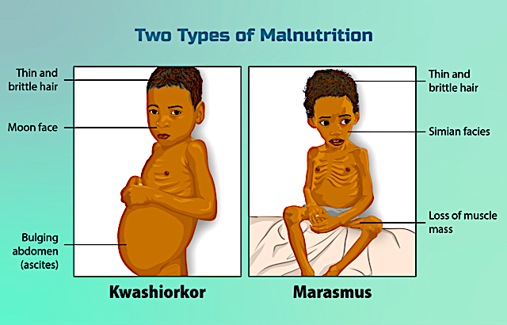
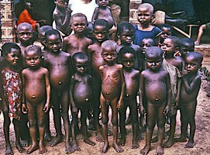
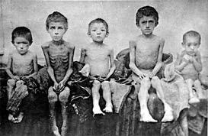
The two main categories of macronutrient deficiencies in children are kwashiorkor (lack of protein) and marasmus (lack of of calories).
Victims of kwashiorkor in sub-Saharan Africa.
Victims of marasmus during the 1930’s famine in Ukraine

Slide 7
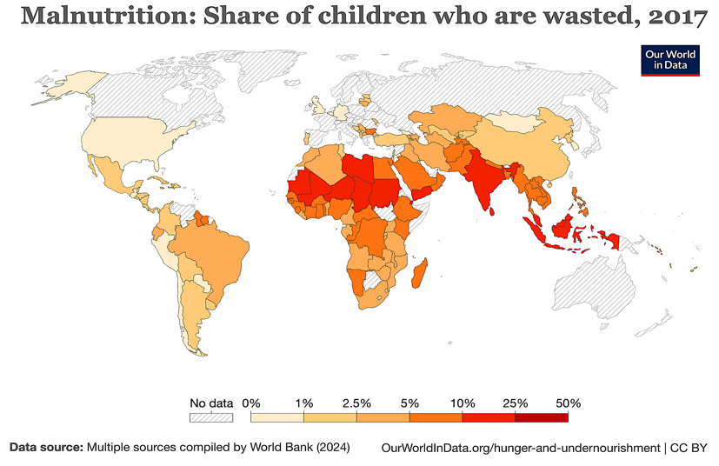
Most of the severe cases of childhood malnutrition today occur in South Asia and Sub-Saharan Africa.
Downloaded from: https://ourworldindata.org/wasting-definition

Slide 8
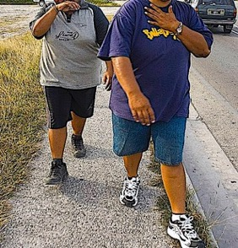
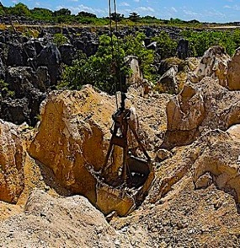
Obesity is often a far bigger problem in middle to high income nations, but much like malnutrition, obesity involves poor nutrition. This is why it is more common among poor people lacking access to healthy meals.
The residents of the Island nation of Nauru have the world’s highest rates of type 2 diabetes. Almost 90% of the population is overweight.
In the 1970’s Nauru became one of the world’s richest nations, but decades of strip mining for phosphates undermined Nauru’s ability to feed itself, and the traditional diet of fresh fish, coconut, fruit, and vegetables was replaced by cheap processed foods like white rice and instant noodles. In 2006 Nauru’s phosphate reserves were exhausted and the nation now struggles pay its bills.*
The 2007 “Walk against diabetes.”
Phosphate strip mine in Nauru.
* Information from: https://www.diabetes.co.uk/in-depth/i-have-seen-so-many-funerals-for-such-a-small-island-the-astonishing-story-of-nauru-the-tiny-island-nation-with-the-worlds-highest-rates-of-type-2-diabetes/

Slide 9
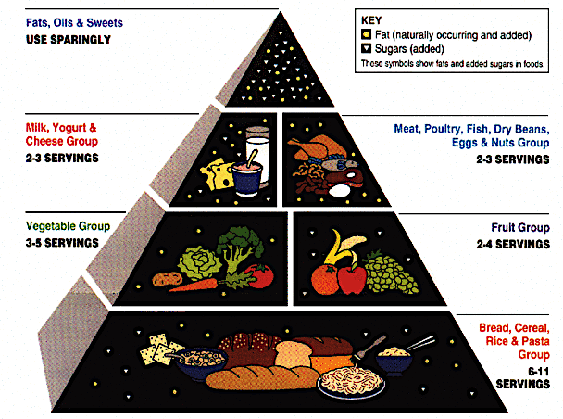
The 1992 “food pyramid” recommended a standard diet low in fat and high in carbohydrates. Concerns were raised that these recommendations were contributing to obesity in the US, and that special interests played a role in the USDA’s decision to publish this chart.*
Twenty years later, the USDA published “My Plate” and even though this is an improvement over the pyramid, the USDA’s inclusion of a dairy beverage instead of water has raised concerns that this was a concession to the dairy industry.
* Information from: https://ninateicholz.com/concern-about-the-science-of-the-dgas/

Slide 10
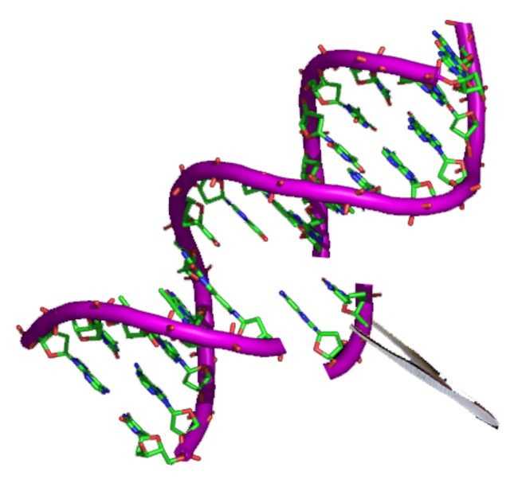
Biotechnology

Slide 11
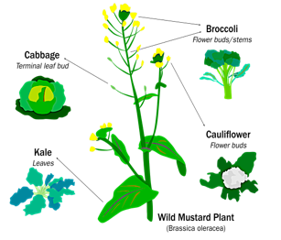
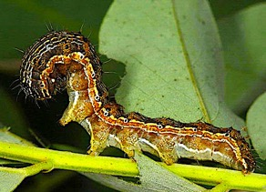
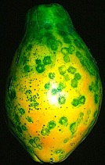
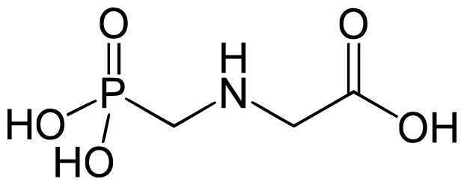
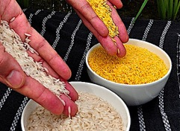
Since the dawn of agriculture, humans have been selectively breeding plants and animals to enhance desired traits.
Biotechnology has sped up this process dramatically because it allowed researchers to insert genes from completely unrelated species.
Some of the desirable traits that have been added through genetic modification include:
Pest Resistance: Bt cotton produces a chemical that resists the bollworm.
Disease Resistance: A transgenic papaya that resists the ringspot virus.
Glyphosate Resistance: “Round-Up Ready” crops facilitate weed management.
Nutritional Enhancement: Golden rice was engineered to contain vitamin A.
Glyphosate

Slide 12
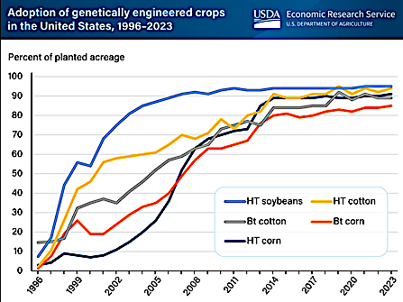
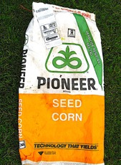
By 2008, more than half of all corn, cotton, and soybean acres in the US were planted with crops containing at least one GMO trait.
HT = Herbicide resistant
Bt = Insect resistant
The chart indicates that some of these crops were engineered to contain both these traits.
Chart downloaded from the USDA: https://www.ers.usda.gov/data-products/charts-of-note/charts-of-note/?topicId=a2d1ab41-13b3-48b5-8451-688d73507ff4

Slide 13
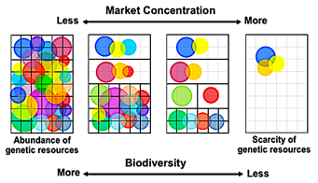
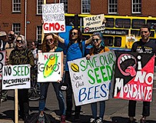
GMO crops may eventually play a major role in sustainable agriculture because they require less pesticides and less land. Nevertheless, legitimate concerns over GMO include:
Crops with smaller and less diverse gene pools.
Propriety rules that prevent farmers from replanting seeds from their own crops.
Increased residues of glyphosate on herbicide-resistant crops.
Interbreeding with wild relatives to generate herbicide-resistant “superweeds.”
Food allergies from novel proteins present in GMO products.
Novel proteins that are toxic to wildlife.
?
?
?
The last three concerns have yet to come true, but as with all novel technologies the precautionary principle is the the most prudent way to move forward.

Slide 14
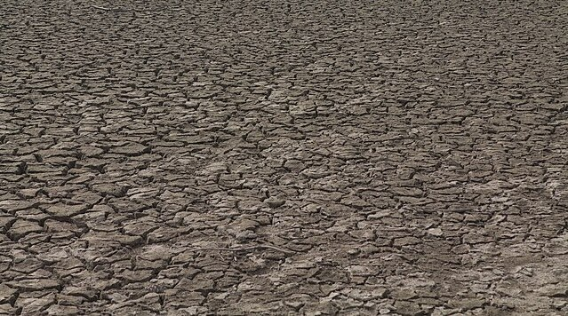
Soil Health

Slide 15
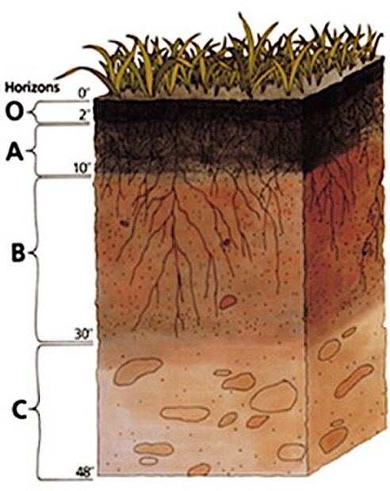
Depending on climate and parent materials, most soils form distinct layers. A typical soil profile can be subdivided into the following five horizons:
O-Horizon: Organic matter from decaying vegetation.
A-Horizon: A combination of organic matter and parent material. This is commonly referred to as “topsoil.”
B-Horizon: Inorganic soil particles consisting almost entirely of parent material.
C-Horizon: Courser particles and more rocks.
R-Horizon (not shown): This is not soil. It is the bedrock parent material that generated the inorganic portion of the soil.

Slide 16
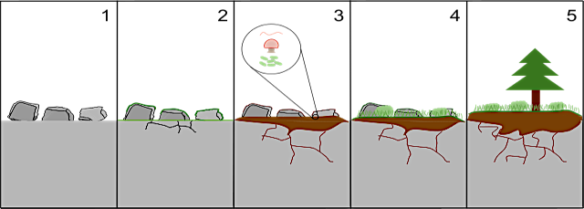
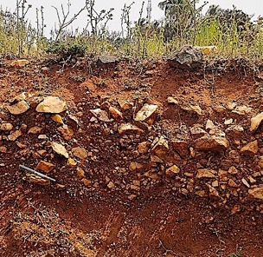
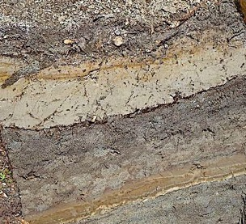
Primary succession involves the formation of soil over time from solid rock.
Climate and parent material affect soil depth:
Soils generated from quartz are courser and less productive because quartz resists weathering activity and lacks nutrients.
Soils rich volcanic ash are deeper and more productive because the parent material is rich in phosphate nutrients and easily weathered.

Slide 17
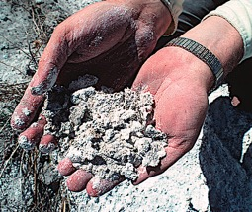
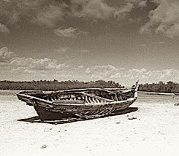
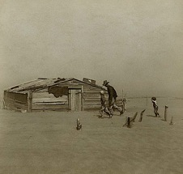
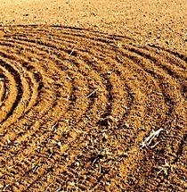
Over the long run, traditional irrigation can lead to mineral residues cumulatively deposited from pumped groundwater repeatedly evaporating over the land. This can lead to result in soil salinization.
Clearing the land for agriculture is problematic when extensive deforestation results in desertification.
During the Dust Bowl of the 1930’s, Oklahoma lost nearly 20% of its 1930 population to migration after farmlands were devasted by wind erosion. This was attributed in part to the over-tilling of farmland.
The repeated use of chemical fertilizer without the supplemental addition of organic matter eventually results in mineralized soils that lack textural qualities that are conducive to plants.

Slide 18
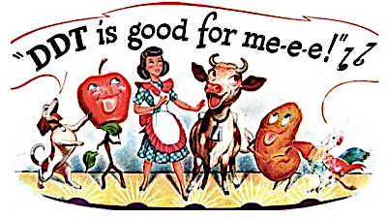
Pest Management

Slide 19
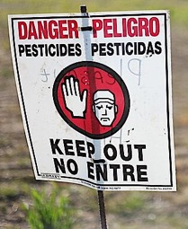
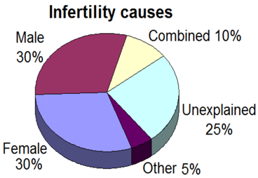
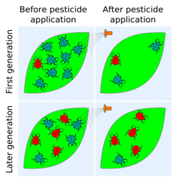
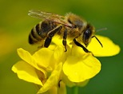
Pesticides increase productivity but contaminate ecosystems and many of the persistent organic pollutants (POPs) are pesticides.
Pesticides might be playing a role a recent decline in pollinators that play a critical role in the production of fruits and vegetables.
Some pesticides and POPs are endocrine disruptors that adversely affect reproduction in both humans and wild animals.
Pesticides are known to lose their effectiveness when insects generate pesticide-resistant populations through the process natural selection. This problem occurs more often among species with short life cycles.

Slide 20
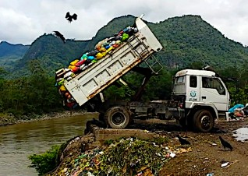
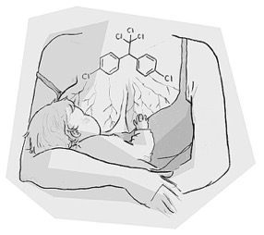
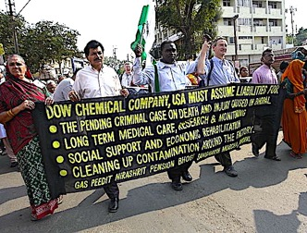
Pesticide use is heavily regulated in the US, but many many less affluent nations loosely control how hazardous products are used and discarded.
Making matters worse, many poor countries still use some pesticides that were banned in the US many decades ago. Researchers in South Africa detected levels of DDT in breast milk exceeding safety limits determined by the WHO.*
In 1984, 45 tons of methyl isocyanate escaped from an insecticide factory in Bhopal, India. About 15,000 people were killed and half a million suffered from life-changing injuries. An investigation later attributed this disaster to a lack of safety precautions.
* Information from Science Daily, 2012: https://www.sciencedaily.com/releases/2012/09/120903142949.htm

Slide 21
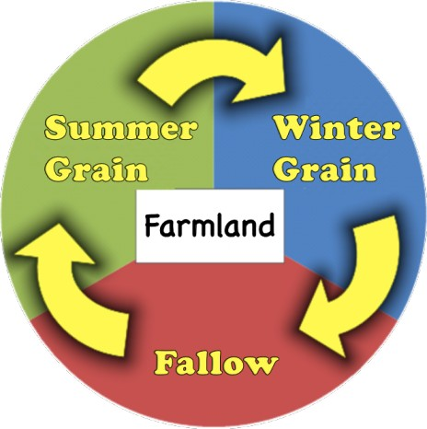
Integrative Pest Management (IPM) incorporates a wide rage of strategies that minimize pesticide use. These include:
Selective Application of Pesticides: Minimizes ecosystem contamination.
Intercropping/Polyculture: Reduces population of specialized pests.
Biological control: A cleaner alternative to pesticides.
Conservation Tillage: Enhances biological control by conserving soil biodiversity.
Crop Rotation: Disrupts the life cycles of pests and parasites.
Image of selective application from Kentucky University: https://www.uky.edu/Ag/Entomology/PSEP/14appequip2.html

Slide 22
Sustainable Agriculture

Slide 23
Organic farming is more sustainable because it results in less pesticides in the environment, less erosion, and less nutrient runoff. Food that is certified organic forbids the use of:
Chemical Fertilizers
Synthetic Pesticides & Herbicides
Sewage Sludge
Ionizing Radiation
GMO
Antibiotics (livestock)

Slide 24
Sustainable practices used in organic farming include:
Composting as a source of organic matter to restore topsoil nutrients and texture.
Nitrogen-fixing cover crops like clover and alfalfa to restore nitrates and minimize erosion, runoff, and soil mineralization.
Integrated Pest Management (IPM).
Genetically diverse heritage breeds that are less prone to disease.
Livestock with access to the outdoors for improved health and a more natural diet.
Bollworm Trap

Slide 25
The roller crimper facilitates conservation tillage on a large scale by cutting the cover crop close to the ground so the resulting straw can serve as mulch that suffocates the weeds while protecting the newly planted seeds.*
* Information and video stills from the Rodale Institute: https://rodaleinstitute.org/why-organic/organic-farming-practices/organic-no-till/ and https://www.youtube.com/watch?v=xRbNJpUEXj0

Slide 26
Regenerative farming is similar to organic, but the main goal of is rebuilding of the soil.
In conventional ranching livestock roam freely over large sections of pasture. This undermines rangeland biodiversity because when given a choice, grazers preferentially eat away the perennials that play a key role in soil health and carbon sequestration
In nature, perennials are preserved because the grazers are constantly on the lookout for predators that keep them on the move. This minimizes opportunities for selective grazing.
Regenerative grazing involves the use of sectional fencing that forces livestock to intensely graze sections of pasture for short periods of time.
Last image from the University of CA Chico: https://www.csuchico.edu/regenerativeagriculture/ra101-section/managed-grazing.shtml

Slide 27
Acknowledgement:
Unless otherwise indicated, all images in this presentation were downloaded from Wikimedia Commons: https://commons.wikimedia.org/wiki/Main_Page

