Slide 1
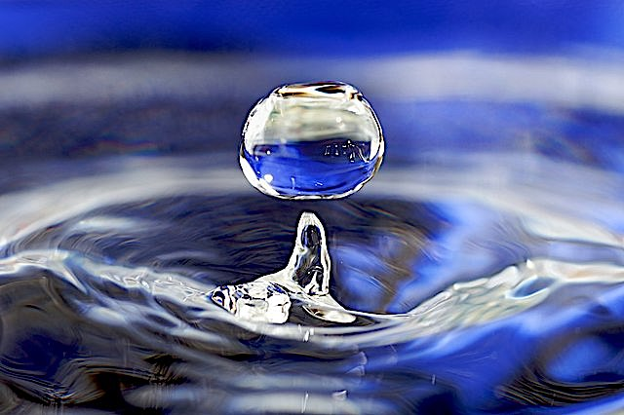
Freshwater Resources

Slide 2
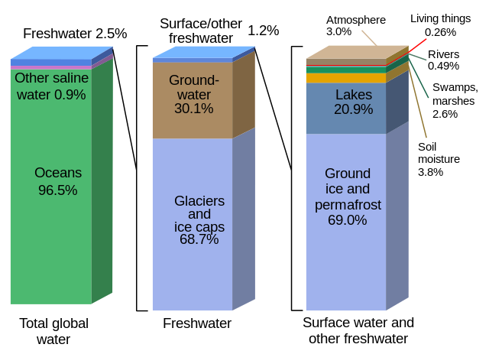
Where is Earth’s Water?
2.5% of world’s water is freshwater
Majority of freshwater is in glaciers and ice caps

Slide 3











Water Cycle
Transpiration may account for as much as 75% of evapotranspiration that occurs over dry land.*
Water Vapor
Evaporation, Sublimation,
& Transpiration
Precipitation
Surface Water
Surface waters include wetlands, lakes, streams, and rivers. Runoff that enters streams and rivers flows to the sea.
Water & Ice
Runoff
Infiltration
Ground Water
Forests play a key role in the recharging of ground water because forest soils are better at absorbing the rain.
*Information from CID Bio-Science: https://cid-inc.com/blog/transpiration-in-plants-its-importance-and-applications/

Slide 4
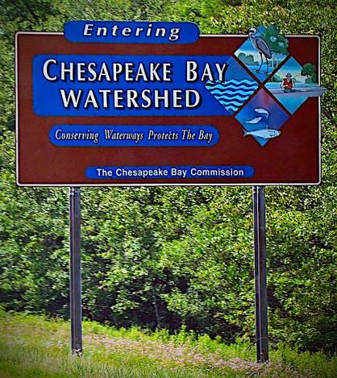
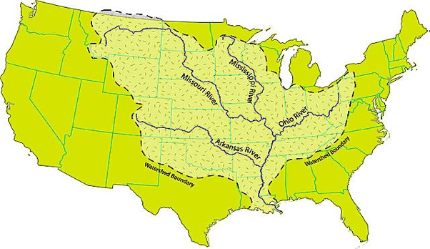
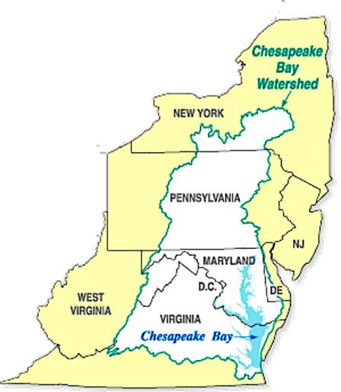
Watersheds – an area of land from which all water is channeled to a common outlet
Mississippi River watershed is the largest in the US
Chesapeake Bay watershed is much smaller, but includes portions of five different states

Slide 5
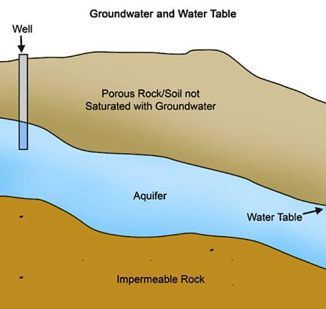
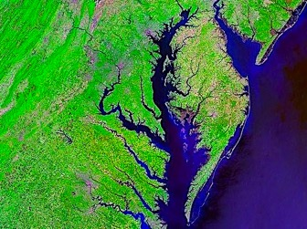
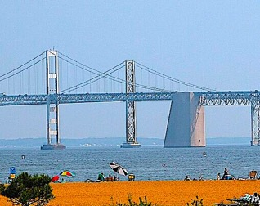
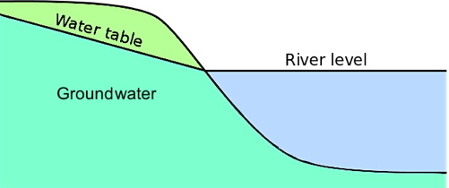
Water table - boundary between saturated and unsaturated rock/soil
  Groundwater separated by impermeable rock into distinct “bodies” of groundwater called aquifers
In dry weather, water from rivers comes primarily from groundwater discharge to the surface
Much of the water in rivers flows into estuaries and into the ocean

Slide 6
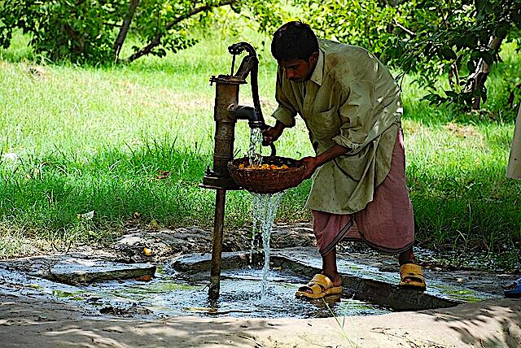
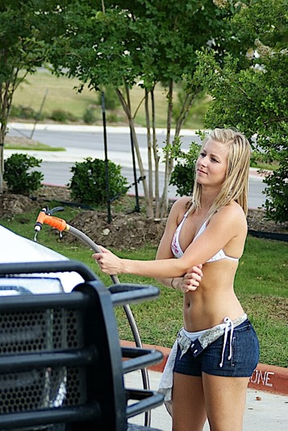
Securing Access to Freshwater

Slide 7
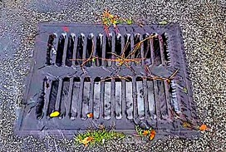
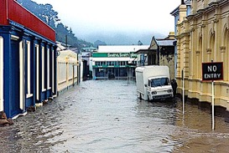
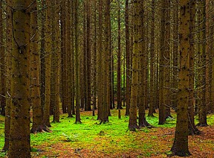
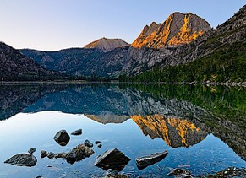
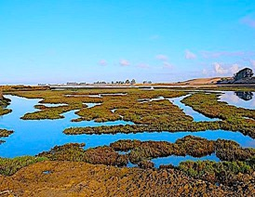
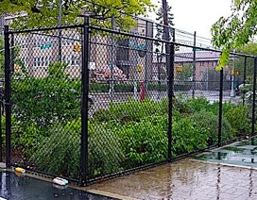
Replenishing Groundwater
Forests play key role in recharging aquifers - soils more permeable
Seepage from standing waters like lakes and wetlands
Rain gardens reduce pavement and sidewalk that increase runoff and the expense of infiltration
  Also mitigate urban flooding by reducing the burden on stormwater drainage systems

Slide 8
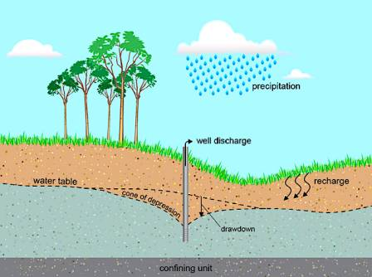
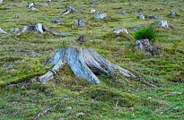
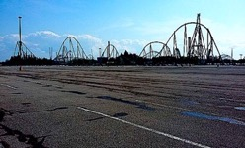

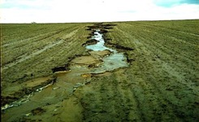
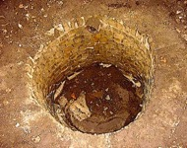
The impact of farming on freshwater resources:
Aquifers are the main source of water for urban and agricultural needs, and withdrawals of groundwater can significantly lower the water table when the withdrawal rate exceeds the rate of recharge.
Adding insult to injury, changes to the Earth’s surface such as deforestation and pavement construction increase runoff at the expense of infiltration.
In the short run, this causes flooding and erosion.
In the long run, the decline in ground water recharge combined with transpiration losses from a lack of trees result in a lower water table.

Slide 9
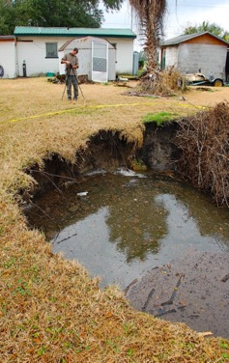
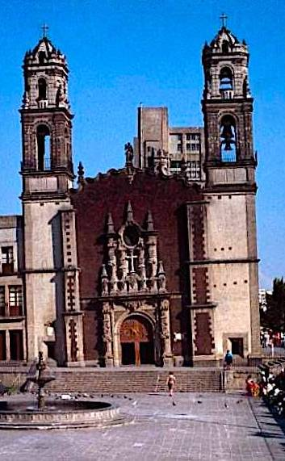
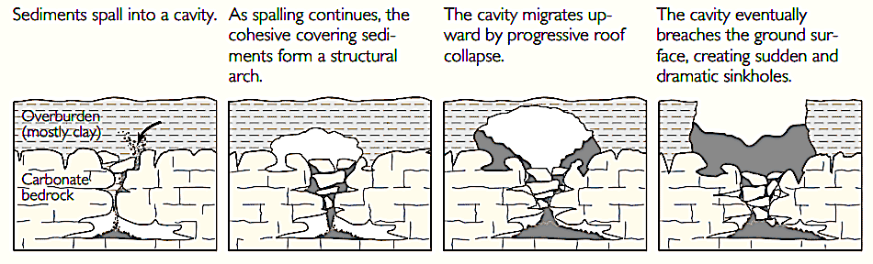
Loss of underground water pressure can result in land subsidence, where land sinks to fill the gap
  Abrupt land subsidence can cause life-threatening sinkholes
  Gradual subsidence responsible for “leaning” Santa Veracruz cathedral in Mexico City

Slide 10
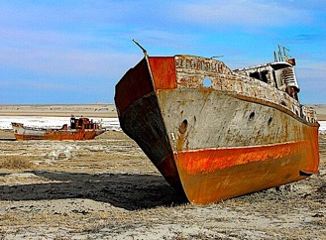
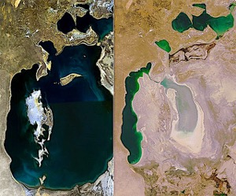
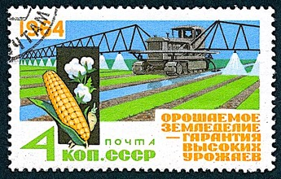
Excessive withdrawals of surface waters can also generate serious problems: The Aral Sea in Central Asia was a large inland saline lake that once supported fishing communities in what is now Kazakhstan and Uzbekistan. In the 1960’s the Soviet government started to divert water from rivers feeding the lake to irrigate cotton farms in the surrounding desert.
Deprived of its water sources, the Aral Sea diminished to a less than a quarter of its original size and salinity levels rose over tenfold. Not only was the fishery destroyed, miscarriages and chronic diseases became widespread as desert winds picked up toxic salts from the exposed seabed. The UN characterized this incident as “the most staggering disaster of the 20th century.”*
1989
2008
* Information from: https://www.un.org/en/chronicle/article/dry-tears-aral
You will not be tested on this!

Slide 11
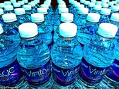
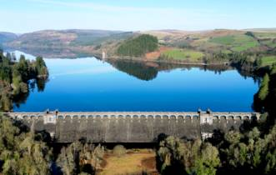
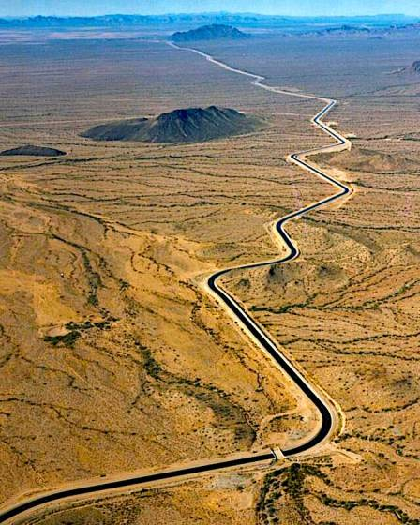
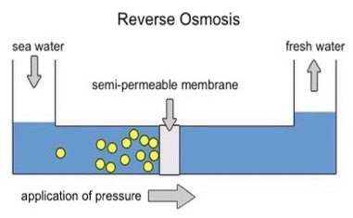
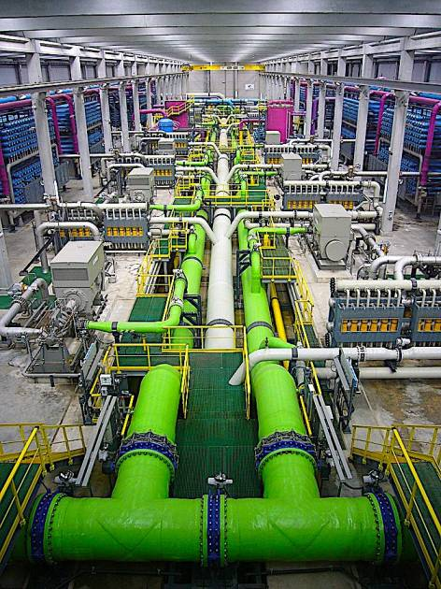
Strain on water resources will only get worse with expected increases in population and standards of living.
Strategies for increasing access to water may include:
Augmentation Strategy | Pros | Cons
Building dams to create reservoirs. | Reduces the amount of water reaching the ocean. | Dams disrupt the natural river flow and reproduction of migratory fish.
Building aqueducts to transport water to places in need. | Less strain on local aquifers. | Aqueducts are less conducive to biodiversity because they lack shorelines.
The desalinization of seawater. | Seawater is abundant. | The process is energy-intensive.

Slide 12

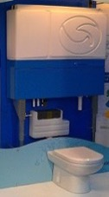
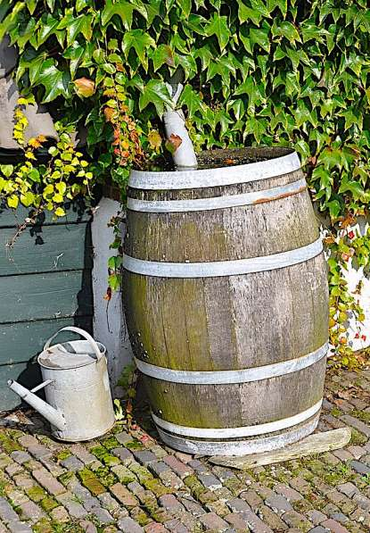
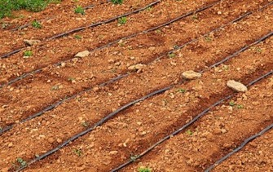
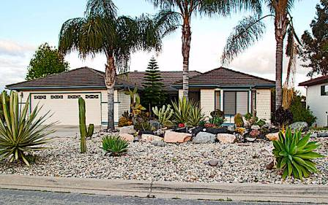
Freshwater augmentation strategies are problematic - all cause varying degrees of harm. Conservation is a guaranteed long-term solution.
Here are some strategies for saving water:
Conservation Strategy | Pros | Cons
The recycling of grey water from showers or laundry to flush toilets. | Conserves water and reduces the burden on sewage systems. | Requires dual plumbing to separate out grey water.
Use of rain barrels to harvest rain. | Conserves water and reduces burden on stormwater drains. | This water is usually not potable.
Use of drip irrigation in agriculture. | Conserves water and prevents soil salinization from excess water. | Installation is expensive.
Xeriscaping as an alternative to lawns. | Minimizes need for irrigation. | Personal preferences.

Slide 13
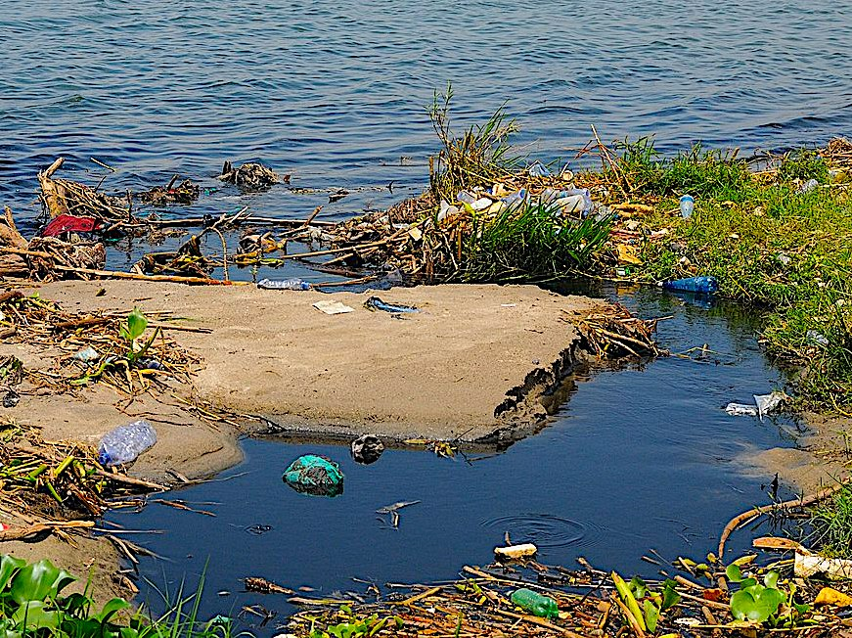
Water Pollution

Slide 14
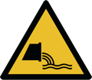
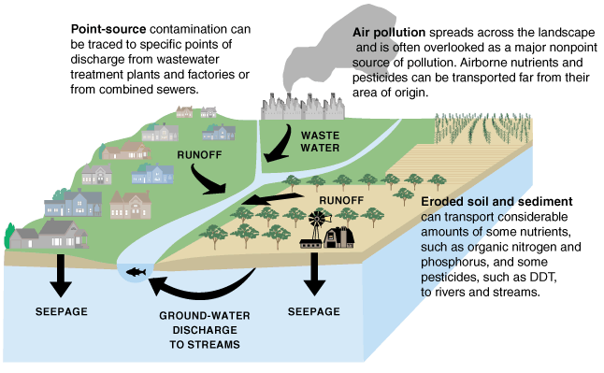
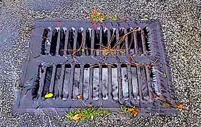
Point sources of water pollution are traceable concentrated sources like factories, feedlots, and sewage treatment plants.
Nonpoint sources are not traceable because they are spread out. Most of them enter the water in the form of runoff that drains into the surface waters.

Slide 15
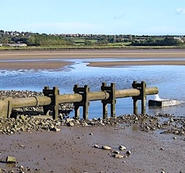
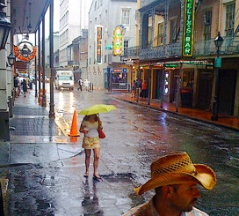
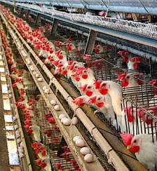
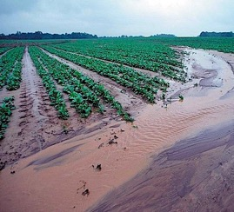
Nutrient pollution is the most prevalent form of water pollution worldwide
Urban point source | Sewage treatment plant discharge
Rural point source | Discharge from factory farms (e.g., chicken farms on Eastern Shore of MD)
Urban nonpoint source | Runoff from urban streets
Rural nonpoint source | Fertilizer runoff from farms*
*Information from The Environmental Integrity Project: https://htv-prod-media.s3.amazonaws.com/files/md-cafo-enforcement-report-embargoed-for-10-28-21-1635354222.pdf

Slide 16
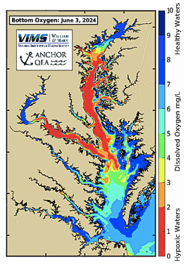
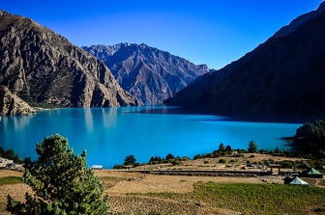
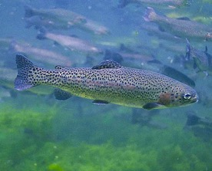
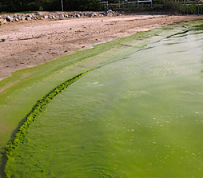
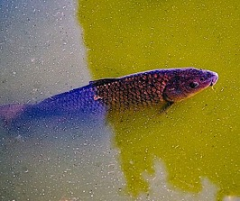
Nutrient levels in bodies of water
Oligotrophic bodies of water have low nutrients and are clear and amenable to species that require high levels of dissolved oxygen, like trout
Nutrient pollution results in hypereutrophic bodies of water with high biological oxygen demand (BOD) as the result of too much algae. Carp are more likely to prevail under these murky conditions.
Algae make oxygen during daylight hours, but under warm conditions most of this oxygen does not remain in the water. Warm conditions also increase BOD. Can result in catastrophic oxygen deficits that are responsible for the seasonal “dead zones” that occur the Chesapeake Bay during the summer.
Map downloaded from the Virginia Institute of Marine Science: https://www.vims.edu/research/products/cbefs/cbay/
Map based on research by Beaver et al., 2021: https://www.sciencedirect.com/science/article/pii/S1364815221000797?via%3Dihub

Slide 17


Cost-effective ways to mitigate nutrient pollution include:
Forest buffers to intercept runoff from surrounding farms and provide habitat for pollinators
Reconstructed wetlands that filter pollutants before they reach rivers and aquifers

Slide 18



Oxygen demanding wastes like raw sewage dramatically increase BOD and generate localized dead zones of anaerobic bacteria. This is a serious problem in less affluent communities with outdated infrastructure.
Sometimes raw sewage overflows into rivers when storm drainage is overwhelmed.
This graph from the US Geological Survey shows a major low oxygen event occurring in in the middle of July 2019.

Slide 19


Water can also be polluted with water-borne pathogens that cause diseases such as typhoid, cholera, giardia, dysentery, hepatitis A, and salmonella. These diseases are common in nations with inadequate sewage treatment.
Diarrheal diseases are a leading cause of childhood death in South Asia and sub-Saharan Africa.

Slide 20







Chemical pollutants are harmful substances found at concentrations higher than the natural background rate. These chemical agents can be either inorganic or organic.
Inorganic chemical pollutants include many toxic heavy metals like arsenic, cadmium, and mercury. The movie “Erin Brockovich” is based on the true story about a legal clerk whose persistence played a key role in winning a $333 million settlement against a utility company that had been dumping chromium-6 ions into the water supply of Hinkley (a rural town in California).
Persistent organic pollutants (POPs) include a long list of petrochemicals associated with agriculture and industry. Unlike inorganic pollutants, POPs can be broken down into less harmful substances through high-temperature incineration.
A crop duster plane sprays pesticides over crops.
DDT
A military helicopter sprays agent orange over Vietnam.
Sodium Chromate
Dioxin
An abandoned construction in Hinkley, CA.

Slide 21




Some chemicals (e.g., certain mercury compounds, lead, and DDT) are magnified up the trophic pyramid.
  Extensive use of DDT in 1950’s devasted populations eagles and ospreys after DDT poisoning resulted in fragile egg shells that were prone to break
Both species made remarkable comebacks after DDT was banned in the US in 1972
A crop duster sprays DDT over a forest in 1955 to control the Eastern spruce budworm.

Slide 22


Sewage Treatment

Slide 23



Water Treatment Process
Primary treatment removes solids through screening and sedimentation
Secondary treatment uses microorganisms to help breakdown remaining organic matter
Tertiary treatment (not shown) removes phosphates and nitrates via chemical or biological methods. This step is optional.
Dried Sludge
Aeration Tank

Slide 24


An alternate method of secondary treatment is the use of constructed wetlands.
The example below is from Thailand.

Slide 25


Septic systems are used in locations where connecting to a centralized sewage system is impractical

Slide 26

Acknowledgement:
Unless otherwise indicated, all images in this presentation were downloaded from Wikimedia Commons: https://commons.wikimedia.org/wiki/Main_Page

