Slide 1
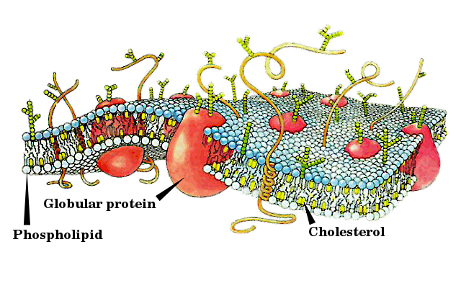
The Matter of Life

Slide 2
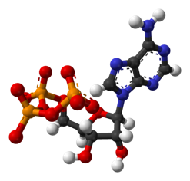
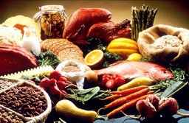
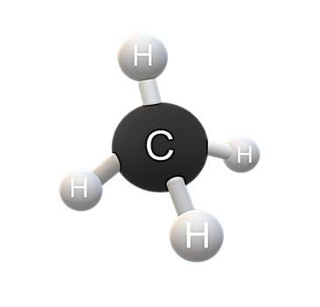
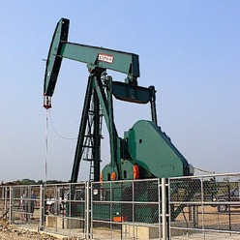
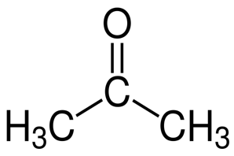
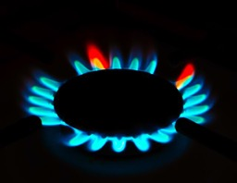
Organic Molecules
Organic molecules make up nearly all matter in living and previously living things.
The simplest organic molecule is methane. Methane is also the main ingredient in natural gas.
Like methane, all organic molecules center on carbon.
acetone

Slide 3
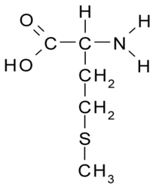
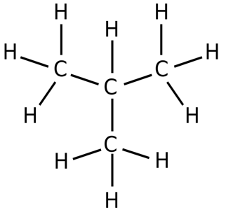
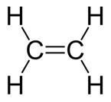
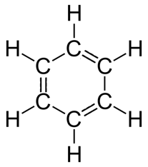

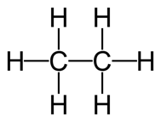
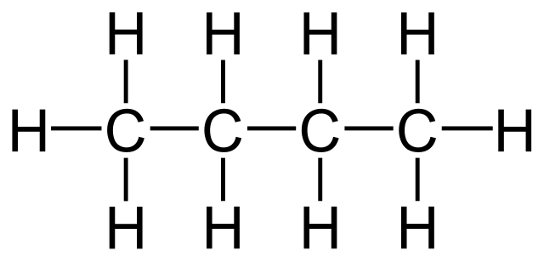
Carbon is special in its ability to form complex structures in combination with other elements like hydrogen, oxygen, nitrogen, and sulfur.
The simple examples below show just a fraction of what carbon can do in combination with just hydrogen.

Slide 4

Carbon is special in its ability to form complex structures in combination with other elements like hydrogen, oxygen, nitrogen, and sulfur.
The simple examples below show just a fraction of what carbon can do in combination with just hydrogen.
All of the hydrocarbons depicted below can be found in crude oil.

Slide 5
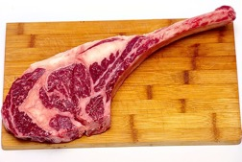
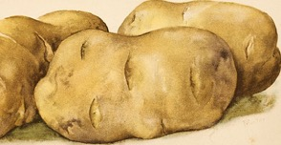
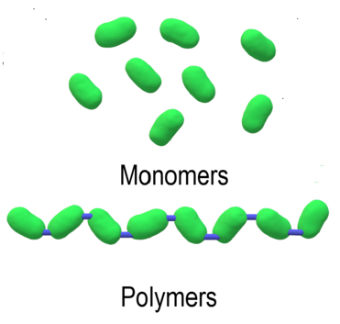
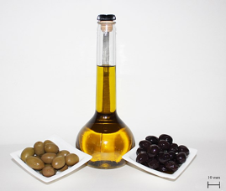
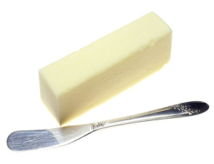

Macromolecules
Some organic molecules form polymer chains from monomer building blocks. These include:
  Carbohydrates
  Proteins
  Nucleic Acids
Lipids are not polymers, but they do contain distinct building blocks.

Slide 6
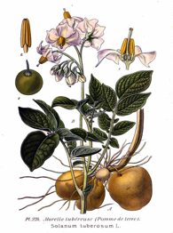

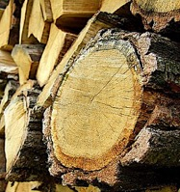
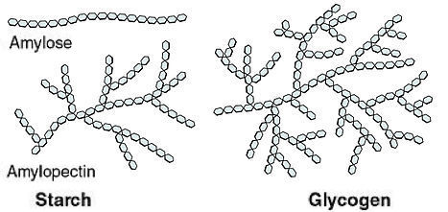
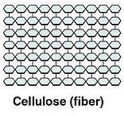
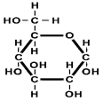
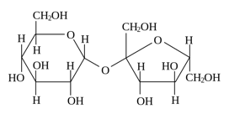
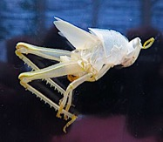
Carbohydrates range in size from simple sugars of 1-2 monomer units to polymers made up of long chains of repeating monomers.
Glucose and sucrose are simple sugars that taste sweet.
Starch and glycogen are polymers made from glucose monomers. They are used to store energy in plants and animals respectively.
Cellulose is also a polymer made of glucose monomers. It is used by plants for structural support. Unlike starch and glycogen, cellulose it is undigestible to most animals.
Chitin is a polymer that provides support in the exoskeletons of insects & crustaceans.
Glucose
Sucrose

Slide 7
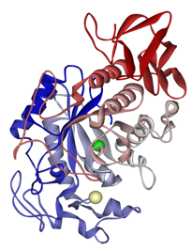
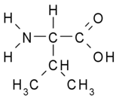

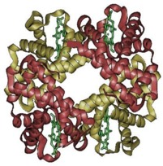
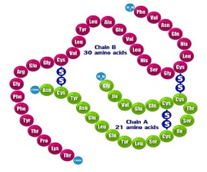
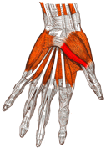

Proteins are enormously diverse polymers that fold into complex 3-dimensional shapes.
The building blocks of proteins are amino acids, and since there are 20 naturally occurring amino acids the possible combinations are infinite.
Proteins play many roles. Here are just a few:
  movement
  gas exchange
  hormones
  enzymes*
Amylase: the enzyme that breaks down starch
Glycine
Valine
Hemoglobin
Myosin + Actin
Insulin
Amino Acid Chain
*Without enzymes, nearly all the chemical reactions of life would grind to a halt!

Slide 8
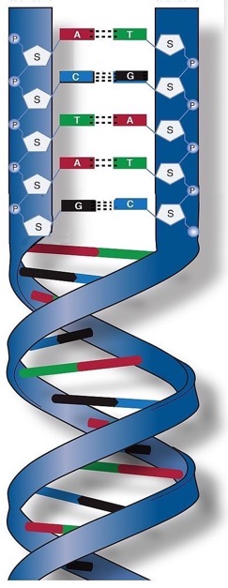
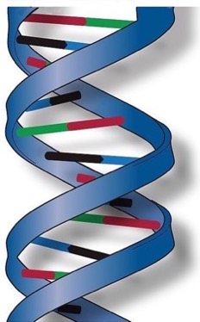
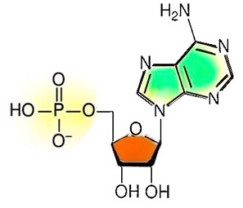
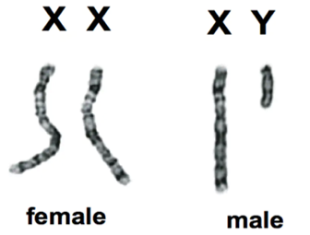
Nucleic Acids are extremely long polymers made from 4 different nucleotide monomers. The polymer forms a “double helix” due to complimentary pairing of the bases in the nucleotides.
The ordering of the bases in DNA (A,C,G, & T) determines your genetic make-up.
DNA is found in the chromosomes. Chromosomes are found in the nuclei of living cells.
Base
Phosphate
Sugar
Nucleotide Monomer
DNA Base Paring

Slide 9
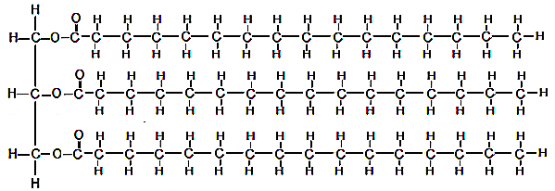
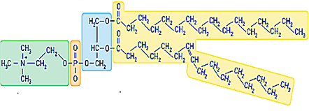
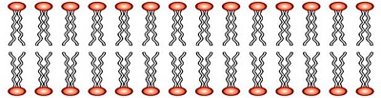
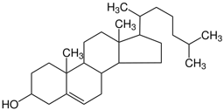

Lipids are made up largely of hydrocarbons. This limits their solubility in water. There are three categories of lipids:
Fats and oils have 3 fatty acids. Their role is energy storage, cushioning, and insulation.
Phospholipids have just 2 fatty acids. The portion of the molecule containing phosphate is water-soluble. Phospholipid bilayers make up a major component of cell membranes.
Steroids consist mainly of 4 interlocking hydrocarbon rings. Cholesterol stabilizes cell membranes and many sex hormones are steroids.
Fat molecule
Phosphate
Fatty Acid “Tail”
Phospholipid bilayer with tails facing each other to avoid the water inside and outside the cell.
Cholesterol
Testosterone

Slide 10
This is all you need to know about macromolecules. You will not be tested on molecule images.
Macromolecule | Subcategory | Building Blocks | Examples | Functions
Carbohydrates | Simple Sugars | N/A | Glucose, Sucrose | Energy
 | Polysaccharides | Monosaccharides (usually glucose) | Starch | Energy
 |  |  | Cellulose | Structure (plants)
 |  |  | Chitin | Structure (animals)
Proteins | N/A | Amino Acids | Enzymes, many others… | Catalysts, many other functions…
Nucleic Acids | N/A | Nucleotides | DNA | Genes
Lipids | Fats and Dietary Oils | Mostly Hydrocarbons | Butter, Olive Oil, many others… | Energy, Cushioning, Insulation
 | Phospholipids | Mostly Hydrocarbons | N/A | Cell Membranes
 | Steroids | Mostly Hydrocarbons | Cholesterol, Sex Hormones | Cell Membranes, Gender Traits

Slide 11
Review Questions
What element do all organic molecules have in common?
Organic molecules are usually much (larger/smaller) and (more/less) complex than inorganic molecules.
What are the four basic categories of macromolecules?
Notes:
Answer: a

Slide 12
Review Questions
What element do all organic molecules have in common? carbon
Organic molecules are usually much (larger/smaller) and (more/less) complex than inorganic molecules.
What are the four basic categories of macromolecules?
carbohydrates, lipids, proteins,
nucleic acids
Notes:
Answer: a

Slide 13
Review Questions
What are the main functions of carbohydrates?
What are the main functions of lipids?
What are the main functions of proteins?
What are the main functions of nucleic acids?
Notes:
Answer: a

Slide 14
Review Questions
What are the main functions of carbohydrates? energy, structure
What are the main functions of lipids? energy, cushioning, hormones, cell membranes
What are the main functions of proteins? enzymes, almost everything!
What are the main functions of nucleic acids? genes
Notes:
Answer: a

Slide 15
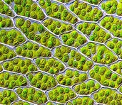
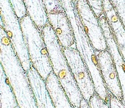
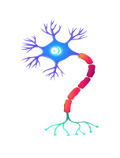
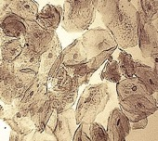
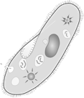
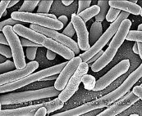
The Organization of Life
Cells are the smallest unit of life. All living organisms are made up of cells and nearly all organisms visible to the naked eye are composed of millions of specialized cells that are organized into distinct tissues like the leaves, roots, skin, and nerves.
All cells have a cell membrane consisting mostly of phospholipids. The interior of each cell contains structures that allow it to carry out basic processes of life like the processing of nutrients, removal of wastes, and replication. Most of the DNA is inside the chromosomes.
Some living organisms like paramecia and bacteria consist of only one cell.
Moss Leaf Cells
Onion Root Cells
Cheek Cells
Nerve Cell
Phospholipid bilayer with tails facing each other to avoid the water inside and outside the cell.
Paramecium
Coliform Bacteria

Slide 16
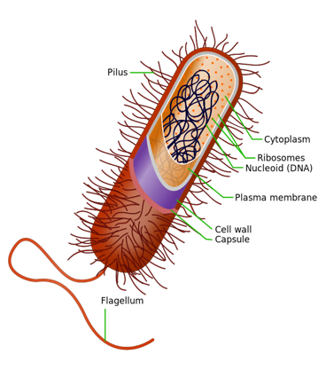
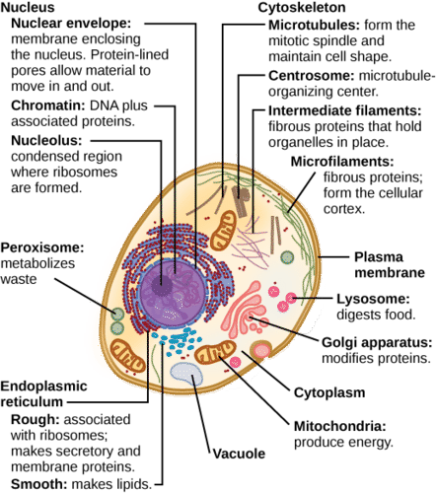
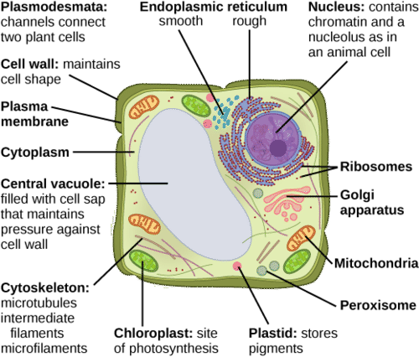
Prokaryotic cells consist of very simple cells that lack a nucleus. Most prokaryotes are bacteria.
Eukaryote cells are larger, more complex, and have a nucleus. Plants, animals, fungi, and many single-celled organisms are eukaryotes. Plant cells have cell wall that is made of cellulose.
Images are from “Environmental Issues” by Andrew Frank https://pressbooks.bccampus.ca/environmentalissues/front-matter/introduction/

Slide 17
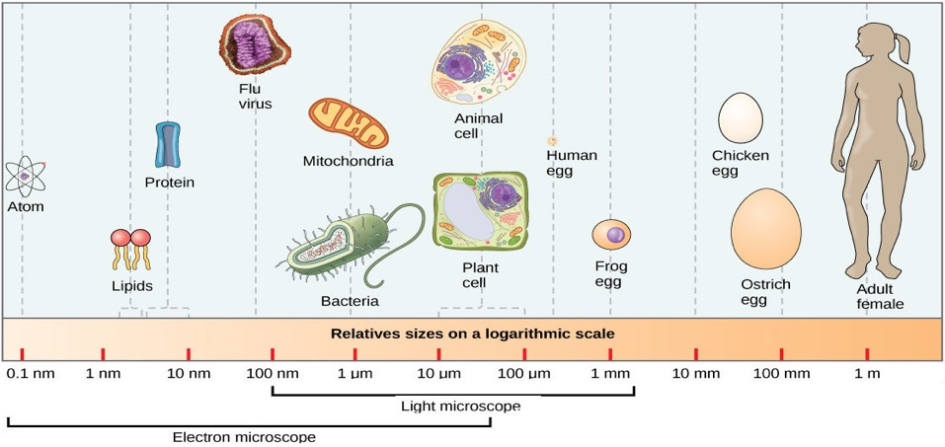
Most cells can only be seen with the help of a microscope.
Most viruses are so small that they can only be seen with an electron microscope. They can reproduce, but since they are not cells they are not regarded as “alive.” This is why viruses are defined as “infectious particles.”
Images are from “Environmental Issues” by Andrew Frank https://pressbooks.bccampus.ca/environmentalissues/front-matter/introduction/

Slide 18

Acknowledgement:
Unless otherwise indicated, all images in this presentation were downloaded from Wikimedia Commons: https://commons.wikimedia.org/wiki/Main_Page

