Slide 1
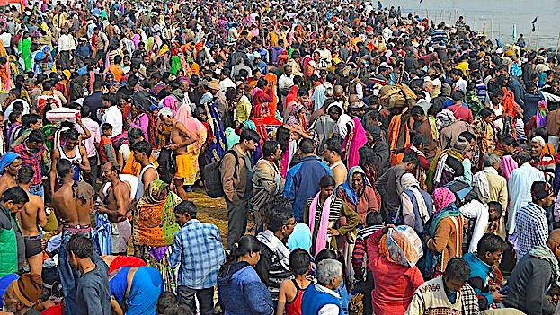
Human Population
& Ecological Footprint

Slide 2
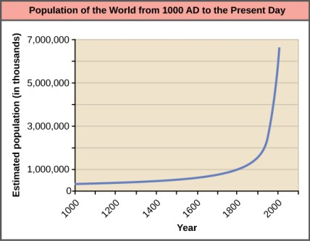

Industrial Revolution technological advances - exponential rise in the human population
What is the Earth’s carrying capacity for sustaining our quality of life?
From “Environmental Issues” by Andrew Frank https://pressbooks.bccampus.ca/environmentalissues/front-matter/introduction/

Slide 3

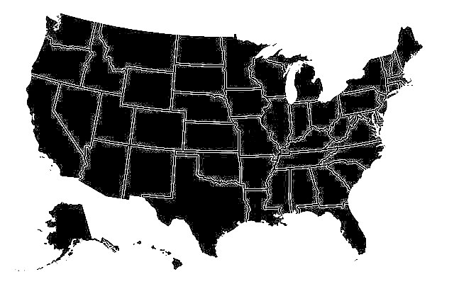
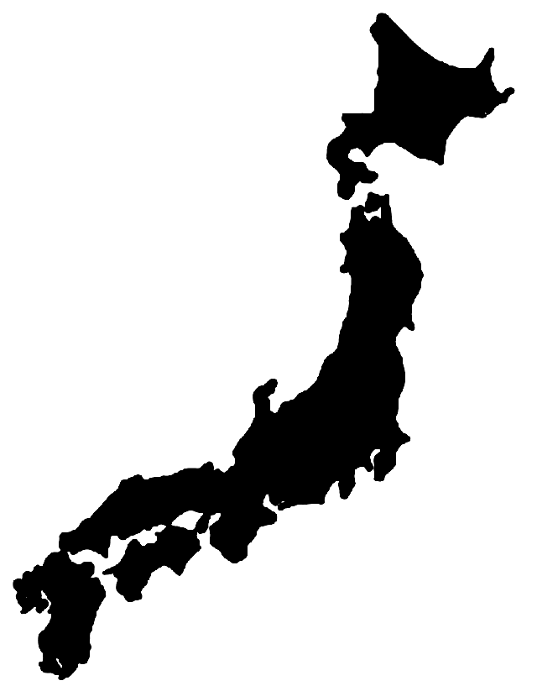

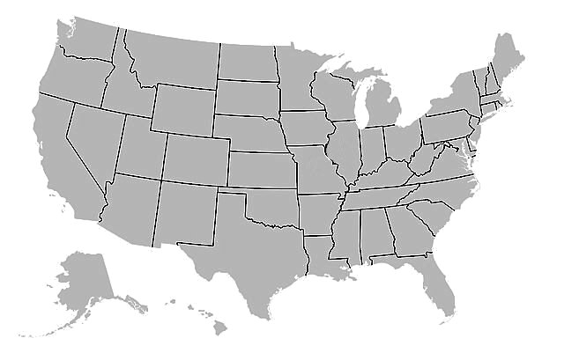
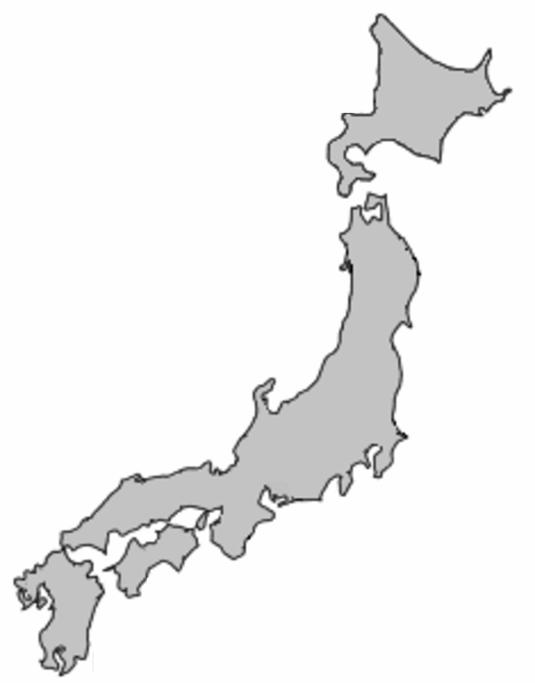

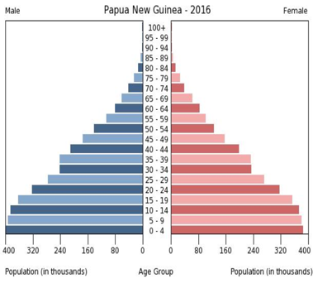
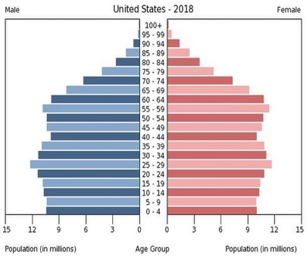
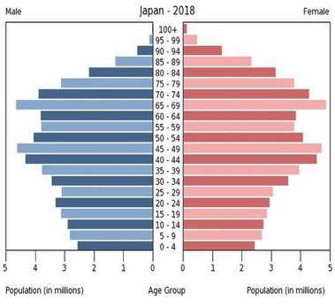
Today, growth rates differ by nation:
Papua New Guinea - population growing rapidly; children make up the largest portion of demographic pyramid
United States - population growing slowly; number of children is roughly equivalent to that of reproductive-aged adults
Japan - population declining; number of reproductive-aged adults far exceeds children

Slide 4
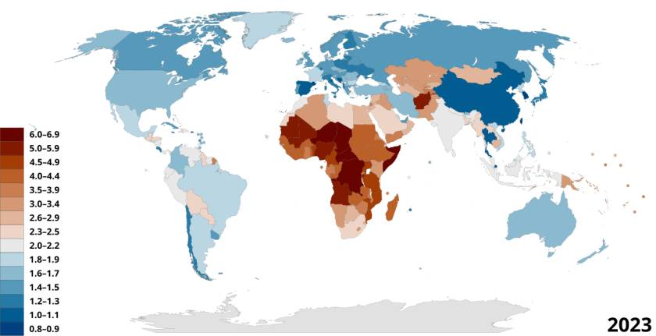
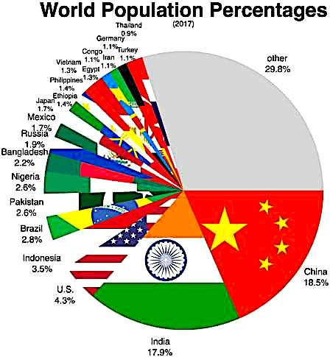
Population growth is fastest in Africa and portions of Central Asia,
but about a third of the world’s population lives in China and India.
Map provided by the Population Reference Bureau: https://2022-wpds.prb.org/

Slide 5
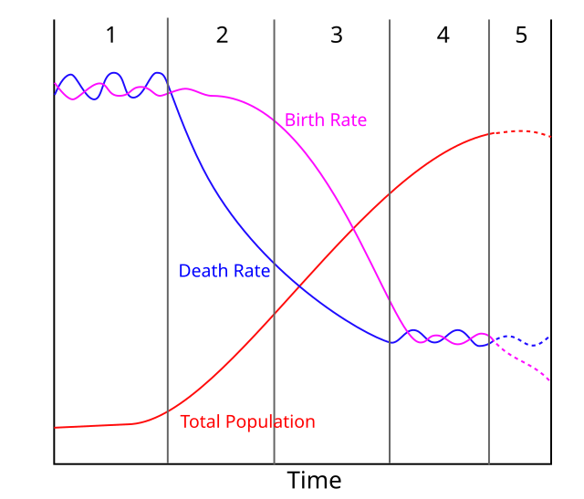
Demographic transition model shows how human population growth goes through five stages:
Stage 1: Both birth and death rates are high, and there is no net growth. This was the main pattern during pre-industrial times.
Stage 2: The population is growing at its fastest rate due to rapidly declining death rates.
Stage 3: Both birth and death rates are declining, but the population continues to grow because birth rates continue to exceed death rates.
State 4: Population growth slows down as birth rates decline to the same level as death rates.
Stage 5: Population levels start to decline as birth rates decline below death rates.
1
2
3
4
5

Slide 6




These demographic pyramids correspond to portions 2-5 of the demographic transition model.

Slide 7
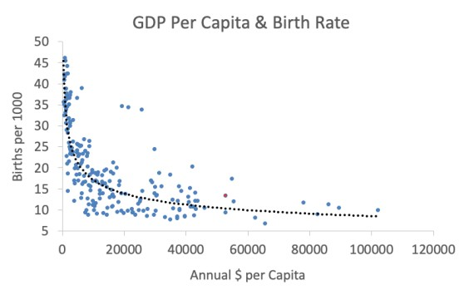




The pyramids are also indicators of societal changes that accompany development.
This is why lower GDP nations that rely more on agriculture have faster growing populations.
•US
Source: CIA Factbook (data from 2012-2015). Each point represents a nation.

Slide 8

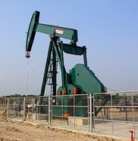

These nations (in blue) are outliers because nearly all their wealth is from recently discovered oil deposits.
Their birth rates are still high because despite high GDP, they did not experience the cultural transitions that normally occur during industrialization.
Gabon
•
•
•
Equatorial Guinea
East Timor
•
Oman
US
•
Source: CIA Factbook (data from 2012-2015). Each point represents a nation.

Slide 9
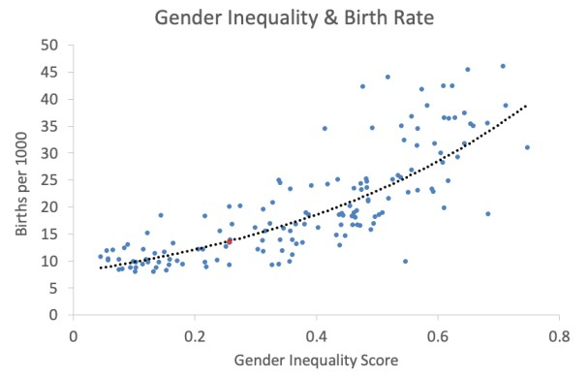
Sources: CIA Factbook (data from 2012-2015) and UN Human Development Programme Reports (2012). Each point represents a nation.
One of these cultural changes is female empowerment.
This is why gender inequality is correlated with high birth rates.
•
US

Slide 10
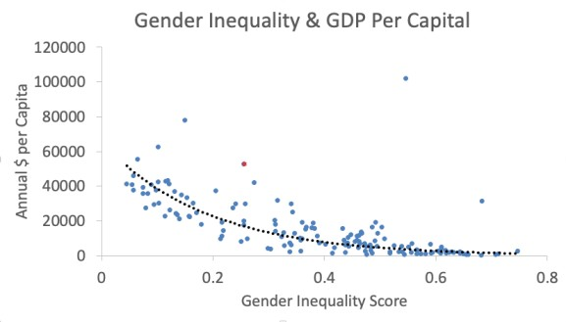


Unsurprisingly, most nations with less gender equality also have a lower per capita GDP.
These nations (in blue) are outliers because nearly all their wealth comes from oil exports.
Qatar
•
US
•
Saudi Arabia
•
Sources: CIA Factbook (data from 2012-2015) and UN Human Development Programme Reports (2012). Each point represents a nation.

Slide 11

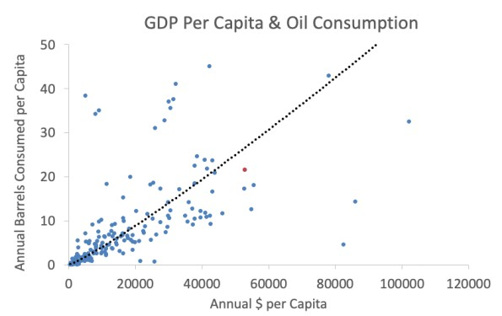
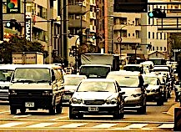


Source: CIA Factbook (data from 2012-2015). Each point represents a nation. To minimize statistical artifact, this graph excluded five nations that serve as fueling depots for passing ships.
Population growth is not the only driver of growing environmental pressures.
Affluent nations usually consume more fossil fuels per capita…
US
•

Slide 12
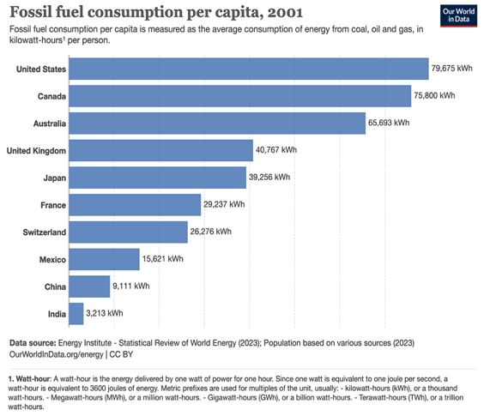
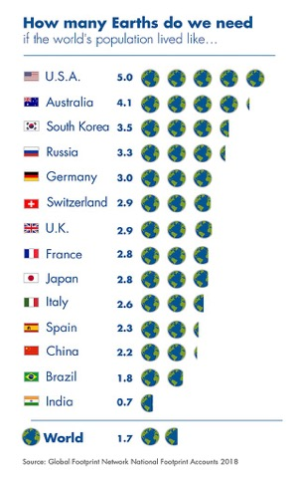
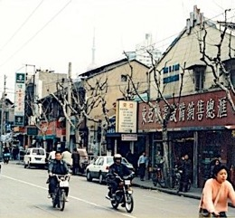

…and Americans use significantly more resources than Western Europeans with comparable standards of living.
Further strains on the environment are anticipated as heavily populated nations like China and India grow their economies.

Slide 13
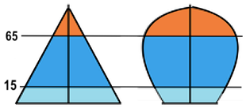

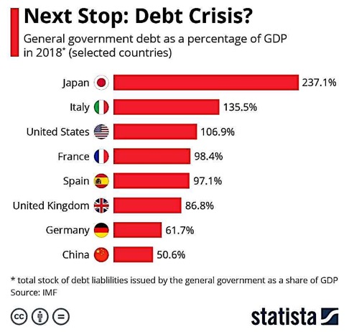

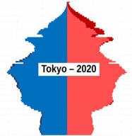
Declining population may ease pressures on the environment, but it can incur economic hardships:
Nations with falling birth rates struggle to finance the increasing number of retirees that outlive their contributions to social security programs
Longer life spans and declining fertility are now the main drivers of the debt crisis in Japan and Italy

Slide 14
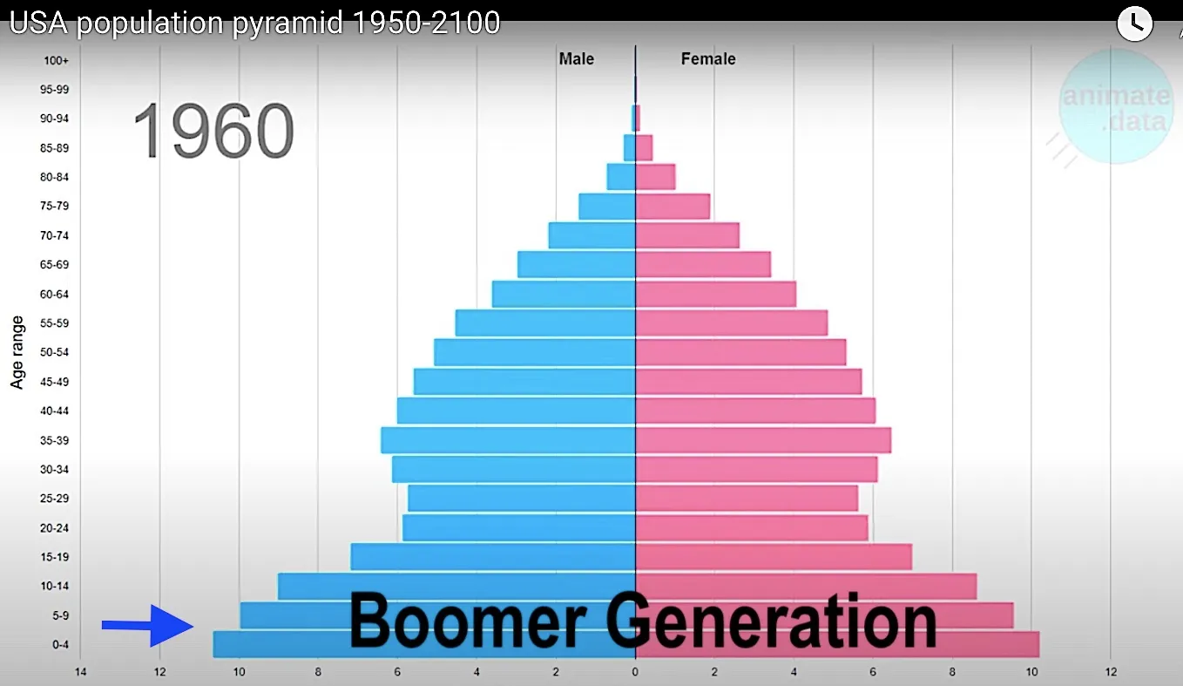
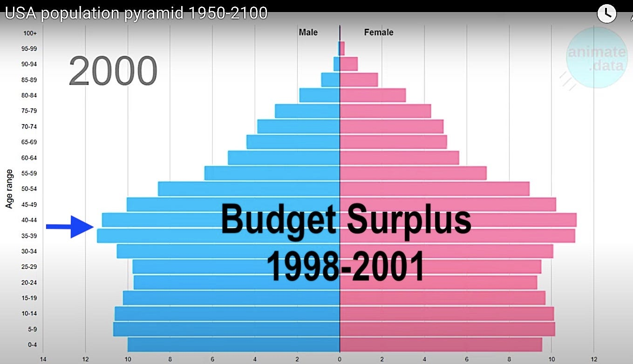
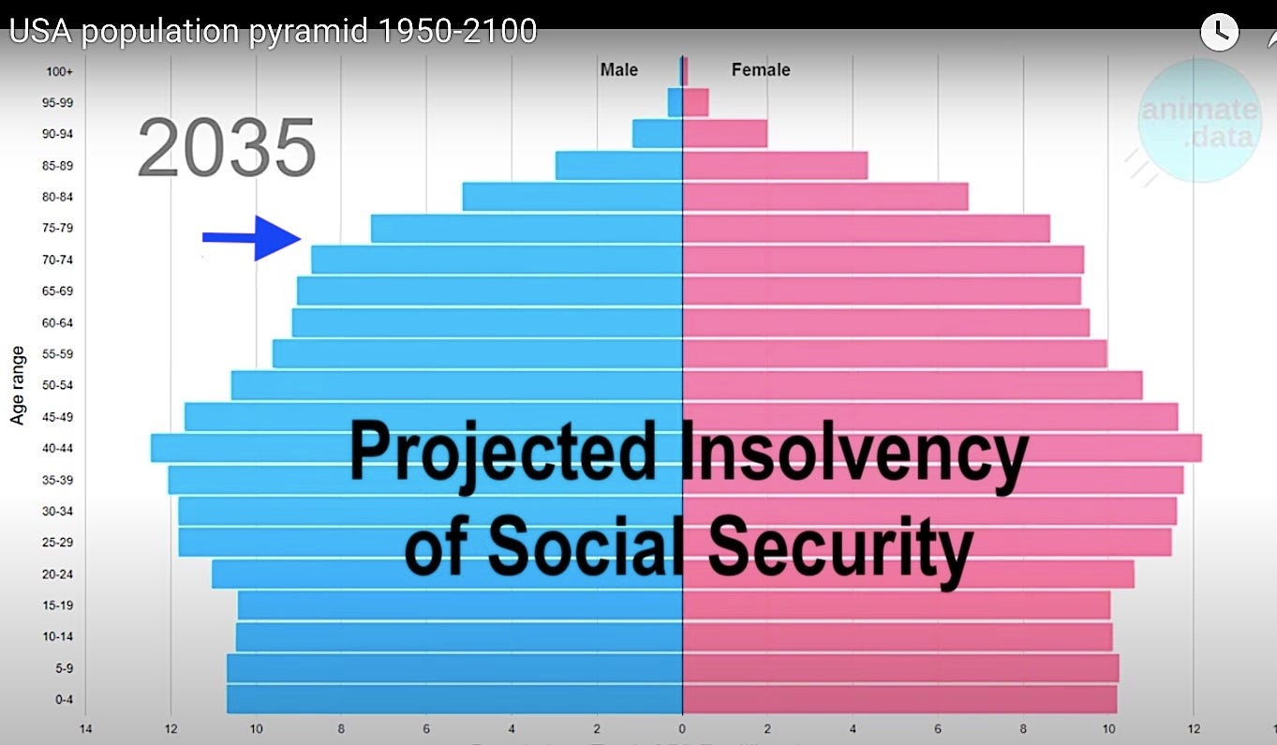
The term “boomer” refers to Americans born during the “baby boom” that happened after the end of World War II (1946 to 1964).
The budget surplus of 1998-2001 was largely driven by a critical mass of working Americans contributing record amounts of tax revenue. This is when these boomers were in their prime.
Ironically the same boomers that helped balance the budget may end up bankrupting social security after large numbers of them retire.
Video stills from AnimateData: https://www.youtube.com/@AnimateData

Slide 15




Tentative Solutions for Addressing Ongoing Challenges of Human Population:
Empower women in less affluent nations.
Minimize environmental impact in affluent nations through green technologies and best practices.
Implement a retirement age that takes longer life expectancies into account.
Facilitate the preservation of extended families to minimize societal costs of aging populations.

Slide 16

Acknowledgement:
Unless otherwise indicated, all images in this presentation were downloaded from Wikimedia Commons: https://commons.wikimedia.org/wiki/Main_Page

