Slide 1

Why Study Environmental Science?

Slide 2
How Environmental Science Incorporates Many Disciplines
The delicate balancing act between environmental protection and the economic growth requires an interdisciplinary approach to discern where best to “draw the line”.

Slide 3
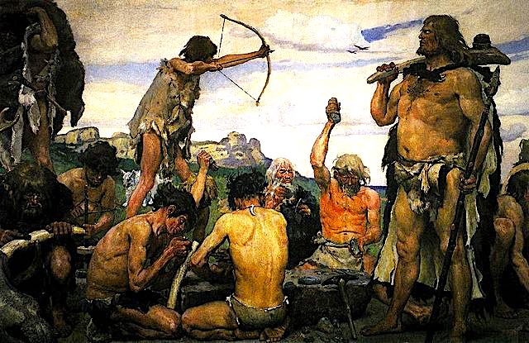
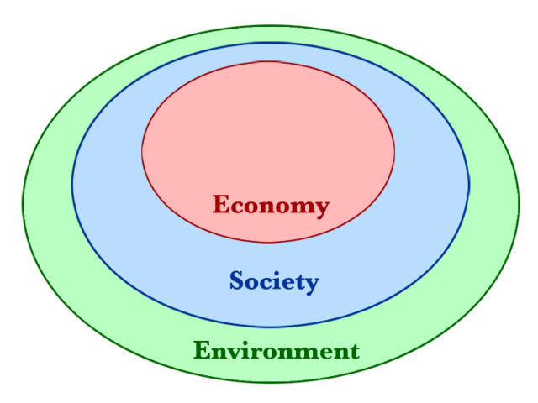
Without an economy or social order, life is “poor, nasty, brutish, and short,”*
but neither of these can exist in the absence of natural resources.
* Quote from ”The Leviathan” by Thomas Hobbes

Slide 4
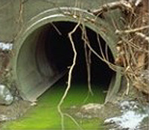

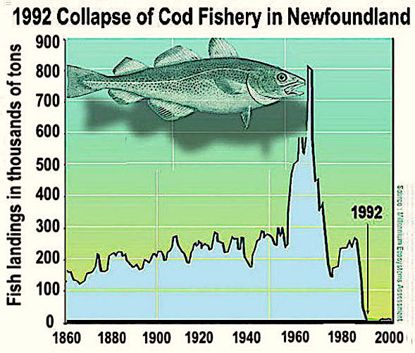


Environmental scientists and policy-makers deal with issues like pollution and resource depletion…
…with the ultimate goal of striking a balance between our economic needs and the environment.

Slide 5

This is why environmental science is the most interdisciplinary of the natural sciences.
STEM
Biology
Chemistry
Physics
Geology
Engineering
Statistics
Social Sciences
Economics
History
Politics
Law
Humanities
Philosophy
Literature
Ethics

Slide 6
Environmental Science is More Contentious than Most Other Sciences Because it Drives Policies that Affect Many People’s Lives
The environmental science must stay grounded in science in order to separate the science from the politics.

Slide 7

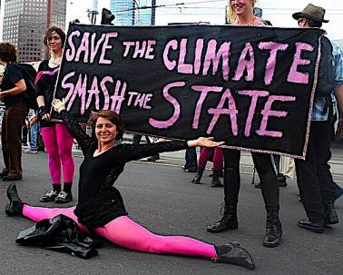
Environmental science is not only interdisciplinary, it also confronts issues that are deeply controversial.
Passion is a powerful force, but without rational discussion it cannot provide helpful solutions.

Slide 8
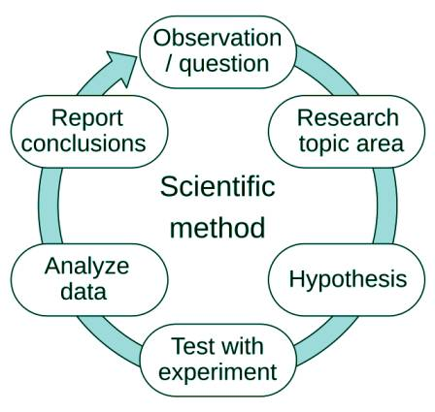
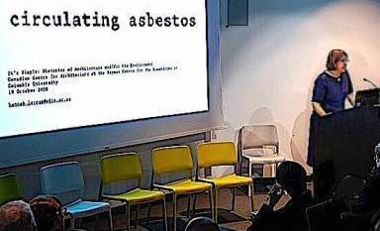

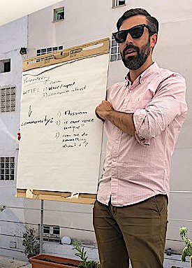
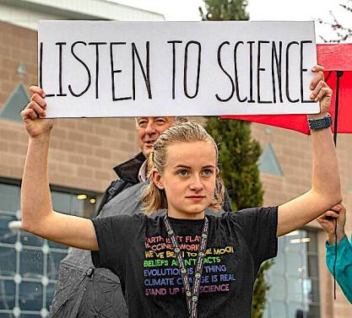
The conscientious scientist presents data that is carefully vetted...
…and listens to other perspectives…
…in hopes that cooler heads prevail,
…because at the end of the day, science is not a religion:
It is an ongoing process.

Slide 9
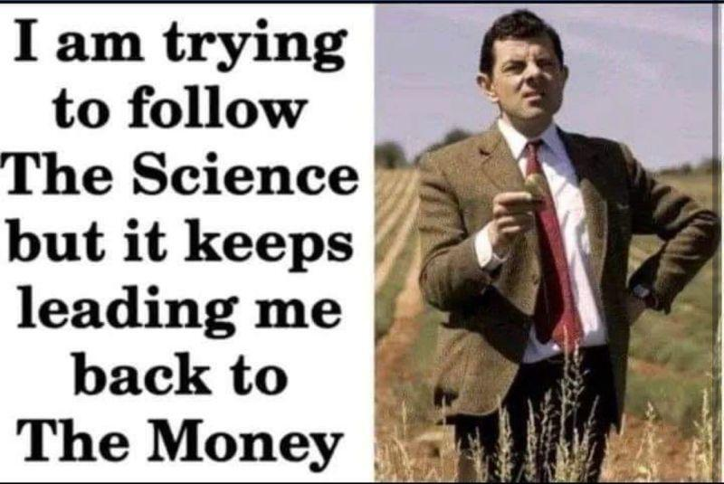

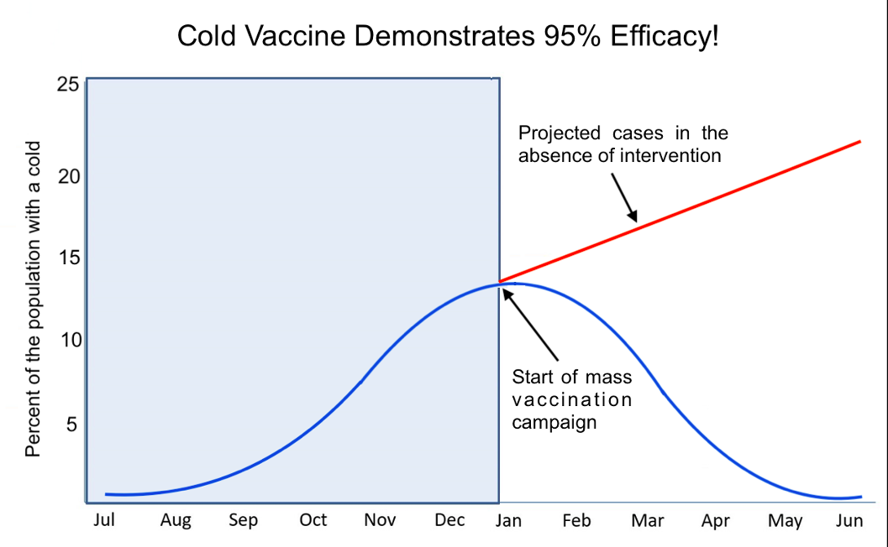

Scientific progress is vital to our quality of life, but it is often messy…
…and not all results are presented in good faith!
A major goal of this course is to give you skills to objectively discern the issues without wasting time on junk science or bottomless rabbit holes.
FYI: This chart is satire!
Inspired by a chart by Norman Fenton https://www.youtube.com/watch?v=8Avq_tMz2LU&t=74s
Image generated by Bing AI.

Slide 10
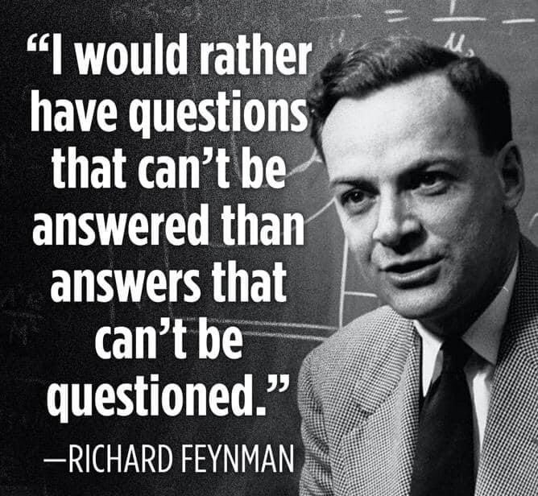

Slide 11








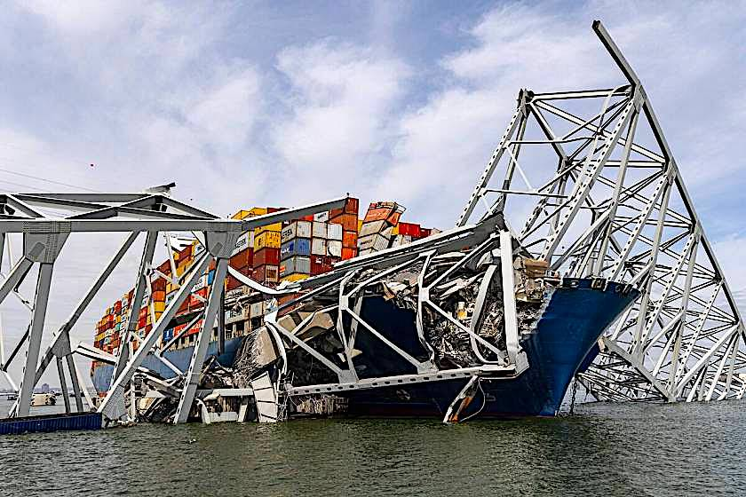
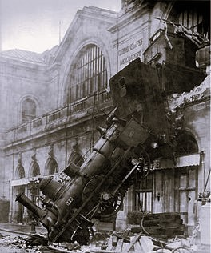
Guidelines for Dealing with Controversy:
Occam's razor: a scientific and philosophical rule that entities should not be multiplied unnecessarily which is interpreted as requiring that the simplest of competing theories be preferred to the more complex or that explanations of unknown phenomena be sought first in terms of known quantities.
Merriam-Webster: https://www.merriam-webster.com/dictionary/Occam's%20razor
Hitchen’s razor: What can be asserted without evidence can be dismissed without evidence.
Life Lessons: https://lifelessons.co/critical-thinking/philosophical-razors/
Hanlon’s razor: Never attribute to malice that which can be adequately explained by incompetence or stupidity.
Life Lessons: https://lifelessons.co/critical-thinking/philosophical-razors/
Key Bridge Collapse in Baltimore (3/26/24)

Slide 12
How to Succeed in the Class

Slide 13

Survival Guide for this Course

Slide 14
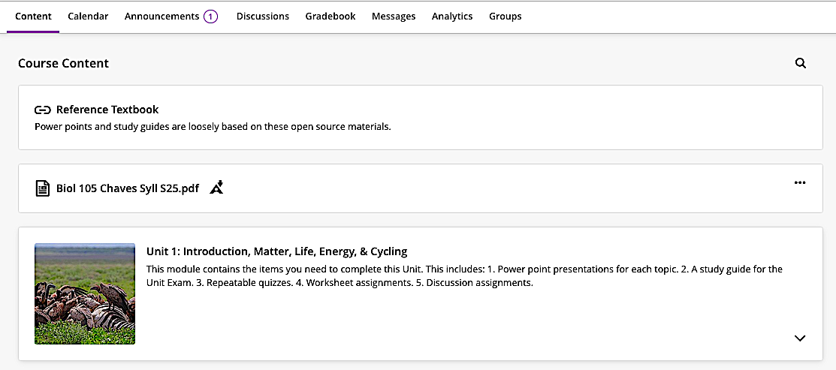
Check for unread announcements on a daily basis.

Slide 15
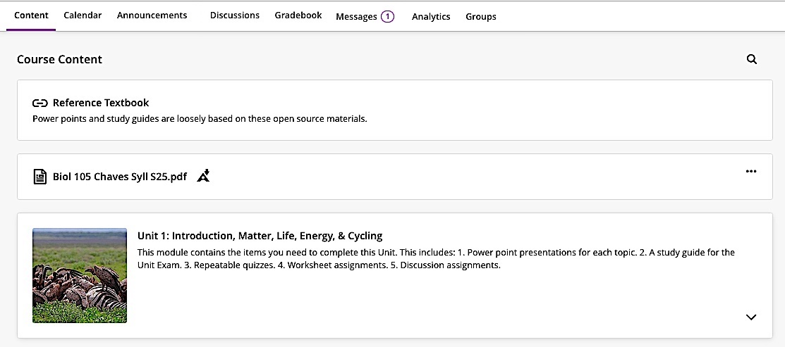
Check for unread course mail on a daily basis.

Slide 16
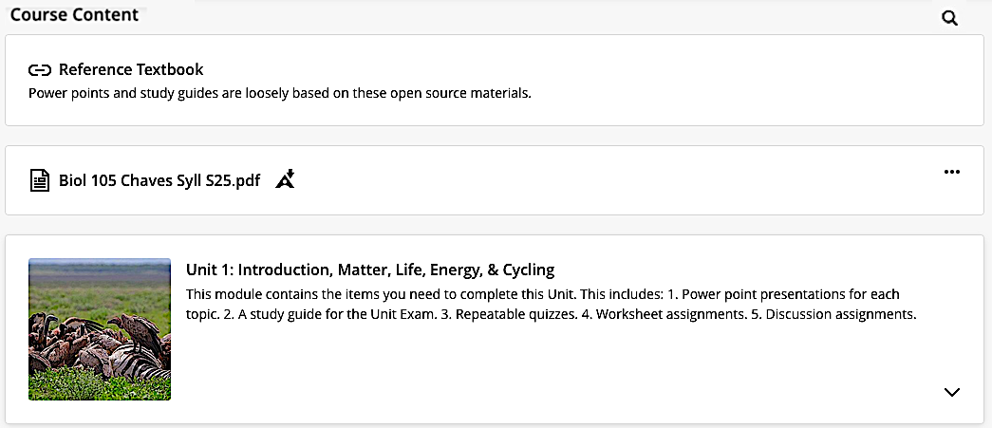
Open this link for access to power points, quizzes and assignments.

Slide 17
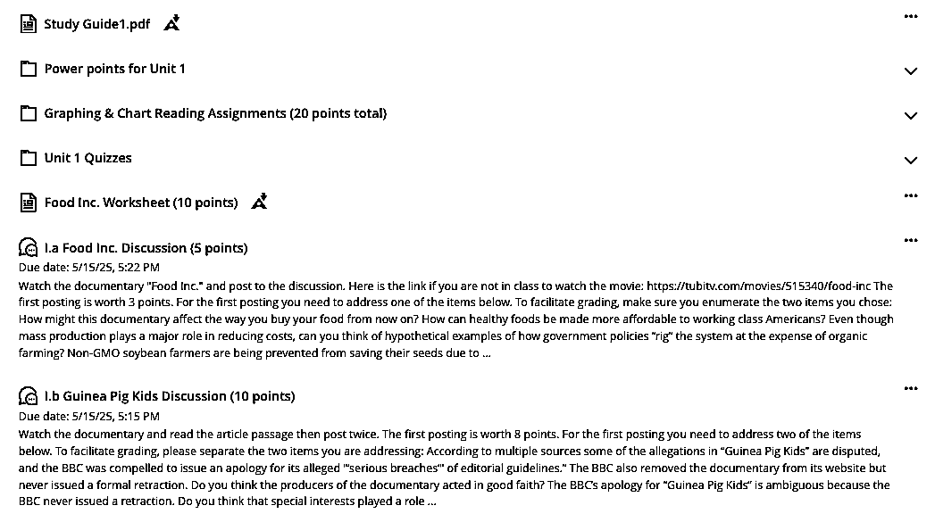
The contents of your unit folder should look something like this.
Do not forget to complete the quizzes and assignments pertaining to the unit!

Slide 18

Acknowledgement:
Unless otherwise indicated, all images in this presentation were downloaded from Wikimedia Commons: https://commons.wikimedia.org/wiki/Main_Page

