Slide 1
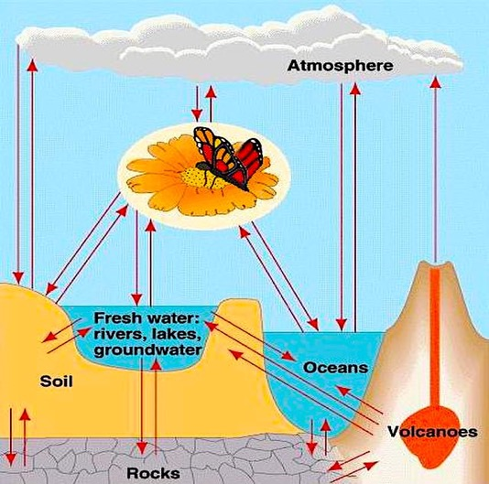
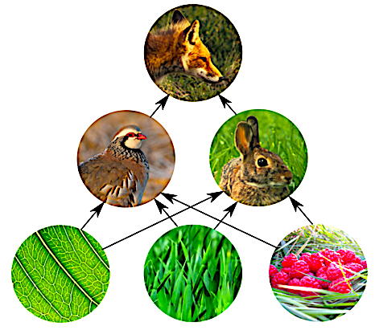
Energy Flow & Biogeochemical Cycling

Slide 2
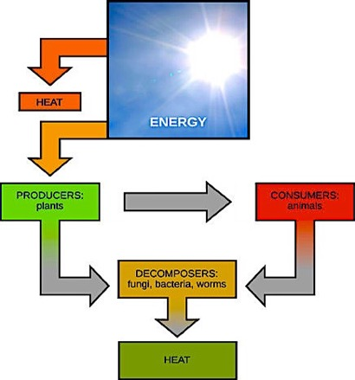
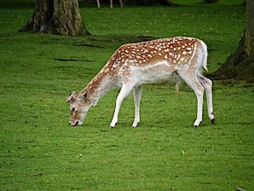
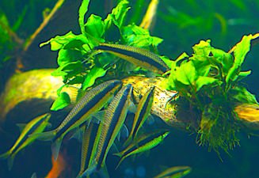
Energy Flow
The matter of life constantly cycles, but the energy from the sun flows in only one direction.
Producers directly use sunlight energy to generate the chemical energy that drives the cycling of matter in the ecosystem.
From “Environmental Issues” by Andrew Frank https://pressbooks.bccampus.ca/environmentalissues/front-matter/introduction/

Slide 3

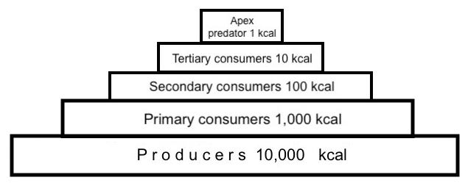








The Trophic Pyramid
As a rule of thumb, only 10% of the calories consumed make it to the next level, due in part to energy that is used for basic needs of survival like movement and reproduction.
Even more of of these calories end up as dissipated heat due to the 2nd Law of Thermodynamics.
This is why apex predators require so much territory!

Slide 4
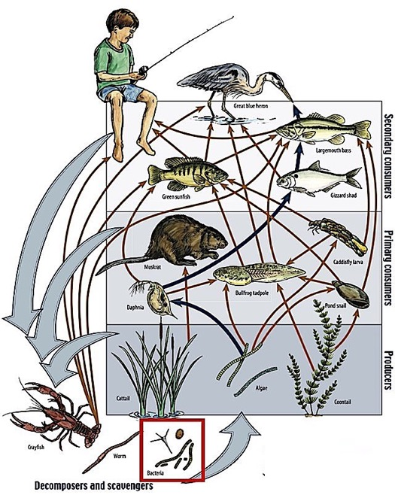

The trophic pyramid is useful for determining how much producers need to produce in order to maintain a diverse ecosystem that can accommodate apex predators.
But the reality is more complicated because many participants (like the bullfrog tadpole) consume at multiple levels of the pyramid. Consequently, the ”food web” provides a more comprehensive image of energy flow in the ecosystem.
All nutrients are eventually broken down and “recycled” with the help of decomposers and scavengers.

Slide 5
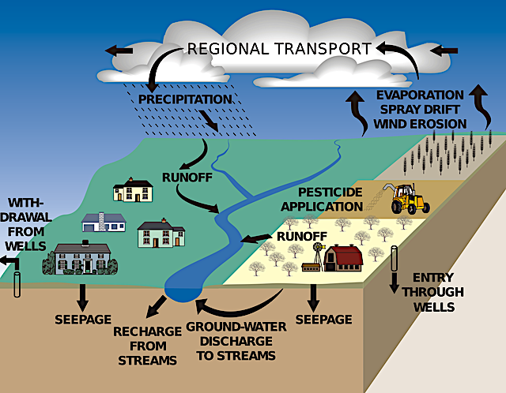
The Biogeochemical Cycling of Water

Slide 6

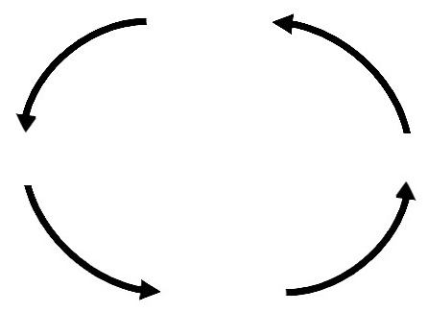









Water Cycling Simplified
Transpiration may account for as much as 75% of evapotranspiration that occurs over dry land.*
Water Vapor
Evaporation, Sublimation,
& Transpiration
Precipitation
Surface Water
Surface waters include wetlands, lakes, streams, and rivers. Runoff that enters streams and rivers flows to the sea.
Water & Ice
Runoff
Infiltration
Ground Water
Forests play a key role in the recharging of ground water because forest soils are better at absorbing the rain.
*Information from CID Bio-Science: https://cid-inc.com/blog/transpiration-in-plants-its-importance-and-applications/

Slide 7
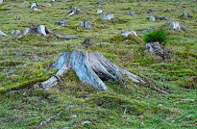
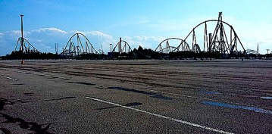
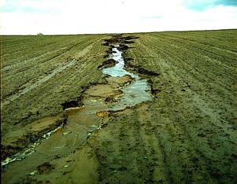
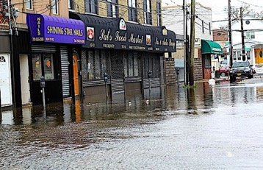
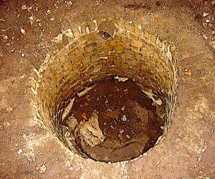
Changes to the Earth’s surface such as deforestation and the laying down of pavement increases runoff at the expense of infiltration.
In the short run, this causes erosion and flooding.
In the long run, the decline in ground water recharge from forest soils combined with transpiration losses from a lack of trees results in drier climate and lower water table.

Slide 8
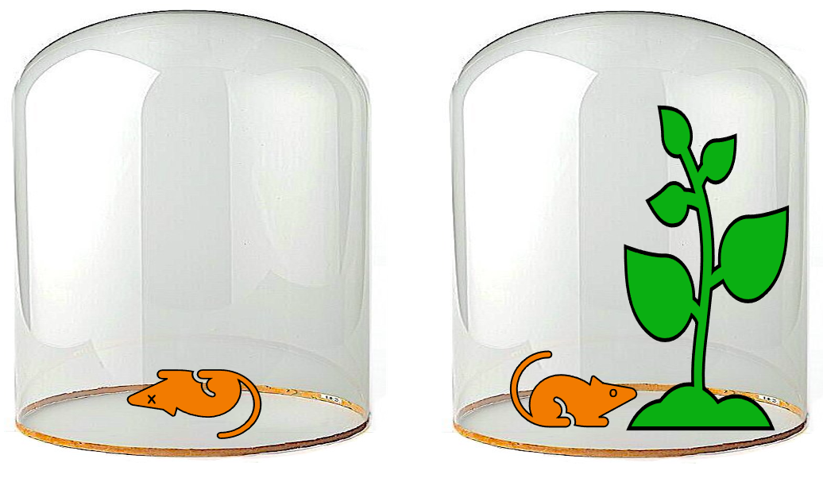
The Biogeochemical Cycling of Carbon
The Joseph Priestley experiment demonstrating the relationship between respiration and photosynthesis in the 1770’s.

Slide 9
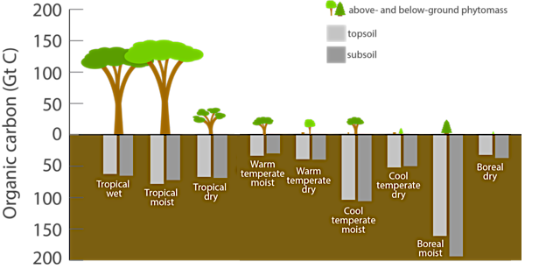
Most of the world’s total carbon is stored in rocks and marine sediments, but most organic carbon comes from the biomass of producers.
Organic Carbon Storage by Different Terrestrial Ecosystems https://www.fs.usda.gov/research/treesearch/54316

Slide 10







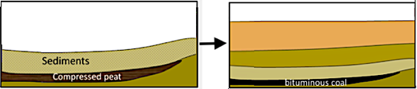
Biological Cycling of Carbon
Respiration & Combustion
CO₂
Organic Molecules
Photosynthesis
Over millions of years and under the right conditions, a small portion of this biomass is transformed into fossil fuels.

Slide 11
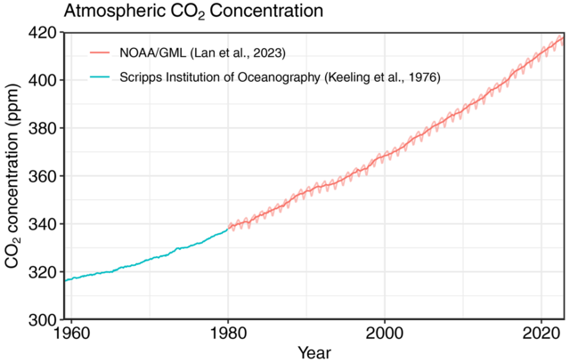

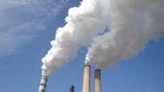
Is human activity now affecting the global climate?
There are concerns that burning of fossil fuels and deforestation are contributing to rising levels of carbon dioxide, and that this greenhouse gas is playing a significant role in overall warming of the climate. This is addressed in greater depth in a later chapter.

Slide 12
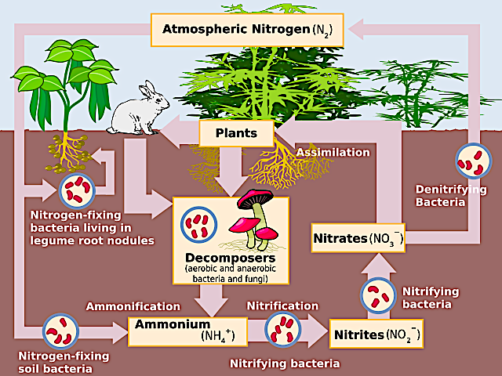
The Biogeochemical Cycling of Nitrogen

Slide 13
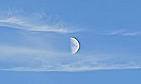

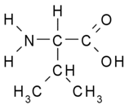
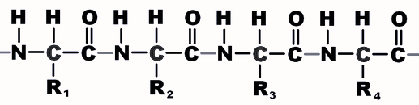
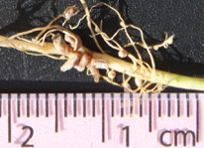
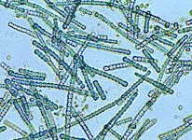


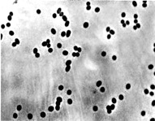
Nitrogen enters the ecosystem from above.
The main source of nitrogen is the atmosphere.
Nitrogen is a key element in organic molecules like amino acids and proteins.
Nitrogen enters the ecosystem via nitrogen-fixing bacteria and blue-green algae that use it to make ammonia (NH₃).
Producers assimilate the nitrogen from this compound into their macromolecules after the NH₃ is chemically transformed into nitrate (NO₃⁻) by nitrifying bacteria.
Glycine
Valine
Amino Acid Chain

Slide 14
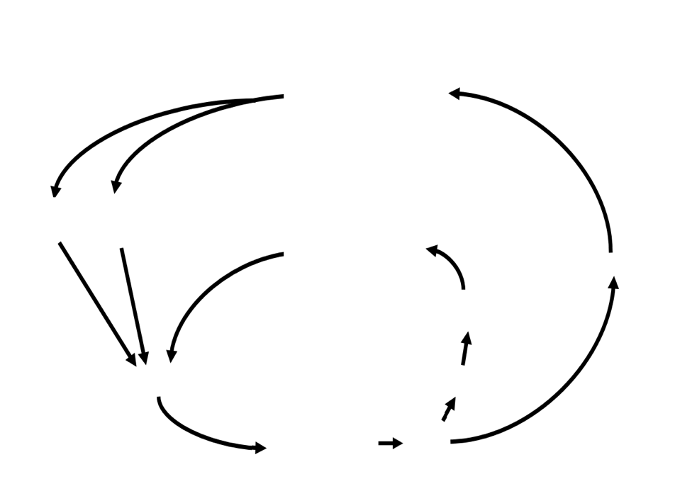


Nitrogen Cycling Simplified
Atmospheric N₂
Nitrogen is used to generate ammonia through both natural and industrial processes.
Ammonia is toxic to most organisms, so it must be converted into nitrate before it can be assimilated by the producers.
Biological N₂ fixation
Industrial N₂ fixation
Decomposition
Denitrification
The protein building blocks in all consumers originally came from producers.
Ammonia is a by-product of protein decomposition.
Denitrification breaks down nitrate and returns the nitrogen to the air. This is done by anaerobic bacteria.
Proteins
Internal Cycling
NH₃
Assimilation
Nitrification
NO₃⁻

Slide 15
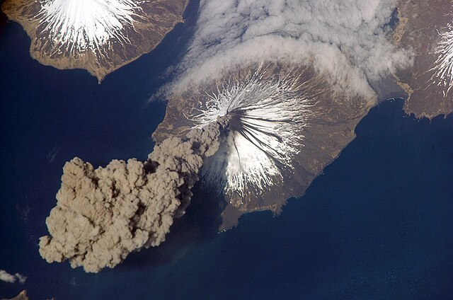
The Biogeochemical Cycling of Phosphorous

Slide 16
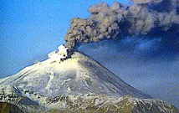
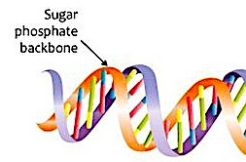
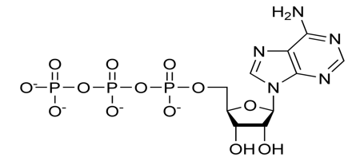


Phosphorus enters the ecosystem from below.
The main sources of phosphorous are rocks and sediments.
Phosphorus is a key element in macromolecules like nucleic acids and ATP.
Phosphorous enters the ecosystem via producers that directly assimilate phosphorous from the soil or water into their macromolecules.

Slide 17
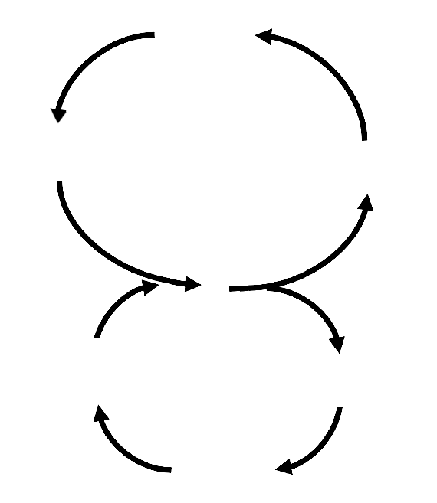
Phosphorous Cycling Simplified
DNA & ATP
Phosphorous enters the ecosystem through volcanic emissions, Earthquakes, and phosphate mining.
Decomposition
Biological Cycling
Assimilation
The phosphorous in all consumers originally came from producers.
Geological Uplifting & Mining
Geological Cycling
Runoff & Burial
Rocks & Sediments
Phosphorous can leave the ecosystem through soil erosion.

Slide 18
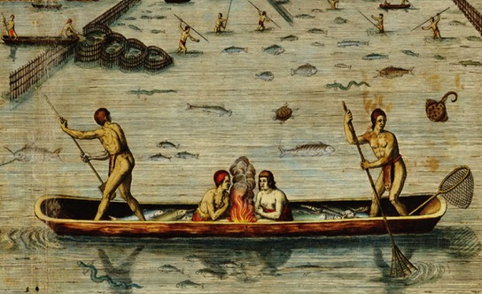
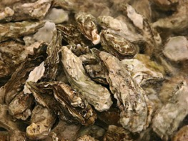
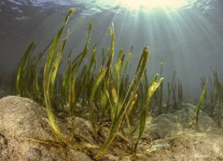
Early explorers to the New World marveled at the biodiversity and transparency of the Chesapeake. Shortly after his arrival in 1607 Englishman George Percy described oyster reefs “as thick as stones,” and in 1608 Captain John Smith described this estuary as “full of “sturgeon, grampus, porpoise, seals, stingrays … brits, mullets, white salmon [rockfish], trouts, soles, perch of three sorts.”*
We know today that oysters played a central role maintaining the water clarity that allowed seagrasses to thrive and support the diverse community described by Captain John Smith.
* Incolarum Virginiae piscandi ratio (The Method of Fishing of the Inhabitants of Virginia), c. 1590. https://encyclopediavirginia.org/wp-content/uploads/2020/11/213hpr_c527f0b8feabb40.jpg

Slide 19
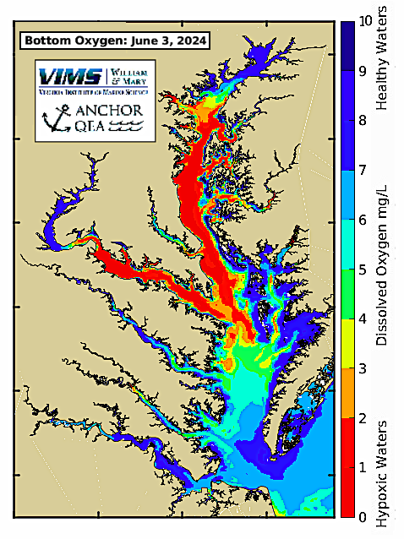

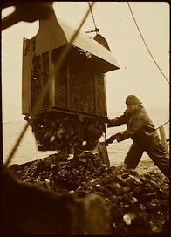
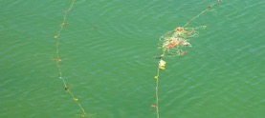
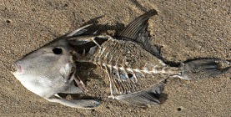
Today Chesapeake waters are murky due to overharvesting of oysters and nutrient pollution from chemical fertilizers and urban runoff.
These excess levels of phosphate and nitrates result in algae blooms that generate “dead zones” of low dissolved oxygen during the summer months. Making matters worse, oyster populations are now less than 1% of original levels. This greatly limits their role in curbing these population explosions of phytoplankton.
Map downloaded from the Virginia Institute of Marine Science: https://www.vims.edu/research/products/cbefs/cbay/
Map based on research by Beaver et al., 2021: https://www.sciencedirect.com/science/article/pii/S1364815221000797?via%3Dihub

Slide 20
Review Questions
What process makes atmospheric nitrogen available to plants?
  Nitrification
  Denitrification
  Nitrogen fixing
  Assimilation
Notes:
Answer: c

Slide 21
Review Questions
What process involves the uptake of nitrate by plants?
  Nitrification
  Denitrification
  Nitrogen fixing
  Assimilation
Notes:
Answer: c

Slide 22
Review Questions
Which organic molecule releases ammonia when it decomposes?
  Nitrate
  Protein
  ATP
  DNA
Notes:
Answer: c

Slide 23
Review Questions
What process makes inorganic phosphorus (from rocks) available for biological cycling?
  Geological uplifting
  Decomposition
  Runoff
  Assimilation
Notes:
Answer: c

Slide 24
Review Questions
Which macromolecule contains phosphorus?
  DNA
  Starch
  Protein
  Fat
Notes:
Answer: c

Slide 25
Review Questions
What cycle can take place in the absence of decomposers?
  Phosphorous Cycle
  Nitrogen Cycle
  Carbon Cycle
  None of these
Notes:
Answer: c

Slide 26
Review Questions
What cycle can take place in the absence of producers?
  Phosphorous Cycle
  Nitrogen Cycle
  Carbon Cycle
  None of these
Notes:
Answer: c

Slide 27

Acknowledgement:
Unless otherwise indicated, all images in this presentation were downloaded from Wikimedia Commons: https://commons.wikimedia.org/wiki/Main_Page

