Slide 1
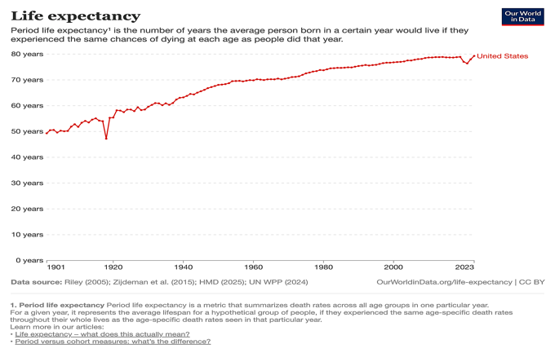
Life Expectancy Timeline for the US 1901-2023
https://ourworldindata.org/life-expectancy
From 1901 to 2023 there were two significant declines in life expectancy.
These trends reached their respective lowest points in 1918 and 2021.
Both appear to be pandemic-related.

Slide 2
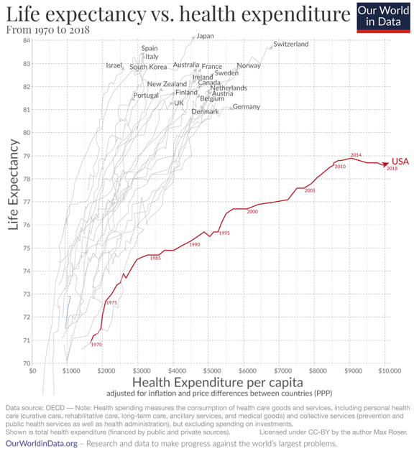
But this graph from “Our World in Data” shows US life expectancy already trending downwards in 2016.
Why did life expectancy in the US decline 3-4 years before the the reported emergence of COVID-19?
https://ourworldindata.org/us-life-expectancy-low

Slide 3
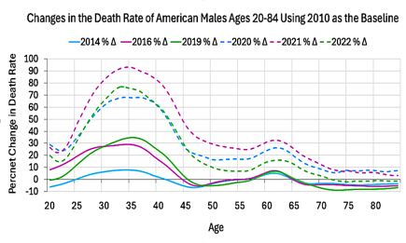
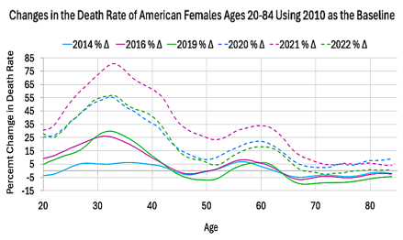
Death Rate Comparison in the US by Age and by Year
These numbers are calculated from raw data from the Actuarial Life Table of the US Social Security Administration
https://www.ssa.gov/oact/STATS/table4c6.html
The drop in US life expectancy coincides with a near doubling of the death rate for Americans 30-40 years old in 2021.
This upwards trend may have started as early as 2014.
But for Americans over 70 years, there was no increase in death rate until 2020, and even at its peak in 2021 the increase barely exceeded 20% over its lowest point in 2019.
Why did death rates rise more sharply for Americans between the ages 30 and 40 during a pandemic that mainly affected the elderly?
How many of these deaths can be attributed to COVID-19?

Slide 4
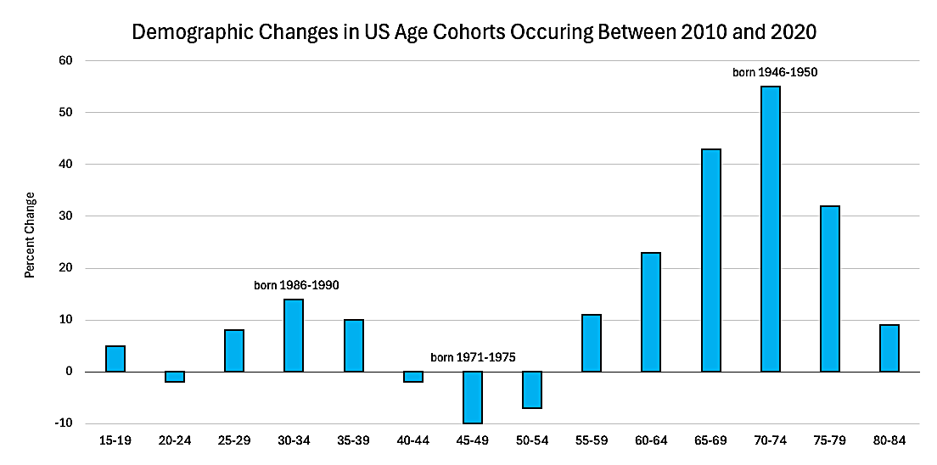
To answer this, we must take into account this demographic transition:
These numbers are calculated from raw data taken from Our Changing Population: United States. USA Facts. https://usafacts.org/data/topics/people-society/population-and-demographics/our-changing-population/?endDate=2021-01-01&startDate=2010-01-01
A massive spike in the population of Americans ages 60-79 increased the overall rate at which Americans were dying of old age by 2020.
This may have played a role in the perception that hospitals were “overwhelmed” during the declared pandemic.

Slide 5
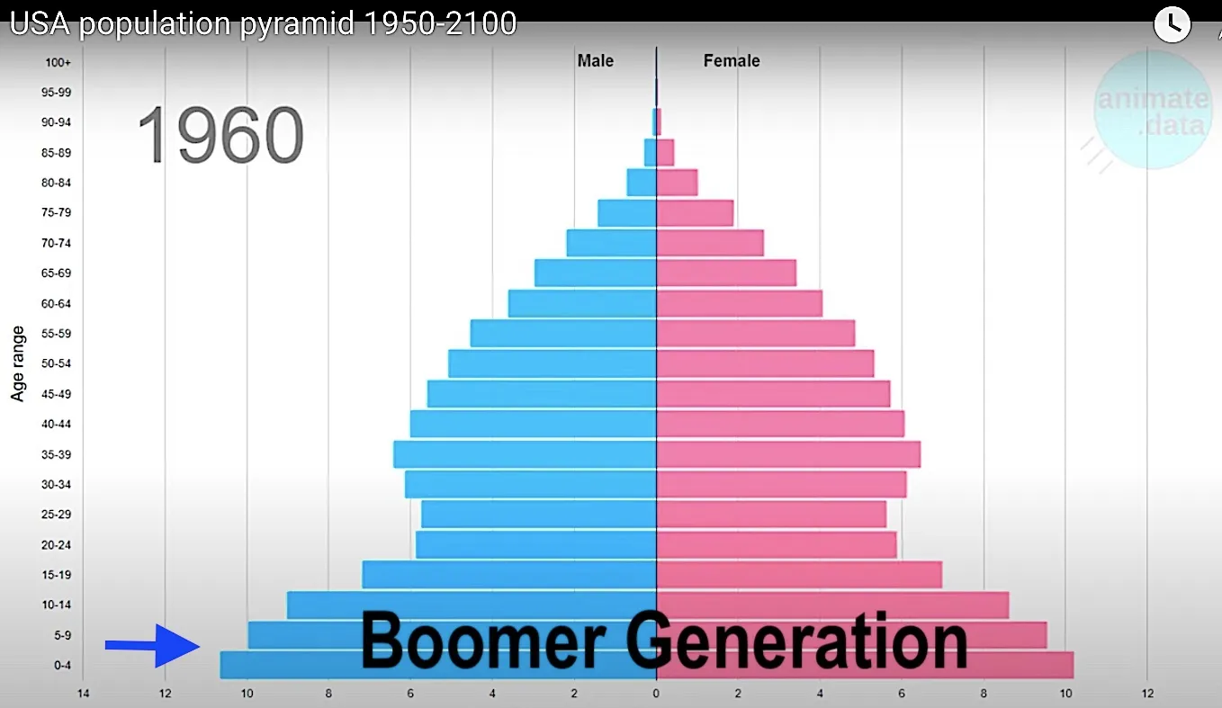
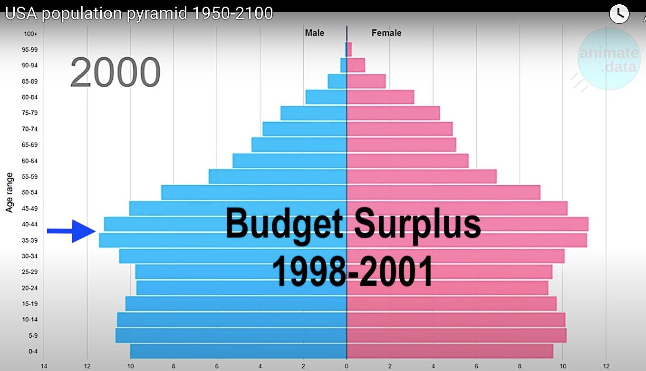
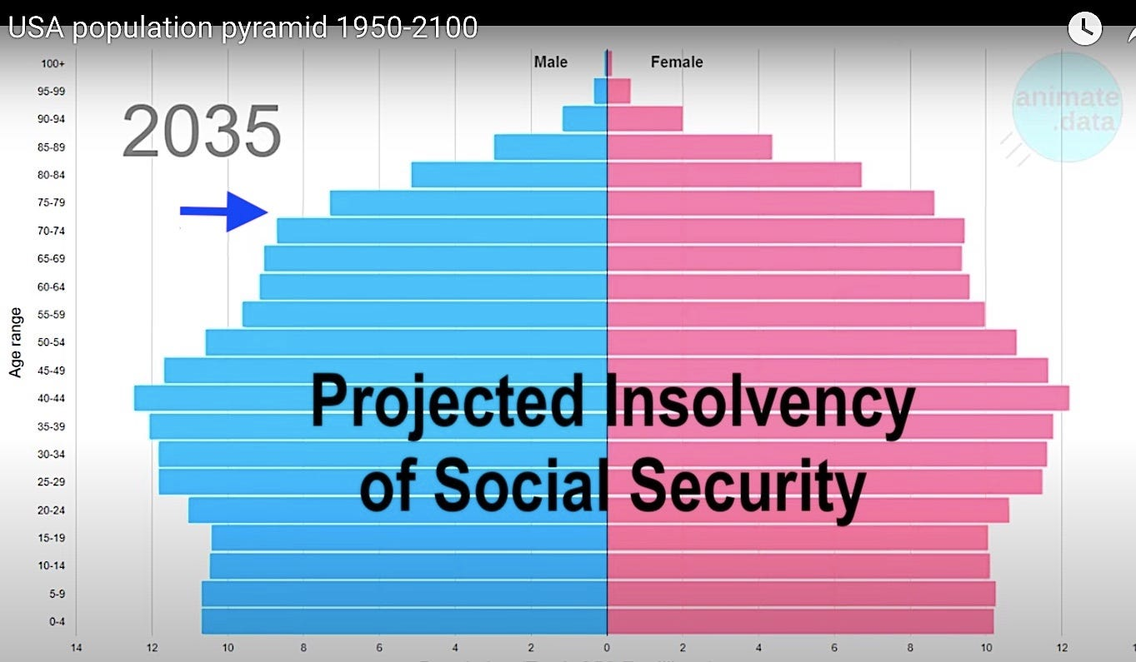


The term “boomer” refers to Americans born during the “baby boom” that happened after the end of World War II (1946 to 1964).
The budget surplus of 1998-2001 was largely driven by a critical mass of working Americans contributing record amounts of tax revenue. This is when these boomers were in their prime.
Ironically the same boomers that helped balance the budget may end up bankrupting social security after large numbers of them retire.
Video stills from AnimateData: https://www.youtube.com/@AnimateData

Slide 6
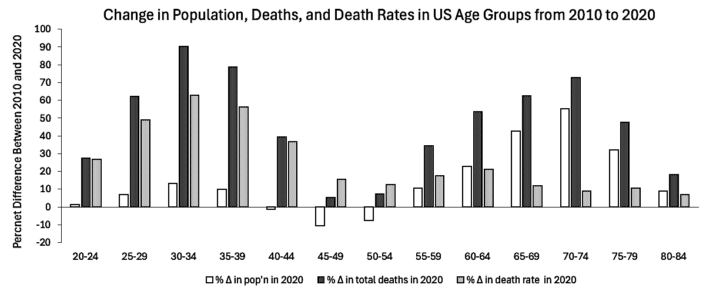
This graph indicates how combined changes in death rate and population size affected the changes in the total number of deaths per age group.
To better understand the implications of this data, we need to break it down:
The references for the original data are available at the end of this slide deck.

Slide 7
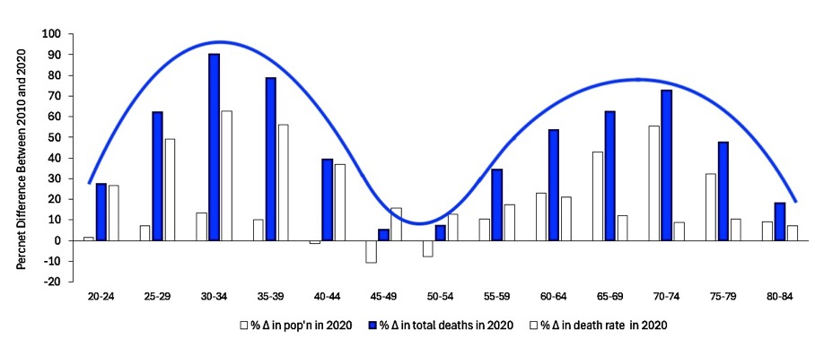
If we highlight the percent change in deaths per age group, we get a bimodal distribution with peaks between ages 25-39 and 60-79.
The age groups under these peaks (millennials and boomers) make up most of the 2020 increase in deaths.

Slide 8
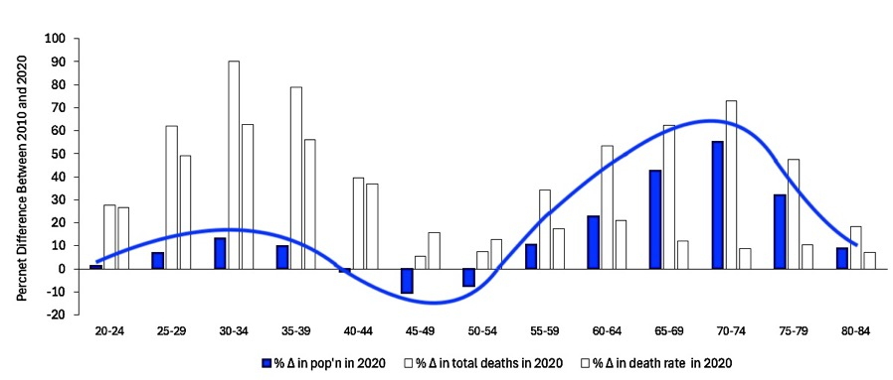
If we highlight the percent change in population per age group, we just get the peak on the right (ages 60-79).
This indicates that most of the increase in deaths for this age group was caused by a surge in the population of aging boomers.

Slide 9
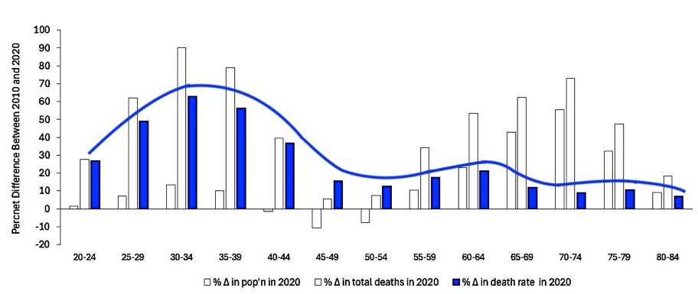
If we highlight the percent change in death rate per age group, we mainly get the peak on the left (ages 25-39).
This indicates that most of the increase in deaths for millennials was caused by the surge in the death rates indicated earlier by the actuarial life tables.
Why did Americans aged 25-39 die at such a high rate?

Slide 10
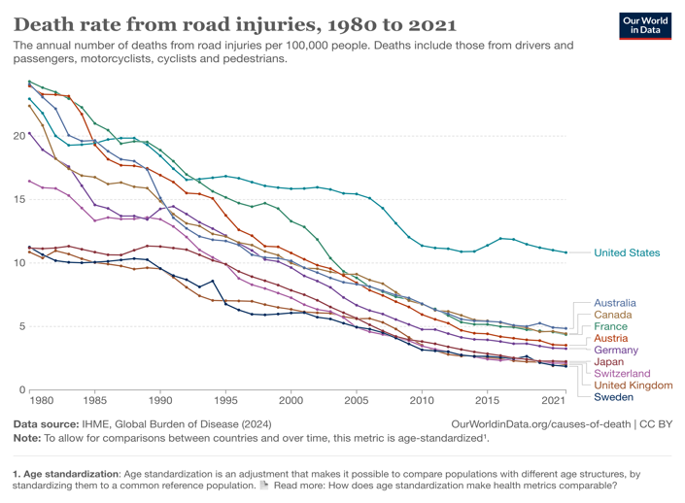
https://ourworldindata.org/us-life-expectancy-low
Road injuries played a role in the life expectancy gap between the US and other affluent nations between 2000 and 2021, but this gap did not grow after 2010.

Slide 11
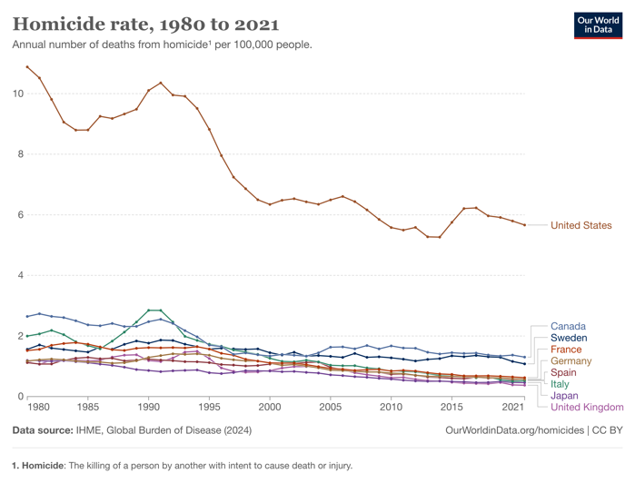
https://ourworldindata.org/us-life-expectancy-low
Homicides also played a role in the life expectancy gap between the US and other affluent nations, but this gap became narrower in 2000.

Slide 12
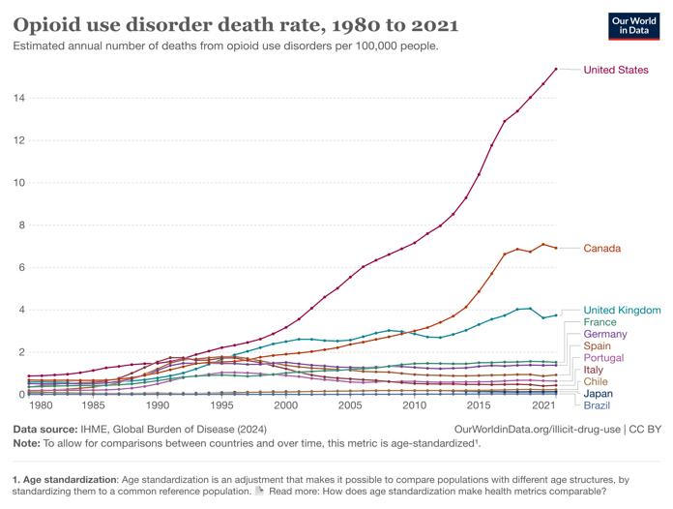
https://ourworldindata.org/us-life-expectancy-low
In sharp contrast to these other causes of death, opioid overdose deaths increased exponentially after 2010…

Slide 13
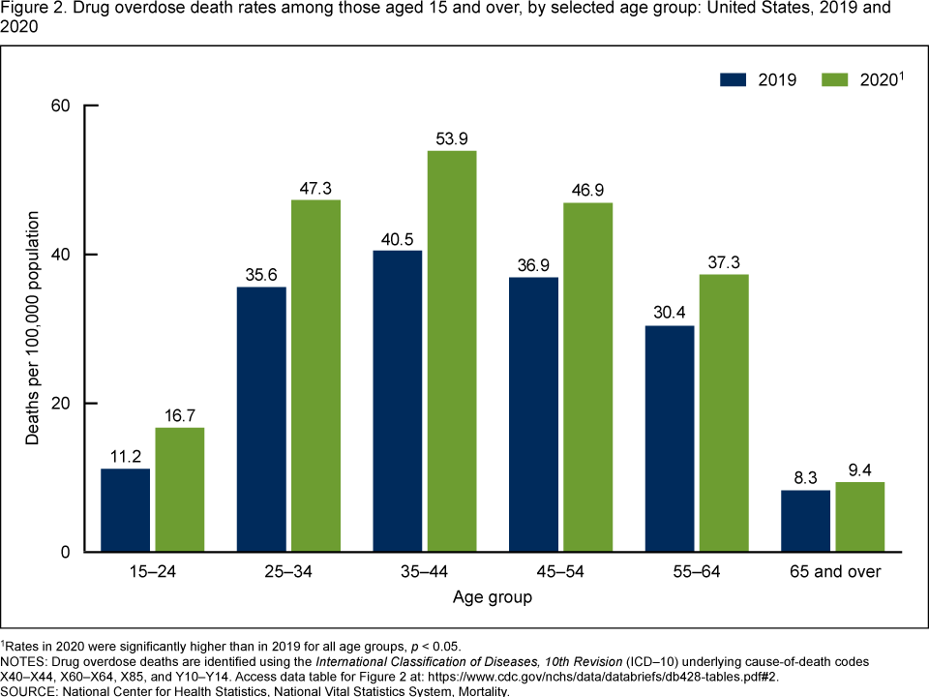
Data Briefs Number 428. December 2021.
https://www.cdc.gov/nchs/products/databriefs/db428.htm
This chart from the CDC indicates that ages 25-54 were most affected by drug overdose deaths in the US during these years.
This concurs with the aforementioned spike in the death rate for ages 30-40.

Slide 14
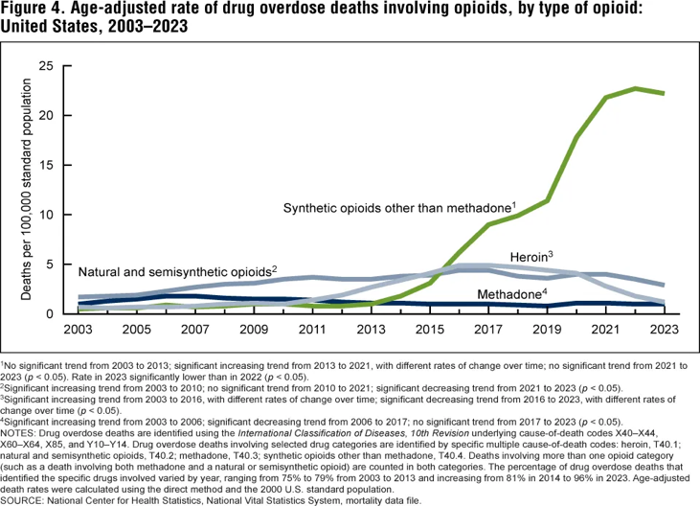
Data Briefs Number 428. December 2021. https://www.cdc.gov/nchs/products/databriefs/db428.htm
Death rates from synthetic opioids also reached their peak during the time period that is associated with the pandemic countermeasures.

Slide 15
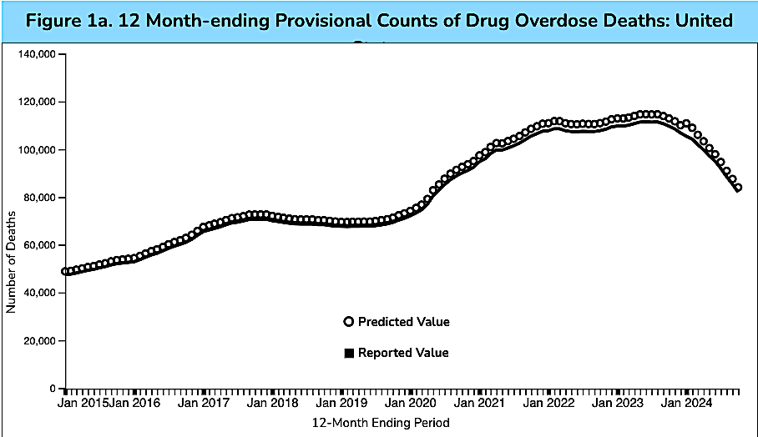
Data downloaded from the CDC: https://www.cdc.gov/nchs/nvss/vsrr/drug-overdose-data.htm
This interactive chart from the CDC indicates that about 416,000 Americans died from drug overdoses from January of 2020 to January of 2024.
This averages to over 100,000 drug overdose deaths per year in the US during this time period.

Slide 16
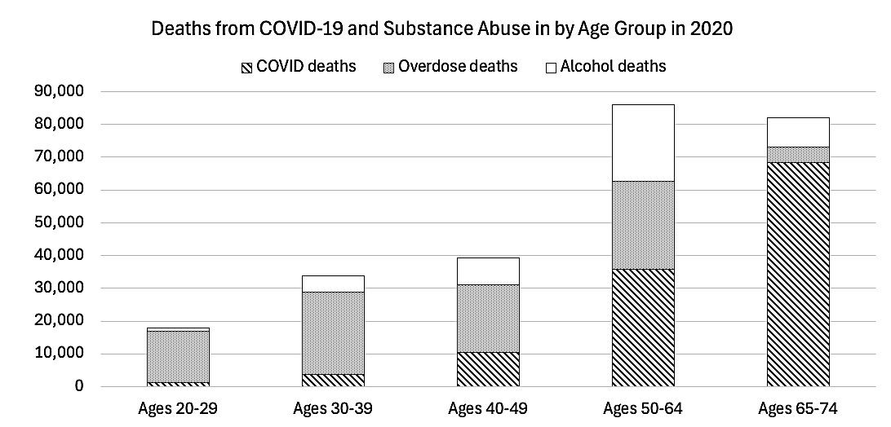

Slide 17
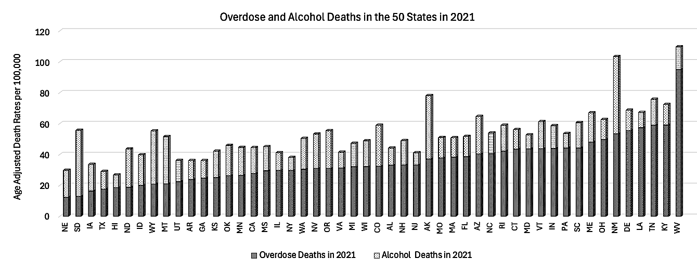
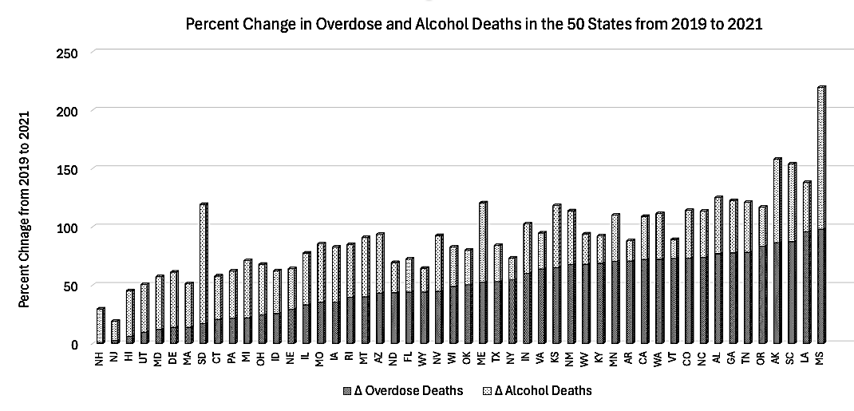

Slide 18
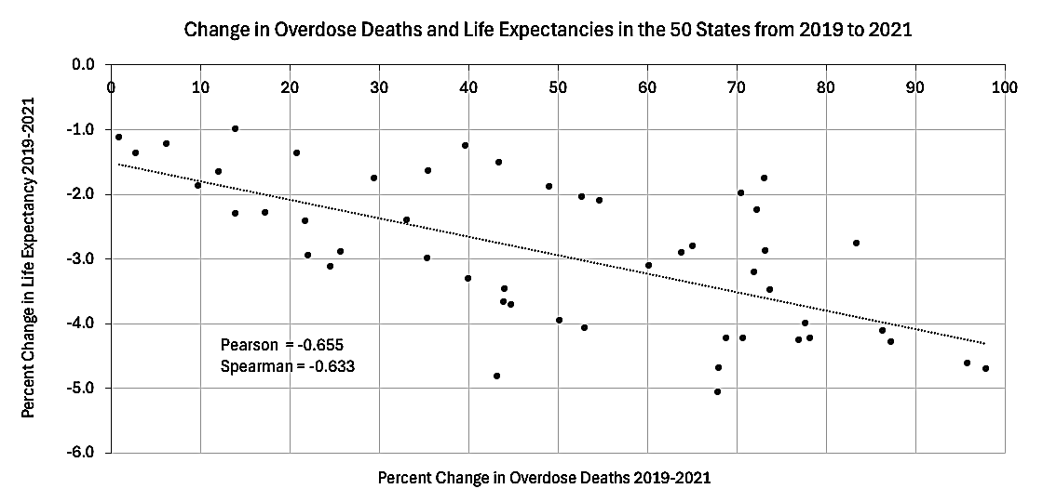

Slide 19

References for the Data Used in the Bar Graphs:
Our Changing Population: US. USA Facts.
https://usafacts.org/data/topics/people-society/population-and-demographics/our-changing-population/?endDate=2021-01-01&startDate=2010-01-01,
Annual death rate by age group, United States. Our World in Data https://ourworldindata.org/grapher/annual-deaths-by-age
Annual death rate by age group, United States. Our World in Data.
https://ourworldindata.org/grapher/annual-death-rate-by-age-group?time=2006,

Slide 20


Hat tip to Mark Kulacz (Housatonic) for linking the opioid epidemic to the decline in life expectancy and Jonathan Couey (Gigaohm Biological) for linking the demographic transition to the COVID-19 body count. All of this research is follow-up to ideas conveyed on their podcasts.
https://rumble.com/user/Housatonic
https://gigaohmbiological.com/

Slide 21
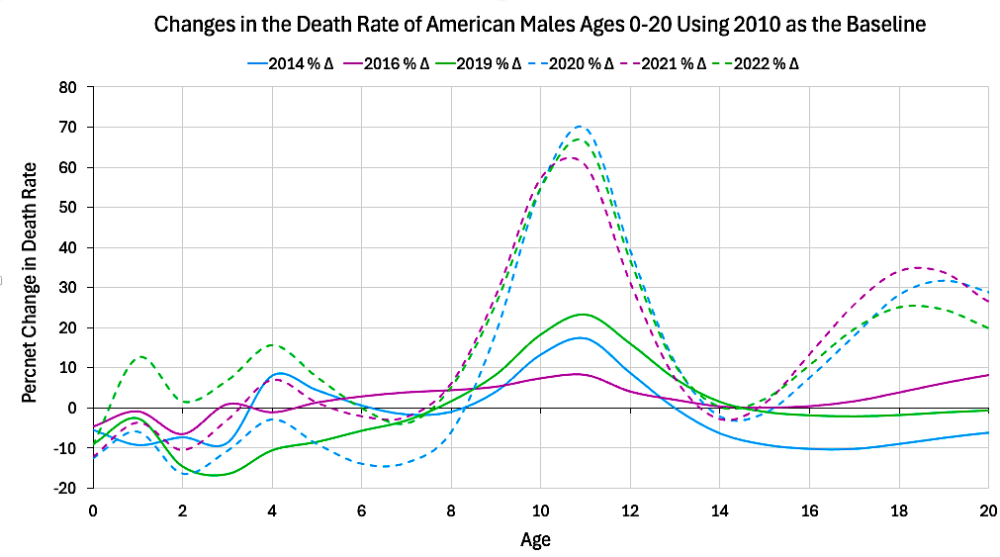
Addendum: There was an unusual surge in the death rate of American males ages 10-11.

Slide 22
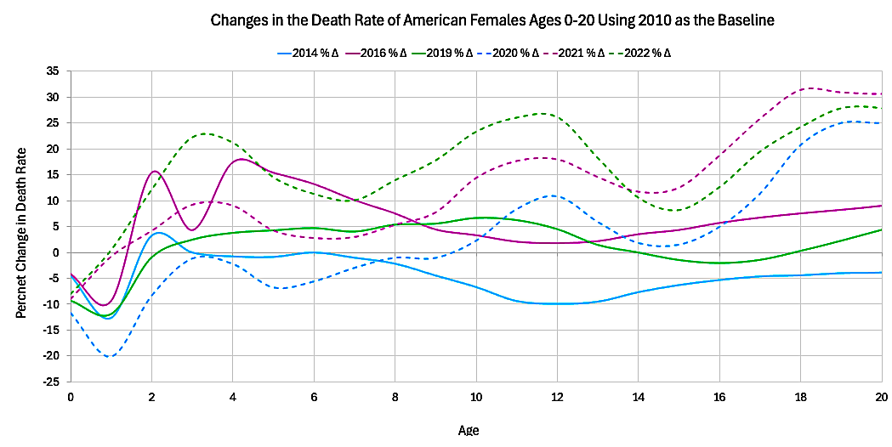
This unexplained pattern is much less evident in females.

Slide 23
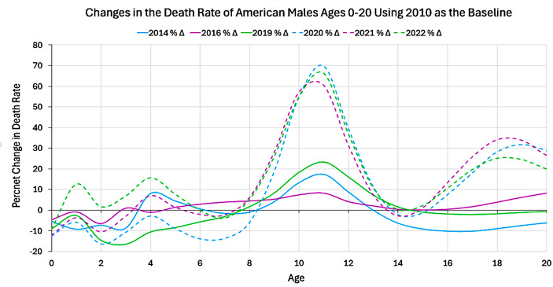
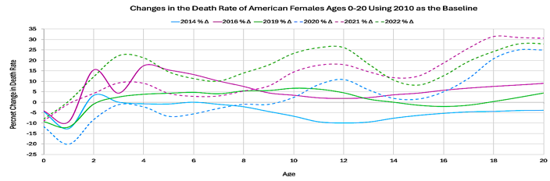
The difference is more evident when these graphs are displayed side-by-side.

