Slide 2
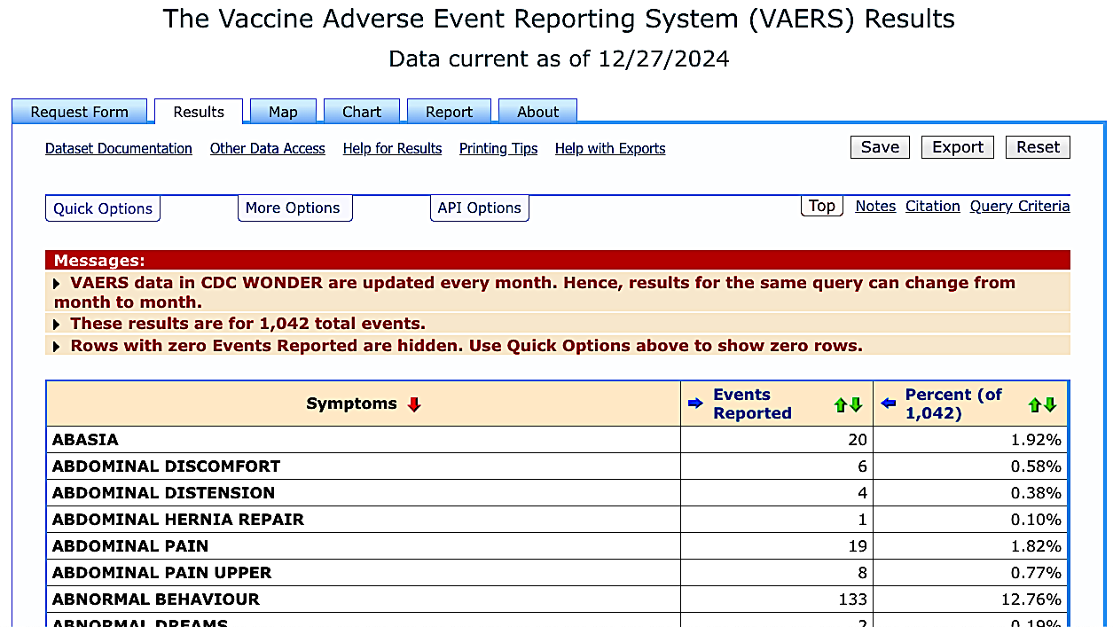
MMR

Slide 3
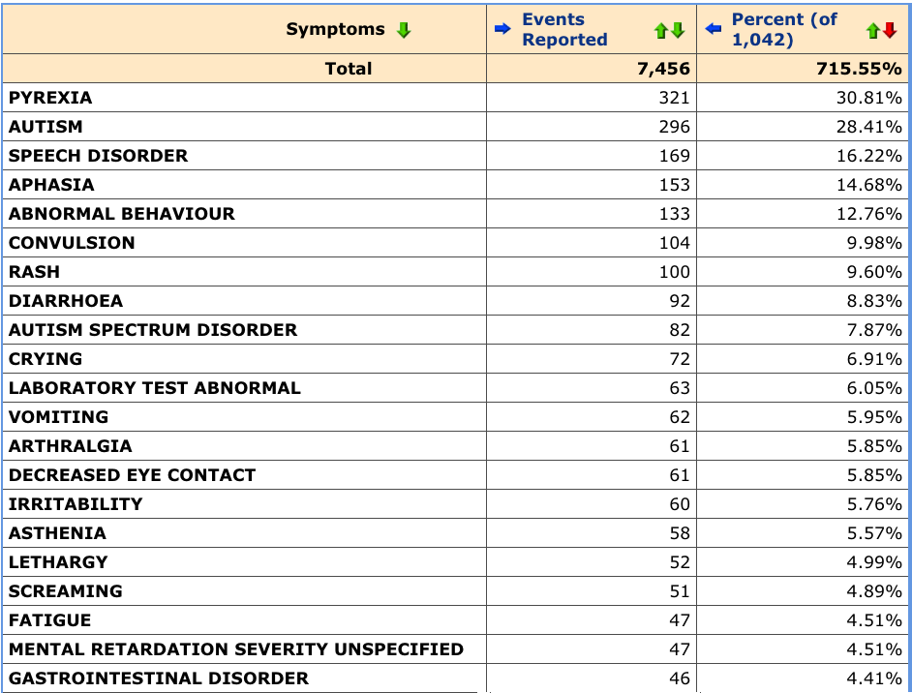
MMR

Slide 4
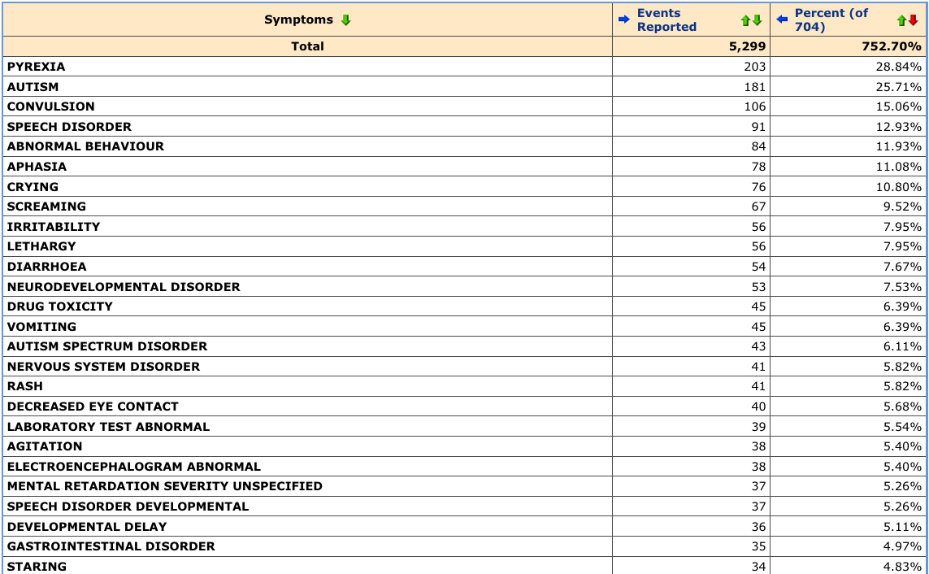
DTAP

Slide 5
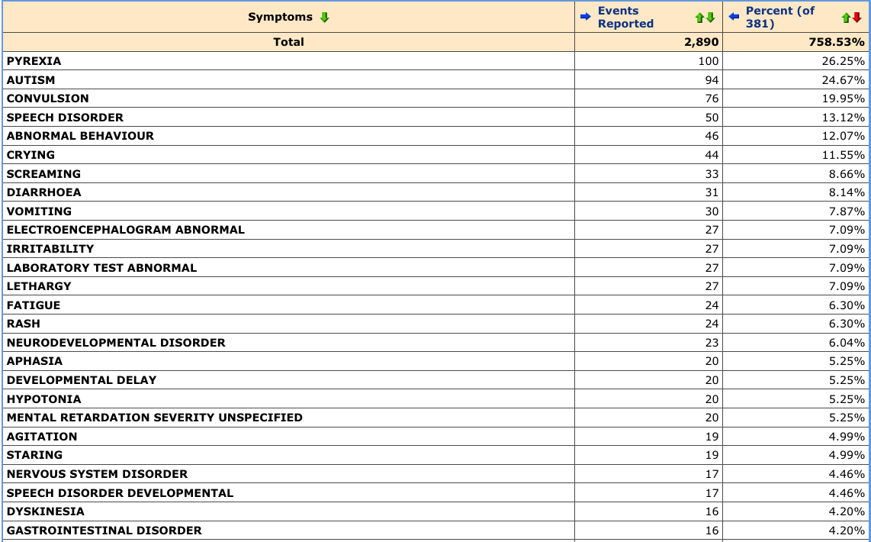
IPV (polio)

Slide 6
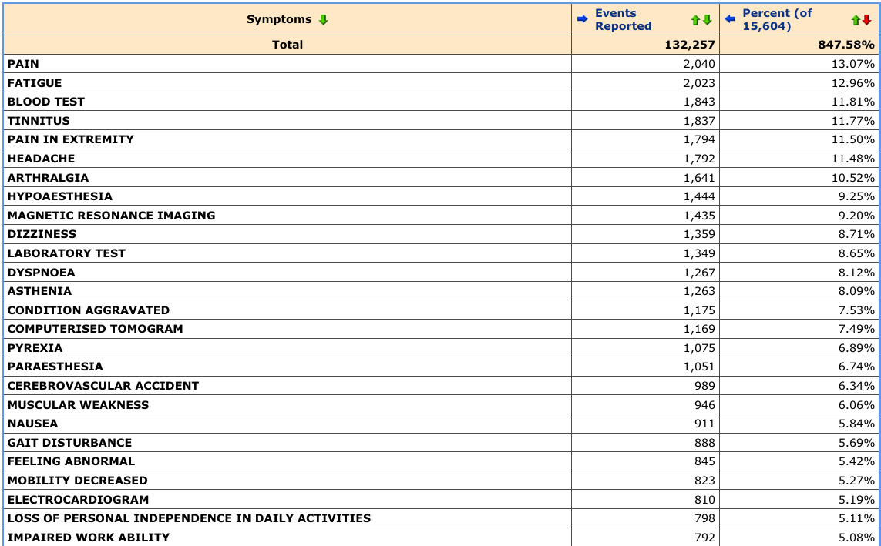
COVID-19
vaccine

Slide 7
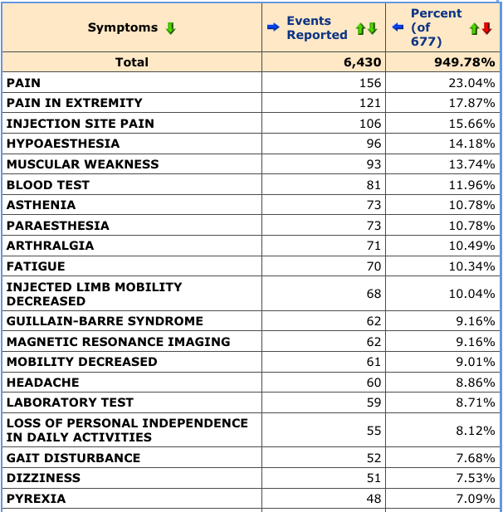
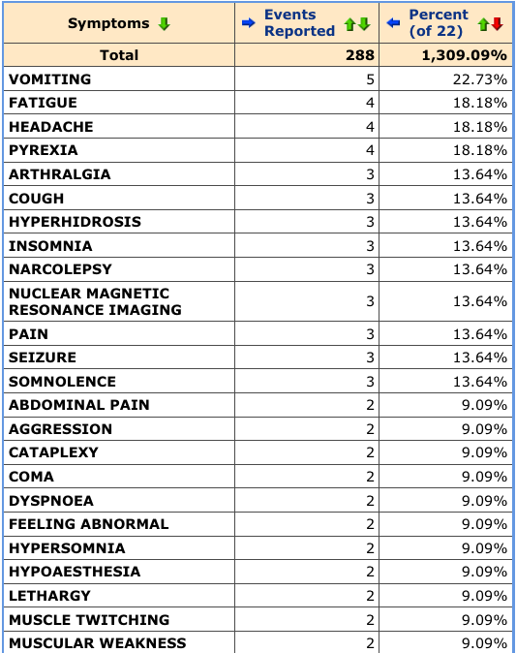
Flu (injected)
Flu (nasal spray)

Slide 8
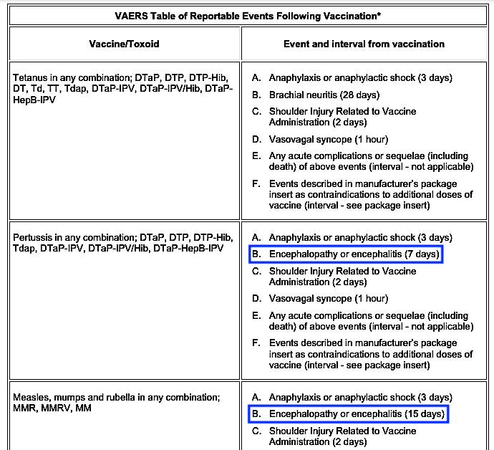
CDC VAERS for the DTAP & MMR: https://vaers.hhs.gov/docs/VAERS_Table_of_Reportable_Events_Following_Vaccination.pdf

Slide 9
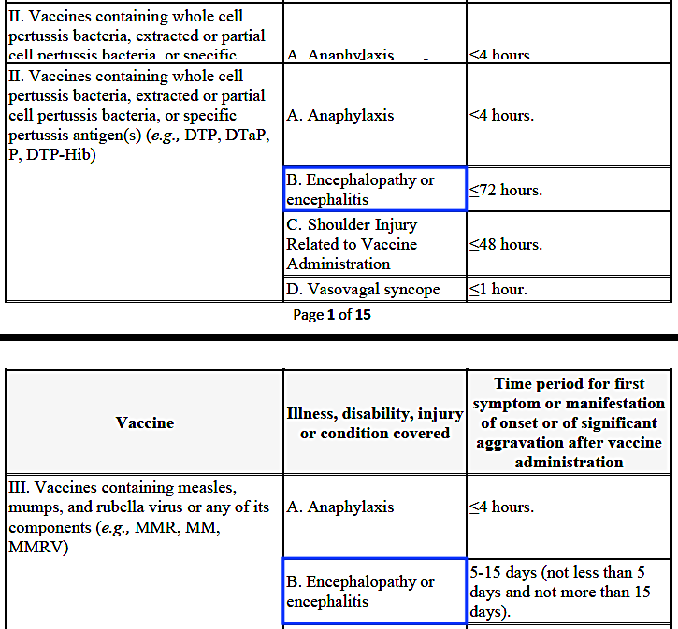
HHS Compensation Criteria for DTAP & MMR: https://www.hrsa.gov/sites/default/files/hrsa/vicp/vaccine-injury-table-01-03-2022.pdf

Slide 10
This does not include COVID vaccine injuries.
https://www.hrsa.gov/vaccine-compensation/data

Slide 11
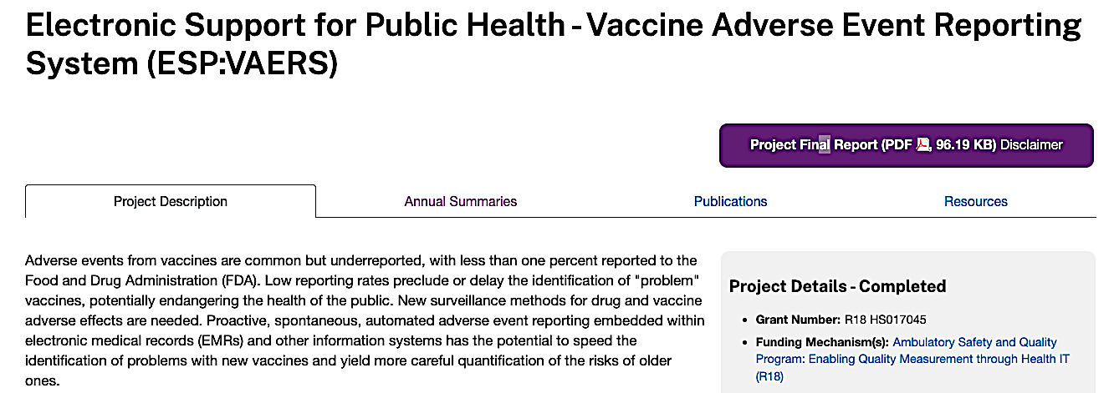
https://digital.ahrq.gov/ahrq-funded-projects/electronic-support-public-health-vaccine-adverse-event-reporting-system

