Slide 1
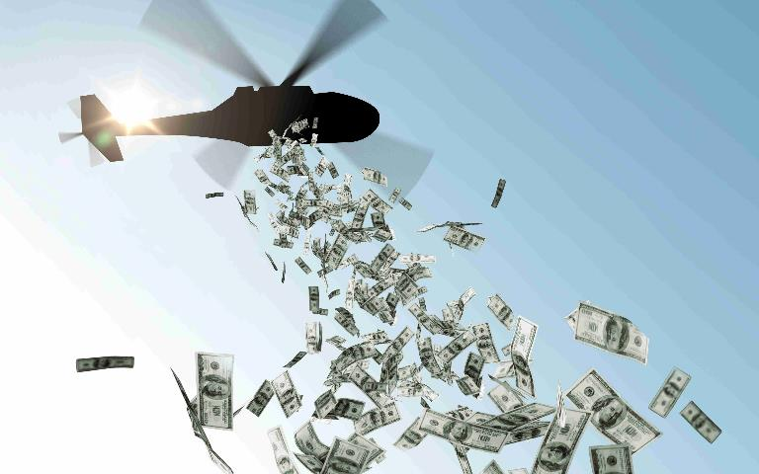
Following the Science in the
Age of Institutional Corruption
Adobe Photoshop stock image

Slide 2
Problem: The COVID-19 countermeasures laid bare the extent to which special interests undermine the scientific process. It also pitted those who blindly trust governmental institutions against those who habitually question prevailing narratives. The first group facilitates corruption by making federal agencies less accountable to the public. On the other side of the coin, those who distrust the government create opportunities for charlatans who take advantage of their sense of institutional distrust. The goal of this lesson plan is to provide students with a rough guide for discerning whether or not the “science” is based on systematic or narrative-driven data-gathering. Most importantly, it gives students a checklist for objectively evaluating what they consume from both mainstream and alternative sources of news.

Slide 3
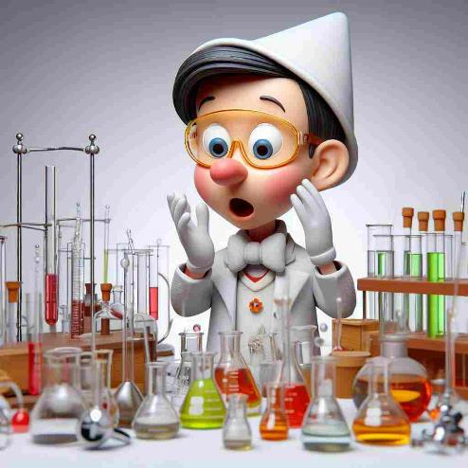
1. Scientific Fraud
Image generated by Image Creator from Microsoft Bing
Notes:
Answer: a

Slide 4
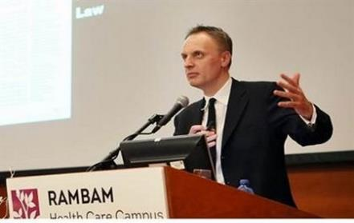
Editor of Lancet: Medical Research is Unreliable at Best or Completely Fraudulent
Dr Richard Horton declared, “Much of the scientific literature, perhaps half, may simply be untrue. Afflicted by studies with small sample sizes, tiny effects, invalid exploratory analyses, and flagrant conflicts of interest, together with an obsession for pursuing fashionable trends of dubious importance, science has taken a turn towards darkness.”
https://www.drugawareness.org/editor-of-lancet-medical-research-is-unreliable-at-best-or-completely-fraudulent/

Slide 5



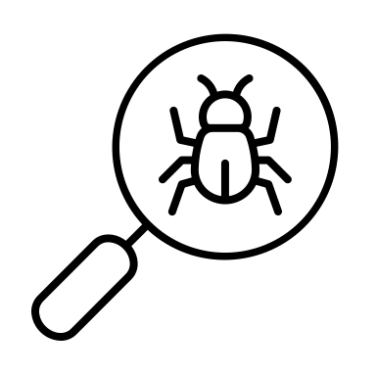




Red Flags for Discerning Fraud
Is it corroborated? Does it concur with raw data? Does it concur with independent sources?
Who benefits? Do any of the authors have a conflict of interest?
How do the authors and their supporters react when confronted with contrary evidence?
  Non-evasive: Criticism that focuses on specific details of the study (itemized)
  Evasive: ad hominem attacks, straw man, gaslighting, censorship

Slide 6



Which two of the aforementioned red flags are evident in this real-life example of scientific fraud?
In May 2020,The Lancet published the results of a global dataset analysis demonstrating that COVID-19 patients treated with hydroxychloroquine died at a higher rate than patients not receiving this drug. This study was retracted when readers started reporting glaring inconsistencies with national registries of hospitalized COVID-19 patients and the third party providing the data suddenly became unavailable. At the time of publication, one of two lead co-authors was conducting trials with the far more profitable COVID treatment, Remdesivir.
Lack of corroboration & conflict of interest.
Sapan Desai, head of Surgisphere

Slide 7
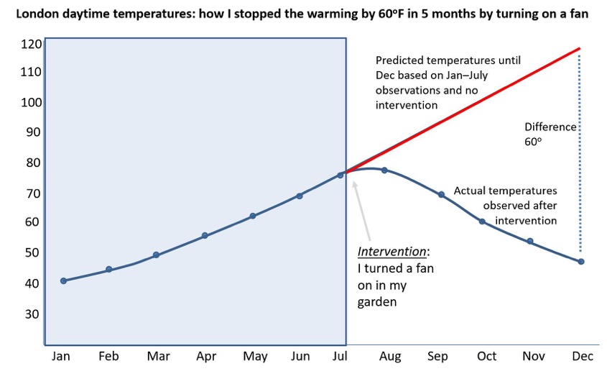
Hypothetical Example of Junk Science:
Do you see how it was rigged?
FYI: This chart is parody!
Chart by Norman Fenton https://www.youtube.com/watch?v=8Avq_tMz2LU&t=74s

Slide 8










2. Narrative Control
Notes:
Answer: a

Slide 9

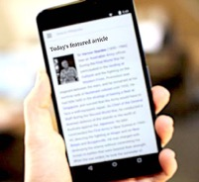







Astroturfing = fake grassroots movement
The whole point of astroturf is to try to convince you there’s widespread support for or against an agenda when there’s not. Sharyl Attkisson, investigative reporter
https://sharylattkisson.com/2016/07/top-10-astroturfers/
Example: You choose to “do your own research” on the safety of a given drug, not knowing that your internet search was rigged (via bots & algorithms), your primary care doctor was influenced (via free samples & workshops) and your other “trusted sources” like mainstream media and government agencies were captured (via sponsors, grants, user fees, job offers, & partnerships).
Notes:
Answer: a

Slide 10
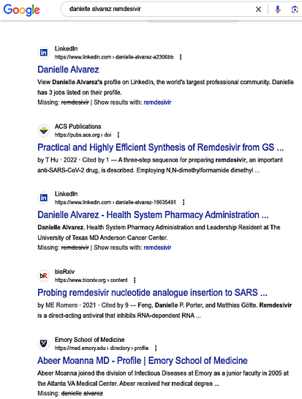
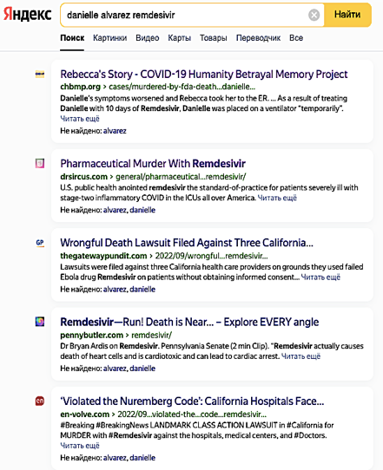


Real Life Example: A Tale of Two Search Engines
The same search terms get totally different results.

Slide 11
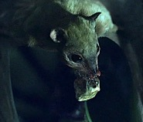
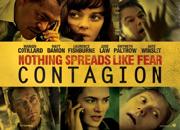

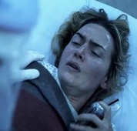
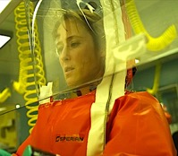
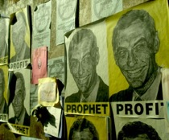

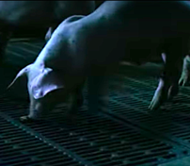
The Power of Fear Porn
The 2011 thriller “Contagion” paved they way for the official COVID-19 narrative:
1. A chimeric virus from China generates a fast-growing pandemic.
2. Strict lockdown policies are enforced in order to stop the spread.
3. The WHO and CDC work heroically to track the origin and find solutions.
4. Fast-tracked vaccines generated via public-private partnership are the only way out.
5. Therapies not endorsed by government agencies are either unreliable or fraudulent.
6. This chimeric virus was not made in a lab: It was generated after a virus from an infected bat picked up genes from an animal destined for human consumption.

Slide 12

3. Problematic Legislation
Image generated by Image Creator from Microsoft Bing

Slide 13
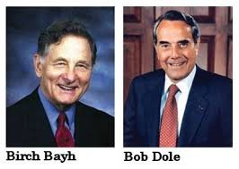
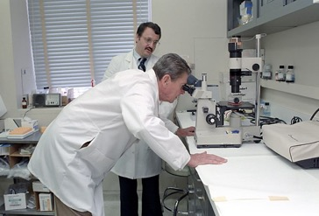


The Bayh-Dole Act of 1980 allowed federal agencies to collect royalties.
https://www.hhs.gov/about/news/2023/03/21/hhs-doc-announce-plan-review-march-in-authority.html.
NIH now benefits from all purchases of mRNA vaccines because Moderna and NIH “co-own” the patent for this commercial product.
This is a conflict of interest because NIH is also the primary US government agency responsible for research that determines public health.
President Reagan during a visit to NIH.

Slide 14
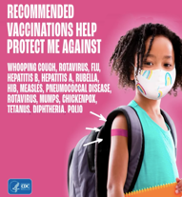
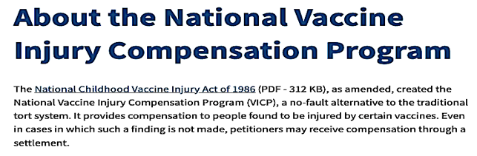
The National Childhood Vaccine Injury Act of 1986 provided liability protection to manufacturers of all products listed on the childhood immunization schedule.
https://digitalcommons.law.uw.edu/cgi/viewcontent.cgi?article=3792&context=wlr.
This made childhood vaccines far more profitable because it shifted financial responsibility for vaccine injury to taxpayers by means of a “vaccine court” administered by Health and Human Services. https://www.hrsa.gov/vaccine-compensation/about

Slide 15
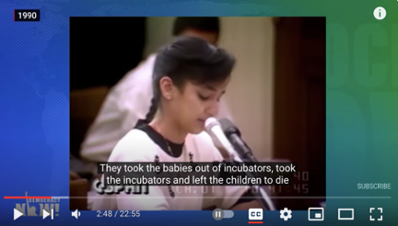
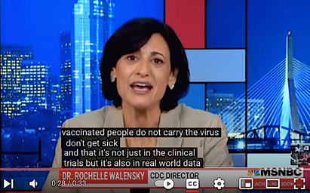
HR-5736 Smith Mundt Modernization Act of 2012 lifted the domestic ban on government propaganda. Prior to this law, most government propaganda could only be disseminated in other nations. https://www.usagm.gov/who-we-are/oversight/legislation/smith-mundt-faqs/
A critic raised concerns that this law lacked oversight, and that there was no way of assuring the accuracy of this information.
https://www.buzzfeednews.com/article/mhastings/congressmen-seek-to-lift-propaganda-ban
The daughter of a Kuwaiti ambassador presenting fictitious testimony to garner support for the Gulf War.
Head of CDC Rochelle Wallensky presenting unsupported claims to garner wider acceptance of COVID vaccines.

Slide 16
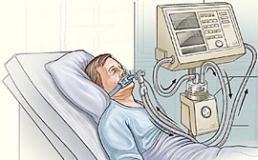

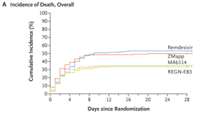
The Prep Act of 2020 provided liability protection to health workers and manufacturers from all procedures and products designated as “pandemic countermeasures.”
https://www.federalregister.gov/documents/2020/03/17/2020-05484/declaration-under-the-public-readiness-and-emergency-preparedness-act-for-medical-countermeasures
A repurposed Ebola drug became the “standard of care” for hospitalized COVID-19 patients despite its deeply problematic safely profile.
https://www.nejm.org/doi/10.1056/NEJMoa1910993?url_ver=Z39.88-2003&rfr_id=ori:rid:crossref.org&rfr_dat=cr_pub%20%200pubmed
https://principia-scientific.com/doctor-reveals-remdesivir-is-real-cause-of-covid-19-maladies/

Slide 17







4. Captured Institutions

Slide 18
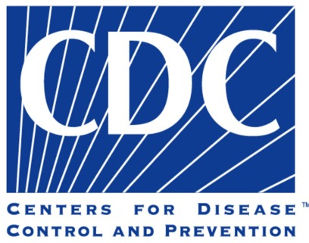
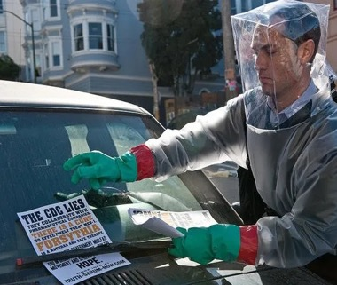
The blogger in the science fiction thriller “Contagion” accused the CDC of being “in bed” with Big Pharma.
Why did the movie go to great lengths to discredit this point of view?

Slide 19

The CDC is a government agency has existed since 1946, but a significant portion of its operating budget comes from donors to the “CDC Foundation,” which was founded in 1992.

Slide 20
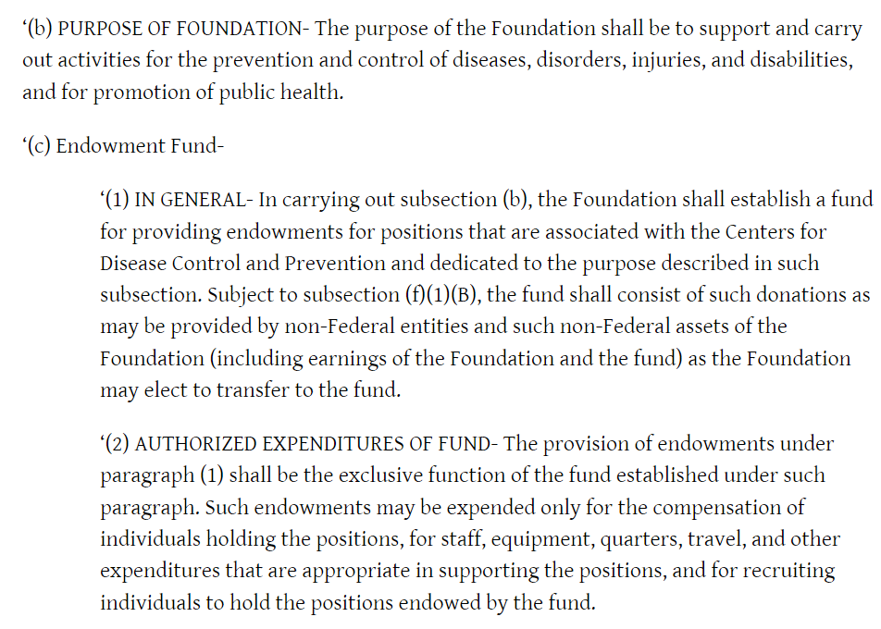
Some CDC jobs are funded through the CDC Foundation.
Who is financing these jobs?
https://www.govtrack.us/congress/bills/102/hr3635/text

Slide 21


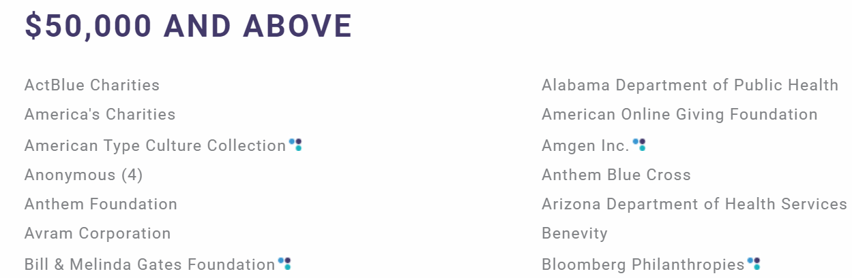
Here are some of the main funders of the CDC Foundation:
biotech
biotech
???
health
health
health
biotech/vaccines
https://www.cdcfoundation.org/FY2021/donors?group=corp
Hat Tip “The COVID Blog: https://thecovidblog.com/2021/03/23/cdc-foundation-is-not-a-government-entity-has-many-conflicts-of-interest/

Slide 22
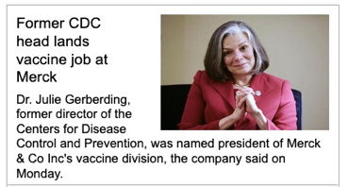
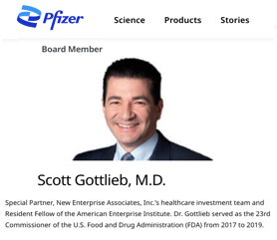
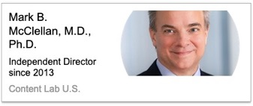
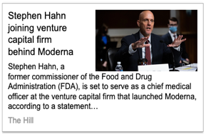
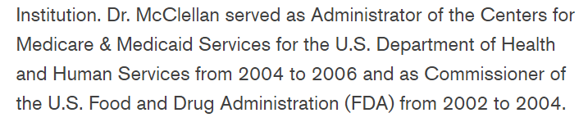
The Revolving Door Between Government & Big Pharma

Slide 23
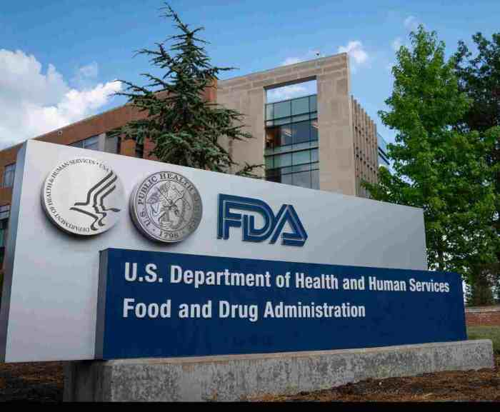
What about the Food and Drug Administration?

Slide 24
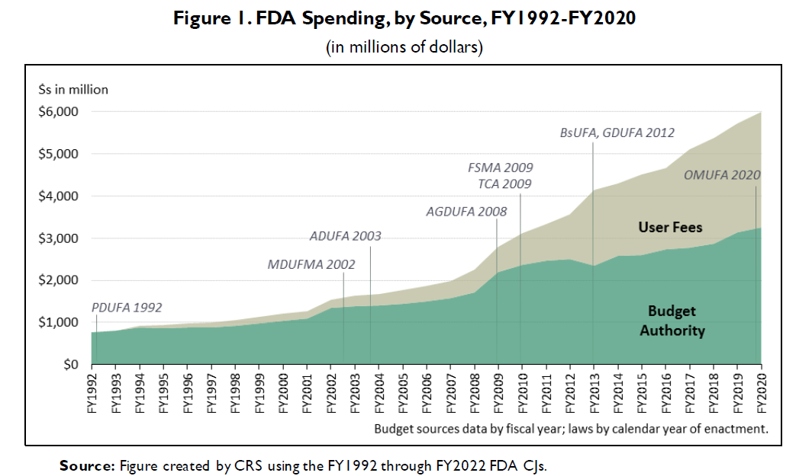
User fees now cover nearly half of the FDA operating budget.
https://crsreports.congress.gov/product/pdf/R/R44576/13

Slide 25
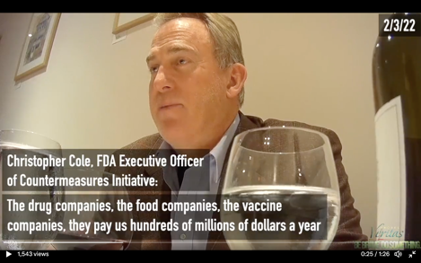
According to this FDA executive, reviewers are under pressure to expedite approval of products from the companies that provide the most funding.
Cole: The drug companies, the food companies, the vaccine companies, they pay us hundreds of millions of dollars per year to hire and keep reviewers to approve their products.
Project Veritas: What happens if you speak out?
Cole: You’re not going to get to certain levels of government.
It’s better to stay quiet and accept it.
https://www.projectveritas.com/news/fda-executive-officer-on-hidden-camera-reveals-future-covid-policy-biden/

Slide 26
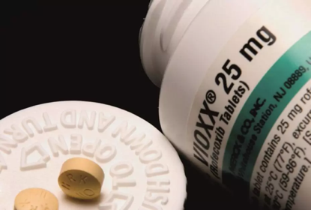
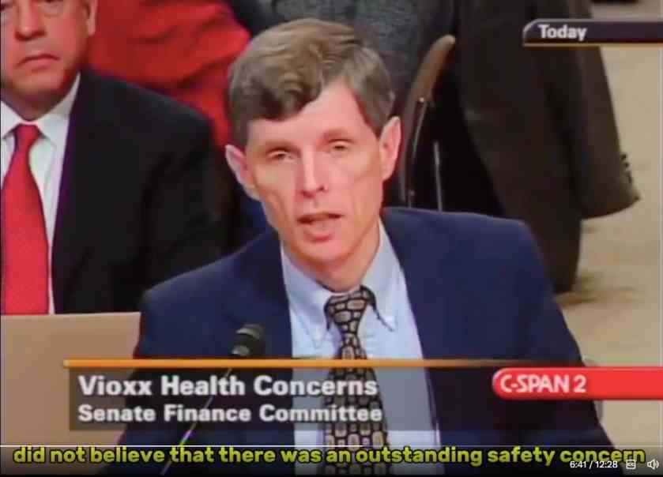
In 2004, FDA research epidemiologist David Graham testified before congress on how the FDA suppressed safety concerns over the anti-inflammatory Vioxx. Graham estimates that the FDA’s negligence led to at least 100,000 heart attacks with as many as 40,000 deaths. Eventually, the makers of Vioxx pulled this drug from the market on their own initiative.
Graham claimed this was not isolated incident, and that the FDA consistently downplayed new safety concerns on drugs that were previously FDA-approved.
https://x.com/MidwesternDoc/status/1817610306782425133

Slide 27

Who funds the WHO?

Slide 28
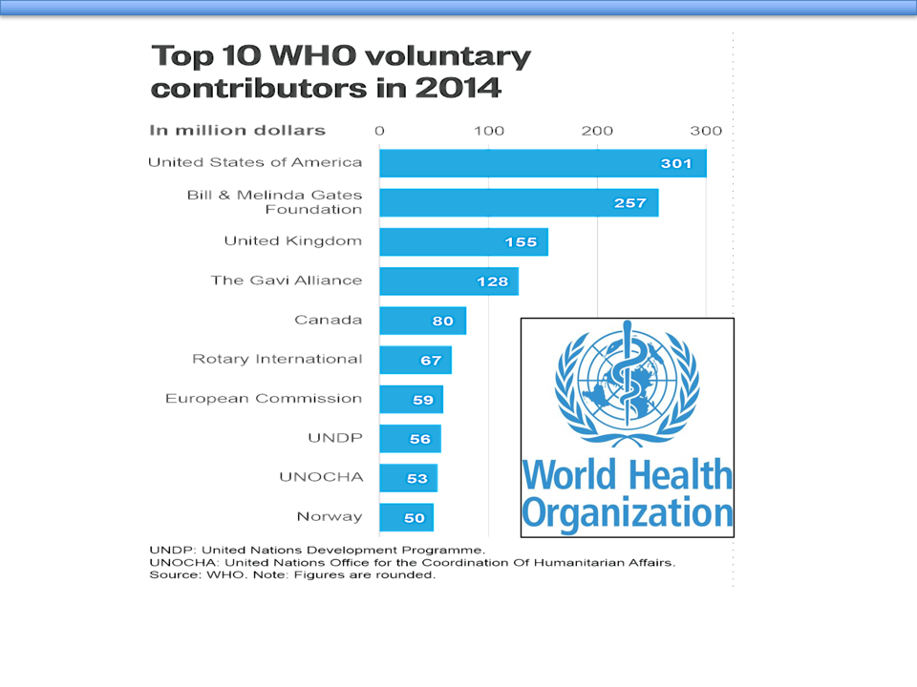

Slide 29
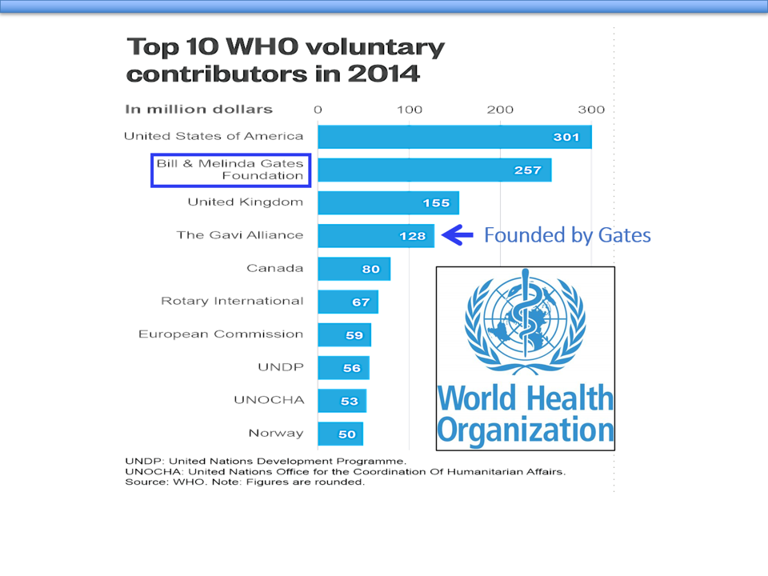
The Gates Foundation is the (unofficial) top funder of the WHO.

Slide 30
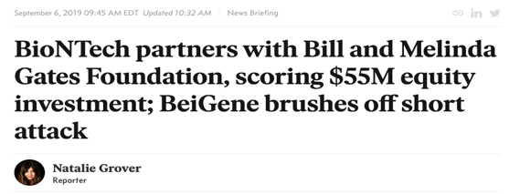
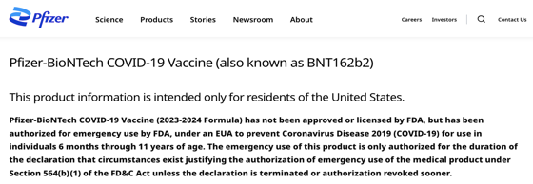
In 2019 Gates partnered with one of the main producers of mRNA vaccines, so it was in their interest to finance influential institutions like the WHO and CDC.
https://www.pfizer.com/products/product-detail/pfizer-biontech-covid-19-vaccine
https://endpts.com/biontech-partners-with-bill-and-melinda-gates-foundation-scoring-55m-equity-investment-novartis-sells-china-unit/

Slide 31
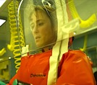

As you may recall, Contagion exalted the roles of the CDC and WHO.
Who is behind the making of this movie?

Slide 32
As you may recall, Contagion exalted the roles of the CDC and WHO.
Who is behind the making of this movie?
funded
The movie “Contagion”
Skoll
Foundation
science
advisor
science
advisor
science
advisor
science
advisor
Ian
Lipkin
Nathan
Wolfe
Larry
Brilliant
Laurie
Garrett
funded
editorial
advisor
young
global
leader
advisory
board
partner
advisory
board
EcoHealth
Alliance
World
Economic
Forum

Slide 33





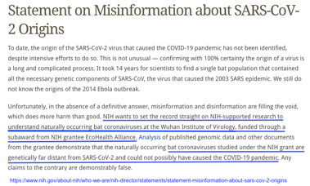
EcoHealth Alliance is central to the hypothesis that COVID-19 came from a lab due to research they funded in China in 2018.
$$
$
genetic modification of bat viruses
But just for the record, NIH emphatically denies that this research played a role in the generation of COVID-19.

Slide 34
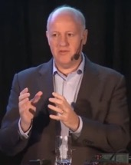
We need to increase public understanding of the need for medical counter-measures such as a pan-coronavirus vaccine.
A key driver is the media, and the economics will follow the hype.
Peter Daszak, president of EcoHealth Alliance at a health policy conference in February, 2016
https://www.ncbi.nlm.nih.gov/books/NBK349040/
This statement from the EcoHealth Alliance president may explain why Contagion promoted mass vaccination at the expense of antiviral therapeutics.

Slide 35

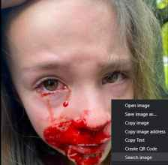

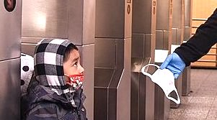
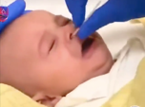

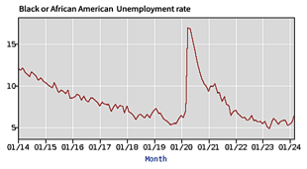

Uncovering the true origin of COVID-19 is useful, but...
…it should not distract from the crucial task of learning why public institutions recommended controversial policies that were so damaging and inhumane.
Video of deep nasal swab on baby: https://twitter.com/KathMLee1/status/1640433811656679425
Child with nasal swab injury: https://twitter.com/LegsEnergy/status/1699920730408784377/photo/1
Unemployment chart from U.S. Bureau of Labor Statistics: https://data.bls.gov/timeseries/LNS14000006

Slide 36

5. Assessment

Slide 37
Review Question 1:
A study evaluating the safety of a new hypertension treatment shows a higher death rate in people receiving the new drug. Which critique of the study is an example of a straw man argument?
  The study tries to discredit the use of innovative therapies for treating people with hypertension.
  The study was poorly designed because the sicker patients got the new drug.
  The study was rigged.
  The researchers are just amateurs that teach at a community college.
Notes:
Answer: a

Slide 38
Review Question 2:
A study evaluating the safety of a new hypertension treatment shows a higher death rate in people receiving the new drug. Which critique of the study is an example of an ad hominem attack?
  The study tries to discredit the use of innovative therapies for treating people with hypertension.
  The study was poorly designed because the sicker patients got the new drug.
  The study was rigged.
  The researchers are just amateurs that teach at a community college.
Notes:
Answer: a

Slide 39
Review Question 3:
A study evaluating the safety of a new hypertension treatment shows a higher death rate in people receiving the new drug. Which critique of the study is an example of itemized criticism?
  The study tries to discredit the use of innovative therapies for treating people with hypertension.
  The study was poorly designed because the sicker patients got the new drug.
  The study was rigged.
  The researchers are just amateurs that teach at a community college.
Notes:
Answer: a

Slide 40
Review Questions 4:
A study evaluating the safety of a new hypertension treatment shows a higher death rate in people receiving the new drug. Which critique of the study is points out a possible conflict of interest?
  The study tries to discredit the use of innovative therapies for treating people with hypertension.
  The study was rigged
  The research was funded by competitors profiting from an alternative therapy for hypertension.
  The researchers are just amateurs that teach at a community college.
Notes:
Answer: a

Slide 41

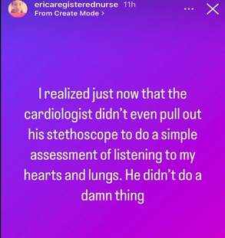
Real life: Which form of evasive rhetoric is demonstrated in this personal account?
A patient with chronic shortness of breath and chest discomfort sees a cardiologist. Without examining her, the cardiologist attributes her symptoms to “anxiety” and “panic disorder.”
  Ad hominem
  Straw man
  Gaslighting
https://twitter.com/React19org/status/1553092518790647808

Slide 42
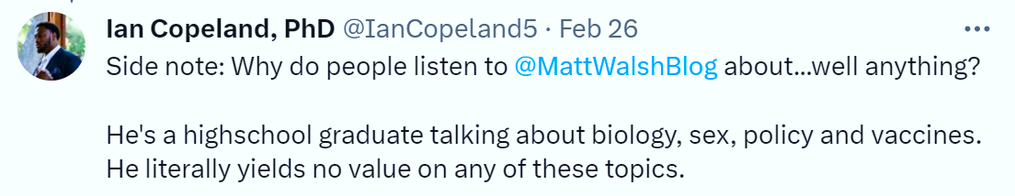
Real life: Which form of evasive rhetoric is demonstrated in this tweet?
https://twitter.com/IanCopeland5/status/1630008321708118019
  Ad hominem
  Straw man
  Gaslighting

Slide 43
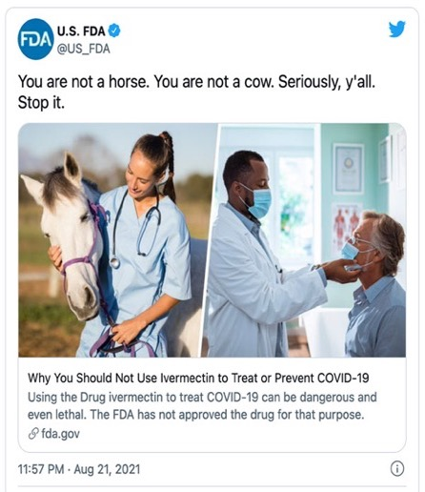
Real life: Which form of evasive rhetoric is demonstrated
in this FDA tweet?
Background: Ivermectin is a broad-range antiparasitic drug on the WHO’s list of “essential medicines.” In affluent nations where parasitic infections are relatively rare, this drug is more likely to be used on animals. Some doctors prescribe ivermectin “off label” in order to treat COVID-19 even though its antiviral properties are disputed.
  Ad hominem
  Straw man
  Gaslighting
https://twitter.com/i/web/status/1429050070243192839

Slide 44


