Slide 1








1. Institutional Capture by Special Interests

Slide 2
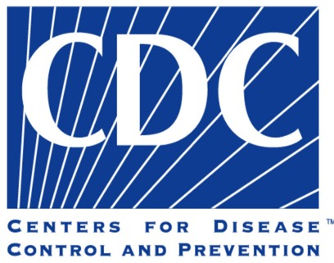
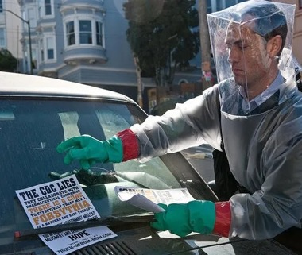
The blogger in the science thriller “Contagion” accused the CDC of being “in bed” with Big Pharma.
Is there any merit to this accusation in real life?

Slide 3

The CDC is a government agency has existed since 1946, but a significant portion of its operating budget comes from donors to the “CDC Foundation,” which was founded in 1992.

Slide 4
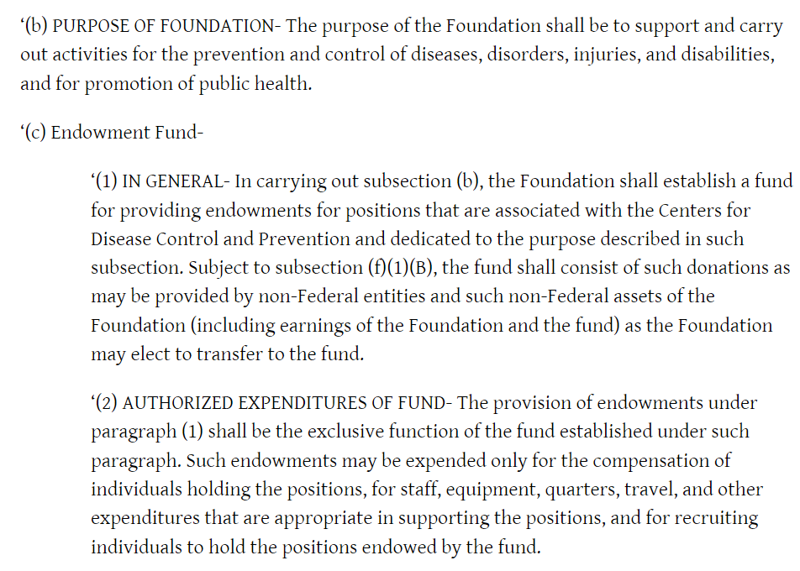
Some CDC jobs are funded through the CDC Foundation.
https://www.govtrack.us/congress/bills/102/hr3635/text

Slide 5

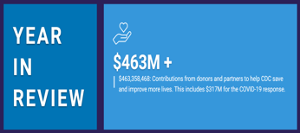
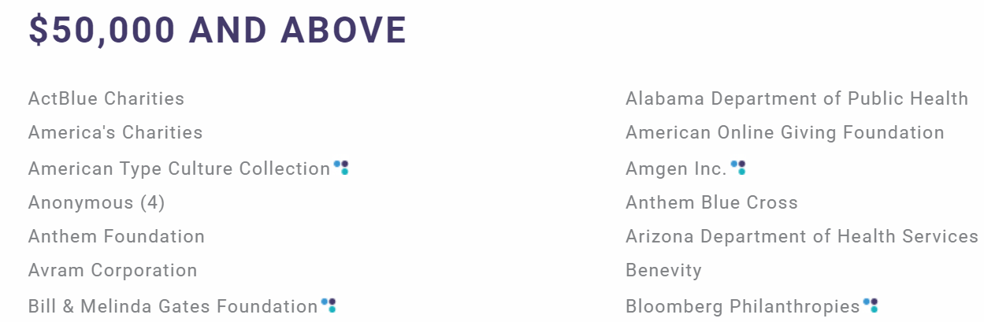
Many of the main funders of the CDC Foundation are in health,
pharmaceutical, and biotechnology industries:
biotech
biotech
???
health
health
health
biotech/vaccines
https://www.cdcfoundation.org/FY2021/donors?group=corp
Hat Tip “The COVID Blog: https://thecovidblog.com/2021/03/23/cdc-foundation-is-not-a-government-entity-has-many-conflicts-of-interest/

Slide 6
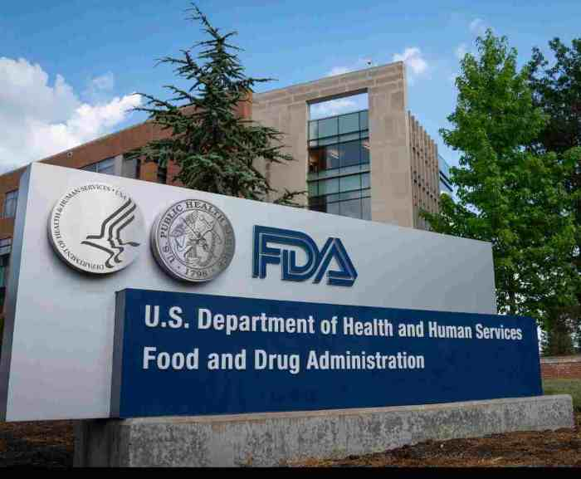
What about the Food and Drug Administration?

Slide 7
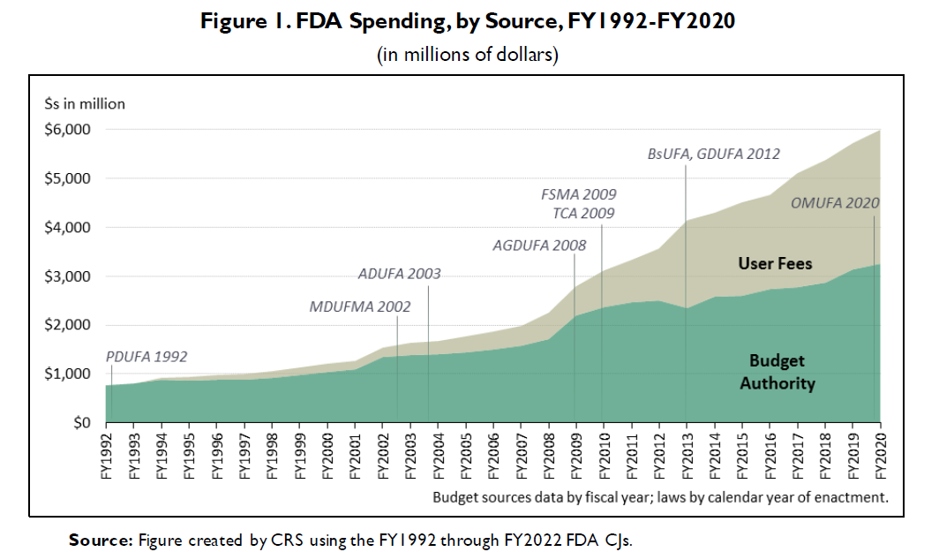
The FDA is increasingly dependent on funding from drug makers because user fees now cover nearly half of the FDA operating budget. What are the implications?
https://crsreports.congress.gov/product/pdf/R/R44576/13

Slide 8
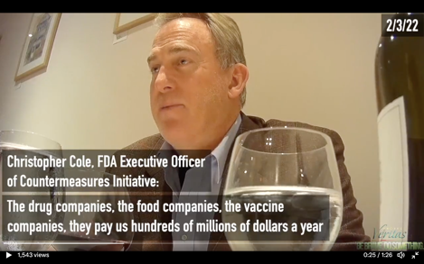
According to this FDA executive, reviewers are under pressure to expedite approval of products from the companies that provide the most funding.
Cole: The drug companies, the food companies, the vaccine companies, they pay us hundreds of millions of dollars per year to hire and keep reviewers to approve their products.
Project Veritas: What happens if you speak out?
Cole: You’re not going to get to certain levels of government.
It’s better to stay quiet and accept it.
https://www.projectveritas.com/news/fda-executive-officer-on-hidden-camera-reveals-future-covid-policy-biden/

Slide 9
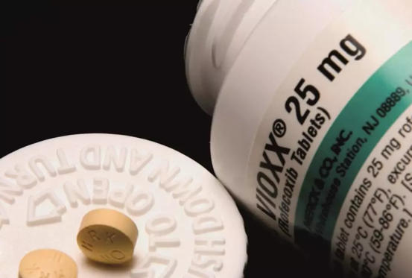
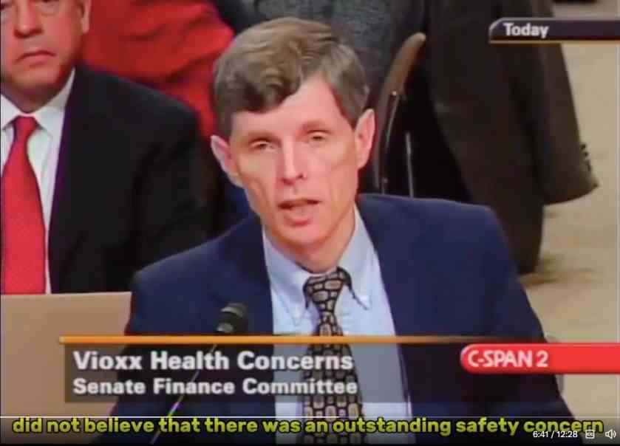
In 2004, FDA research epidemiologist David Graham testified before congress on how the FDA suppressed safety concerns over the anti-inflammatory Vioxx. Graham estimates that the FDA’s negligence led to at least 100,000 heart attacks with as many as 40,000 deaths. Eventually, the makers of Vioxx pulled this drug from the market on their own initiative.
Graham claimed this was not isolated incident, and that the FDA consistently downplayed new safety concerns on drugs that were previously FDA-approved.
https://x.com/MidwesternDoc/status/1817610306782425133

Slide 10
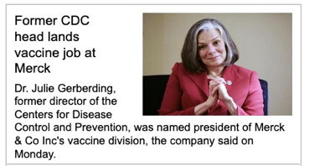
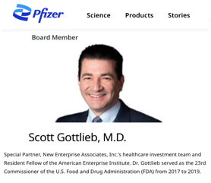
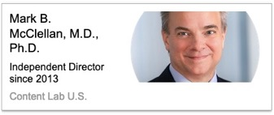
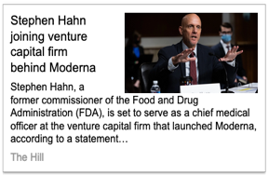
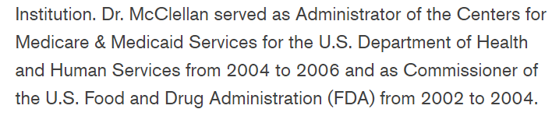
Another concern is how the revolving door between these agencies & Big Pharma contributes to this ongoing conflict of interest in public health and special interests.

Slide 11

Who funds the WHO?

Slide 12
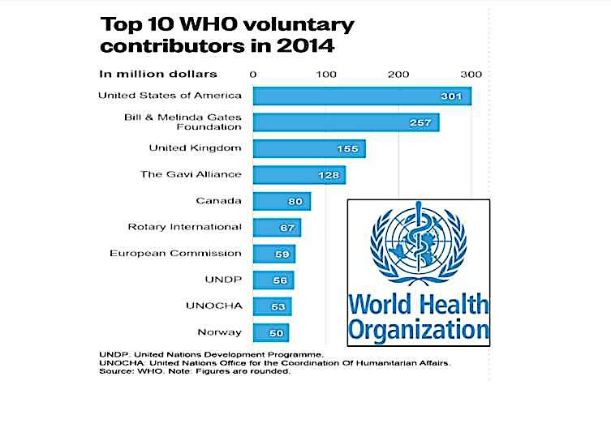

Slide 13
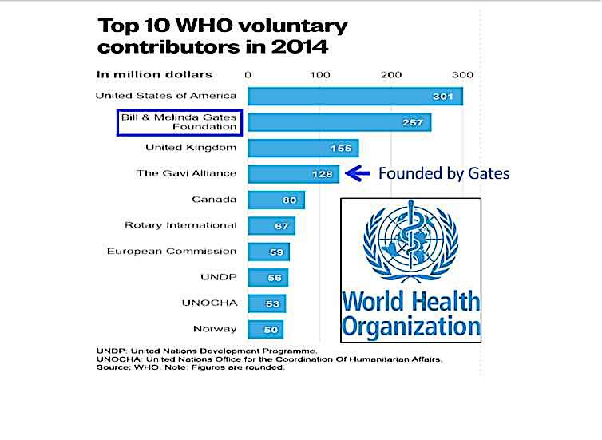
The Gates Foundation is the (unofficial) top funder of the WHO.

Slide 14
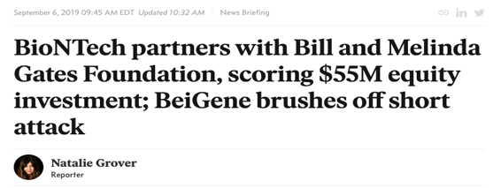
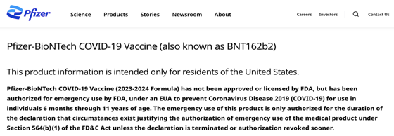
In 2019 Gates partnered with one of the main producers of mRNA vaccines, so it was in their interest to fund influential institutions of public health like the WHO and CDC.
https://www.pfizer.com/products/product-detail/pfizer-biontech-covid-19-vaccine
https://endpts.com/biontech-partners-with-bill-and-melinda-gates-foundation-scoring-55m-equity-investment-novartis-sells-china-unit/

Slide 15
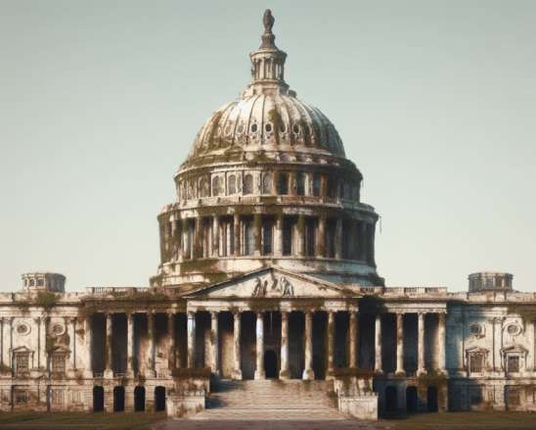
2. Problematic Legislation
Image generated by Image Creator from Microsoft Bing

Slide 16
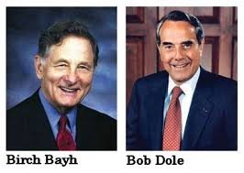
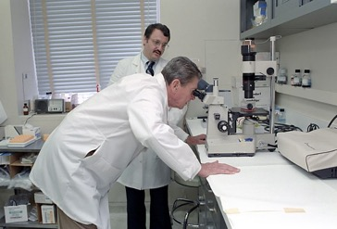


The Bayh-Dole Act of 1980 allowed federal agencies to collect royalties.
https://www.hhs.gov/about/news/2023/03/21/hhs-doc-announce-plan-review-march-in-authority.html.
NIH now benefits from all purchases of mRNA vaccines because Moderna and NIH “co-own” the patent for this commercial product.
This is a conflict of interest because NIH is also the primary US government agency responsible for research that determines public health.
President Reagan during a visit to NIH.

Slide 17
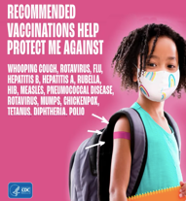
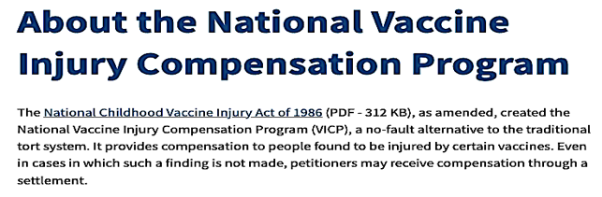
The National Childhood Vaccine Injury Act of 1986 provided liability protection to manufacturers of all products listed on the childhood immunization schedule.
https://digitalcommons.law.uw.edu/cgi/viewcontent.cgi?article=3792&context=wlr.
This made childhood vaccines far more profitable because it shifted financial responsibility for vaccine injury to taxpayers by means of a “vaccine court” administered by Health and Human Services. https://www.hrsa.gov/vaccine-compensation/about

Slide 18
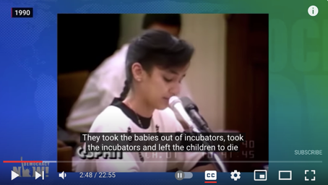
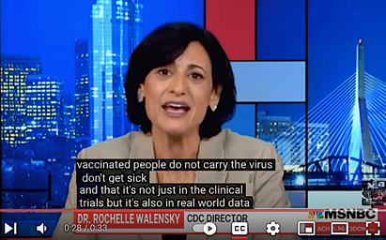
HR-5736 Smith Mundt Modernization Act of 2012 lifted the domestic ban on government propaganda. Prior to this law, most government propaganda could only be disseminated in other nations. https://www.usagm.gov/who-we-are/oversight/legislation/smith-mundt-faqs/
A critic raised concerns that this law lacked oversight, and that there was no way of assuring the accuracy of this information.
https://www.buzzfeednews.com/article/mhastings/congressmen-seek-to-lift-propaganda-ban
The daughter of a Kuwaiti ambassador presenting fictitious testimony to garner support for the Gulf War.
Head of CDC Rochelle Wallensky presenting unsupported claims to garner wider acceptance of COVID vaccines.

Slide 19
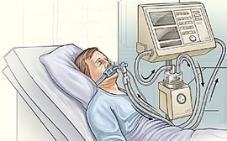

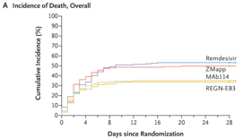
The Prep Act of 2020 provided liability protection to health workers and manufacturers from all procedures and products designated as “pandemic countermeasures.”
https://www.federalregister.gov/documents/2020/03/17/2020-05484/declaration-under-the-public-readiness-and-emergency-preparedness-act-for-medical-countermeasures
A repurposed Ebola drug became the “standard of care” for hospitalized COVID-19 patients despite its deeply problematic safely profile.
https://www.nejm.org/doi/10.1056/NEJMoa1910993?url_ver=Z39.88-2003&rfr_id=ori:rid:crossref.org&rfr_dat=cr_pub%20%200pubmed
https://principia-scientific.com/doctor-reveals-remdesivir-is-real-cause-of-covid-19-maladies/

Slide 20
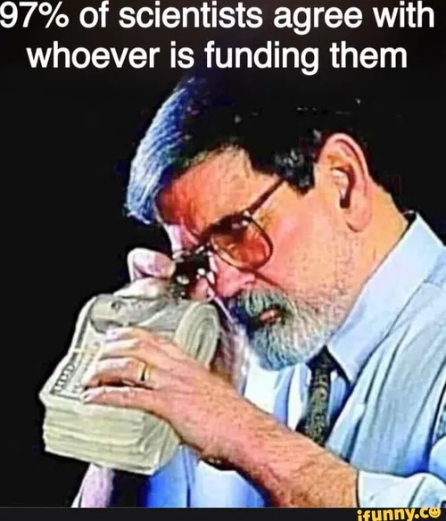

Slide 21

Acknowledgement:
Unless otherwise indicated, all images in this presentation were downloaded from Wikimedia Commons: https://commons.wikimedia.org/wiki/Main_Page

