Slide 1
Did CARES Act funding undermine the accuracy COVID-19 death reporting?
A statistical inquiry by Antonio Chaves
Adobe Photoshop stock image

Slide 2
Abstract: During the first half of 2020 the most deaths from COVID-19 were reported in the Northeast and Midwest, but by the end of 2021 this trend shifted to Southern and Western states. This shift has been attributed in part to a lack of masking and social distancing in these states, but this analysis fails to adjust for differences in pre-existing comorbidities and massive disparities in CARES funding per state (from $20,000 per COVID patient in New York to $470,000 per patient in West Virginia). Preliminary statistical analysis reveals a positive correlation between CARES payments and COVID deaths. Did hospitals in states with higher payments lower their reporting standards in order to get more funding? If these causes of death are inaccurate, how might they have been misconstrued?

Slide 3
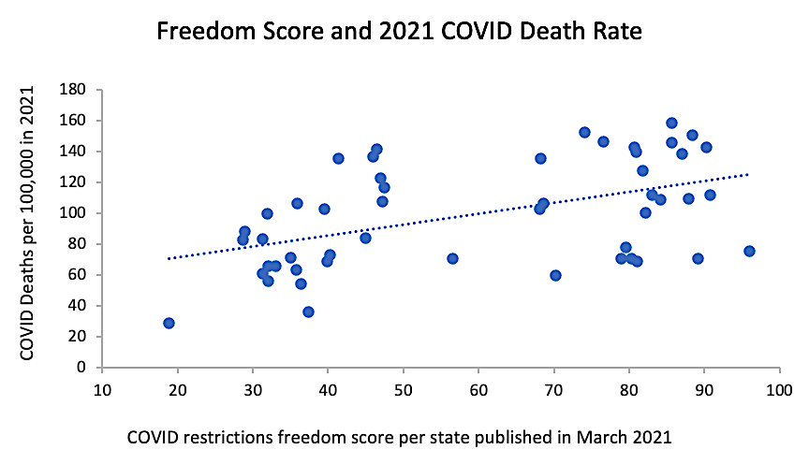
This graph supports the hypothesis that coronavirus restrictions “saved lives.”
But this raw data fails to account for pre-existing differences between these states.
r = 0.49
(Pearson)
X-axis data from WalletHub: https://wallethub.com/edu/states-coronavirus-restrictions/73818
Y-axis data from the CDC: https://www.cdc.gov/nchs/pressroom/sosmap/covid19_mortality_final/COVID19.htm

Slide 4
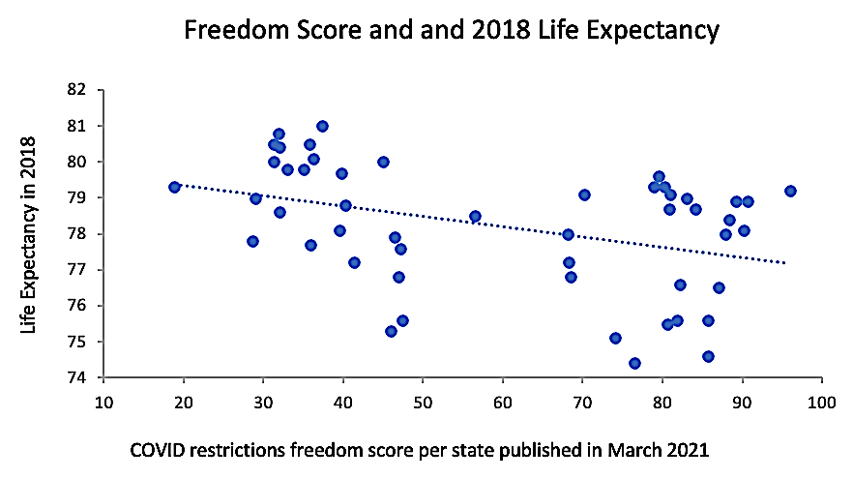
On average, people in states with less COVID restrictions also had lower life expectancies.
r = -0.39
P < 0.01
(Pearson)
r = -0.41
P < 0.005
(Spearman)
X-axis data from WalletHub: https://wallethub.com/edu/states-coronavirus-restrictions/73818
Y-axis data from the CDC: https://www.cdc.gov/nchs/pressroom/sosmap/life_expectancy/life_expectancy.htm

Slide 5
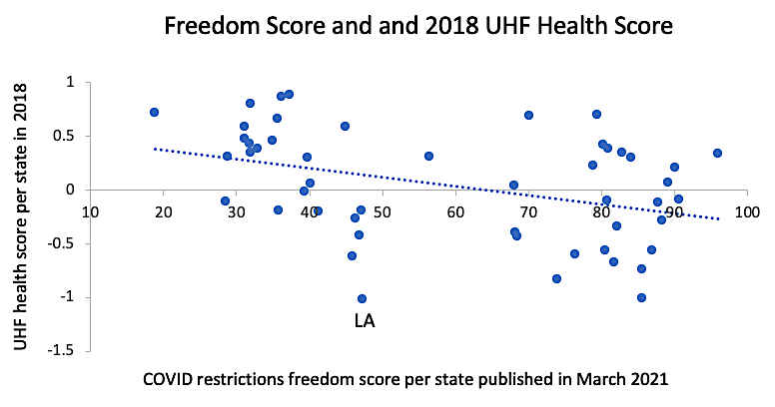
Residents of states with less COVID restrictions were also more likely to score poorly on health.
r = -0.39
P < 0.01
(Pearson)
r = -0.43
P < 0.005
(Spearman)
X-axis data from WalletHub: https://wallethub.com/edu/states-coronavirus-restrictions/73818
Y-axis data from the United Health Foundation: https://assets.americashealthrankings.org/app/uploads/2018ahrannual_020419.pdf

Slide 6
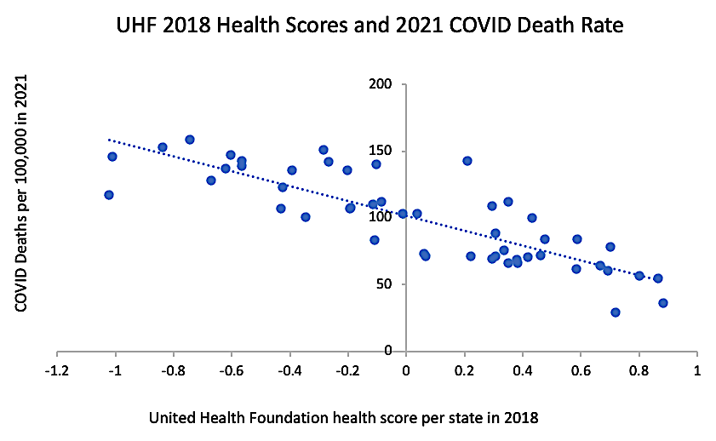
People with better overall health are less likely to die from respiratory infections.
r = -0.84
(Pearson)
X-axis data from the United Health Foundation: https://assets.americashealthrankings.org/app/uploads/2018ahrannual_020419.pdf
Y-axis data from the CDC: https://www.cdc.gov/nchs/pressroom/sosmap/covid19_mortality_final/COVID19.htm

Slide 7
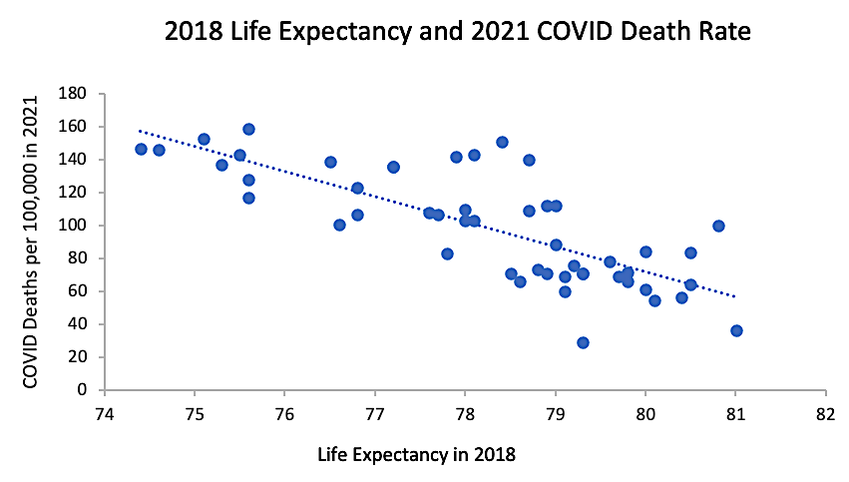
Reporting of COVID-19 deaths are also inversely correlated with life expectancy.
r = -0.77
(Pearson)
X-axis data from the CDC: https://www.cdc.gov/nchs/pressroom/sosmap/life_expectancy/life_expectancy.htm
Y-axis data from the CDC: https://www.cdc.gov/nchs/pressroom/sosmap/covid19_mortality_final/COVID19.htm

Slide 8
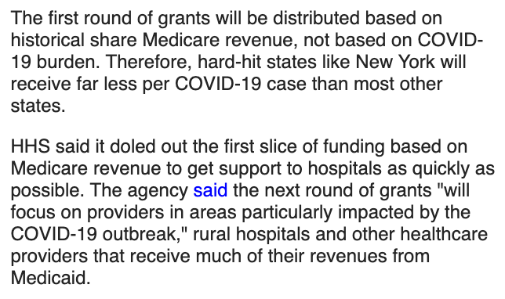
Did CARES funding adversely affect the reporting of COVID deaths per state?
Why did states like Nebraska and West Virginia get 20X more funding per patient than New York and New Jersey?
Data from Becker’s Hospital Review: https://www.beckershospitalreview.com/finance/state-by-state-breakdown-of-federal-aid-per-covid-19-case.html

Slide 9
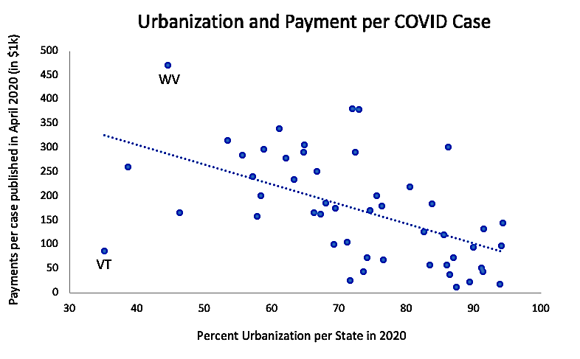
States that were more urbanized often received lower payments.
r = -0.54
(Pearson)
X-axis data from the Visual Capitalist: https://www.visualcapitalist.com/sp/mapping-us-urbanization-by-state/
Y-axis data from Becker’s Hospital Review: https://www.beckershospitalreview.com/finance/state-by-state-breakdown-of-federal-aid-per-covid-19-case.html

Slide 10
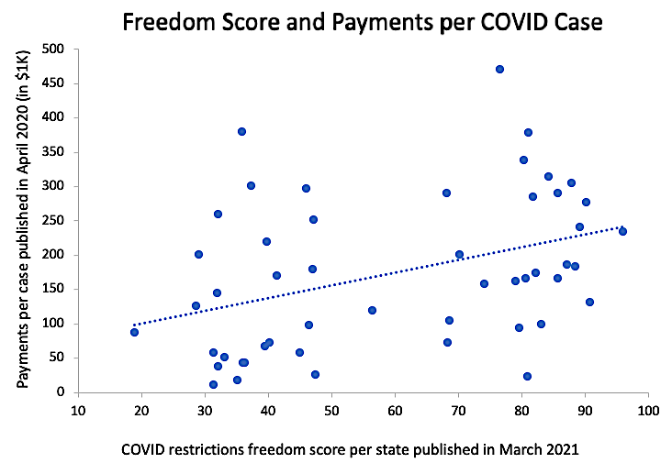
States with less coronavirus restrictions often received higher payments.
r = 0.39
P < 0.01
(Pearson)
r = 0.41
P < 0.005
(Spearman)
X-axis data from WalletHub: https://wallethub.com/edu/states-coronavirus-restrictions/73818
Y-axis data from Becker’s Hospital Review: https://www.beckershospitalreview.com/finance/state-by-state-breakdown-of-federal-aid-per-covid-19-case.html

Slide 11
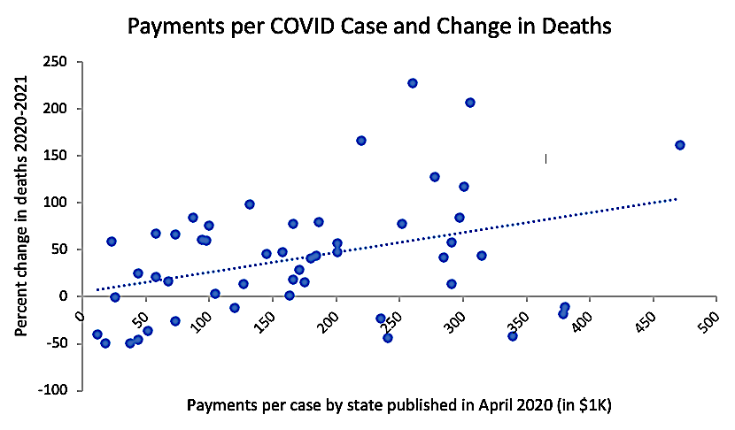
Did these higher CARES payments influence how some states reported COVID deaths in 2021?
If many of these deaths were not caused by COVID-19, how were these numbers generated?
r = 0.37
P < 0.01
(Pearson)
r = 0.32
P < 0.05
(Spearman)
X-axis data from Becker’s Hospital Review: https://www.beckershospitalreview.com/finance/state-by-state-breakdown-of-federal-aid-per-covid-19-case.html
Y-axis data from the CDC: https://www.cdc.gov/nchs/pressroom/sosmap/covid19_mortality_final/COVID19.htm

Slide 12
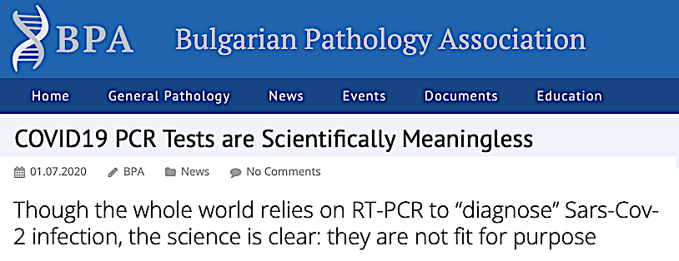
How reliable were the COVID tests?
If PCR testing often generates false positives, what are the odds a hospital patient will be misdiagnosed after getting tested multiple times?
Did high CARES payments incentivize hospitals and clinics to test more frequently?
From the Bulgarian Pathology Association: https://bpa-pathology.com/covid19-pcr-tests-are-scientifically-meaningless/
From the Internet Archive: https://archive.org/details/kary-mullis-with-pcr-you-can-find-almost-anything-in-anybody

Slide 13
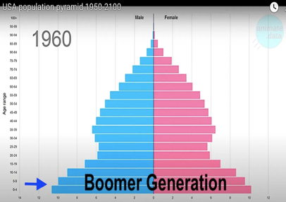
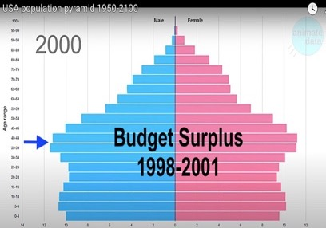
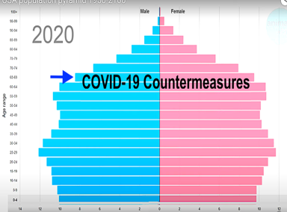
Could some “COVID” deaths be attributed to this anticipated rise in all-cause mortality*?
The term “boomer” refers to Americans born during the “baby boom” that happened after the end of World War II (1946 to 1964).
The budget surplus of 1998-2001 was largely driven by a critical mass of working Americans contributing record amounts of tax revenue during the 1980’s and 1990’s. This is when boomers were in their prime.
In 2020, boomers were between ages 56 and 76. This is when many of them started to die off.
*Hat Tip: Jonathan Couey of Gigaohm Biological https://gigaohmbiological.com/
Video stills from AnimateData: https://www.youtube.com/@AnimateData

Slide 14
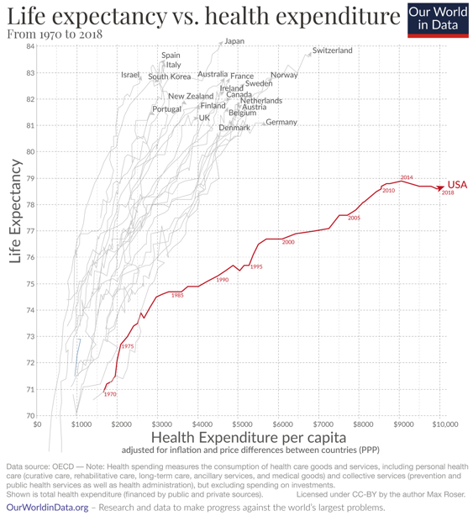
Could some “COVID” deaths be attributed to the recent decline in US life expectancy?
Why did life US life expectancy decline in 2016 and 2018!?
Max Roser (2020) - “Why is life expectancy in the US lower than in other rich countries?” Published online at OurWorldinData.org. Retrieved from: https://ourworldindata.org/us-life-expectancy-low

Slide 15
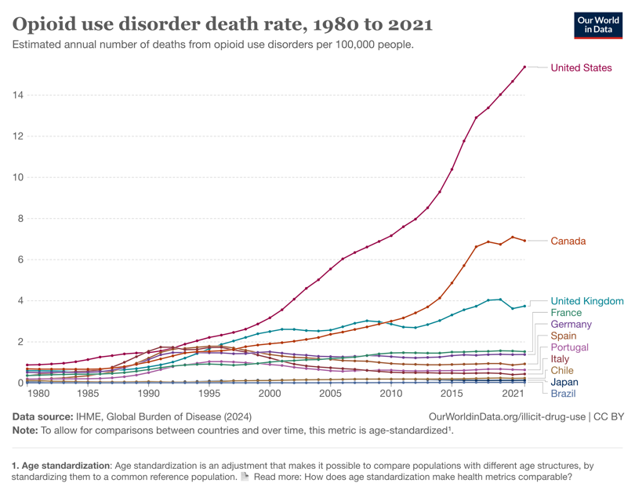
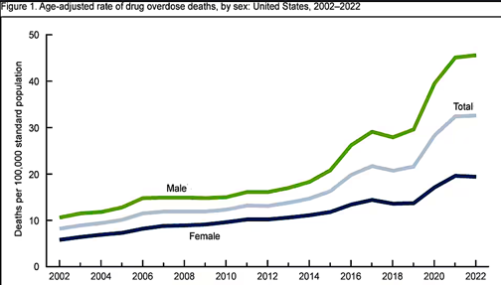
Could some “COVID” deaths be attributed to opioids?*
This chart from the CDC shows US drug overdose deaths spiking …in 2020.
https://www.cdc.gov/nchs/products/databriefs/db491.htm
*Hat Tip: Mark Kulacz of Housatonic https://rumble.com/user/Housatonic
Max Roser (2020) - “Why is life expectancy in the US lower than in other rich countries?” Published online at OurWorldinData.org. Retrieved from: https://ourworldindata.org/us-life-expectancy-low

Slide 16
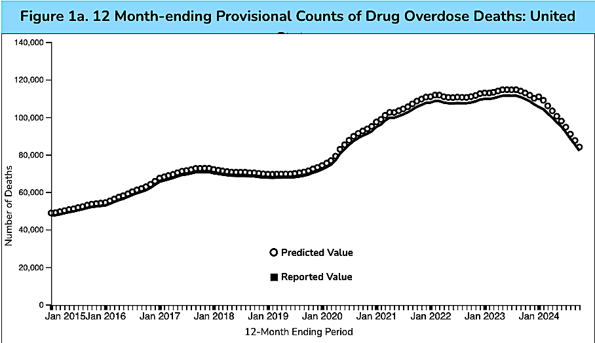
This interactive chart from the CDC indicates that about 416,000 Americans died from drug overdoses from January of 2020 to January of 2024 (about 100,000 per year).
Data downloaded from the CDC: https://www.cdc.gov/nchs/nvss/vsrr/drug-overdose-data.htm

Slide 17
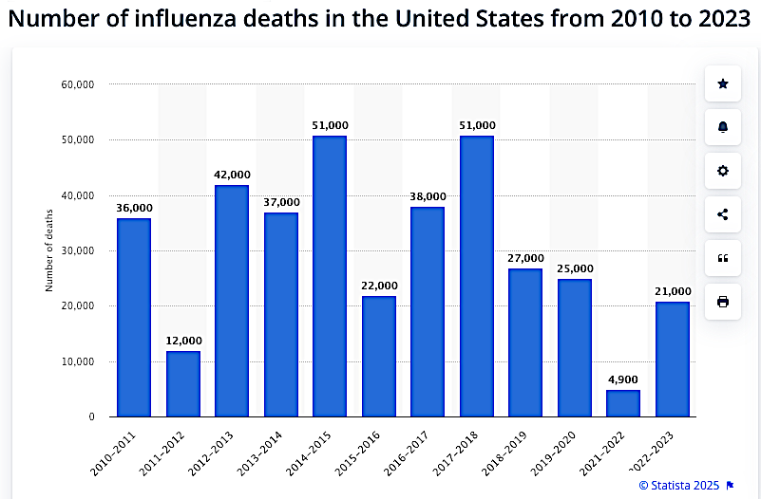
Could some “COVID” deaths be attributed to underreporting of the seasonal flu?
?
Data downloaded from Statista: https://www.statista.com/statistics/1124915/flu-deaths-number-us/

Slide 18
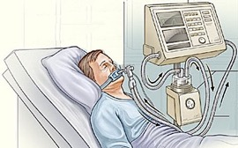
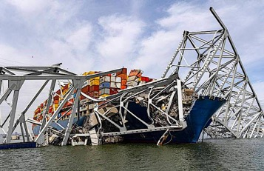
Did pandemic countermeasures make things worse?
The Prep Act of 2020 provided liability protection to health workers and manufacturers from all procedures and products designated as “pandemic countermeasures.”
https://www.federalregister.gov/documents/2020/03/17/2020-05484/declaration-under-the-public-readiness-and-emergency-preparedness-act-for-medical-countermeasures
Did the Prep Act liability protections and CARES Act funding incentivize US hospitals to prioritize novel countermeasures over patient needs?
Did novel recommendations like widespread intubation/ventilation, remdesivir (US), midazolam (UK), high-flow oxygen,* and the withholding of antibiotics do more harm than good?
Hanlon’s razor: Never attribute to malice that which can be adequately explained by incompetence or stupidity.
Key Bridge Collapse in Baltimore (3/26/24)
*Hat Tip: Mark Kulacz of Housatonic https://rumble.com/user/Housatonic

Slide 19
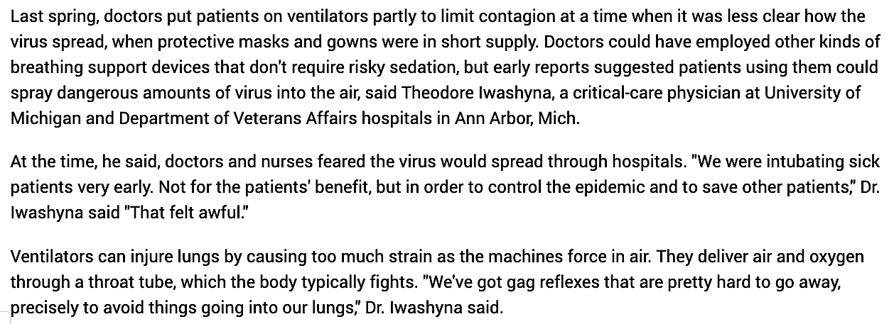
Widespread intubation/ventilation was “not for the patients’ benefit” but to “control the epidemic.”

Slide 20
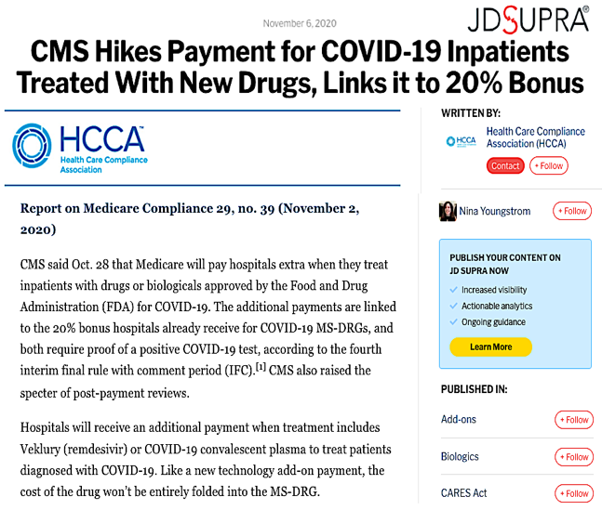
Bonuses were given for remdesivir despite its questionable efficacy and problematic safety record.
From Forbes: https://www.forbes.com/sites/jvchamary/2021/01/31/remdesivir-covid-coronavirus/
From Clinical Pharmacology & Therapeutics: https://pubmed.ncbi.nlm.nih.gov/33340409/
Posted in JD Supra: https://www.jdsupra.com/legalnews/cms-hikes-payment-for-covid-19-19452/

Slide 21
High-flow oxygen therapy may have also irreversibly damaged the lungs of some COVID patients.
From Medicina Intensiva: https://www.medintensiva.org/en-pulmonary-toxicity-by-oxygen-covid-19-articulo-S2173572722000777

Slide 22
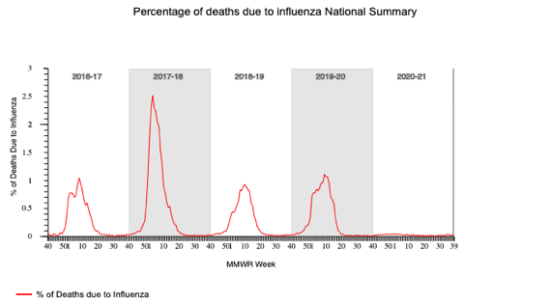
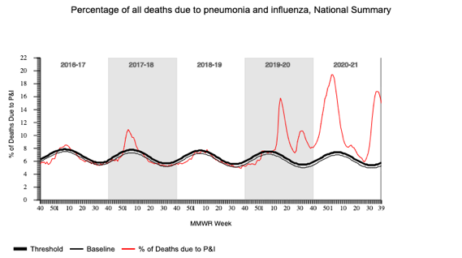
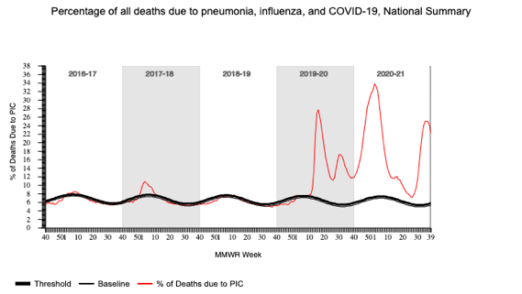
Why did influenza deaths “disappear” 2020-2021?
Why did pneumonia deaths spike 2020-2021?
Why do pneumonia and COVID deaths coincide?*
*Hat Tip: Jonathan Couey of Gigaohm Biological https://gigaohmbiological.com/
Downloaded from the CDC: https://gis.cdc.gov/grasp/fluview/mortality.html

Slide 23
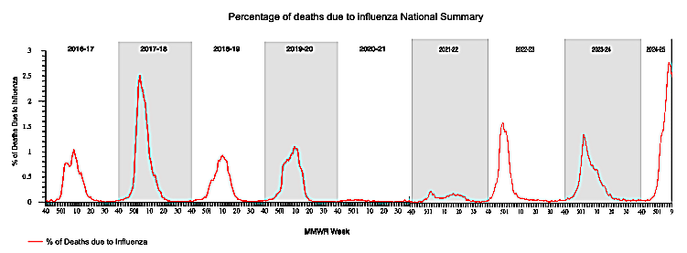
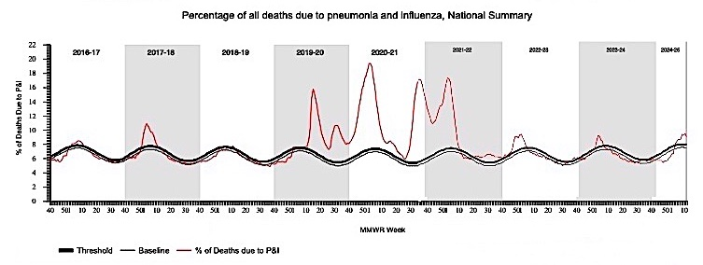
Why did influenza and pneumonia mortality return to “pre-pandemic” levels after 2022?
Downloaded from the CDC: https://gis.cdc.gov/grasp/fluview/mortality.html

Slide 24
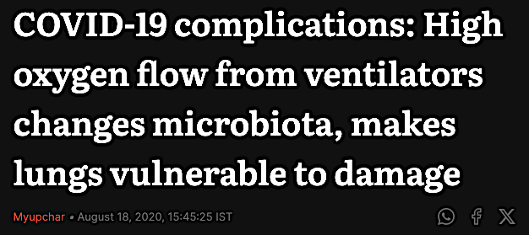
Did government recommendations prevent health workers from detecting the bacterial pneumonia brought about by prolonged exposure to high flow oxygen?
…high flow oxygen from mechanical ventilation promotes the growth of microbes (such as Staphylococcus aureus) in the lungs which can result in pneumonia and abscess. From First Post: https://www.firstpost.com/health/covid-19-complications-high-oxygen-flow-from-ventilators-changes-microbiota-makes-lungs-vulnerable-to-damage-8723411.html
From the CDC: https://www.cdc.gov/antimicrobial-resistance/data-research/threats/COVID-19.html

Slide 25
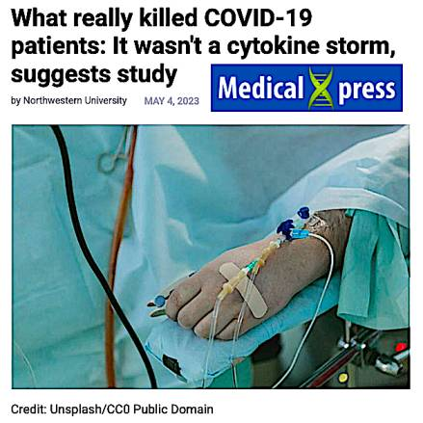
Septic shock is a well-known consequence of untreated pneumonia. How many instances of septic shock were mislabeled as a “cytokine storm”?
The investigators found nearly half of patients with COVID-19 develop a secondary ventilator-associated bacterial pneumonia…Those who were cured of their secondary pneumonia were likely to live, while those whose pneumonia did not resolve were more likely to die…The study findings also negate the cytokine storm theory,…
Downloaded from: https://medicalxpress.com/news/2023-05-covid-patients-wasnt-cytokine-storm.html

Slide 26
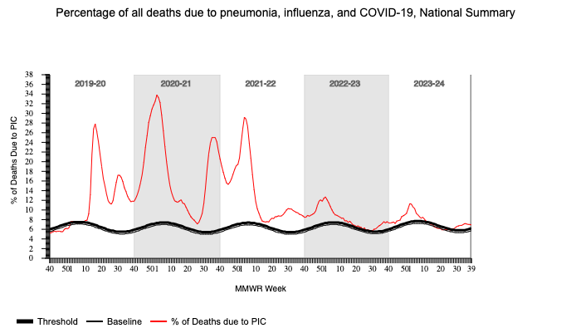
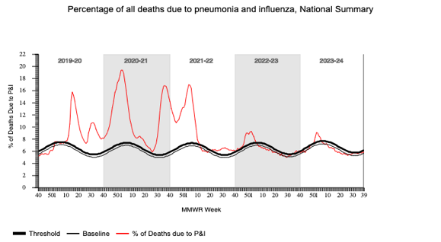
How many of these “COVID” deaths are the consequences of bacterial pneumonia?
How many “COVID” deaths could have been prevented by treatment with antibiotics?
Downloaded from the CDC: https://gis.cdc.gov/grasp/fluview/mortality.html

Slide 27
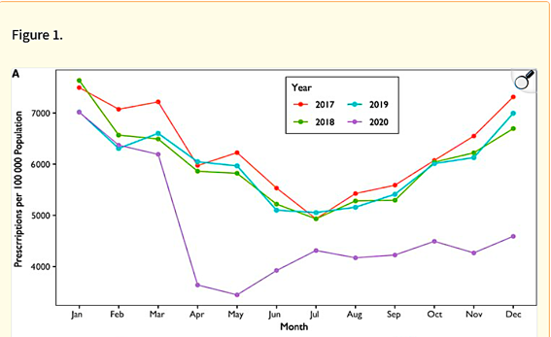
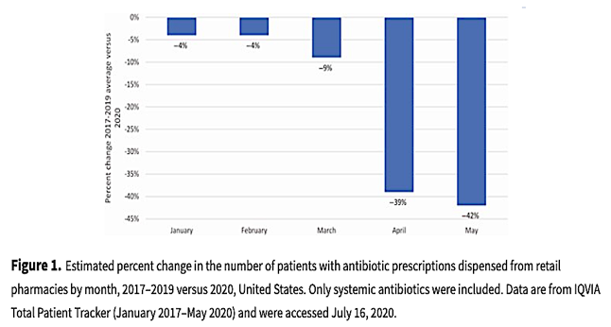
These articles report massive declines in antibiotic prescriptions in the US during the spring of 2020.
Downloaded from: https://pmc.ncbi.nlm.nih.gov/articles/PMC10026546/
Downloaded from : https://academic.oup.com/cid/article/73/3/e652/6054971

Slide 28
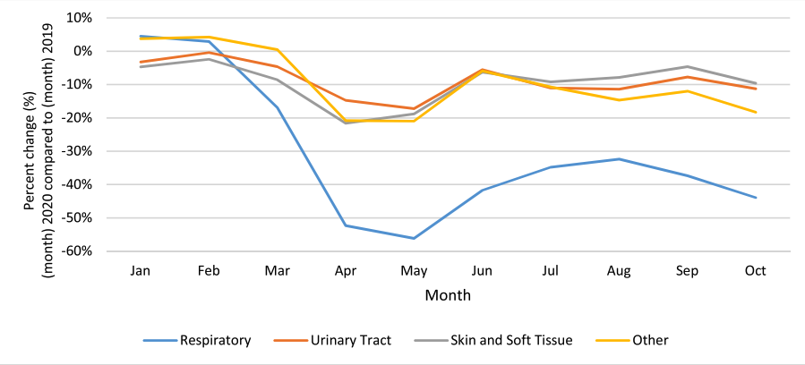
This chart from Canada shows the steepest decline for treatment of respiratory infections.
Downloaded from : https://www.clinicalmicrobiologyandinfection.com/article/S1198-743X(21)00614-5/pdf

Slide 29
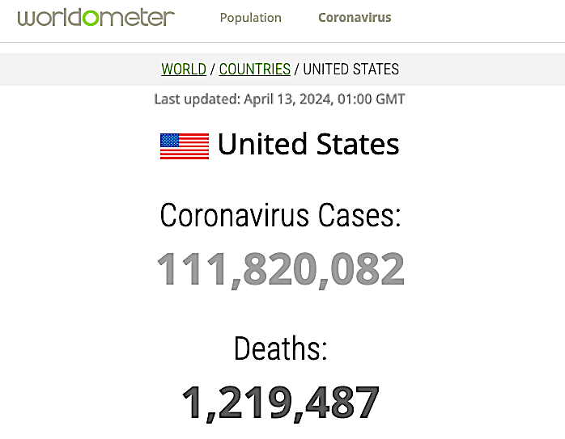
Will we ever learn the true number of Americans that died of COVID-19?
From the Worldometer: https://www.worldometers.info/coronavirus/country/US/

Slide 30
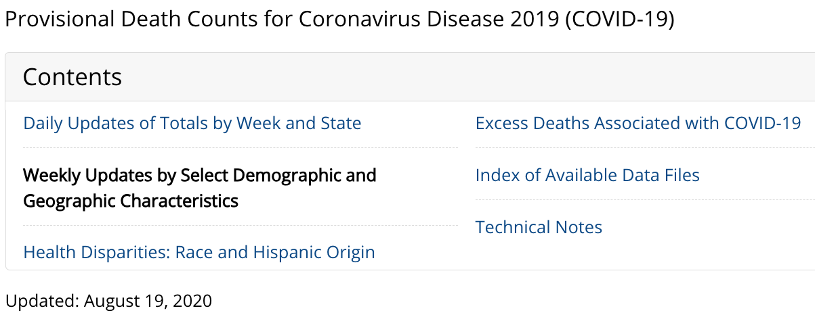
According to the CDC, only 6% of “COVID deaths” listed COVID-19 as the sole cause.
From the CDC: https://web.archive.org/web/20200817174827/https://www.cdc.gov/nchs/nvss/vsrr/covid_weekly/index.htm

Slide 32
entropyrider.com

