Slide 1
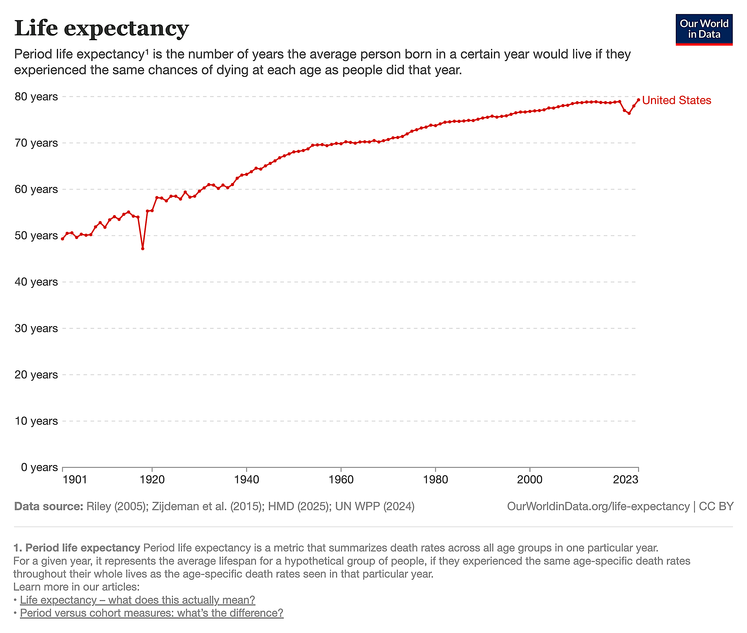
Life Expectancy by Nation 1900-2023
https://ourworldindata.org/life-expectancy

Slide 2
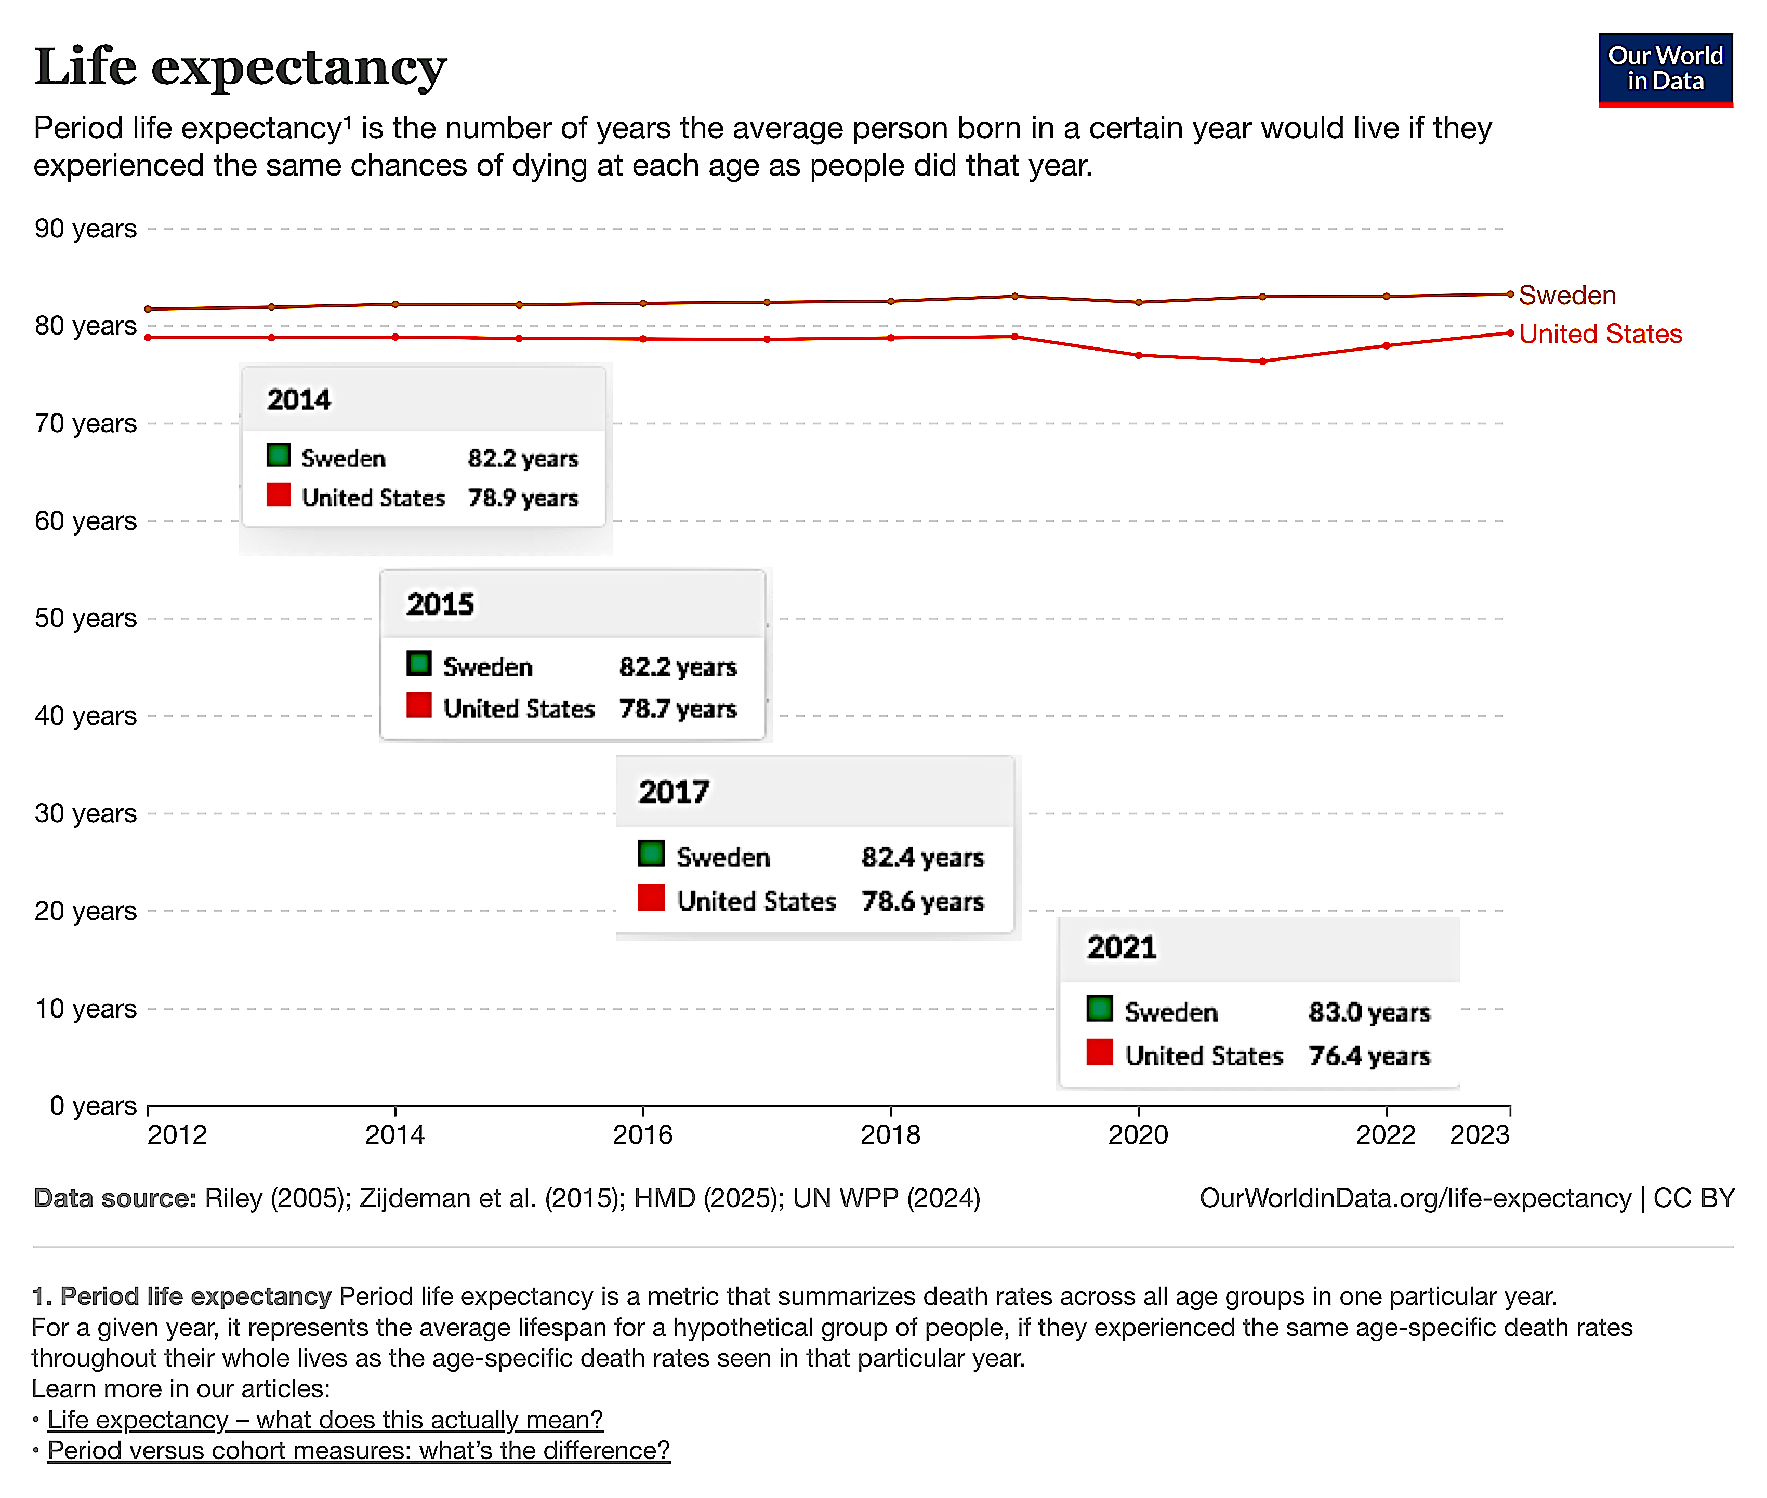
Life Expectancy by Nation 1900-2023
https://ourworldindata.org/life-expectancy

Slide 3
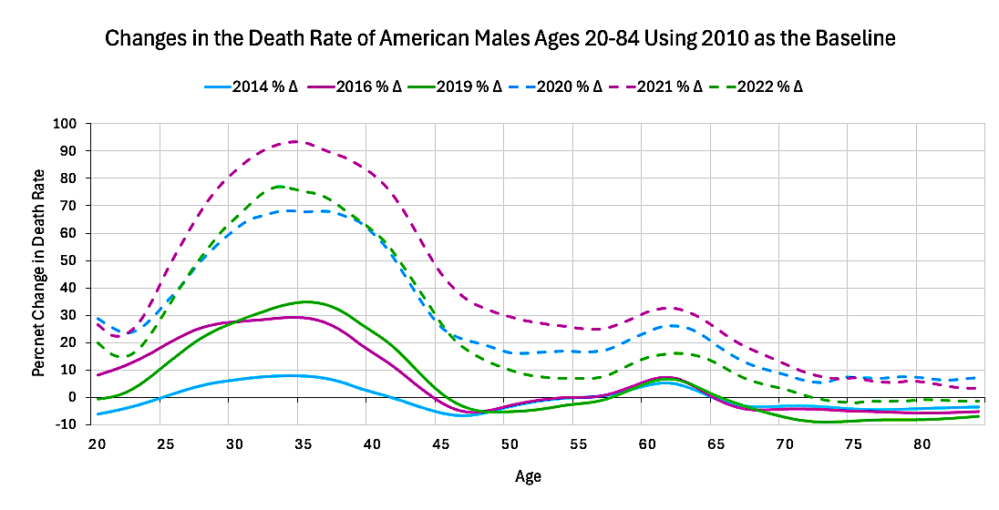
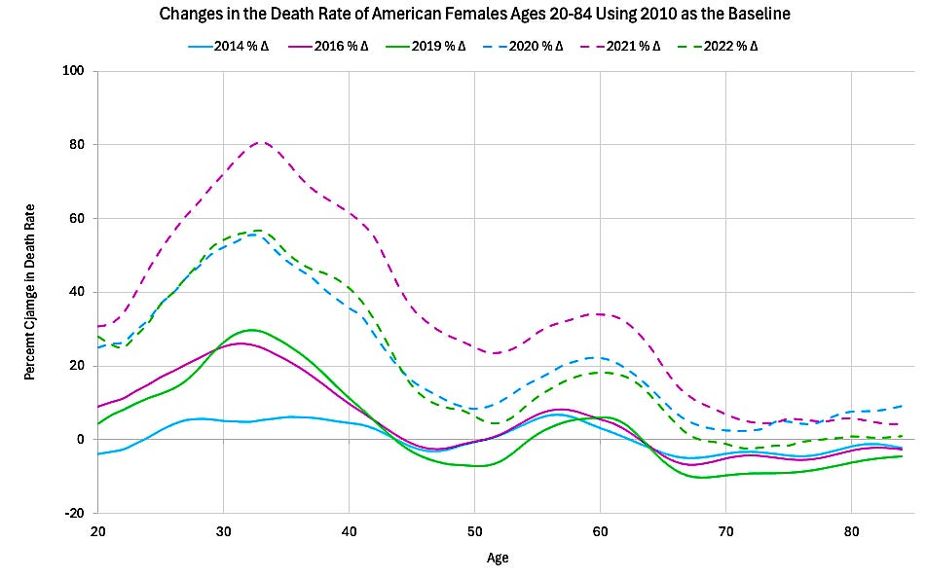
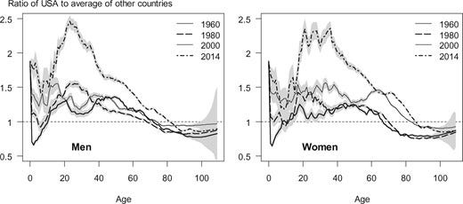
Death Rate Comparison by Age and by Year
These numbers are calculated from raw data from the Actuarial Life Table of the US Social Security Administration
https://www.ssa.gov/oact/STATS/table4c6.html
M. Barbieri. Contribution of Drug-Related Deaths to the US Disadvantage in Mortality. International Journal of Epidemiology. 48(3) 2019: https://academic.oup.com/ije/article/48/3/945/5265302?login=false

Slide 4
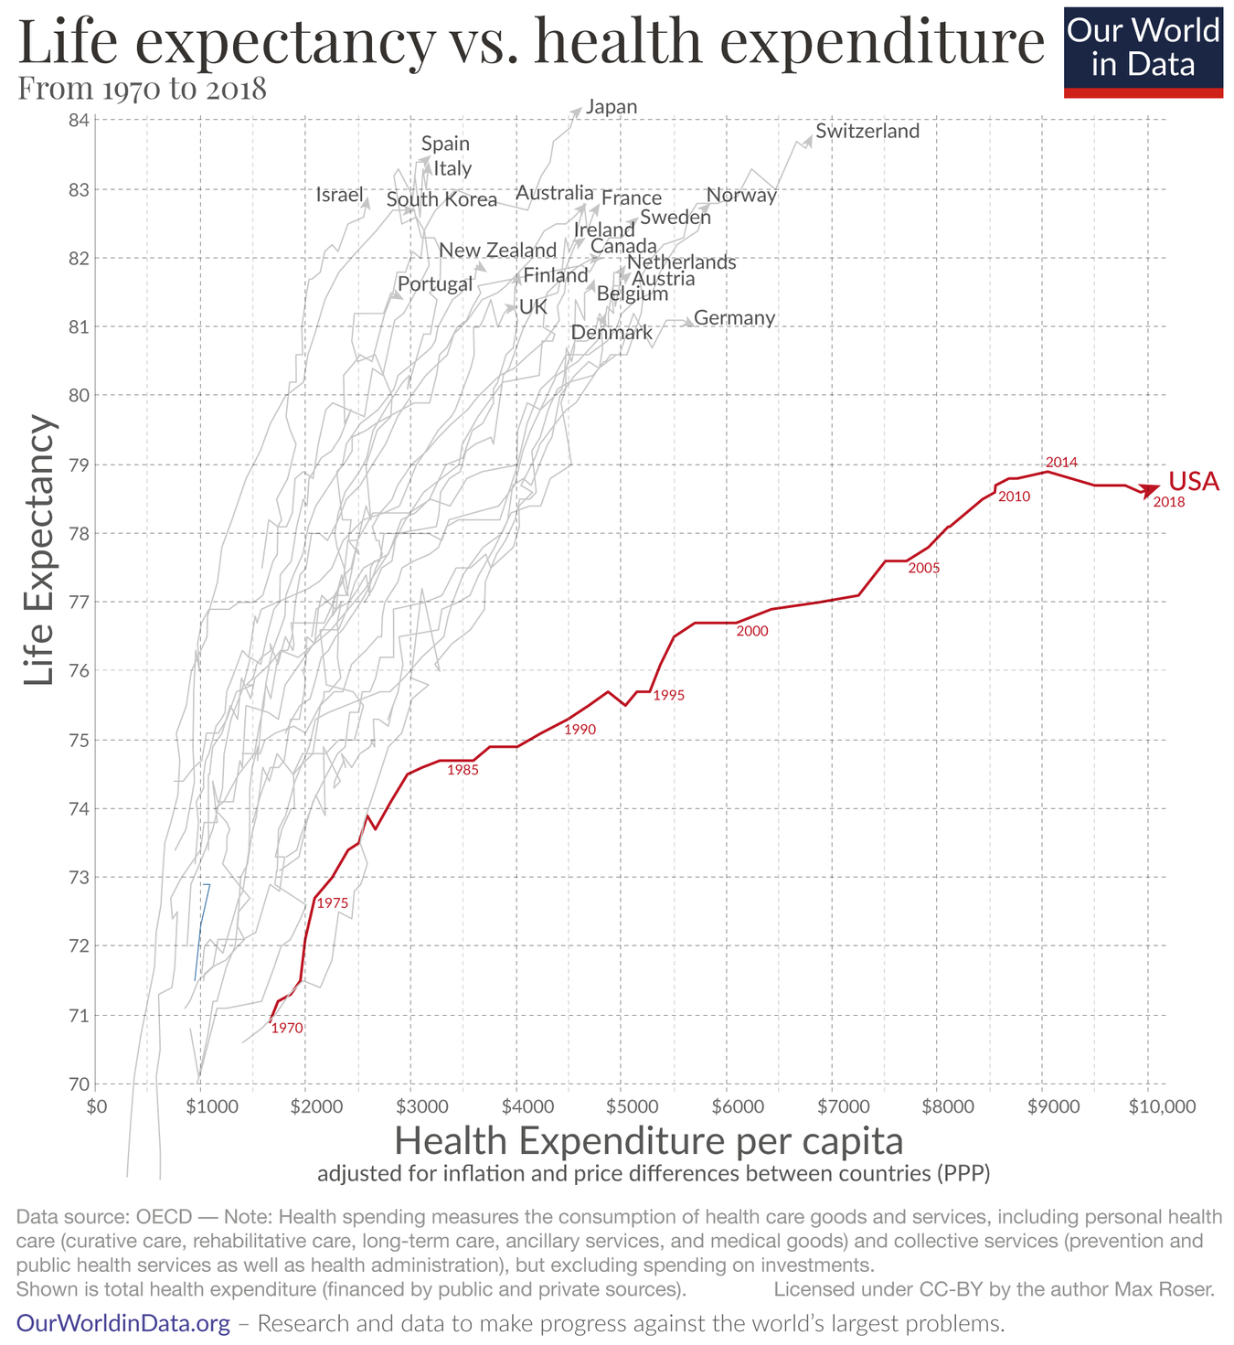
https://ourworldindata.org/us-life-expectancy-low

Slide 5
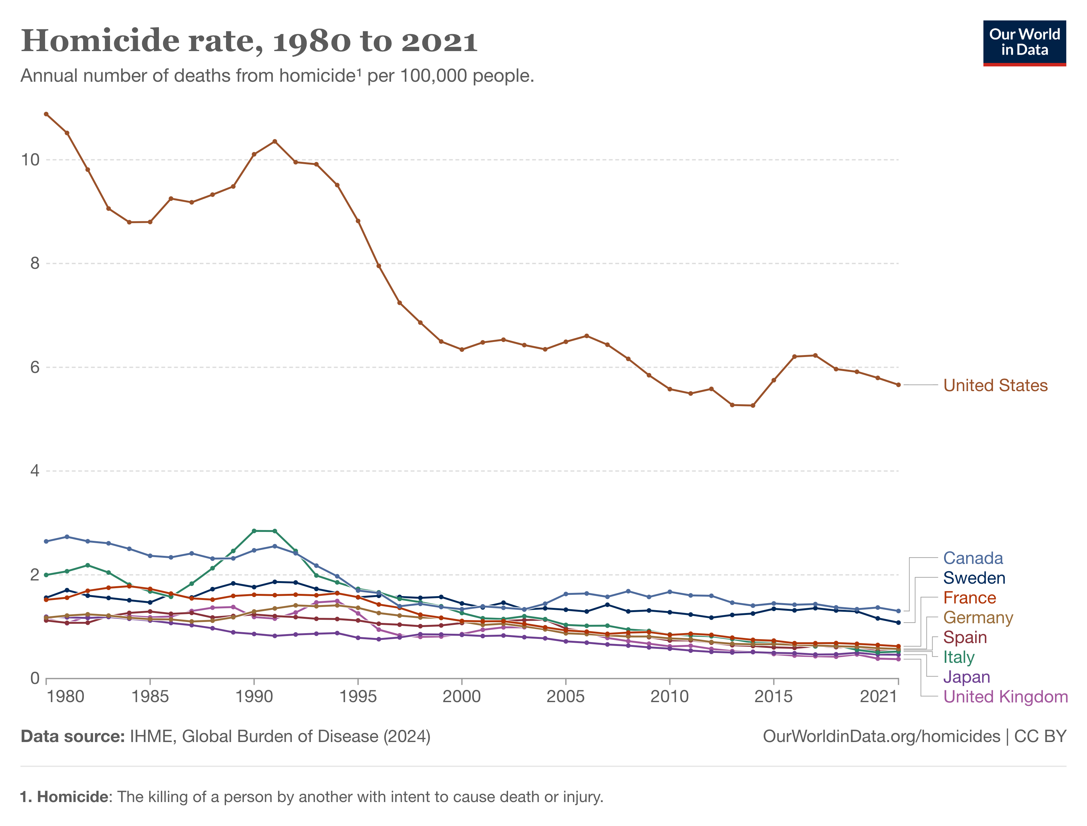
https://ourworldindata.org/us-life-expectancy-low

Slide 6
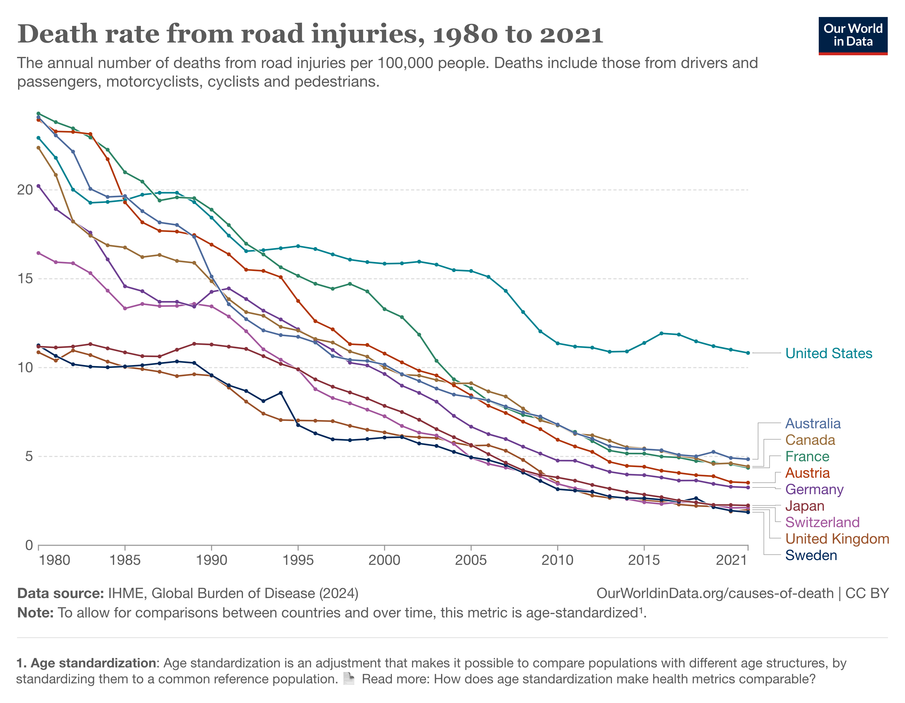
https://ourworldindata.org/us-life-expectancy-low

Slide 7
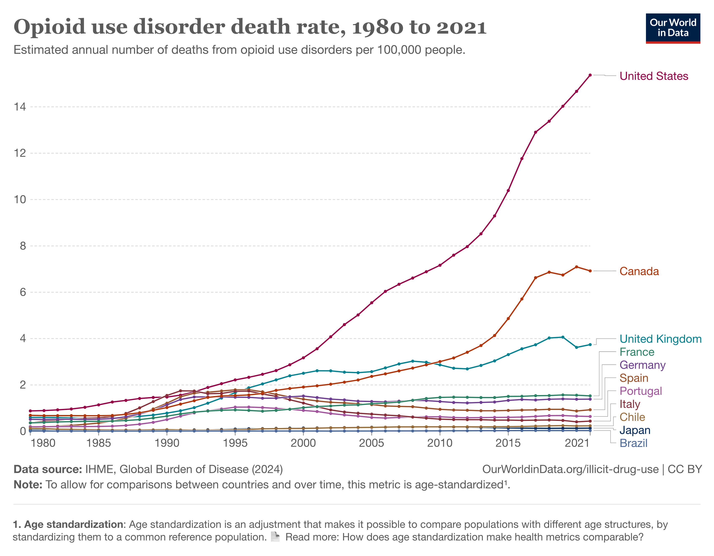
https://ourworldindata.org/us-life-expectancy-low

Slide 8
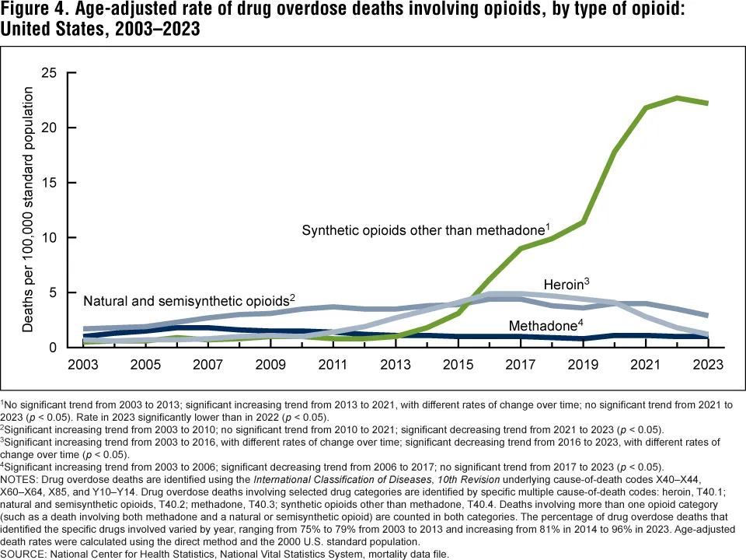
Data Briefs Number 428. December 2021. https://www.cdc.gov/nchs/products/databriefs/db428.htm

Slide 9
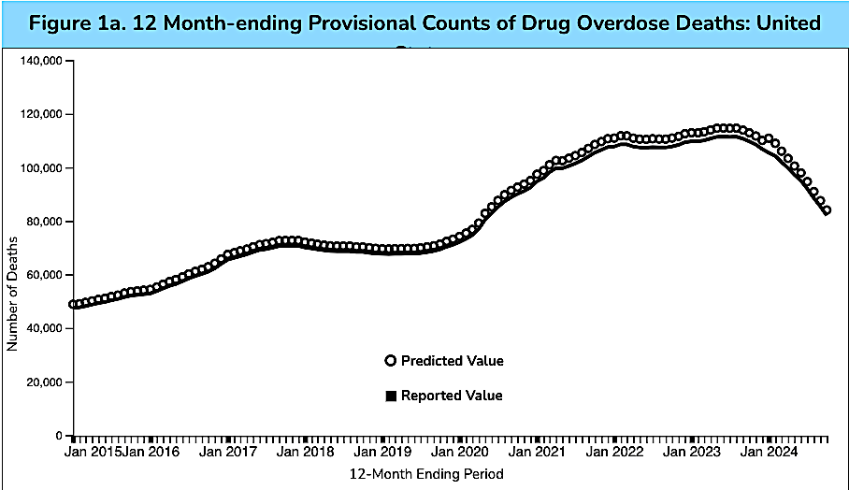
This interactive chart from the CDC indicates that about 416,000 Americans died from drug overdoses from January of 2020 to January of 2024. This comes out to an average of over 100,000 per year.
Data downloaded from the CDC: https://www.cdc.gov/nchs/nvss/vsrr/drug-overdose-data.htm

Slide 10
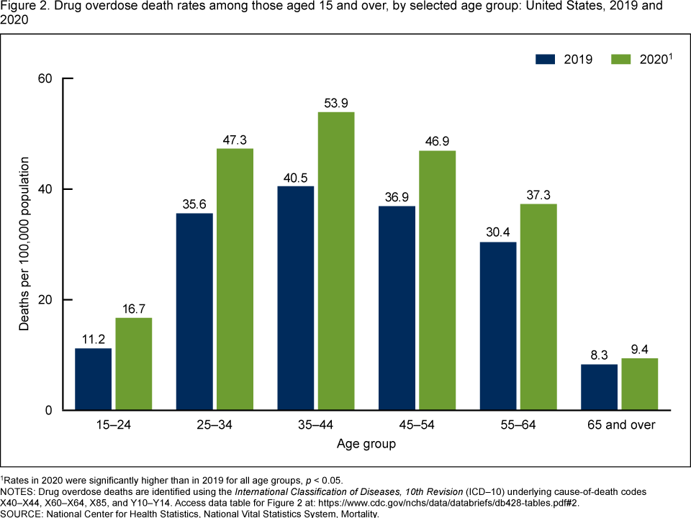
Data Briefs Number 428. December 2021. https://www.cdc.gov/nchs/products/databriefs/db428.htm

