Slide 1
Life Expectancy Comparison by Gender:
Go to the WHO website: https://www.who.int/
Go to the “Data” drop down menu and choose the “Global Health Observatory.”
Go to “Indicators” page and then scroll to the bottom and click on the link for accessing the “old” Global Health Observatory data. This link is directly under the list of indicators in the new system. If you cannot find the link to the old system, use this direct link:
  https://apps.who.int/gho/data/node.main
Click on “Mortality and global health estimates.” Direct link:
https://apps.who.int/gho/data/node.main.686?lang=en

Slide 2
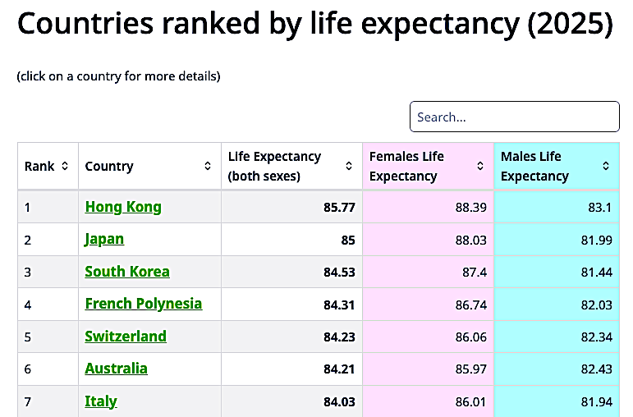
Life Expectancy Comparison by Gender
Or simply open the following alternate link:
https://apps.who.int/gho/data/node.main.1?lang=en
The WHO system was completely redesigned so just open the following link:
https://www.worldometers.info/demographics/life-expectancy/
After you open it, copy and past the accessed data to your spreadsheet:

Slide 3
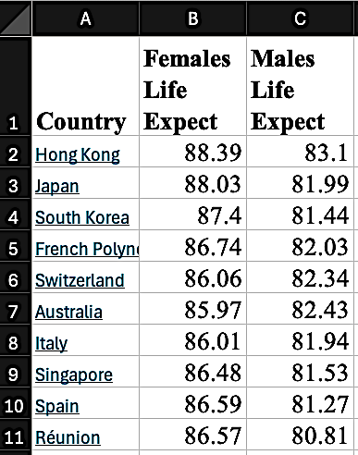
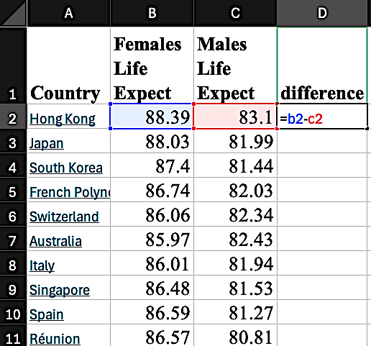
Life Expectancy Comparison by Gender
Remove the columns you do not need:
Insert this equation to calculate the gender difference:

Slide 4
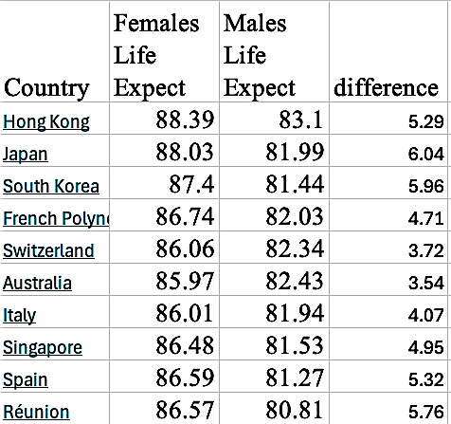
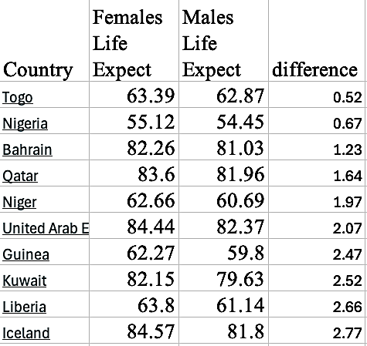
Life Expectancy Comparison by Gender
Copy and paste the equation to the remaining rows:
Sort the nations in order of life expectancy difference:

Slide 5
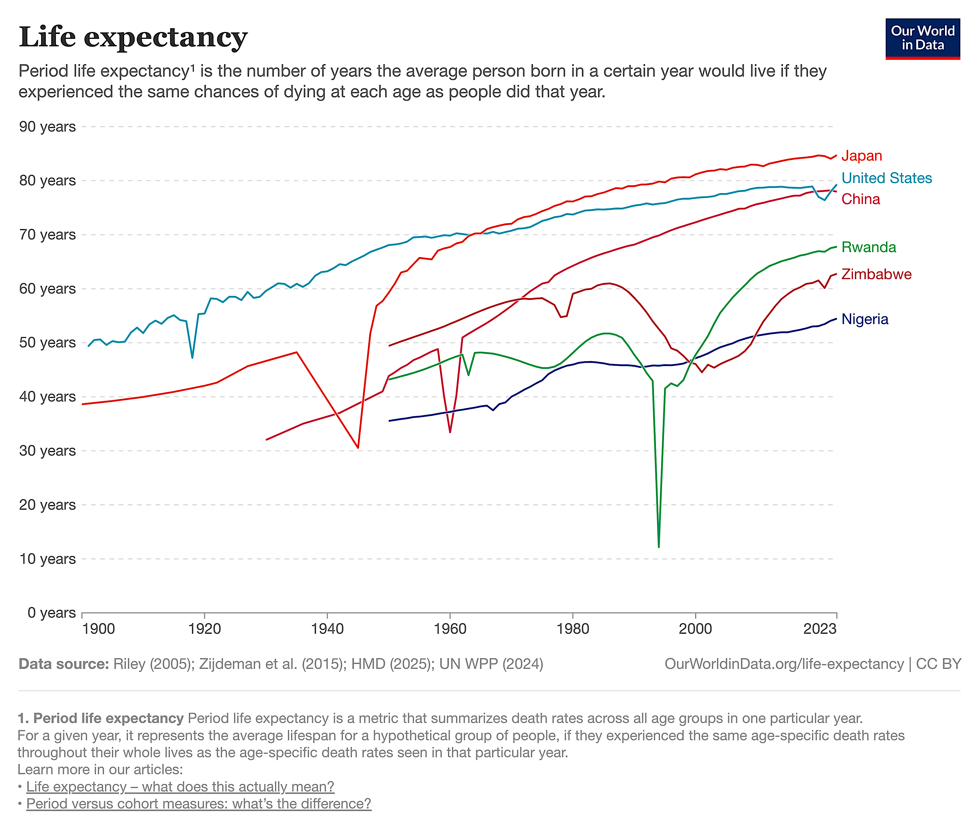
Life Expectancy by Nation 1900-2023
Open the link and graph the data for the US, China, Japan, Nigeria, Rwanda, and Zimbabwe from 1900-2023:
https://ourworldindata.org/life-expectancy

Slide 6
US Health Indicators Ranked by State
Go to the Centers for Disease Control website: www.cdc.gov
To collect data on risk factors, open the link for “Data & Statistics”, then open the link for “Overweight and Obesity.”
Scroll down below the map to “Additional Resources” and then click on “Behavioral Risk Factor Surveillance System (BRFSS).”
Under the heading for “Prevalence Data and Data Analysis Tools” open the link for “Prevalence and Trends Data.” This takes you to an interactive website. Here is the direct link: https://www.cdc.gov/brfss/brfssprevalence/index.html
The CDC system was redesigned so just open the following links:
For smoking rates: https://www.lung.org/research/trends-in-lung-disease/tobacco-trends-brief/data-tables/ad-cig-smoking-state
For obesity rates: https://www.cdc.gov/obesity/data-and-statistics/adult-obesity-prevalence-maps.html
For hypertension rates: https://www.cdc.gov/nchs/state-stats/deaths/hypertension.html
For diabetes rates: https://gis.cdc.gov/grasp/diabetes/diabetesatlas-surveillance.html#
For heart disease rates: https://www.cdc.gov/nchs/state-stats/deaths/heart-disease.html
For exercise rates: https://www.valuepenguin.com/fittest-and-least-fit-states
For cancer rates: https://wonder.cdc.gov/

Slide 7
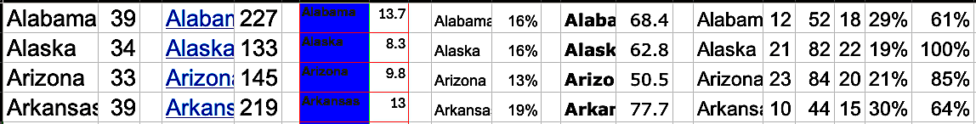
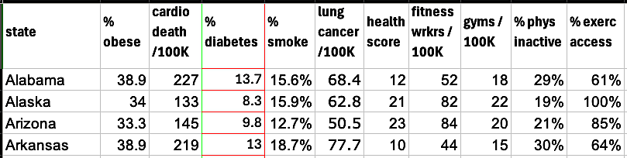
US Health Indicators Ranked by State
Copy and paste the data from each website to your spreadsheets:
Remove unneeded columns, sort states in alphabetical order, and make sure all the states line up with each other:
Label each column and use this data for making scatterplots:

Slide 8
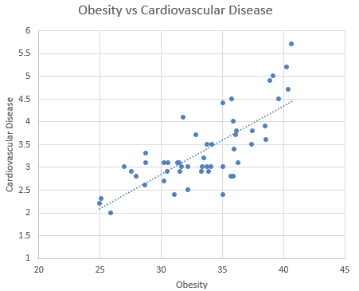
Scatterplot Sample 1:
Cause & effect?

Slide 9
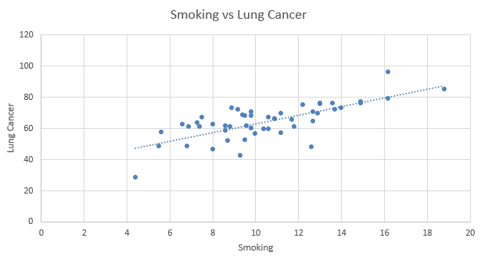
Scatterplot Sample 2:
Cause & effect?

Slide 10
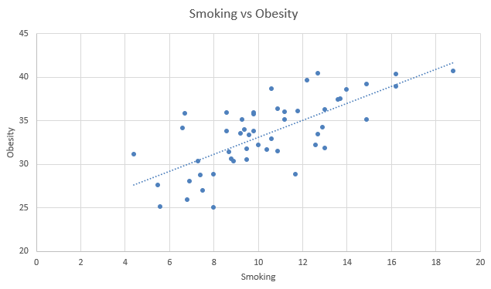
Scatterplot Sample 3:
Cause & effect???

Slide 11

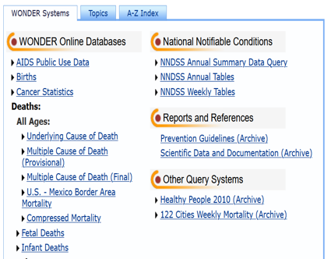
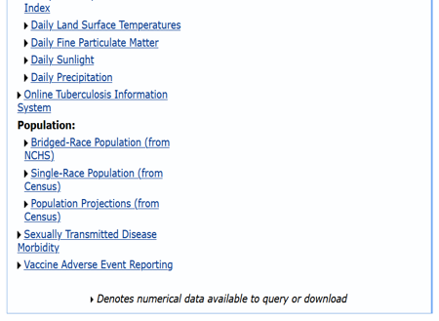
CDC “Wonder” Navigation
Open this link: https://wonder.cdc.gov/
Use this link for exploring cancer data.
Use this link for exploring data from vaccine adverse events.

Slide 12
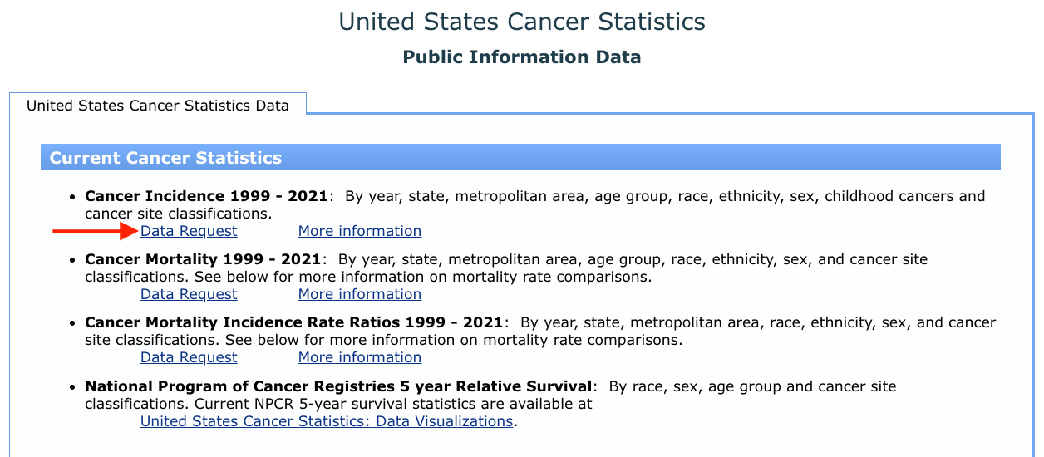
CDC “Wonder” Navigation: Exploring Cancer
Open this link to explore data on cancer:

Slide 13
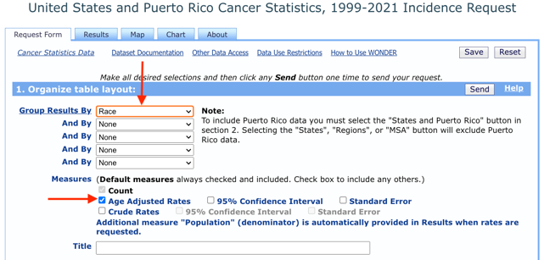
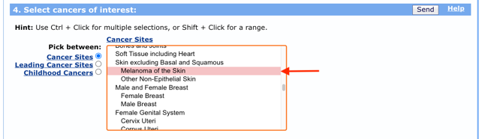
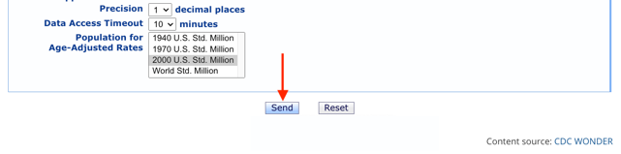
CDC “Wonder” Navigation: Exploring Cancer
State your query by choosing ”race” and “age adjusted” in box 1.
Choose “melanoma” in box 3.
Click on “send” to access your data.

Slide 14
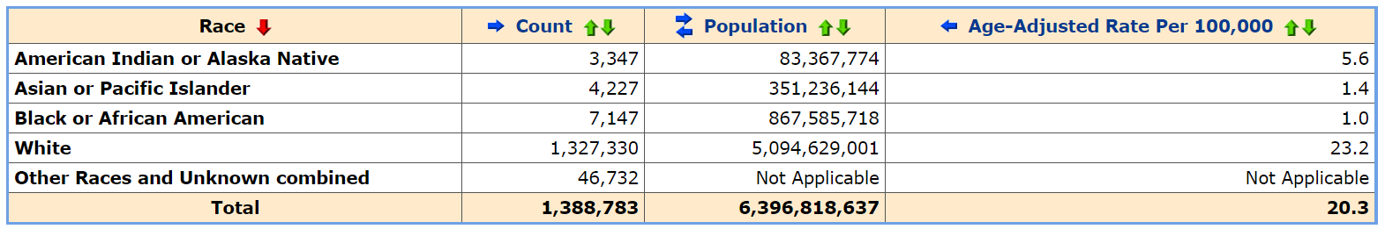
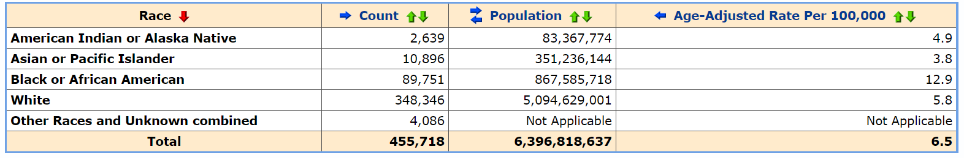
CDC “Wonder” Navigation: Exploring Cancer
Use the interactive website to explore melanoma, myeloma, prostate cancer (males), breast cancer (females), and liver cancer in “white, black/African-American, and Asian/Pacific Islander:
Melanoma
Myeloma

Slide 15
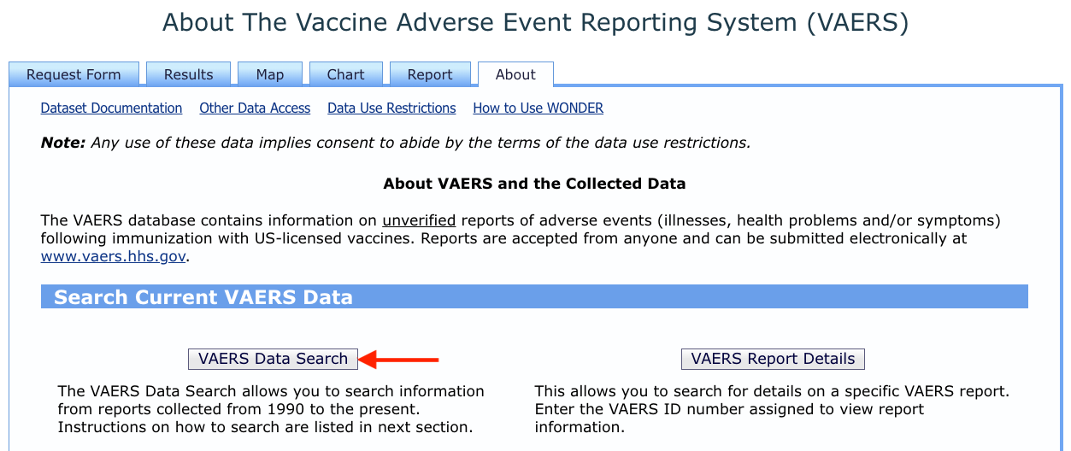
CDC “Wonder” Navigation: Exploring VAERS
Open this link to explore data from vaccine adverse event reporting:

Slide 16
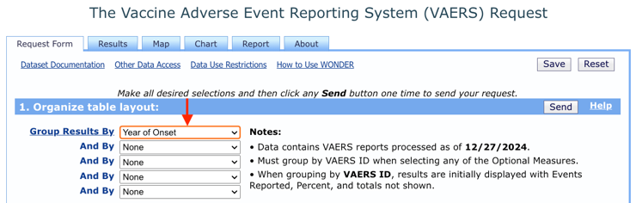
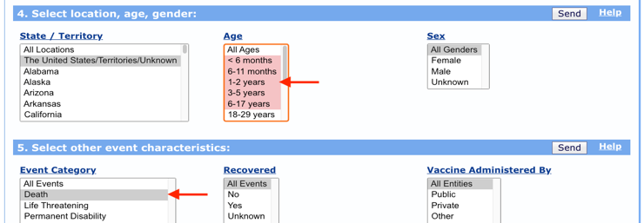
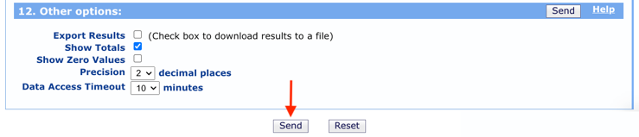
CDC “Wonder” Navigation: Exploring VAERS
State your query by choosing ”year of onset” in box 1.
Choose ages 0-17 in box 4 and “death” in box 5.
Click on “send” to access your data.

Slide 17
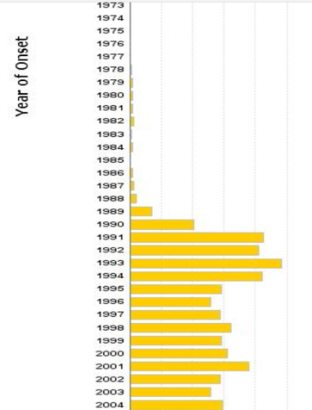
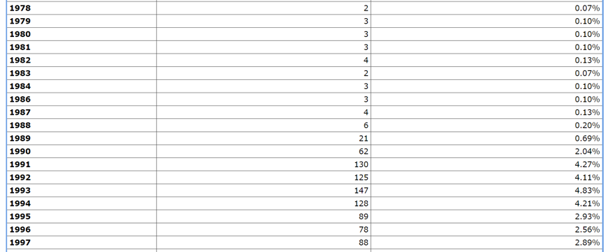
CDC “Wonder” Navigation: VAERS Sample Data
Vaccine deaths reported for ages 0-17

Slide 18
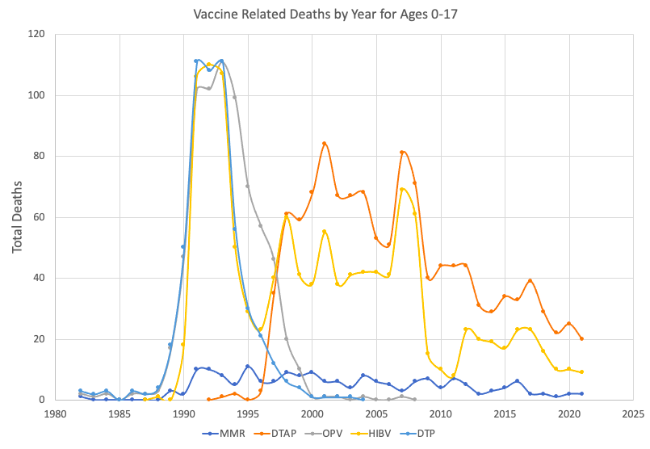
CDC “Wonder” Navigation: Using Excel to Get a Closer Look at the Data for Ages 0-17 (optional)

Slide 19
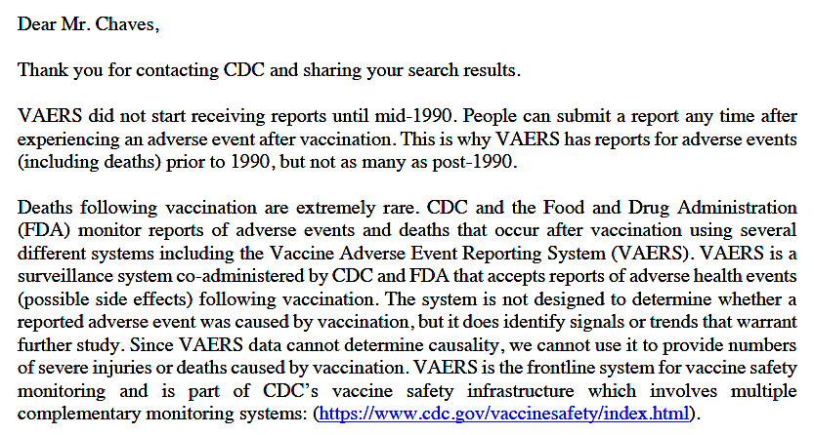

Slide 20
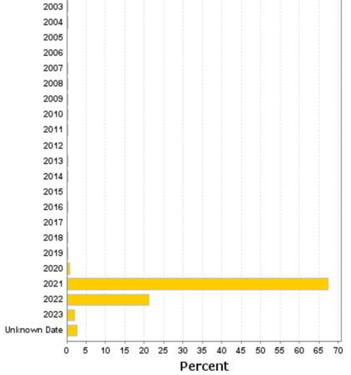
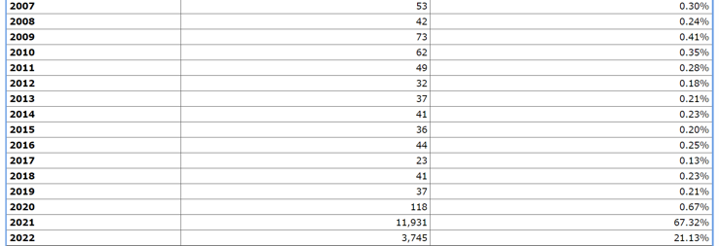
CDC “Wonder” Navigation: VAERS Sample Data
Vaccine deaths reported for ages 18 and up

Slide 21
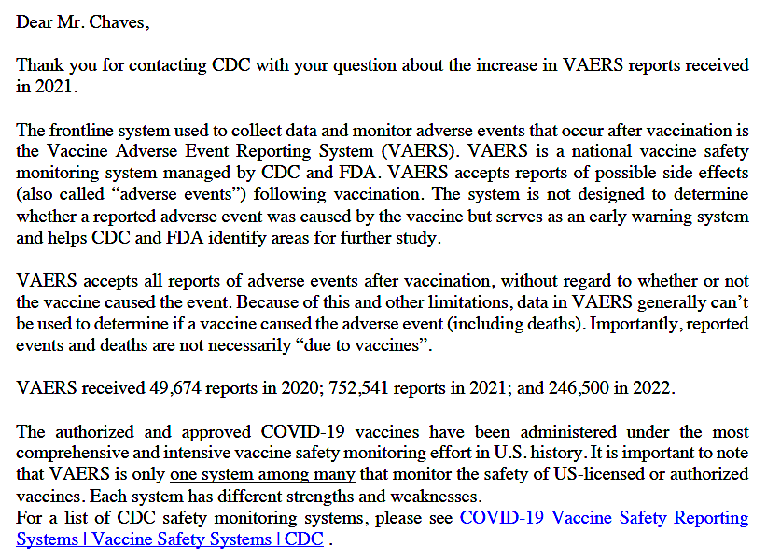

Slide 22
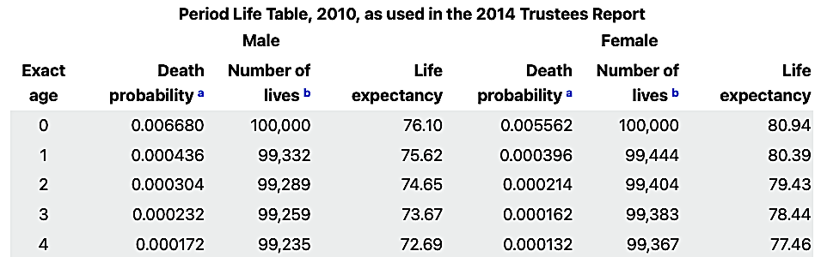
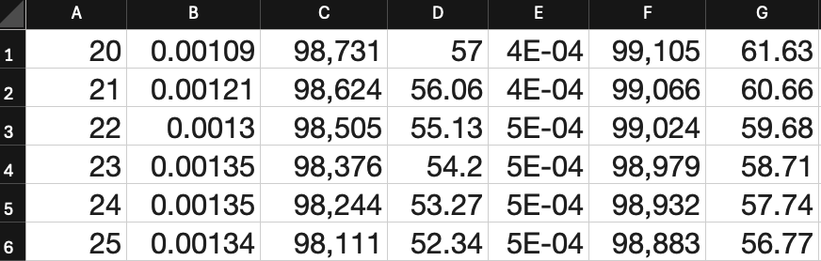
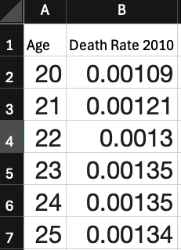
Death Rate Comparison by Age and by Year
Open this link: https://www.ssa.gov/oact/STATS/table4c6.html
Copy and paste the data for ages 20-84 in 2010.
Remove columns C to G and label columns A and B.

Slide 23
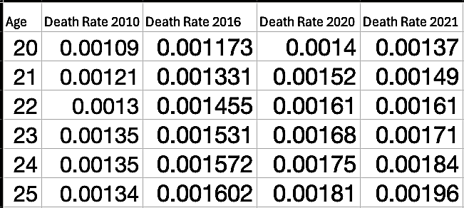
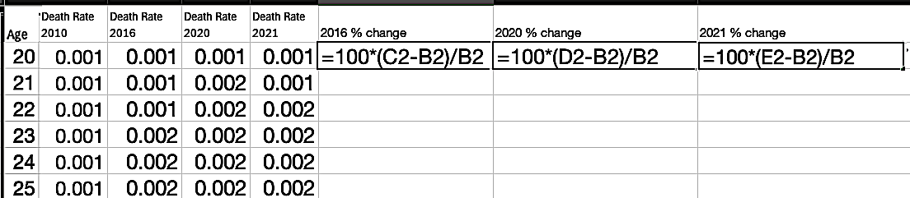
Death Rate Comparison by Age and by Year
Repeat this for death rates for years 2016, 2020, and 2021.
Insert these equations into next three columns to calculate percent change since 2010 for years 2016, 2020, and 2021.
Copy and paste these equations all the way down to age 84.

Slide 24
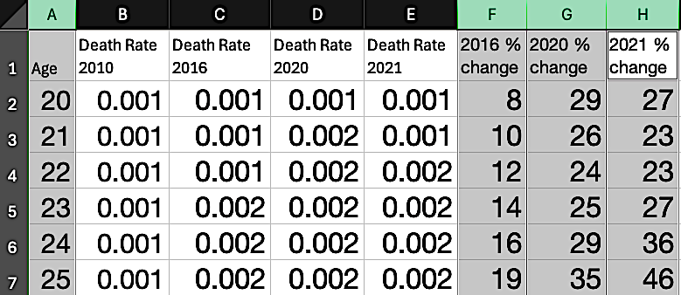
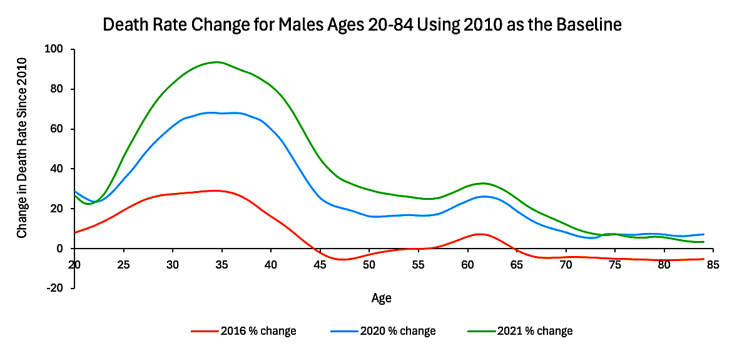
Death Rate Comparison by Age and by Year
Highlight columns A, F, and H to compare ages 20-84 with changes in 2016, 2020, and 2021.
Choose the scatterplot line graph.

Slide 25
Supplement for broken links in the document:
Traffic fatality rates:
https://www.who.int/data/gho/data/indicators/indicator-details/GHO/estimated-road-traffic-death-rate-(per-100-000-population)
Indoor pollution death rates:
https://www.who.int/data/gho/data/indicators/indicator-details/GHO/household-air-pollution-attributable-death-rate-(per-100-000-population-age-standardized)
Polluting fuel use per household:
https://www.who.int/data/gho/data/indicators/indicator-details/GHO/gho-phe-population-with-primary-reliance-on-polluting-fuels-and-technologies-for-cooking-proportion
Obesity rates:
https://www.who.int/data/gho/data/indicators/indicator-details/GHO/prevalence-of-obesity-among-adults-bmi-=-30-(age-standardized-estimate)-(-)
Suicides rates:
https://worldpopulationreview.com/country-rankings/suicide-rate-by-country

