Slide 1
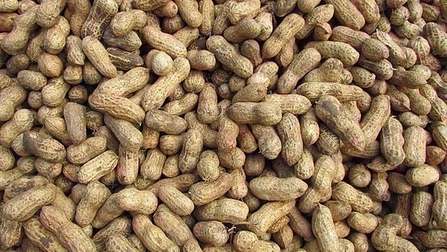
A Review on Probable Causes of the Childhood Allergy Epidemic
Antonio Chaves

Slide 2
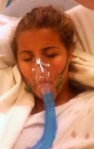
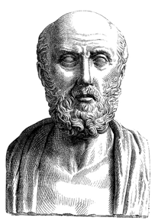
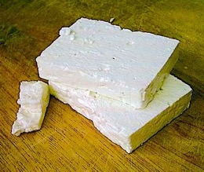
Allergies have been recorded since ancient times.*
But in recent decades, life-threatening food allergies in children started to grow at an alarming rate. Here are some of the numbers:**
Hippocrates (460-375 BC) observed how some people were sickened by the consumption of cheese.
1 in 12 children diagnosed in the U.S.
Every 2-3 minutes there is an ER visit from food induced anaphylaxis.
40% of children with food allergies experience a life-threatening reaction.
$4,184 cost per child per year
$24.8 billion cost to U.S. economy.
* Mark Jackson in “Allergy: History of a Modern Malady.” Reakton Books, 2006, p. 28
** EAT (2025) Food Allergy Statistics: https://endallergiestogether.com/research/food-allergy-statistics/

Slide 3
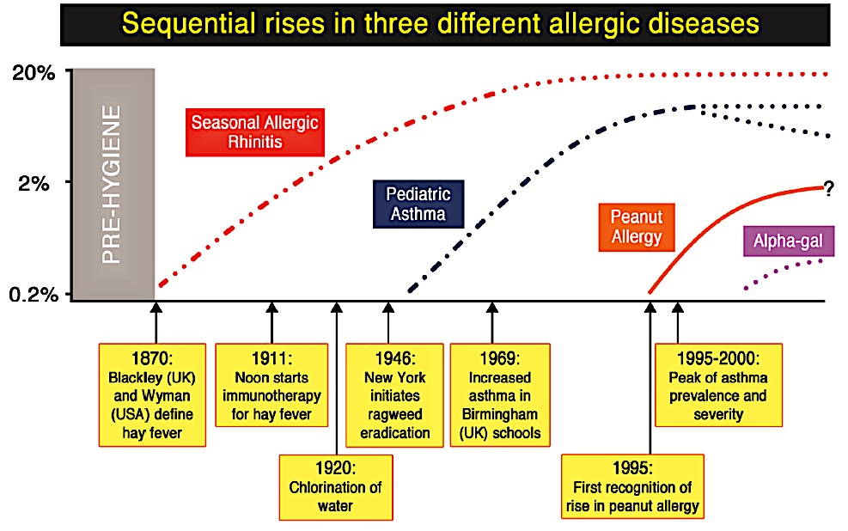
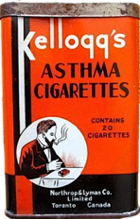

Thomas Platt-Mills in “The Allergy Epidemics: 1870–2010.” J Allergy Clin Immunol. July 2015, 136(1): 3–13 https://pmc.ncbi.nlm.nih.gov/articles/PMC4617537/

Slide 4
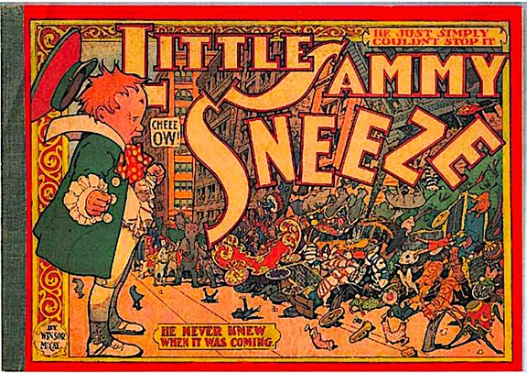
During the 19th century hay-fever was regarded as an ailment of the “privileged” classes.
And when hay-fever appears …it chooses the man before the woman, the educated before the ignorant, the gentle before the rude, the courtier before the clown …It prefers the temperate to the torrid zone, it seeks the city before the country, and out of every climate it chooses the Anglo-Saxon, or at least the English-speaking race.
Lecture given at the West London Medico-Chirurgical Society by Sir Andrew Clark in 1887.*
* Mark Jackson in “Allergy: History of a Modern Malady.” Reakton Books, 2006, p. 62

Slide 5
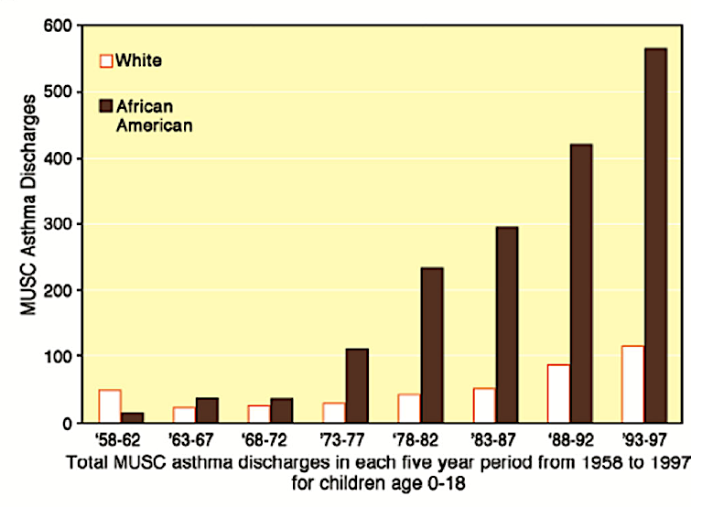

Respiratory allergies became increasingly “inclusive” as black Americans relocated to cities.
Thomas Platt-Mills in “The Allergy Epidemics: 1870–2010.” J. Allergy Clin. Immunol. July 2015 , 136(1): 3–13
https://pmc.ncbi.nlm.nih.gov/articles/PMC4617537/

Slide 6
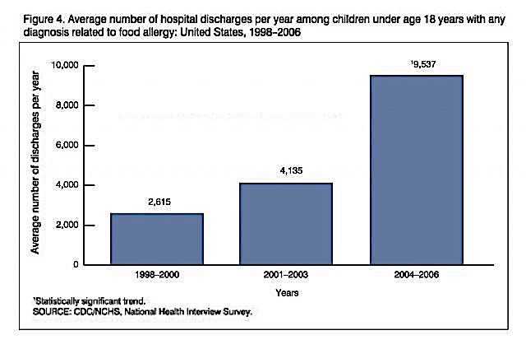
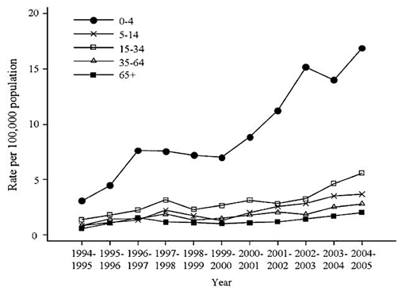


Life-threatening food allergies are not only increasing in the US…
Similar trends are also occurring other Western nations, especially in Australia and the UK.
*
Food-induced hospital anaphylaxis admissions in Australia.**
* CDC (2008) “Food Allergy Among U.S. Children: Trends in Prevalence and Hospitalizations.” NCHS Data Brief No. 10, October 2008 https://www.cdc.gov/nchs/products/databriefs/db10.htm
** From Liew et al. (2009) “Anaphylaxis fatalities and admissions in Australia.” J. Allergy Clin. Immunol. 123(2) 434-442.
https://pubmed.ncbi.nlm.nih.gov/19117599/

Slide 7











Epidemiologist David Strachan was the first to investigate the “hygiene hypothesis.”
# of older siblings * | Prevalence of hay fever at age 23** | Prevalence of hay fever at age 11** | Prevalence of infantile eczema **
0 | 20.4 | 10.0 | 6.1
1 | 15.0 | 7.9 | 5.2
2 | 12.5 | 5.0 | 4.6
3 | 10.6 | 4.0 | 3.7
4+ | 8.6 | 2.6 | 2.8
…allergic diseases (may have been) prevented by infection in early childhood, transmitted by unhygienic contact with older siblings, or acquired prenatally from a mother infected by contact with her older children.
David Strachan, 1989
* The original table presented a significant (but lesser) effect of younger siblings on hay fever (data not shown).
** Adjusted for father's social class, housing tenure and shared household amenities in childhood, breast feeding, region of birth, and cigarette-smoking at 23 (n = 17,414).
David Strachan “Hay fever, hygiene, and household size.” British Medical Journal, November 1989, 299(6710): 1229-1260
https://pmc.ncbi.nlm.nih.gov/articles/PMC1838109/

Slide 8




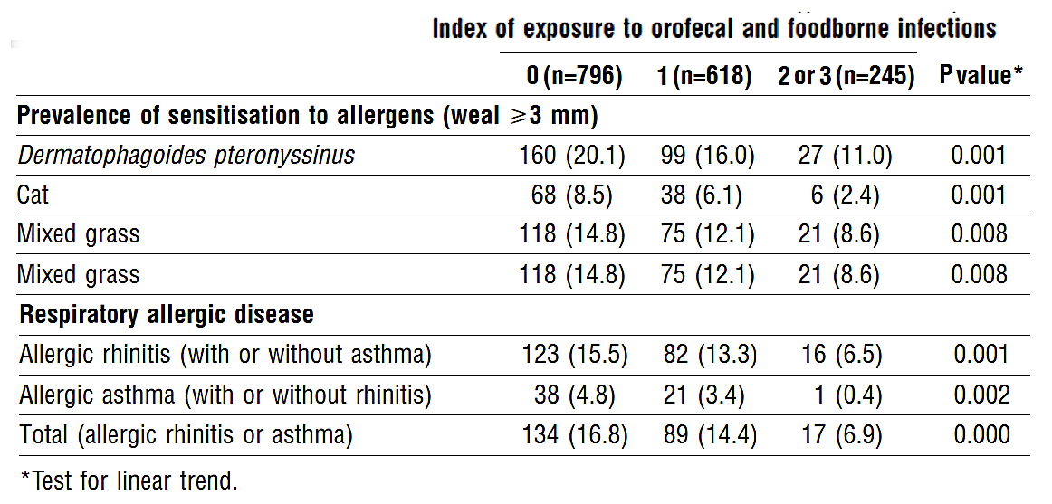



This study of military cadets in Italy showed that recruits with prior exposure to ingested pathogens (Toxoplasma gondii, Helicobacter pylori, and hepatitis A) had less allergies.
Prior infection with measles, mumps, rubella, chicken pox, cytomegalovirus, or herpes had no noticeable effect on allergy outcomes (data not shown).
Our data …support(s) the hypothesis that daily ingestion of traditionally processed food, not treated with antimicrobial preservatives and not subjected to hygienic procedures, may help to
prevent atopy.
Matricardi et al. “Exposure to foodborne and orofecal microbes versus airborne viruses in relation to atopy and allergic asthma: epidemiological study.” British Medical Journal February 2000, 320: 412-417
https://pubmed.ncbi.nlm.nih.gov/10669445/

Slide 9

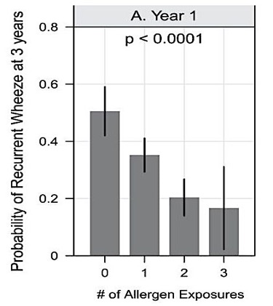
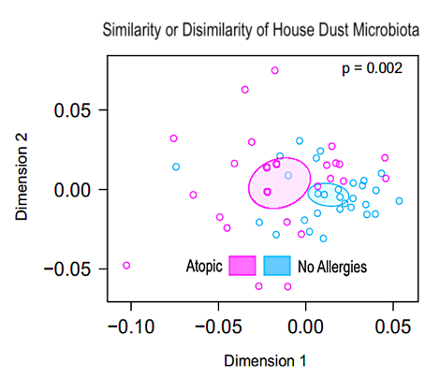



This study from John Hopkins found that infants exposed to cockroach droppings, mouse and cat dander during the first year of life had lower rates of wheezing by age 3.
The same study also recorded significant differences in make-up of the bacteria in houses of children with allergies versus children with no allergy symptoms.
Our observations raise the possibility that the optimal conditions to promote tolerance might be early-life antigenic exposure to allergen in conjunction with exposure to particular bacteria, such as those identified in this study.
Lynch et al. “Effects of early-life exposure to allergens and bacteria on recurrent wheeze and atopy in urban children.” Journal of Allergy and Clinical Immunology (2014) 134(3): 593-601. https://www.jacionline.org/article/S0091-6749(14)00593-4/fulltext

Slide 10



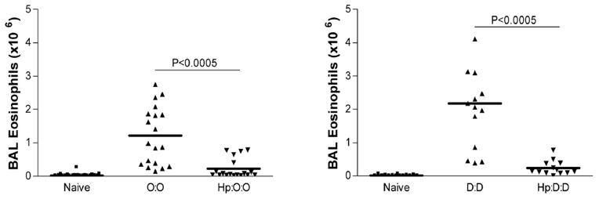

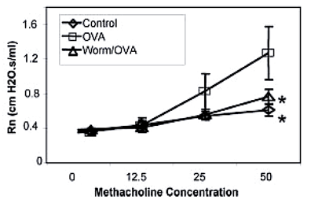

These two experiments show how prior infection with parasitic roundworms may also play a role in preventing respiratory allergies in sensitized mice.
Mice were sensitized via injection of the antigen with alum as the adjuvant.
Bronchial Constriction in Response to Methacholine in Mice Challenged with Aerosolized Ovalbumin*
Eosinophil Levels in Lungs of Mice Challenged with Ovalbumin or Dust Mite**
Naïve = non-sensitized mice (control)
O:O or D:D = mice sensitized to ovalbumin or the dust mite allergen Der p 1
Hp = mice infected with worms prior to sensitization
Control = non-sensitized mice
OVA = mice sensitized to ovalbumin.
Worm/OVA = sensitized mice infected with worms prior to sensitization.
*Kitagaki et al. “Intestinal Helminths Protect in a Murine Model of Asthma.” J. of Immunology (2006) 117(3): 1628-1635. https://pubmed.ncbi.nlm.nih.gov/16849471/
**Wilson et al. “Suppression of Allergic Airway Inflammation by Helminth-induced Regulatory T-Cells.” J. of Exper. Medicine (2005) 202(9): 1199-1212.
https://pubmed.ncbi.nlm.nih.gov/16275759/

Slide 11
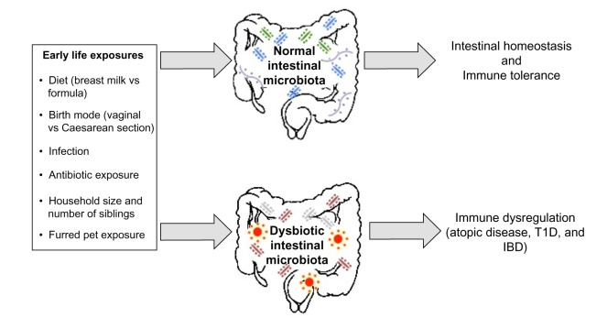





Immune dysregulation is now increasingly attributed to breakdown of the gut biome.
Stiemsma et al. “The hygiene hypothesis: current perspectives and future therapies.” Immuno Targets and Therapy July 27, 2015.
https://pmc.ncbi.nlm.nih.gov/articles/PMC4918254/pdf/itt-4-143.pdf

Slide 12



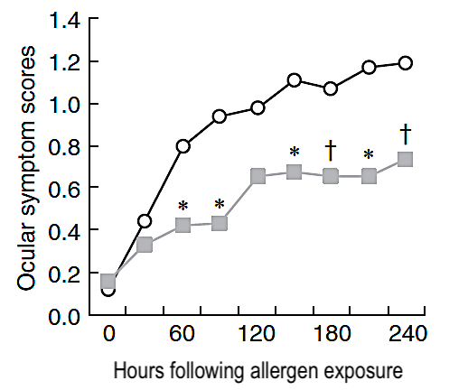
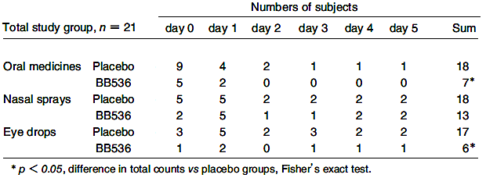

In this experiment, a probiotic powder consumed twice a day for four weeks significantly improved hay fever symptoms of patients allergic to Japanese cedar.
Xiao et al. “Clinical Efficacy of Probiotic Bifidobacterium longum for the Treatment of Symptoms of Japanese Cedar Pollen Allergy in Subjects Evaluated in an Environmental Exposure Unit.” Allergology International (2007) 56 (1) 67-75
https://pubmed.ncbi.nlm.nih.gov/17259812/

Slide 13

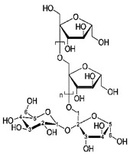
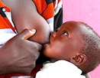
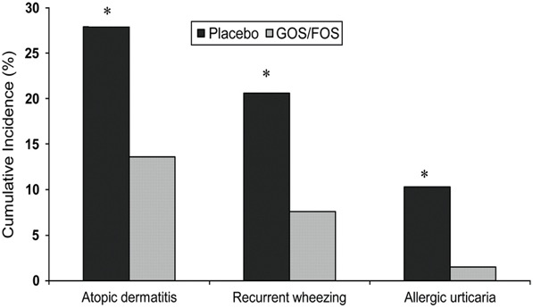
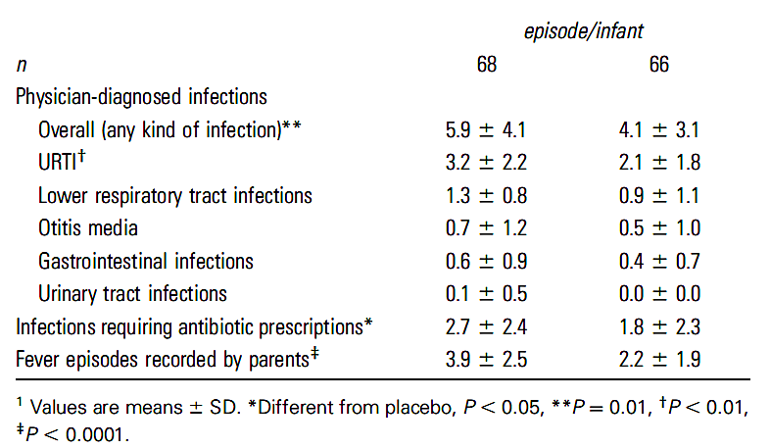

In this experiment, babies with a parental history of atopy who consumed a supplemental “prebiotic” infant formula had less allergies and less infections than the placebo group.
This prebiotic (GOS/FOS) contained galacto- and fructo-oligosaccharides in ratios that approximated those of breast milk.
Cumulative incidence of allergic manifestations at the end of 2-y follow-up period in the placebo and GOS/FOS groups.
Episodes of infections and fever during the 2-y follow-up period in the placebo group (left) and GOS/FOS group (right)¹
Arslanoglu et al. “Early Dietary Intervention with a Mixture of Prebiotic Oligosaccharides reduces the incidence of allergic manifestations and infections during the first two years of life.” Journal of Nutrition 2008 Jun;138(6):1091-1095 https://pubmed.ncbi.nlm.nih.gov/18492839/

Slide 14

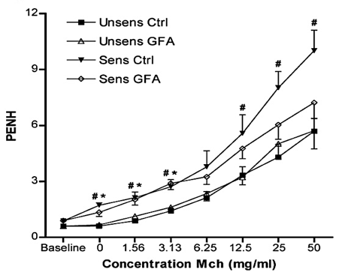

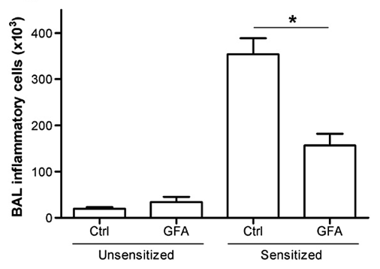



The symptoms of these sensitized mice significantly improved when they consumed a supplement containing oligosaccharides in ratios that approximated those of breast milk.
Mice were sensitized via injection of the antigen with alum as the adjuvant.
Bronchial Constriction in Response to Methacholine in Mice Challenged with Aerosolized Ovalbumin
Lung Inflammation in Mice Challenged with Ovalbumin (GFA= mice on the prebiotic diet)
GFA = a combination of galactooligosaccharides,
fructooligosaccharides, and acidic pectin-derived oligosaccharides
Vos et al. “Dietary supplementation with specific oligosaccharide mixtures decreases parameters of allergic asthma in mice.” International Immunopharmacology 7 (2007) 1582-1587. https://pubmed.ncbi.nlm.nih.gov/17920536/

Slide 15
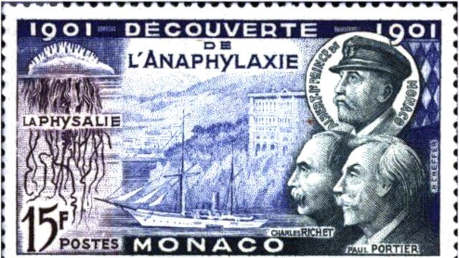
A Short History of the Injected Vaccine Hypothesis

Slide 16




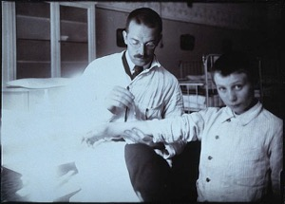
In 1902 Charles Richet and Paul Portier attempted to generate immunity by injecting sublethal doses of sea anemone toxin into dogs and saw that nearly all died after the second dose. Richet coined the term “anaphylaxis” to describe this unexpected “absence of protection” from the second injection.
In 1903 Maurice Arthus showed that sensitization could also be accomplished with non-toxic substances after he injected horse plasma into rabbits. The term “Arthus phenomenon” would later be used to describe adverse reactions to serum therapy.
In 1906 Clemens Von Pirquet concluded that immunity and sensitization are two sides of the immune response and coined the term “allergy” to describe this “altered reactivity” to antigens. He based this on his clinical observations of adverse reactions to serum therapy and vaccine boosters. This model was not well-received, probably because it raised new concerns on the safety of these practices.
Mark Jackson in “Allergy: History of a Modern Malady.” Reakton Books, 2006, pp. 10, 21, 32

Slide 17







In most of these examples of experiments spanning over 100 years, the animals were sensitized via injection; often with the help of an adjuvant (the same as modern-day vaccines).
Ref. | Year | Antigen(s) | Animal | Sensitization method(s) | Evaluation method(s)
1 | 2023 | Ovalbumin | Mouse | Injection with alum as the adjuvant. | Responses to ingestion challenge: Scratching, sneezing, and nasal rubbing. IgE levels in plasma. Eosinophil levels in lungs.
2 | 2022 | Ragweed pollen | Mouse | Intranasal application of 6 doses over 21 days under anesthesia. | Responses to inhalation challenge: Eosinophil and neutrophils in lungs. Inflammation of lungs. Airway resistance of lungs.
3 | 2018 | Whey protein | Mouse | Intragastric application with cholera toxin as the adjuvant. | Responses to ingestion challenge: Digging frequency. IgE levels in plasma. Mast cell activity in brain and intestine. 5-hydroxymethylcytosine reactivity in amygdala.
4 | 2003 | Dust mites | Mouse | Injection with alum as the adjuvant. | Responses to inhalation challenge: IgE levels in plasma. Eosinophil levels in blood. Cytokine levels in lungs. Airway resistance of lungs.
5 | 1960 | Ovalbumin | Guinea pig | Injection with 0.5 % phenol as solvent. Passive sensitization via injection with rabbit antisera. | Histamine release by lung tissue cultured in vitro after the addition of antigen to the culture media.
6 | 1937 | Picryl chloride 2,4-Dinitrochlorobenzene | Guinea pig | Injection with saline as the solvent. | Anaphylaxis and death in response to reinjection. Redness and swelling upon application to skin.
7 | 1903 | Horse plasma | Rabbit | Injection of blood plasma. | Edema, necrosis, and death in response to reinjection.

Slide 18

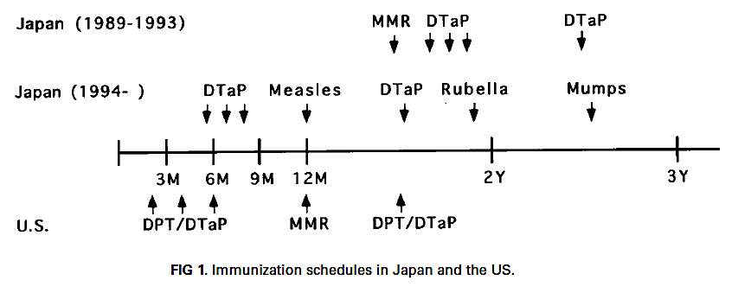
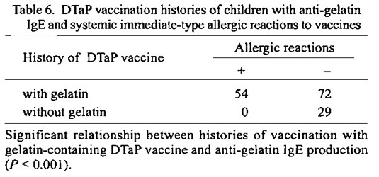


A sudden spike in gelatin allergies Japanese infants in the 1990’s was traced to a change in the schedule whereby a gelatin-containing DTaP was given at a much earlier age.
To address this problem DTaP vaccines ingredients in Japan were changed after 1998.
In the 1989-1993 schedule (top), the DTaP was introduced at 18 months. In the 1994 schedule (middle), the gelatin-containing DTaP was introduced at 6 months.*
Nearly half the children who had received the gelatin-containing DTAP had the allergy. No children in the control group had the allergy.**
* Nakayama et al. “A clinical analysis of gelatin allergy and determination of its causal relationship to the previous administration of gelatin-containing acellular pertussis vaccine combined with diphtheria and tetanus toxoids.” J. Allergy Clin. Immunol. Feb. 1999, 103 (2.1) 321-325 https://pubmed.ncbi.nlm.nih.gov/9949325/
** Sakaguchi and Sakae “Systemic Allergic Reactions to Gelatin Included in Vaccines as a Stabilizer.” Japanese J. Infect. Dis. (2000) 53: 189-195 https://www.jstage.jst.go.jp/article/yoken/53/5/53_JJID.2000.189/_pdf/-char/en

Slide 19
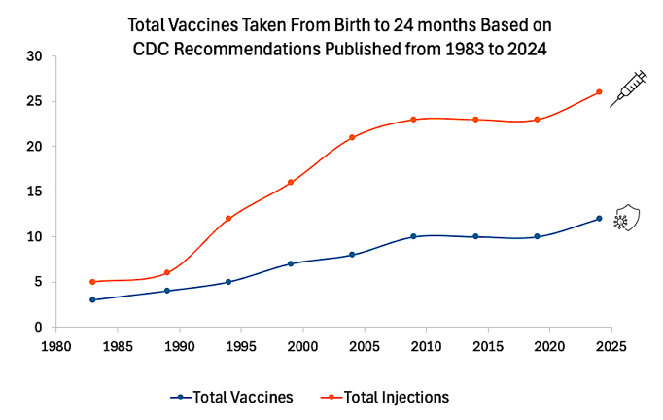

The “National Childhood Vaccine Injury Act of 1986” provided liability protection to manufacturers of all products listed on the US childhood immunization schedule.
This may have played a role in the quadrupling of the immunization schedule from 1990 to 2010.
CDC: Immunization Schedule-Related Resources for Healthcare Providers. https://www.cdc.gov/vaccines/hcp/imz-schedules/resources.html?CDC_AAref_Val=https://www.cdc.gov/vaccines/schedules/hcp/schedule-related-resources.html

Slide 20
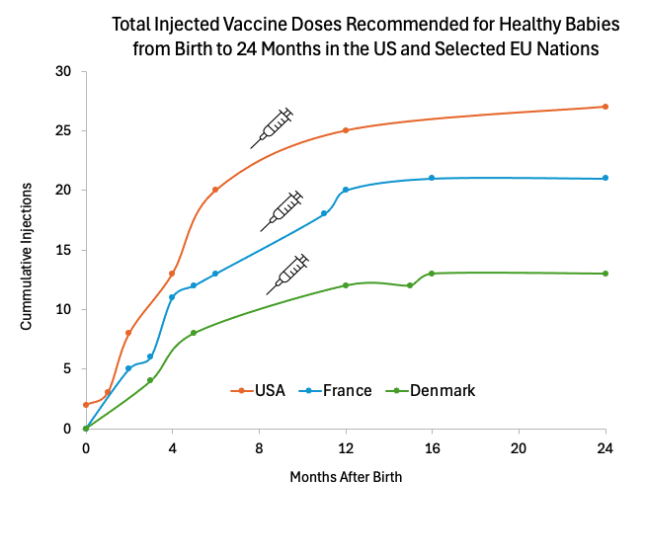



This may also explain why US 2-year-olds accumulate more injections than their EU counterparts.
Data sources: The CDC Immunization Schedule-Related Resources for Healthcare Providers. https://www.cdc.gov/vaccines/hcp/imz-schedules/resources.html?CDC_AAref_Val=https://www.cdc.gov/vaccines/schedules/hcp/schedule-related-resources.html
and the ECDC: Vaccine Scheduler. https://vaccine-schedule.ecdc.europa.eu/

Slide 21
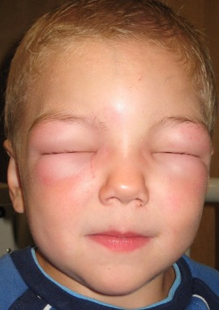
Did these additions to the vaccine schedule play a role in these spikes in childhood anaphylaxis?
Varicella & IPV recommended in 1999
PVC & Influenza recommended in 2004
CDC (2008) “Food Allergy Among U.S. Children: Trends in Prevalence and Hospitalizations.” NCHS Data Brief No. 10, October 2008 https://www.cdc.gov/nchs/products/databriefs/db10.htm
CDC Immunization Schedule-Related Resources for Healthcare Providers.
https://www.cdc.gov/vaccines/hcp/imz-schedules/resources.html?CDC_AAref_Val=https://www.cdc.gov/vaccines/schedules/hcp/schedule-related-resources.html

Slide 22
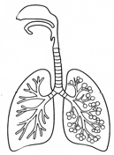
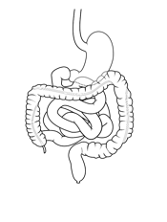
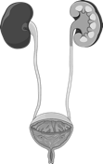

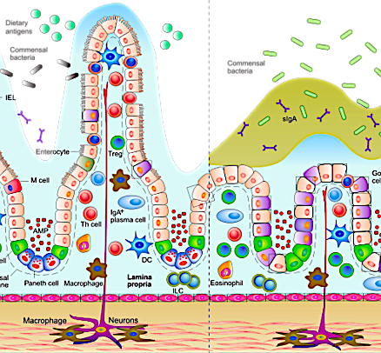
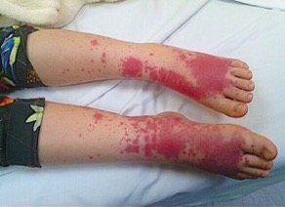

Are we overlooking the significance of mucosal immunity?
Mucosal surfaces exceed skin surfaces by 200X.
Over 90% of infections enter via mucosal surfaces.
The majority of lymphocytes reside in the mucosa and the resident T & B cells are more efficient at stopping infections and discerning pathogens from the other particles.
Mucosal lymphocytes and antibodies are less likely to activate systemic inflammation.
Should we rethink the way vaccines are applied?

Slide 23
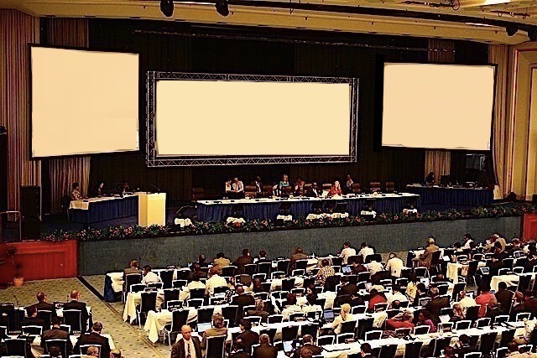





What are the implications for the childhood immunization schedule when the experimental animals are sensitized with injected vaccines?
2029 International Allergy Conference
Honoring 100 years since the passing of Clemens von Pirquet
Injected Vaccine Hypothesis

Slide 24
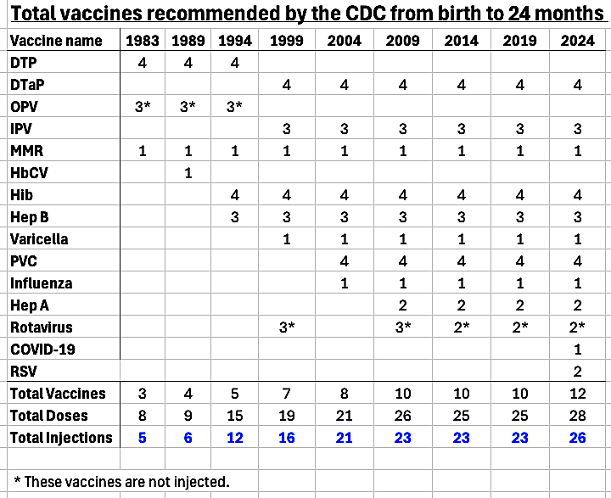
The graph showing how the US childhood vaccine schedule expanded from 1983 to 2024 is based on this table.
Data sources: https://www.cdc.gov/vaccines/hcp/imz-schedules/resources.html?CDC_AAref_Val=https://www.cdc.gov/vaccines/schedules/hcp/schedule-related-resources.html

Slide 25
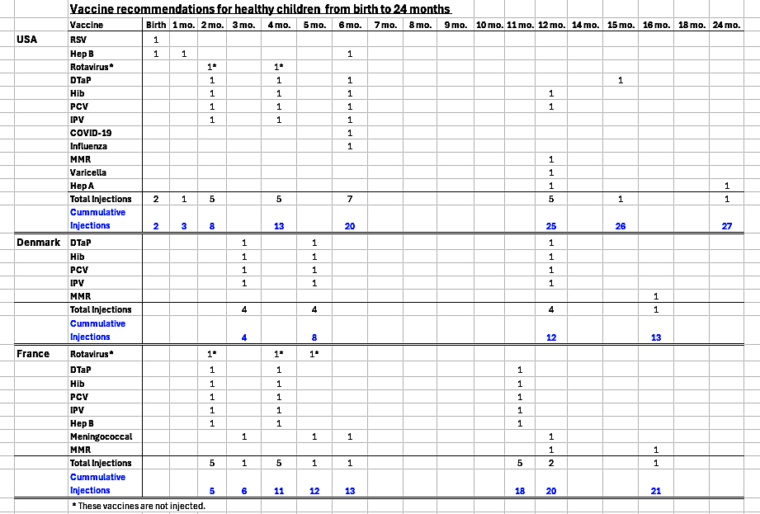
Data sources: https://www.cdc.gov/vaccines/hcp/imz-schedules/resources.html?CDC_AAref_Val=https://www.cdc.gov/vaccines/schedules/hcp/schedule-related-resources.html
and https://vaccine-schedule.ecdc.europa.eu/
The graph comparing the US childhood vaccine schedule to the schedules of France and Denmark is based on this table.

Slide 26
Literature Cited for the List of Animal Research Experiments:
Morinaga et al. (2023) A mouse model of food allergy permitting skin and nasal symptoms. Advances in Medical Sciences 68(2): 372-378. https://www.sciencedirect.com/science/article/abs/pii/S1896112623000391
Liu et al. (2022) Influence of the environment on ragweed pollen and their sensitizing capacity in a mouse model of allergic lung inflammation. Frontiers in Allergy pp 1-17.
https://www.frontiersin.org/journals/allergy/articles/10.3389/falgy.2022.854038/full
Germundson et al. (2018) Oral sensitization to whey proteins induces age- and sex-dependent behavioral abnormality and neuroinflammatory responses in a mouse model of food allergy: a potential role of mast cells. Journal of Neuroinflammation 15 (120): 1-17. https://pubmed.ncbi.nlm.nih.gov/29685134/
Strong at al. (2003) A recombinant fragment of human SP-D reduces allergic responses in mice sensitized to house dust mite allergens. Clinical and Experimental Immunology 134: 181-187.
https://pubmed.ncbi.nlm.nih.gov/14616775/
Austin and Brocklehurst (1960) Anaphylaxis in chopped guinea pig lung. I. Effect of peptidase substrates and inhibitors. Journal of Experimental Medicine 113(3): 521-39. https://pubmed.ncbi.nlm.nih.gov/13685194/
Landsteiner and Chase (1937) Studies on the sensitization of animals with simple chemical compounds: Anaphylaxis induced by picryl chloride and 2:4 dinitrochlorobenzene. Journal of Experimental Medicine 66(3): 337-51. https://pubmed.ncbi.nlm.nih.gov/19870667/
Arthus (1903) Injections répétées de serum du cheval chez le lapin. Comptes rendus des séances de la Société de biologie 55: 817-820. https://pmc.ncbi.nlm.nih.gov/articles/PMC6930064/

Slide 27


Acknowledgements:
Unless otherwise indicated, all images in this presentation were downloaded from Wikimedia Commons or Pixbay: https://commons.wikimedia.org/wiki/Main_Page and https://pixabay.com/

