Slide 1
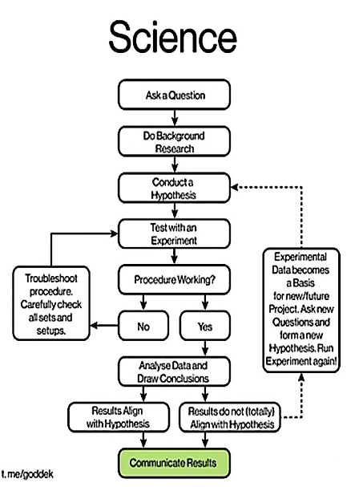
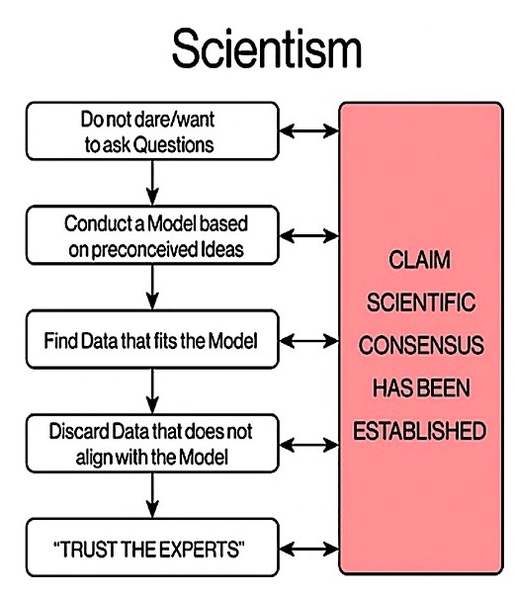
Do not confuse science with scientism!

Slide 2
Scientific Fraud
In May 2020, the British journal The Lancet published a study showing COVID-19 patients treated with hydroxychloroquine dying at a higher rate than patients not receiving this drug.
The WHO and governments all over the world responded by limiting access to this commonly used generic drug.
This study was retracted when readers started reporting glaring inconsistencies in the hospital data, and the third party providing the data suddenly became unavailable.
Sapan Desai, head of Surgisphere
At the time of publication, one of two lead co-authors was conducting trials with the far more profitable COVID treatment, Remdesivir.
Disclaimer: The antiviral properties of hydroxychloroquine are still being debated.

Slide 3
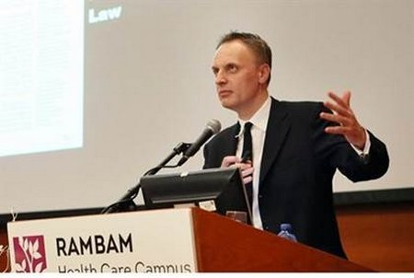
Editor of Lancet: Medical Research is Unreliable at Best or Completely Fraudulent
Dr Richard Horton declared, “Much of the scientific literature, perhaps half, may simply be untrue. Afflicted by studies with small sample sizes, tiny effects, invalid exploratory analyses, and flagrant conflicts of interest, together with an obsession for pursuing fashionable trends of dubious importance, science has taken a turn towards darkness.”
https://www.drugawareness.org/editor-of-lancet-medical-research-is-unreliable-at-best-or-completely-fraudulent/

Slide 4
Red Flags for Discerning Fraud:
Is it corroborated? Does it concur with raw data? Does it concur with independent sources?
Who benefits? Do any of the authors have a conflict of interest?
How do the authors and their supporters react when confronted with contrary evidence?
Evasive: ad hominem attacks, straw man, gaslighting, censorship
Legitimate: Criticism that focuses on specific details of the study (itemized)

Slide 5
Astroturfing = fake grassroots movement
The whole point of astroturf is to try to convince you there’s widespread support for or against an agenda when there’s not. Sharyl Attkisson, investigative reporter
https://sharylattkisson.com/2016/07/top-10-astroturfers/
Example: You choose to “do your own research” on the safety of a given drug, not knowing that your internet search was rigged (via bots & algorithms), your primary care doctor was influenced (via free samples & workshops) and your other “trusted sources” like mainstream media and government agencies were captured (via sponsors, grants, user fees, job offers, & partnerships).
Notes:
Answer: a

Slide 6
Astroturfing flowchart:
Notes:
Answer: a

Slide 7
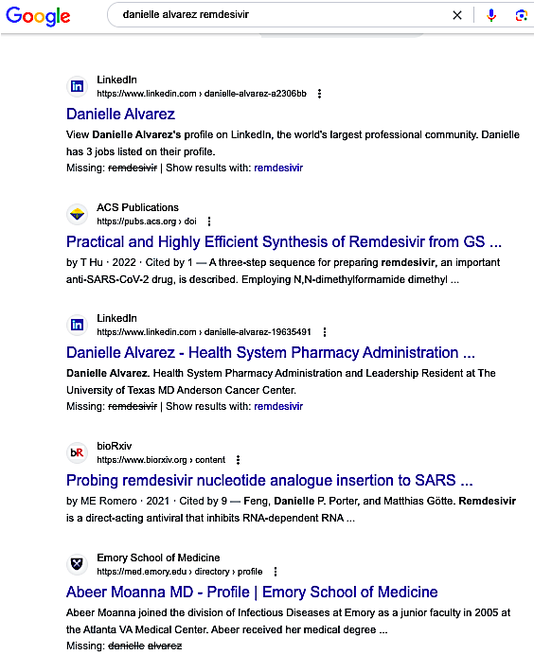
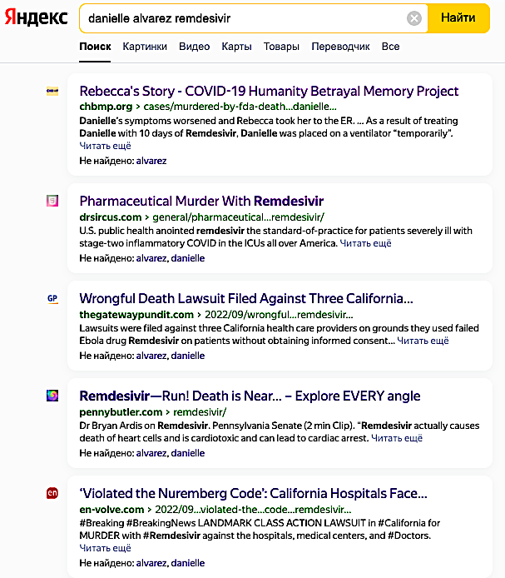
Real Life: A Tale of Two Search Engines:
Same search term, different results

Slide 8
Review Questions
A study evaluating the safety of a new hypertension treatment shows a higher death rate in people receiving the new drug. Which critique of the study is an example of a straw man argument?
The study tries to discredit the use of innovative therapies for treating people with hypertension.
The study was poorly designed because the sicker patients got the new drug.
The study was rigged.
The researchers are just amateurs that teach at a community college.
Notes:
Answer: a

Slide 9
Review Questions
A study evaluating the safety of a new hypertension treatment shows a higher death rate in people receiving the new drug. Which critique of the study is an example of an ad hominem attack?
The study tries to discredit the use of innovative therapies for treating people with hypertension.
The study was poorly designed because the sicker patients got the new drug.
The study was rigged.
The researchers are just amateurs that teach at a community college.
Notes:
Answer: a

Slide 10
Review Questions
A study evaluating the safety of a new hypertension treatment shows a higher death rate in people receiving the new drug. Which critique of the study is an example of itemized criticism?
The study tries to discredit the use of innovative therapies for treating people with hypertension.
The study was poorly designed because the sicker patients got the new drug.
The study was rigged.
The researchers are just amateurs that teach at a community college.
Notes:
Answer: a

Slide 11
Review Questions
A study evaluating the safety of a new hypertension treatment shows a higher death rate in people receiving the new drug. Which critique of the study is points out a possible conflict of interest?
The study tries to discredit the use of innovative therapies for treating people with hypertension.
The study was rigged
The research was funded by competitors profiting from an alternative therapy for hypertension.
The researchers are just amateurs that teach at a community college.
Notes:
Answer: a

Slide 12
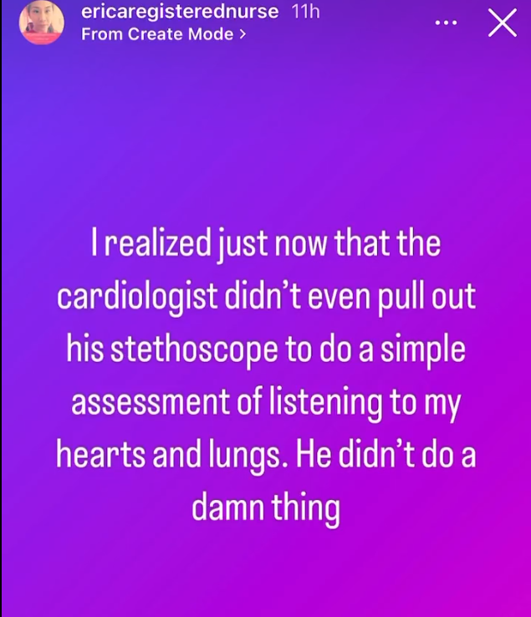
Real life: Which one of the three types of evasive rhetoric is demonstrated in this personal account?
A patient with chronic shortness of breath and chest discomfort sees a cardiologist. Without examining her, the cardiologist attributes her symptoms to “anxiety” and “panic disorder.”
Ad hominem
Straw man
Gaslighting.
https://twitter.com/React19org/status/1553092518790647808

Slide 13
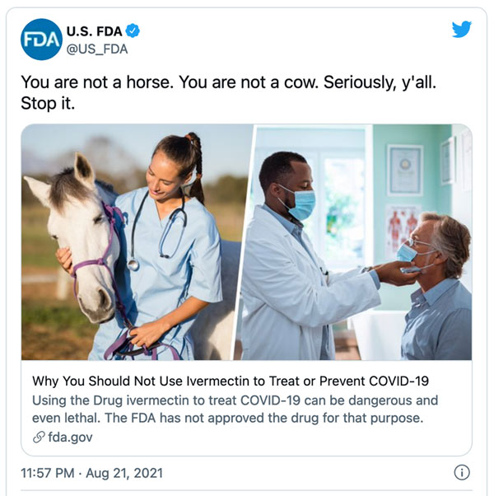
Real life: Which one of the three types of evasive rhetoric is demonstrated in this FDA tweet:
Background: Ivermectin is a broad-range antiparasitic drug on the WHO’s list of “essential medicines.” In affluent nations this drug is more commonly used on farm animals. Some doctors prescribe ivermectinin order to treat COVID-19, but the drug’s antiviral properties are still being debated.
Ad hominem
Straw man
Gaslighting.
https://twitter.com/i/web/status/1429050070243192839

Slide 14
Real life Example: Which one of the three types of evasive rhetoric is demonstrated in this tweet?
https://twitter.com/IanCopeland5/status/1630008321708118019
Ad hominem
Straw man
Gaslighting.

