Slide 1
Pathway for link to WHO data:
Go to the WHO website: https://www.who.int/
Go to the “Data” drop down menu and choose the “Global Health Observatory.”
Go to “Indicators” page and then scroll to the bottom and click on the link for accessing the “old” Global Health Observatory data. This link is directly under the list of indicators in the new system. If you cannot find the link to the old system, use this direct link:
https://apps.who.int/gho/data/node.main
Click on “Mortality and global health estimates.” Direct link:
https://apps.who.int/gho/data/node.main.686?lang=en

Slide 2
Alternate direct link for WHO data:
Or simply open the following link:
https://apps.who.int/gho/data/node.main.1?lang=en

Slide 3
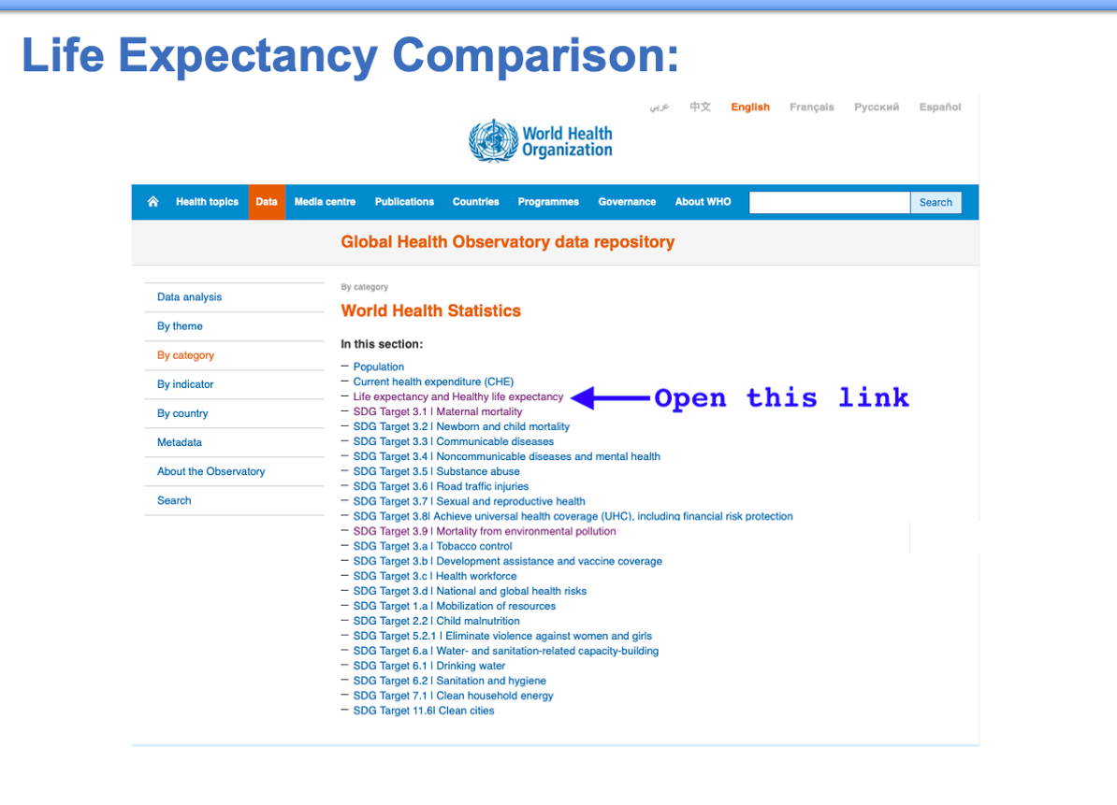
Life Expectancy Comparison:

Slide 4
Life Expectancy Comparison:

Slide 5
Life Expectancy Comparison:

Slide 6
Life Expectancy Comparison:

Slide 7
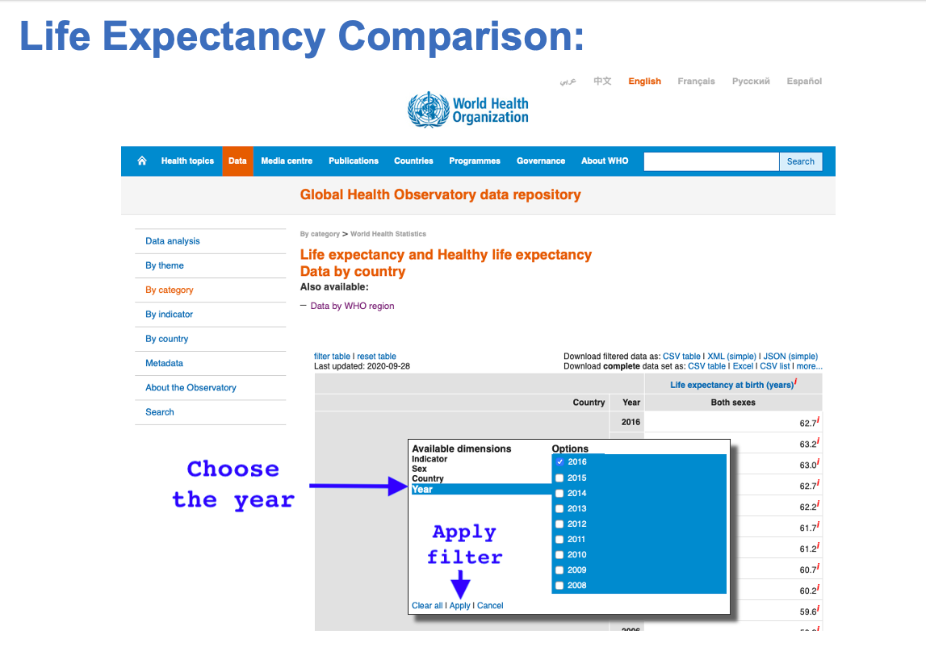
Life Expectancy Comparison:

Slide 8
Life Expectancy Comparison:

Slide 9
Life Expectancy Comparison:
Follow the same procedure for downloading two files for life expectancy by gender, then copy and paste these items to the same excel file so you can compare differences by gender. These are the items:
Male life expectancy at birth in 2016
Female life expectancy at birth in 2016

Slide 10
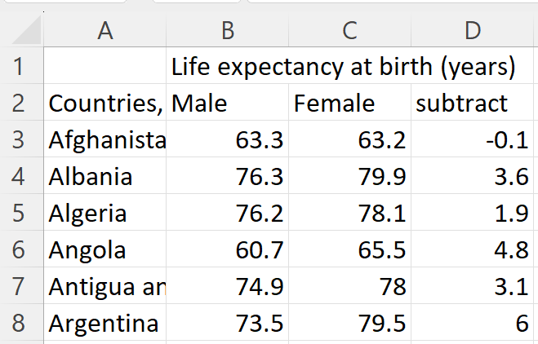
Life expectancy by gender in alphabetical order:

Slide 11
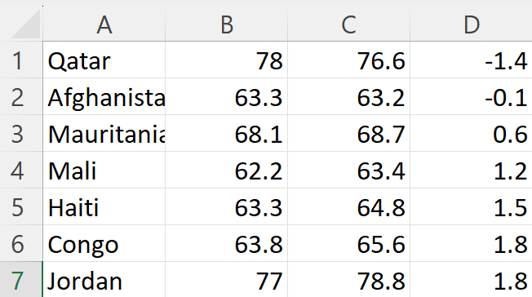
Life expectancy by gender ordered by difference (smallest difference):

Slide 12
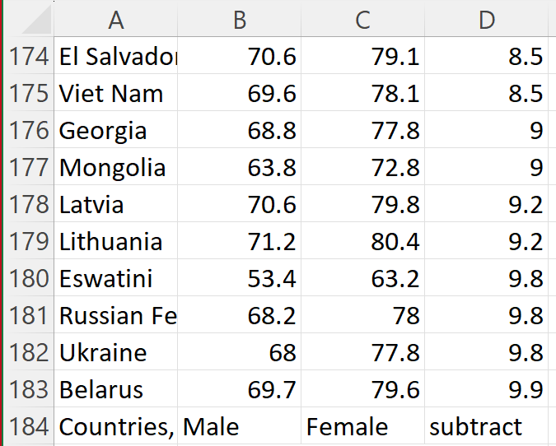
Life expectancy by gender ordered by difference (biggest difference):

Slide 13
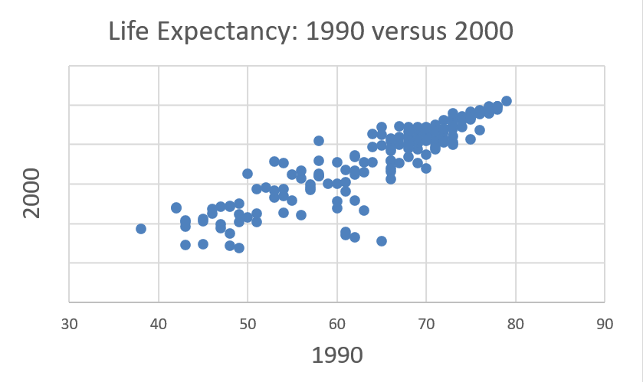
Life expectancy by graphed by decade:
Why did life expectancy decline in these nations from 1990-2000?

Slide 14
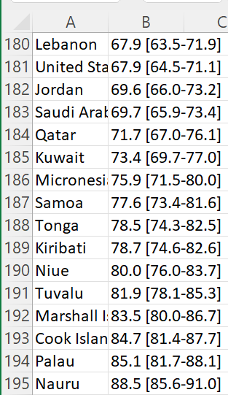
Highest obesity rates according to WHO:

Slide 15
CDC Website Navigation:
Go to the Centers for Disease Control website: www.cdc.gov
To collect data on risk factors, open the link for “Data & Statistics”, then open the link for “Overweight and Obesity.”
Scroll down below the map to “Additional Resources” and then click on “Behavioral Risk Factor Surveillance System (BRFSS).”
Under the heading for “Prevalence Data and Data Analysis Tools” open the link for “Prevalence and Trends Data.” This takes you to an interactive website. Here is the direct link: https://www.cdc.gov/brfss/brfssprevalence/index.html

Slide 16
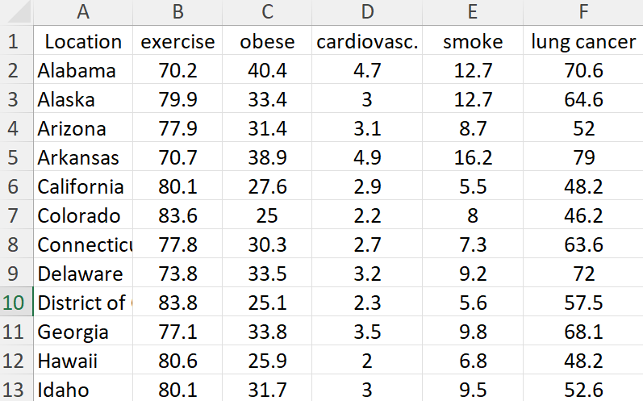
Portion of spreadsheet based on data compiled from CDC:

Slide 17
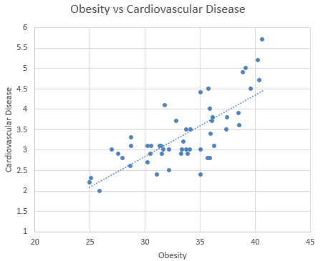
Scatterplot Sample 1:
Cause & effect?

Slide 18
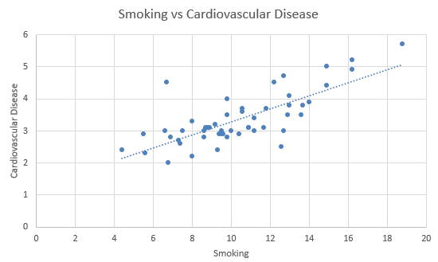
Scatterplot Sample 2:
Cause & effect?

Slide 19
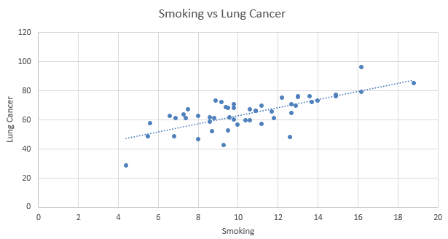
Scatterplot Sample 3:
Cause & effect?

Slide 20
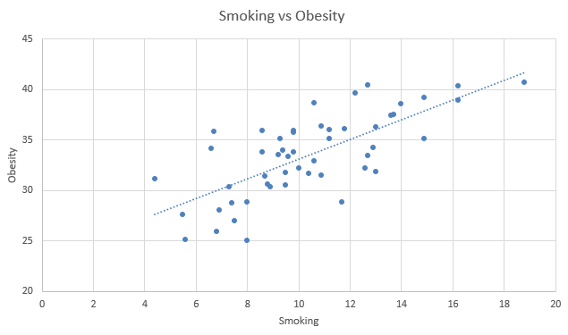
Scatterplot Sample 4:
Cause & effect???

Slide 21
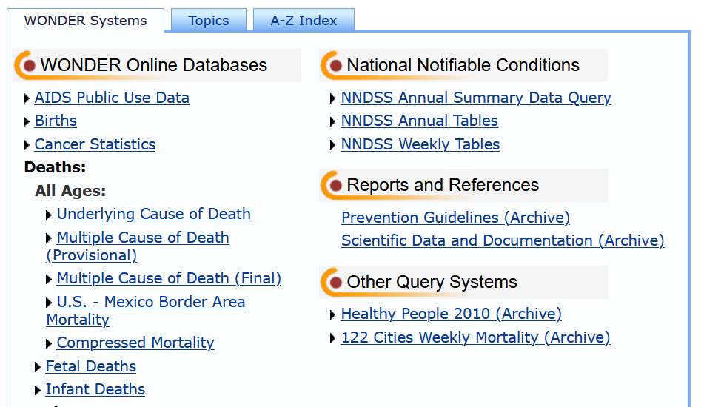
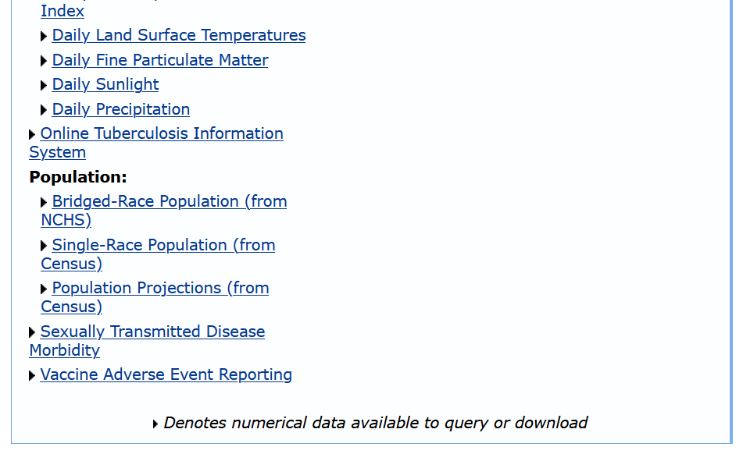
CDC “Wonder” Navigation:
https://wonder.cdc.gov/Welcome.html

Slide 22
Melanoma
Myeloma

Slide 23
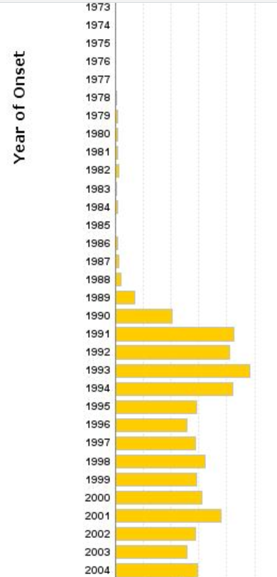
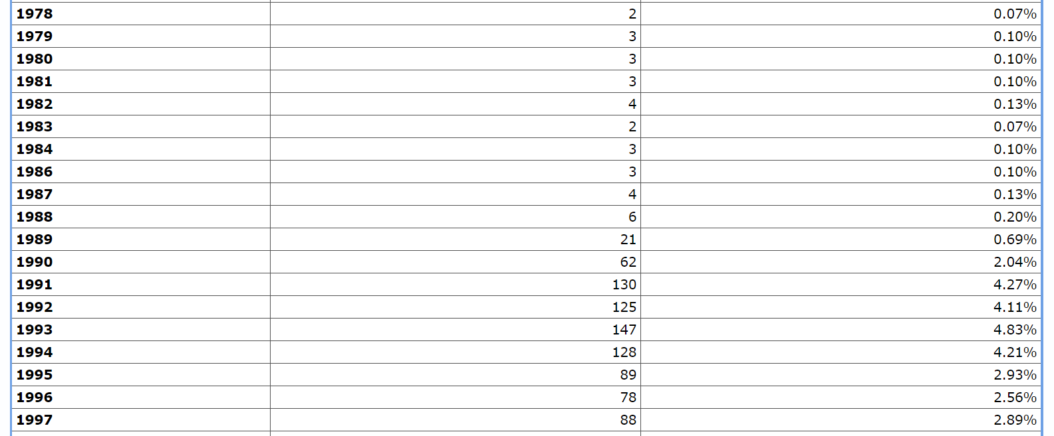
Vaccine deaths reported for ages 0-17

Slide 24
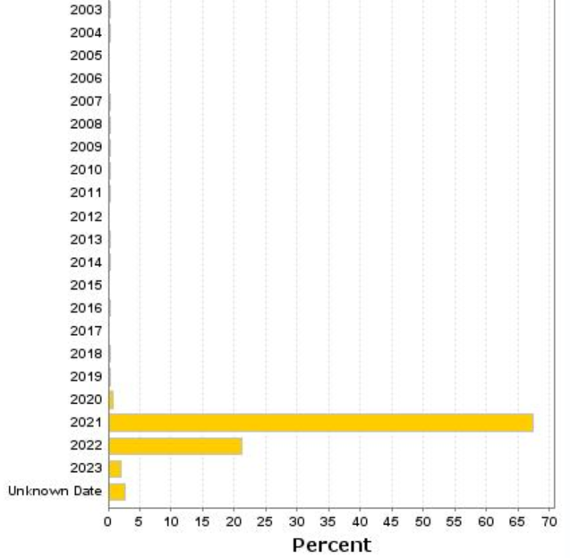
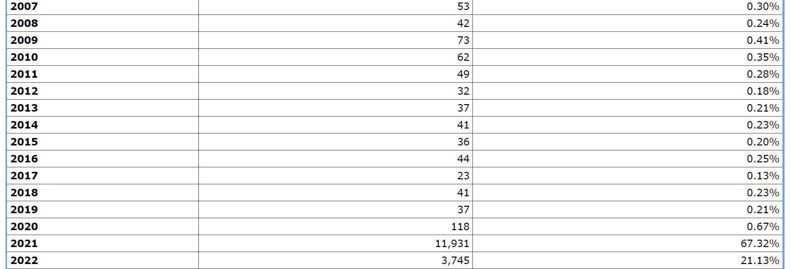
Vaccine deaths reported for ages 18 and up

